Slide 1
Approving in InfoEd

Slide 2
What is InfoEd?
WCU is going to be replacing RAMSeS with a comprehensive research administration software that will help streamline administrative processes and consolidate research administration function. The Proposal Development (PD) module that will have the capability to build complete proposals within the system and allow us to submit federal proposals to grants.gov through a system-to-system (S2S) interface. All external grant and contract proposals will be routed for approval within this module and will be managed by the pre-award team in the Office of Research Administration (ORA).

Slide 3
Login to InfoEd
Click here for single sign on
using your WCU credentials

Slide 4
Home page after signing in

Slide 5
First path to get to approval.
Click on Messages tab

Slide 6
Click on the hyperlink

Slide 7
Second way to get to approvals
Click here

Slide 8
Change the Messages from Disable to Enable

Slide 9
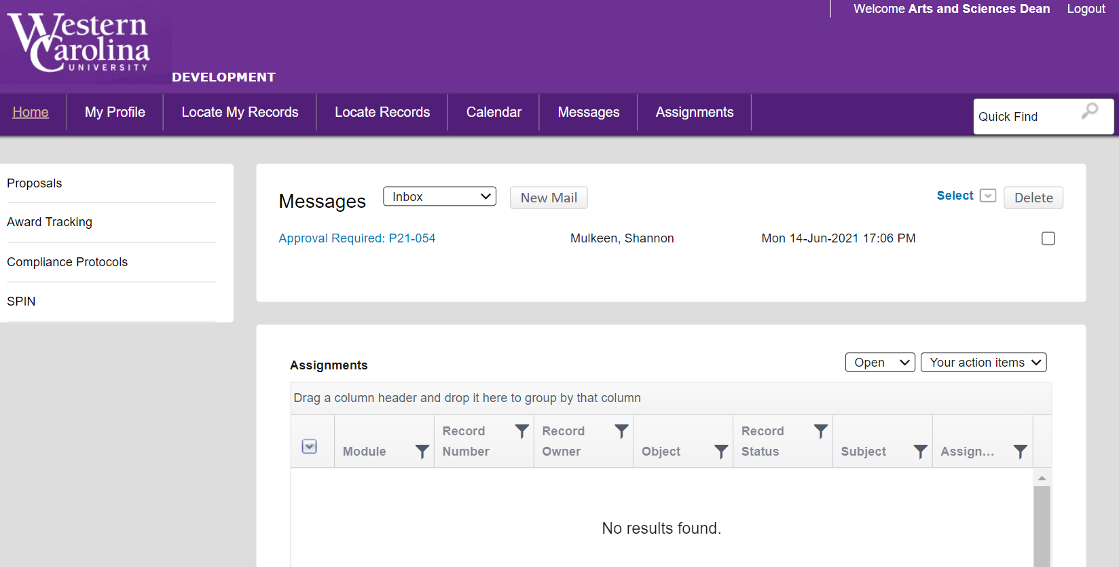
Your home page now will show all your messages and you can click on the hyperlink.

Slide 10
With either of the previous two methods, after you click on the proposal hyperlink a box will appear. Click on Reviewer Dashboard hyperlink.

Slide 11
Third path to get to approval. You will receive an email similar to the one below. Click on the hyperlink and you will be brought directly to the Reviewer Dashboard.

Slide 12
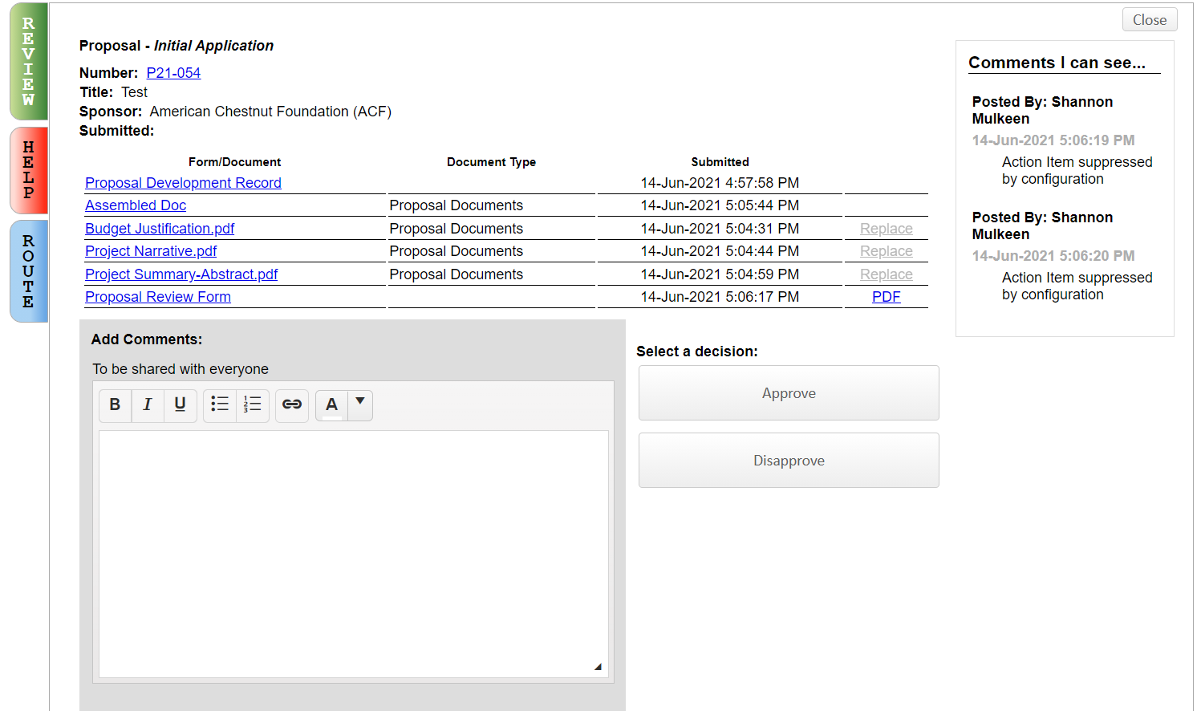
Reviewer’s Dashboard
The Proposal Review Form is a one page
overview of the proposal with key information

Slide 13
Proposal Review Form – Page 1 Provides overview information such as sponsor, deadline date, abstract, new space request

Slide 14
Proposal Review Form – Page 2 Provides overview information such as personnel, course reductions, budget overview, and cost sharing

Slide 15
Reviewer’s Dashboard
Proposal Development Record will take you to
the full proposal record in InfoEd

Slide 16
Proposal Development Record
Click on different menu areas
to see the various aspects of the
proposal.

Slide 17
Reviewer’s Dashboard
All documents related to the proposal
are attached here.

Slide 18
Reviewer’s Dashboard Help Tab has some basic information to help with process and who to contact if you have questions.

Slide 19
Reviewer’s Dashboard Route Tab shows overview of who is in the routing chain and what progress has been made so far.

Slide 20
After review is complete, add any comments that you wish in the fields to the left – provide feedback/comments to PI, other approvers, etc. These must be made before approving or disapproving. After you have approved or disapproved, no further changes can be made.

Slide 21
Reviewer’s Dashboard After review is complete and any comments have been entered, click the approve or disapprove buttons to either push it forward in the routing chain or send the proposal back to Research Administration.

