Slide 1
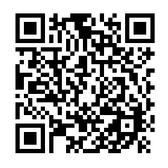
Cullowhee Conference Spring 2024
Link and QR Code to complete at the end of the conference for ASHA CEUs and/or Certificates of Attendance
Link: https://wcu.az1.qualtrics.com/jfe/form/SV_aXnHGAFhq8MGjqu

