Slide 2
Faculty Scholarship
Celebration
23 March 2023

Slide 3
Fall 2022
Provost’s Scholarship Development Grants

Slide 4
2022 Provost’s Scholarship Development Grant
“Ancient Others: Race and Empire in Italian Renaissance Humanism”
Dr. Robert Clines
Arts and Sciences

Slide 5
2022 Provost’s Scholarship Development Grant
“Keratin Biomaterial Modulation
of Autophagy”
Dr. Heather Coan
Arts and Sciences

Slide 6
2022 Provost’s Scholarship Development Grant
“Who is Invited to the Vesta Fiesta? Systematic Revision and Species Delimitation in Neotropical Vesta Fireflies”
Dr. Luiz Lima da Silveira
Arts and Sciences

Slide 7
2022 Provost’s Scholarship Development Grant
“Project ECO-TRAIL (Executive functions and Conversations Outdoors: Testing Relations with Adult Input of Language)”
Dr. Sarah Pedonti
Education and Allied
Professions

Slide 8
2022 Provost’s Scholarship Development Grant
Dr. Jamie Wallen
Ms. Brittania Bintz
Dr. Maria Gainey
Arts and Sciences
“Identification of DNA Binding Protein Specificities using High-throughput Sequencing”

Slide 9
2023 Faculty Scholarship Celebration

Slide 10
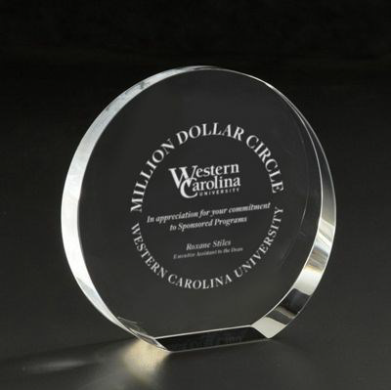
Million Dollar Circle

Slide 11
Million Dollar Circle
Ms. Wendy Cagle, Business
Dr. Shawn Collins, Health and Human Sciences
Dr. Linda Comer, Health and Human Sciences
Dr. James Costa, Arts and Sciences

Slide 12
Million Dollar Circle
Ms. Sandra Dennison, Business
Dr. R. Turner Goins, Health and Human Sciences
Dr. Patrick Gardner, Engineering and Technology
Dr. Kae Livsey, Health and Human Sciences

Slide 13
Million Dollar Circle
Dr. Pat Morse, Health and Human Sciences
Mr. Todd Murdock, Education and Allied Professions
Dr. Judy Neubrander, Health and Human Sciences
Dr. Billy Ogletree, Health and Human Sciences

Slide 14
Million Dollar Circle
Dr. Tamera Pearson, Health and Human Sciences
Dr. Joseph Pechmann, Arts and Sciences
Dr. Jessica Weiler, Education & Allied Professions

Slide 15
Million Dollar Circle
Dr. David Westling, Education and Allied Professions
Dr. Robert Young, Arts and Sciences
Dr. Jayne Zanglein, Business

Slide 16
2023 Million Dollar Circle

Slide 17
2023 Million Dollar Circle
Dr. Cathy Grist, Professor,
Department of Human Services,
College of Education and Allied Professions

Slide 18
2023 Million Dollar Circle
Dr. Brett Riggs,
Sequoyah Distinguished Professor of Cherokee Studies,
Department of Anthropology and Sociology,
College of Arts and Sciences

Slide 19
2023 Million Dollar Circle
Dr. Paul Yanik, Associate Professor,
School of Engineering and Technology,
College of Engineering and Technology

Slide 20
Hunter Scholar

Slide 21
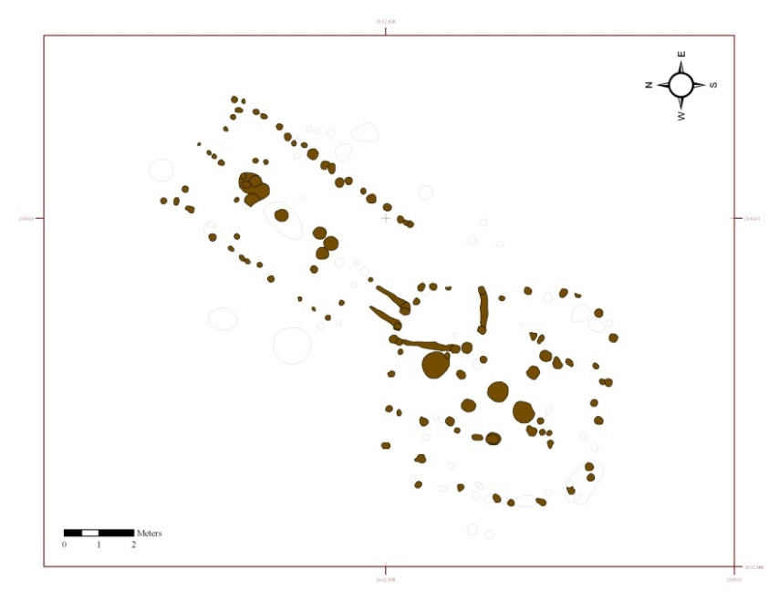
WCU Hunter Scholar Award 2022-2023 An Archaeological Study of Ancestral Cherokee Architecture
Ben Steere, Anthropology and Sociology
Database created:
170 archaeologically recorded houses from 6 ancestral Cherokee sites in southwestern North Carolina and eastern Tennessee (and counting!)
Key findings:
Improved understanding of geography of ancestral Cherokee housing traditions, especially during the Middle Woodland (ca. AD 100 – 600) and Early Mississippian period (ca. AD 1000 – 1200)
Early evidence for council houses at sites in Cherokee, North Carolina and WCU Campus
Completed and in-progress presentations and publications:
Two papers at national conferences (National Meeting of the Trail of Tears Association, Cherokee, NC and the Annual Meeting of the Society for American Archaeology, Portland, OR)
Four public archaeology talks, including LIFE@WCU and presentation to Cherokee Community of Puget Sound
Summary articles in preparation
Many thanks to the Hunter Library and intrepid History graduate student Danielle Duffy for her assistance.

Slide 22
Hunter Scholar Award

Slide 23
2023-2024 Hunter Scholar
Dr. Luiz Lima da Silveira
Department of Biology,
College of Arts and Sciences

Slide 24
facultyscholarship.wcu.edu

