Slide 1
Non-Recurring Budget Request
Graduate School and Research Priority #1
$30,000 Carnegie Slate Services for Graduate Student Admissions
Increase graduate student applicant pools
Hone marketing campaigns targeting specific applicant populations
Improve communications with targeted applicant populations

Slide 2
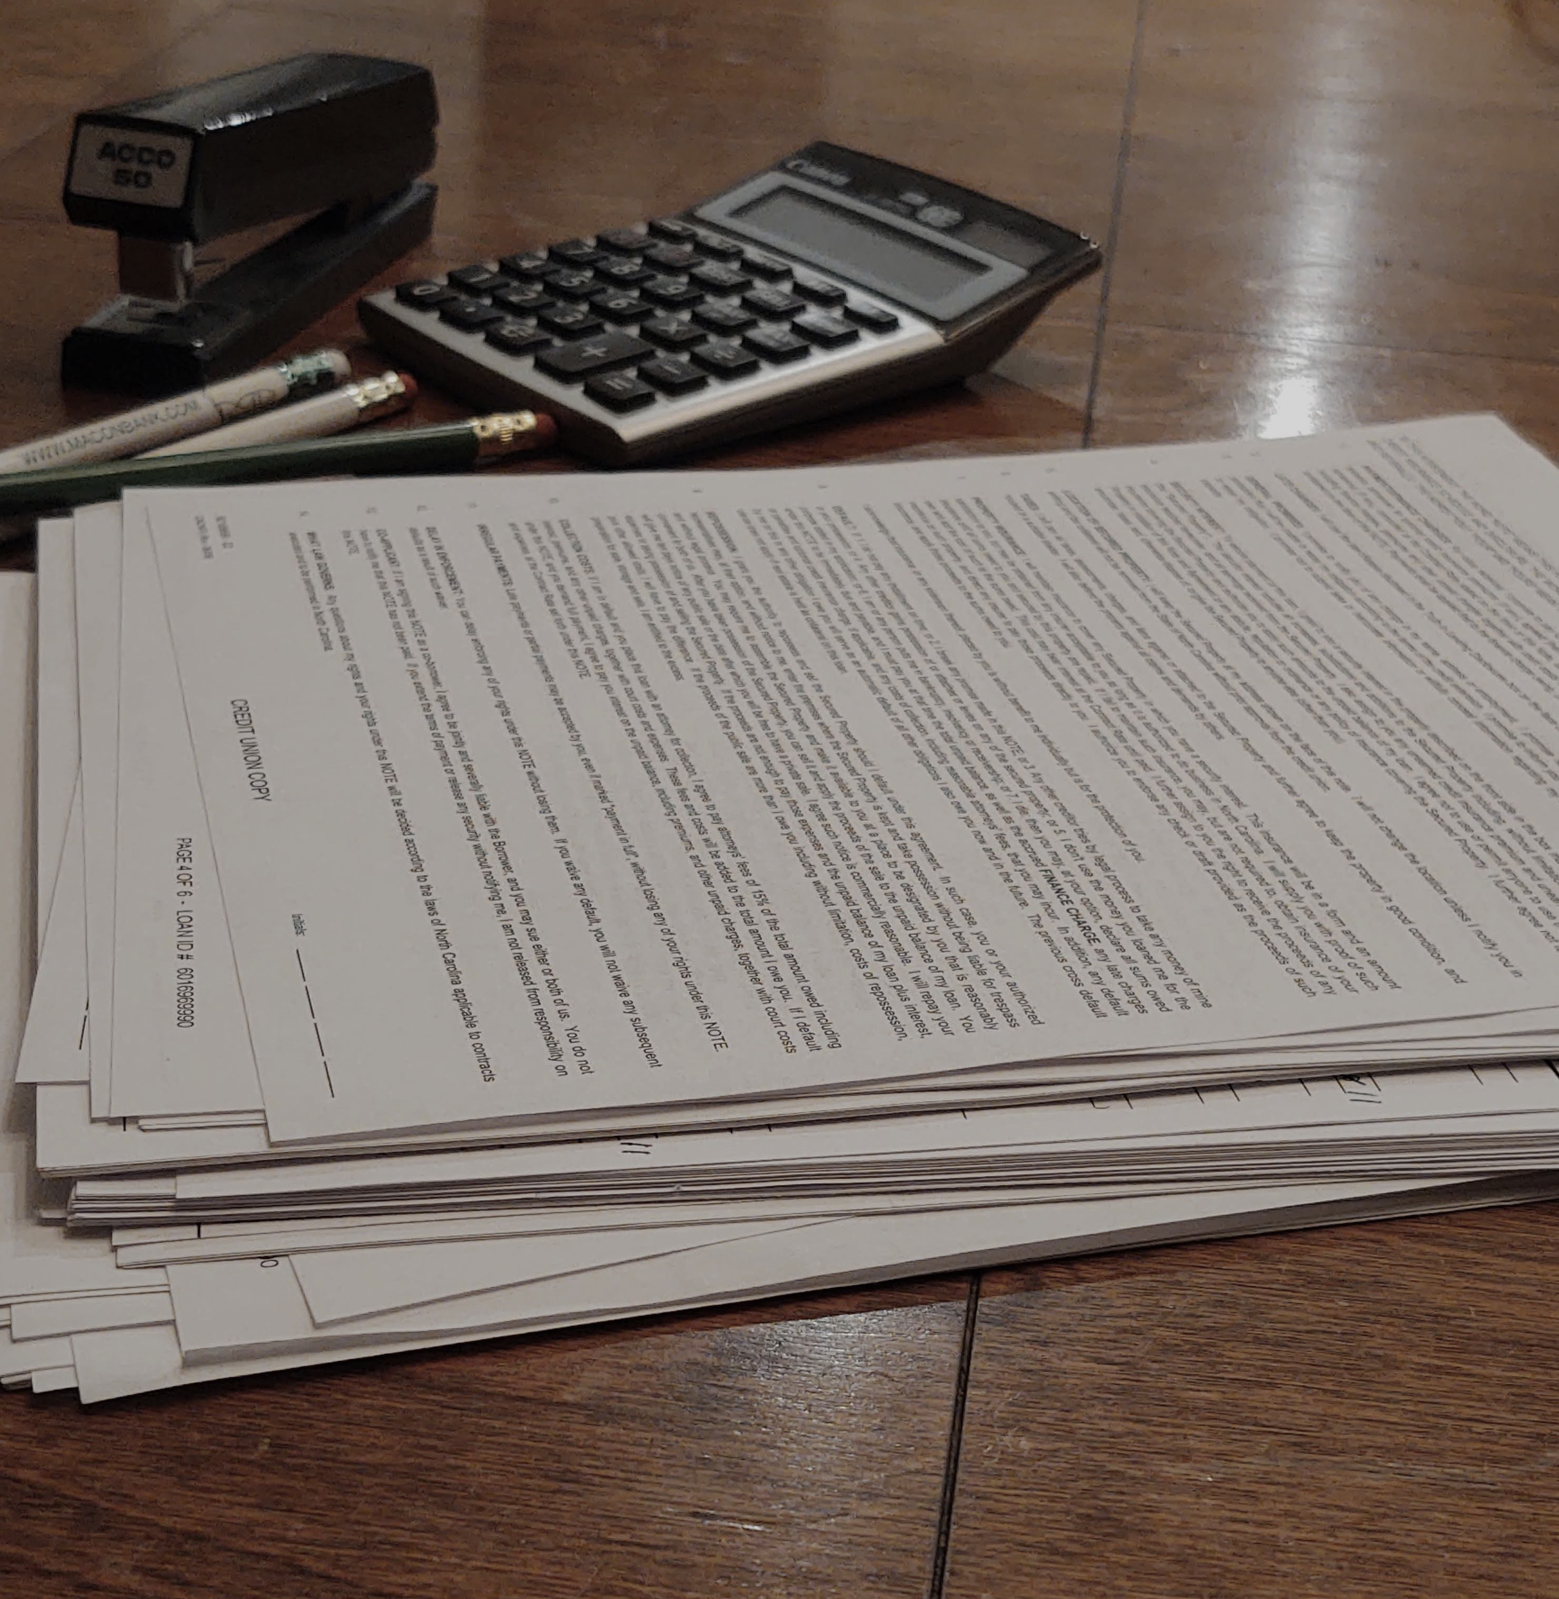
Non-Recurring Budget Request
Graduate School and Research Priority #2
$33,300 InfoEd Conflict of Interest Module
Contributing to Institutional Effectiveness
Future Time and Cost Savings
Satisfying Compliance/Mandated Requirements
COMPLIANCE

