Slide 1
Western Carolina University
Controller’s Office
Capital Assets

Slide 2
Governing Standards
Office of the State Controller
UNC Business Process Standards

Slide 3
Controller’s Office Responsibilities
To maintain and control the university’s inventory records
To update the asset records in the accounting system for information submitted on various forms
To assure each department verifies and certifies the annual departmental inventory
To perform quarterly audits

Slide 4
Fixed Asset Policy
Fixed Asset Coordinator (FAC) Procedures and Responsibilities
Fixed Asset Coordinator Powerpoint Presentation
Information and forms available here: https://www.wcu.edu/discover/campus-services-and-operations/controllers-office/fixed-assets.aspx
WCU’s website
Click magnifying glass and type, “Fixed Assets”
Select first link listed as, “Fixed Assets”

Slide 5

Fixed Assets
FIXED ASSET POLICY
FIXED ASSET COORDINATOR (FAC) PROCEDURE AND RESPONSIBILITIES
FIXED ASSET COORDINATOR POWERPOINT PRESENTATION
FORMS AND REPORTS | List of FACs

Slide 6
Fixed Asset Policy
Fixed Asset Coordinator (FAC)
Tracking of Equipment
  Controller’s Office – “Capital Assets” (IT/Non-IT =>5,000)
  Information Technology (IT)

Slide 7
Fixed Asset Coordinator (FAC)
The FAC will serve as the liaison between the unit and the University’s Fixed Assets Accountant (Controller’s Office) for items recorded in the University’s Fixed Assets System and as the liaison to Information Technology for data processing items tracked by Information Technology. The FAC will become the unit’s resident fixed assets expert.
Pursuant to WCU Policy # 75, accountability for property purchased by (or for) a department, college, or other unit of the university is the responsibility of the department/administrative head of that unit.

Slide 8
FAC’s Responsibilities
The next several slides will demonstrate the
process of completing the WCU Asset Inventory
Control Form for the following situations:
Updating asset’s location, condition, serial number, etc. (timely manner)
Missing asset (steps taken to locate)
Vandalized/Stolen asset
  Campus Police
  Fixed Asset Accountant (Controller’s Office)

Slide 9
Fixed Asset Policy
Fixed Asset Coordinator (FAC) Procedures and Responsibilities
Fixed Asset Coordinator PowerPoint Presentation
FORMS AND REPORTS List of FACs
WCU Asset Inventory Control
WCU Asset Inventory Control Form
Whenever a qualifying asset is permanently moved, missing, or stolen, the department is required to complete this form (an asset qualifies if it is $5,000 or greater, or an IT tracked asset). If you have questions about whether an asset qualifies, please contact Lacy Ensley (227-2583) or Jason Pry (227-2734).

Slide 10
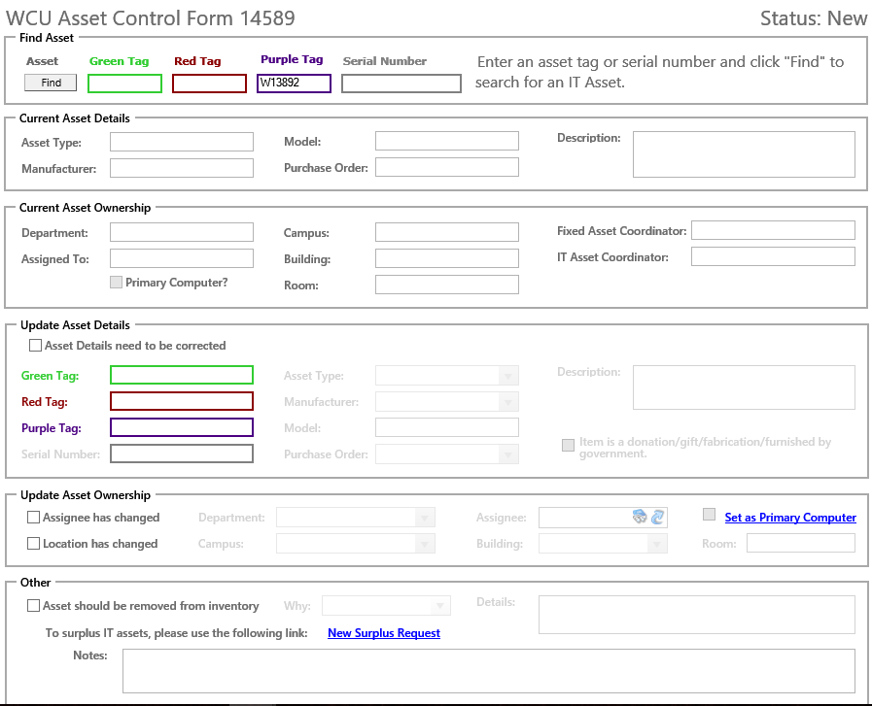
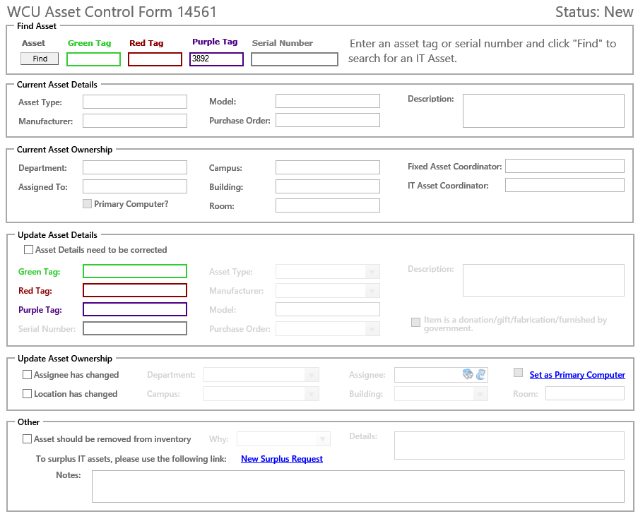
To locate a fixed asset, first enter purple tag number here and click “Find”

Slide 11
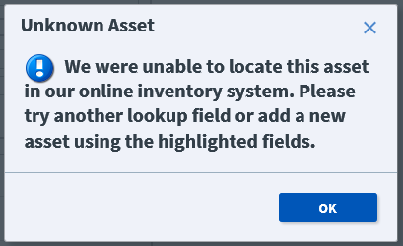

Slide 12
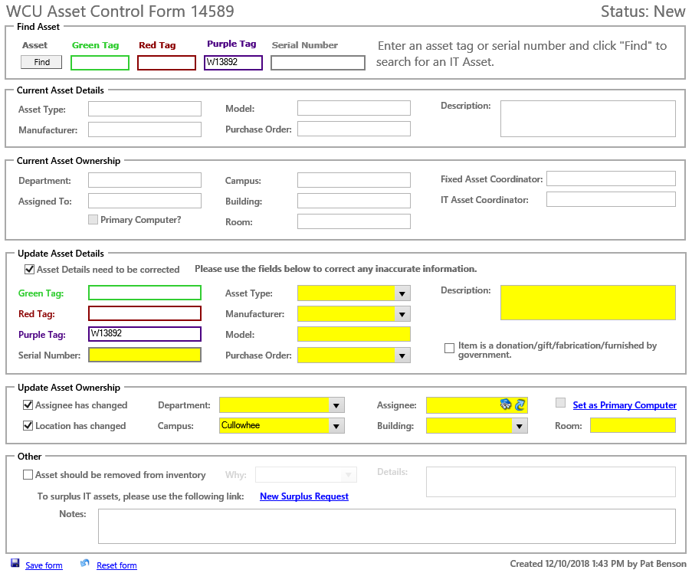
To update a Fixed Asset
Add description of fixed asset in the Description field
To add Serial#/ Manufacturer/Model
To update Assignee/Location, complete appropriate field(s)
Enter updated condition code for fixed asset (Excellent, Good, Fair, Poor)
To save changes, click Save form

Slide 13
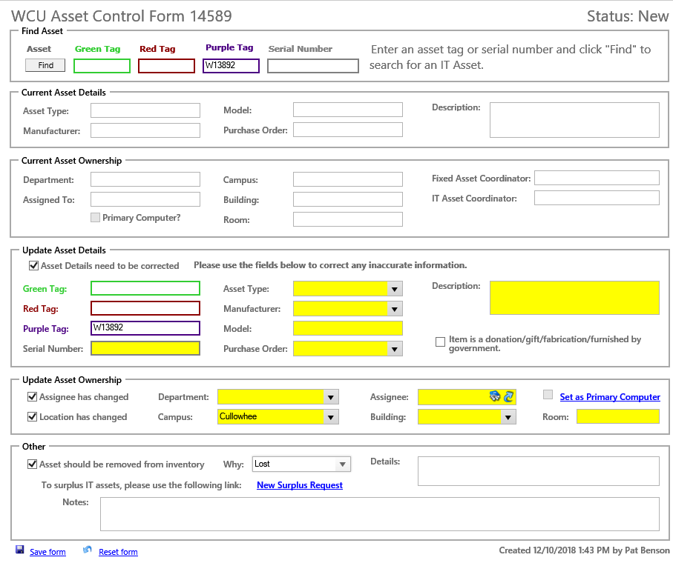
Missing Asset
Add description of fixed asset in the Description field
Enter steps to locate Lost fixed asset
To save changes, click Save form

Slide 14

Vandalized or Stolen Asset
Add description of fixed asset in the Description field
Indicate that police report has been filed for stolen fixed asset
To save changes, click Save form

Slide 15
Gifts, Donations, Fabrications
Gift/Donation
  Prior to acceptance & receipt, contact Office of Development
  Fixed Asset Accountant (Controller’s Office)
Fabricated assets (by assembly)
For gift/donation or fabricated assets, go on-line to the WCU Asset Inventory Control Form. Go to, “Update Asset Details” and check the box beside, “Asset details need to be corrected.” Check the box beside “Item is a donation/gift/fabrication/furnished by government.” In the “Description” field, give detail information. Then, go to “Update Asset Ownership” and complete assignee and location information. Click, “Save form.”

Slide 16
Gift,
Donation,
Fabricated Asset
Item is a donation/ gift/ fabrication/ furnished by government
Asset Details need to be corrected
To save changes, click Save form

Slide 17
Trade-Ins / Returns to Vendor
Trade-Ins (used as partial payment on new equipment and/or not under warranty)
  Notify Surplus Property Manager (Regina Cowan)
  Surplus Property Manager contacts State Surplus Office
  If approved, Surplus Property Manager contacts department; purple/red tag(s) removed - sent to Fixed Asset Accountant, Controller’s Office, HFR 300-O; green tag removed-sent to IT Asset Coordinator, Jason Pry, H57 Hunter Annex
Asset returned to vendor (i.e. insufficient funds)
  WCU tag(s) removed and sent to appropriate personnel

Slide 18
Trade-Ins / Returns to Vendor – Continued
  ▪ For trade-ins and assets returned to vendor, complete the Equipment Return Form
    The Department/Administrative Head’s signature is required. Please print, receive signature and send (or email) the form to Fixed Asset Accountant, Controller’s Office, HFR 300-O. Retain a copy in the department.

Slide 19
Equipment
Return
Form

Slide 20
Transfer of Fixed Assets
Assets permanently transferred to another University or State Agency
  Notify Surplus Property Manager (Regina Cowan)
  Surplus Property Manager contacts State Surplus Office
  If approved, Surplus Property Manager contacts the FAC; purple/red tag(s) removed-sent to Fixed Asset Accountant, Controller’s Office, HFR 300-O; green tag removed-sent to IT Asset Coordinator, Jason Pry, H57 Hunter Annex

Slide 21
Transfer of Fixed Assets - Continued
Assets transferred to another department on campus
  For assets transferred, complete the Equipment Transfer Form
    The Department/Administrative Head’s signature is required. Please print, receive signature and send (or email) the form to Fixed Asset Accountant, Controller’s Office, HFR 300-O. Retain a copy in the department.
  Note: Department transferring asset to another department on campus should complete the Equipment Transfer Form. Then, the receiving department should complete the WCU Asset Inventory Control Form so the correct organization and location is updated in the Banner Fixed Assets Module.

Slide 22
Equipment
Transfer
Form

Slide 23
FIXED ASSET COORDINATOR
Please send an email to all in your college or department notifying them of the importance for completing the WCU Asset Inventory Control Form, the Equipment Return Form, and the Equipment Transfer Form. Refer them to the “Forms and Reports” page located here: https://www.wcu.edu/discover/campus-services-and-operations/controllers-office/fixed-assets.aspx

Slide 24

FAC’s Responsibilities
Surplus
Disposals
Cannibalization

Slide 25

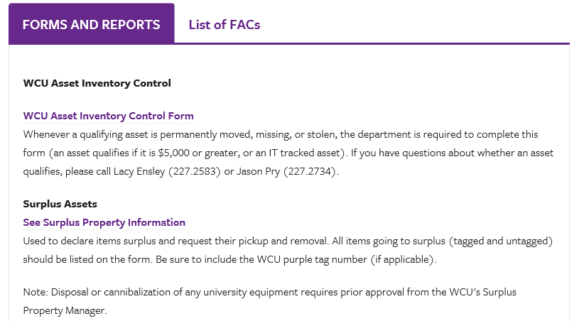

Slide 26


Slide 27
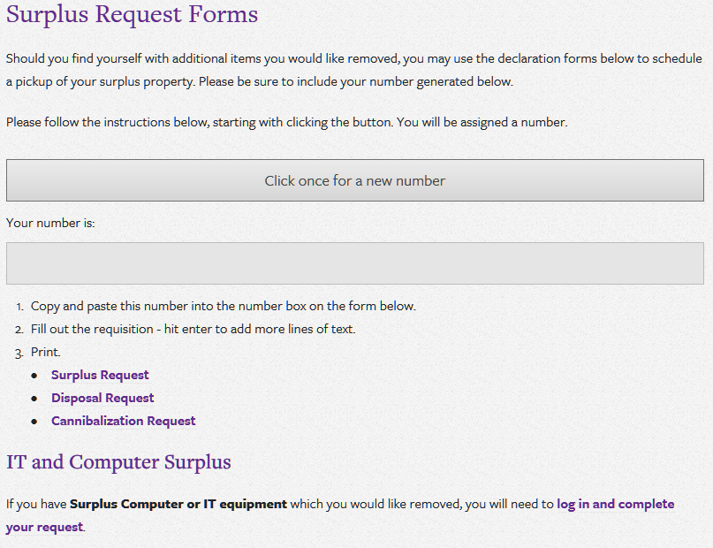

Slide 28
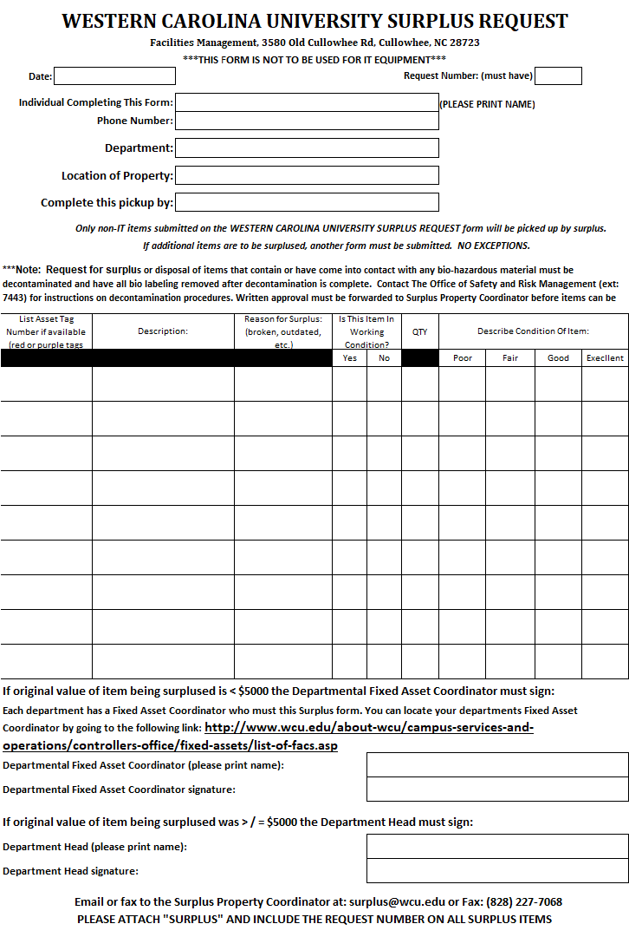
Surplus Request Form

Slide 29
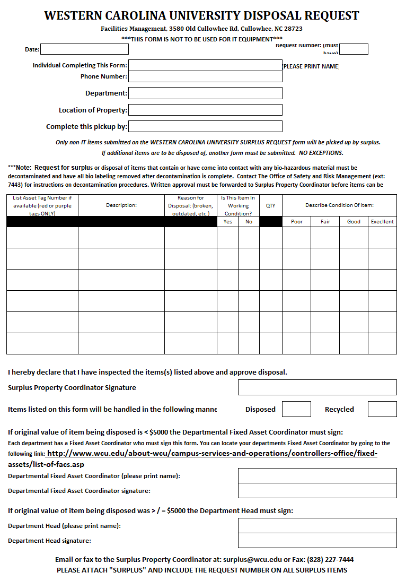
Disposal Request Form

Slide 30
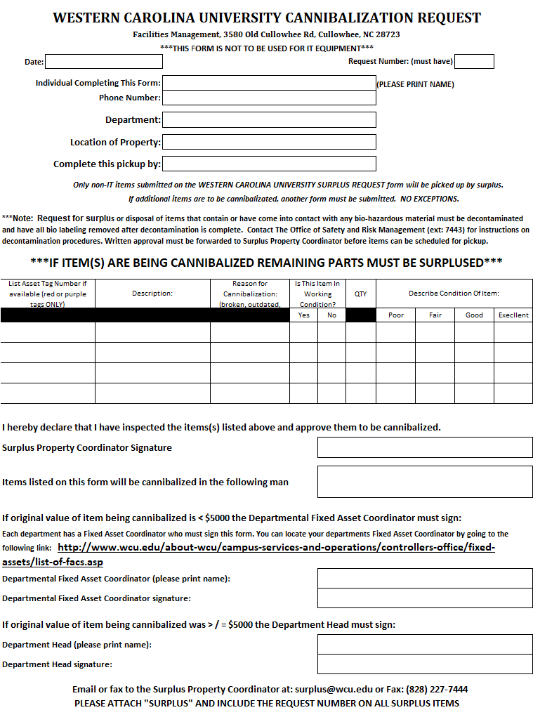
Cannibalization
Request Form

Slide 31
Annual Departmental Fixed Asset Inventory
  Visual verification of asset – place “Y” in Y/N column
  Note any asset updates in “Comments” column (if updates are needed, complete correct fixed asset form)
  List – IT tag (green) on spreadsheet if applicable
  Remaining useful life of six months (will be in RED)
    Appropriate departmental individual evaluates and recommends extension of useful life (in years) and notes in “Comments” column
  Completed inventory spreadsheet email to Lacy Ensley or send to Fixed Asset Accountant, Controller’s Office, HFR 300-O
  Copy retained in department

Slide 32
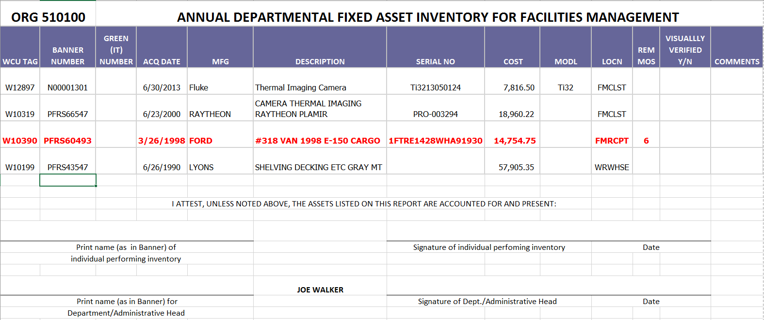

Slide 33
Capital Assets - Impairments
Impairment – An asset’s service utility has declined significantly and unexpectedly
Common Indicators
▪ Evidence of physical damage (e.g., fire or natural disaster)
▪ Changes in legal or environmental factors (e.g., asset does not
meet certain requirements)
▪ Technological change or obsolescence (e.g., asset outdated and
newer asset provides better service)
▪ Changes in manner or duration of use (e.g., asset no longer
used with remaining useful life due to safety reasons)
▪ Permanent construction stoppage prior to completion of an asset
▶ GASB Statement 42

Slide 34
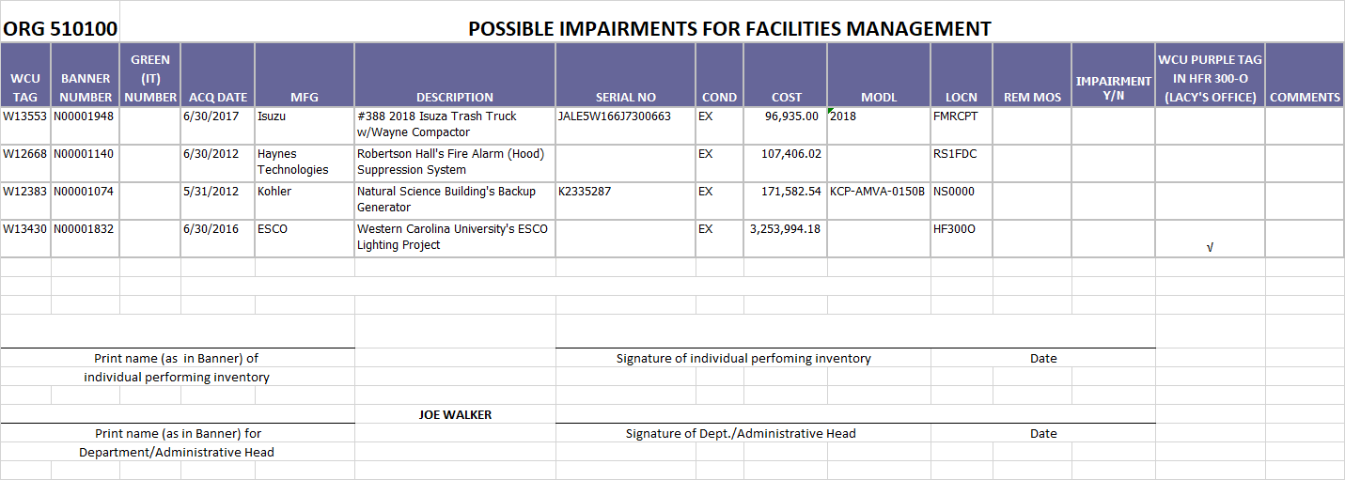

Slide 35
QUESTIONNAIRE FOR CAPITAL ASSET IMPAIRMENTS
1) Please list any impaired WCU capital asset as of February 26, 2021. A capital asset is considered impaired when its service utility has declined significantly and unexpectedly. Please refer to the information on GASB 42 provided in the email’s attachment and limit your listings to major, significant impairments.
2) Please provide a general description of the impairment.
3) For any listed impaired capital asset, is the impairment temporary or permanent?
4) For each listed impaired capital asset, what is the gross amount of the impairment loss?
5) For each listed impaired capital asset, what is the amount of any insurance recovery?

Slide 36
Fixed Asset Policy
Custody and Control
  Each department is responsible for maintaining inventory controls and safeguarding all assets regardless of cost. Department/Administrative Head is required to follow the university’s policies and procedures.
  Equipment purchased through the university is property of the state and cannot be donated, traded-in (if used as partial payment on new equipment and/or not under warranty), sold, scrapped, or otherwise disposed of by the department who has custody of the equipment without prior approval from WCU’s Tagging Specialist and Surplus Property Manager (Regina Cowan).
GRANTS: Generally (rare exception), unless terms are more specific, when equipment is purchased from grants, ownership of asset belongs to the university, thus becoming state property; not individual or departmental property.
  Contact Grants Accountant (ext. 2498) or Fixed Asset Accountant (ext. 2583) with any questions concerning assets purchased from grant funding

Slide 37
Tracking is beneficial for Significant Change of Events
It is recommended that departments have internal tracking procedures for equipment not being tracked in the University’s Fixed Assets System or by IT.
Instances include:
  Changes in department head
  Department or function moving from one building to another
Consideration should be made to perform interim physical inventories at the time of event.
  Based on management decision and based on risk factors and likelihood of assets becoming misplaced, not transferred, or stolen.

Slide 38
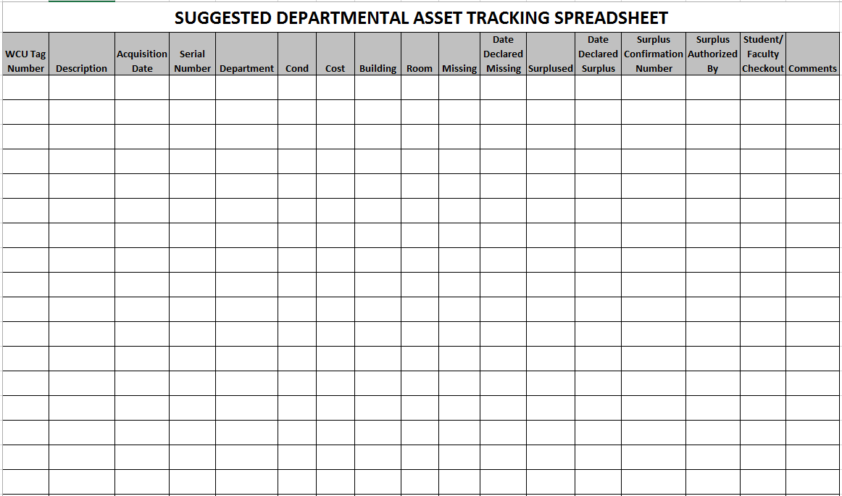
Example
Tracking Template

Slide 39

Western Carolina University
Division of Information Technology Asset Management
Jason Pry
IT Asset Manager
Questions? Ext. 2734

Slide 40
IT Assets
IT Assets
Non- IT Assets
(Departments Responsibility)
Assets $5000
&
Above
Division of Information Technology (DoIT) charged with asset management for all IT assets that belong to WCU.
Active Computers
2019 - 6,011
2020 – 5,809
2021 – 6,241
Approximate Total of Purple Tagged Assets
2019 – 2,575
2020 – 2,669
Computers Out of Warranty
2019 - 3,338
2020 – 2,898
2021 – 3,103
Computers Older than 5 Years
2019 - 1,636
2020 – 1,688
2021 – 1,455
Computers Older than 2010
2019 – 190
2020 – 87
2021 - 112

Slide 41
IT Assets
Computers
a. Laptops & tablets
b. Desktops
Printers for Paw Print only
Servers
a. Enterprise level
b. Snap
Enterprise level networking
a. Switches
b. Routers
c. Wireless APs
Smart boards
Data projectors installed in classrooms
All technology assets purchased by DoIT

Slide 42
All IT items $5,000 and greater will be tracked by the Controller’s Office and the Department via IT database
Please do not remove any old tags.
Best Practice to Check for all tags
Report All Tags: red, green, purple.
Try to Capture Serial Numbers
Verify all information
https://hulahula.wcu.edu/reports/browse/Campus%20Asset%20Reporting

Slide 43
It is highly recommended that departments track assets of significant value to their unit and highly mobile such as listed below.
Scientific equipment (including computer if needed)
Portable hard drives (use server space)
Docking Stations
Monitors
Cameras of any kind
Keyboards / Mice
Portable CD drives
GPS systems
Smart devices - PDAs, phones, etc..
Label makers / Scanners
Audio equipment
Specialized digital equipment - HVAC control systems, check writing machines, etc…
This list is not intended to be all inclusive

Slide 44



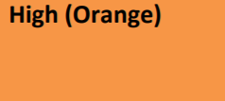



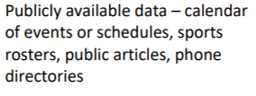

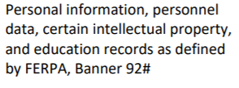
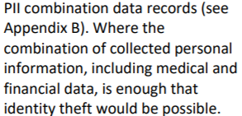
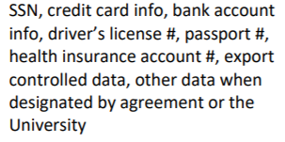
Portable Storage – Everyone’s Responsibility
Flash Drives, External Hard Drives, SD-Cards, Removable Internal Drives, etc.
https://www.wcu.edu/webfiles/itsecuritymanual/Data-Handling-Procedures.pdf

Slide 45
Basic IT Asset Lifecycle
Acquire
Assets
Deploy
Assets
Manage Assets
Retire
Assets
Plan Assets

Slide 46
Policy 67 – Definite Lifespan
“Endpoint device” shall mean a university-owned information technology asset that includes, but is not limited to, a desktop, laptop, notebook, or tablet computer.
All devices have a definite end-of-life, which may be based upon, but is not limited to, in-service date of 5 years, end of vendor support, security vulnerabilities, or any other factor that may require that the device be decommissioned. Any device that exceeds end-of-life may be subject to one or more of the following: increased annual asset fee; limited or no IT support; limited network access; and/or other appropriate considerations.

Slide 47
Acquiring IT Assets
Quotes:
Request quote at go.wcu.edu/quote
Answer 3 Basic Questions for all endpoint devices ordered:
1. Whom will the asset be assigned to?
2. What asset will we be picking up as a One-in, One-out?
3. Whom should the cart be assigned to?

Slide 48
Policy 67 – One-in, One-out
“Endpoint device” shall mean a university-owned information technology asset that includes, but is not limited to, a desktop, laptop, notebook, or tablet computer.
The University maintains a one-in, one-out model. At the time of purchase of a new endpoint device, an existing endpoint device will be designated for surplus. This designated device will be picked up for surplus at the time of the new installation is made. To minimize unintentional data loss, IT will hold systems that are picked up for surplus for 45 days before proceeding with the surplus process. If the endpoint device being replaced does not fit into any of the end-of-life indicators mentioned in item 5, the device may be requested to be repurposed and reallocated to another faculty or staff member within the unit, following the Division of IT’s procedure for doing so. However, this redeployment may only occur one time for each new endpoint device.

Slide 49
Policy 67 – Exceptions
Exceptions include but are not necessarily limited to:
One-in, One-out Exceptions
  New Position? New Project/Grant?
Purchasing Exceptions
  Android Tablet? Vendor Required model?
Lifecycle Exceptions (new approvals yearly)
  a) Vital system device?
All exception requests must be approved by the University Computer Exception Committee
or approved by the CIO, depending on exception type. Exceptions must be submitted via
the Endpoint Device Exception Form.
See Policy 67

Slide 50
Acquiring IT Assets
Purchasing:
Department submits requisition to the Purchasing Department for purchase.
Your Purchase isn’t made until your department Processes the Cart in Catamart
Purchasing places order for asset with “ship to” address specified by IT (currently warehouse). If you purchase directly from vendor make sure the asset is processed by IT.
Asset arrives at WCU and is processed by IT

Slide 51
Deploy Assets
Desktop Services:
Assets are tagged and information is recorded into Cherwell.
If asset is a computer, it is prepped for WCU standards (imaging, deployment).
Asset is delivered to client and the Helpdesk is notified if additional setup is needed.
One-in, One-out Device is picked up and held for 45 days

Slide 52
Manage Assets
The Division of Information Technology uses an inventory management system to track university owned technology assets called Cherwell.
All IT assets that are being moved from one location to another must have an Asset Control Form completed for the move.
Old IT assets may not be prepped for new asset processes. These are being manually tagged and entered when they are discovered.
IT assets that are stolen or lost should be reported immediately to DoIT and proper authorities, and an ACF must be submitted.

Slide 53
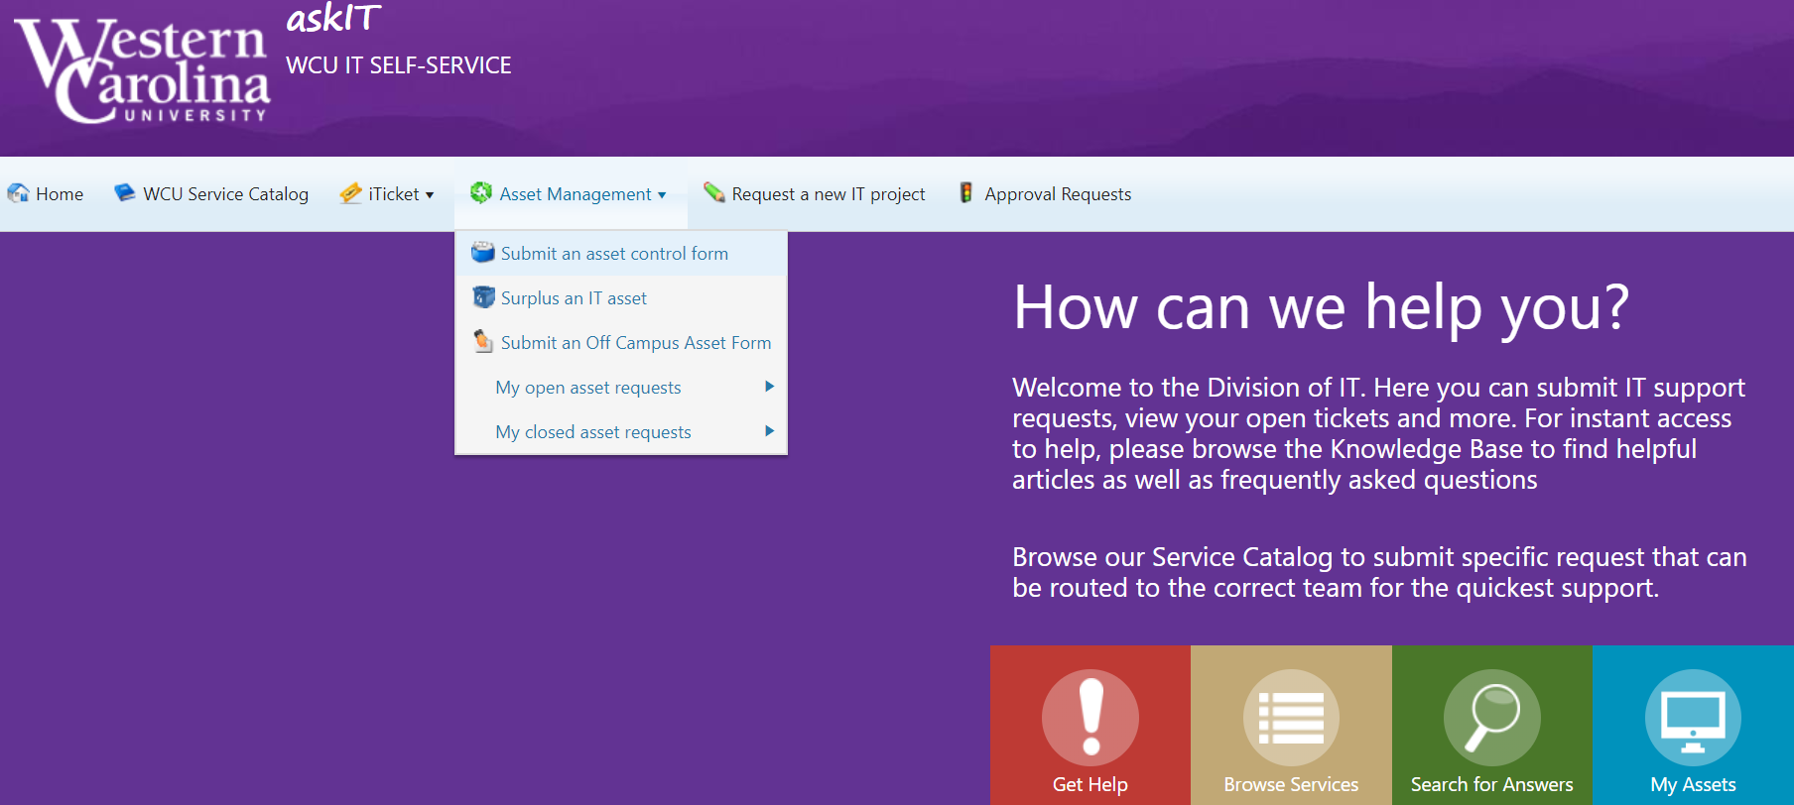
Asset Control Form
Staff/Faculty should be able to create an Asset Control Form
Go to Help.WCU.edu

Slide 54
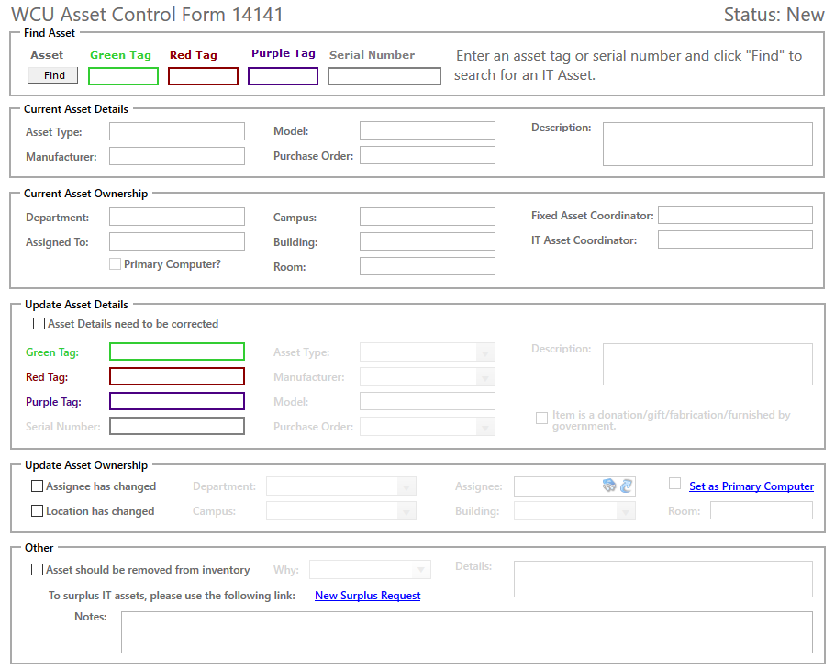
IT
WCU
W
To locate an asset, first enter appropriate tag number here and click find.

Slide 55
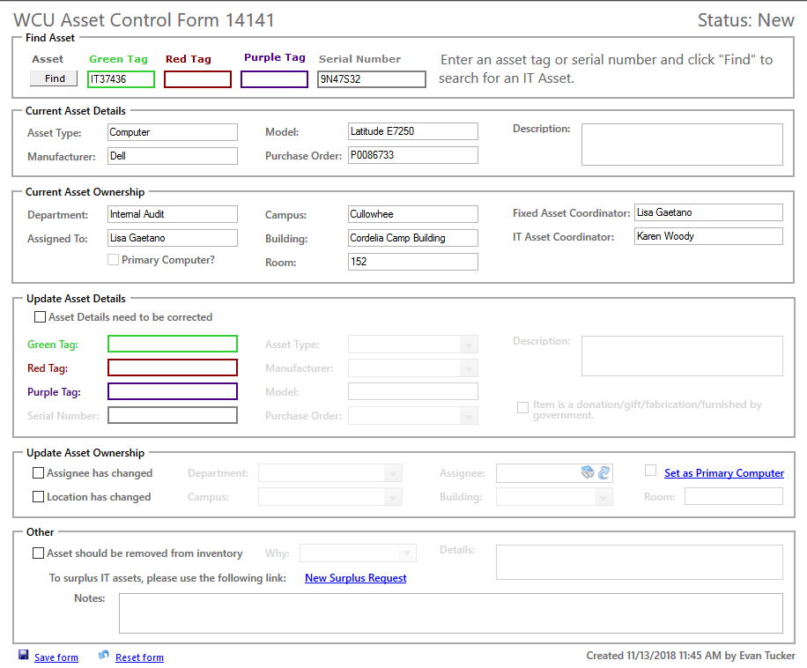
Current information regarding asset is now displayed. If Blank, it likely did not attach to an asset in our system.

Slide 56
To update an asset’s information or ownership, first click “Asset Details need to be corrected”, “Assignee has changed”, or “Location has changed”.

Slide 57
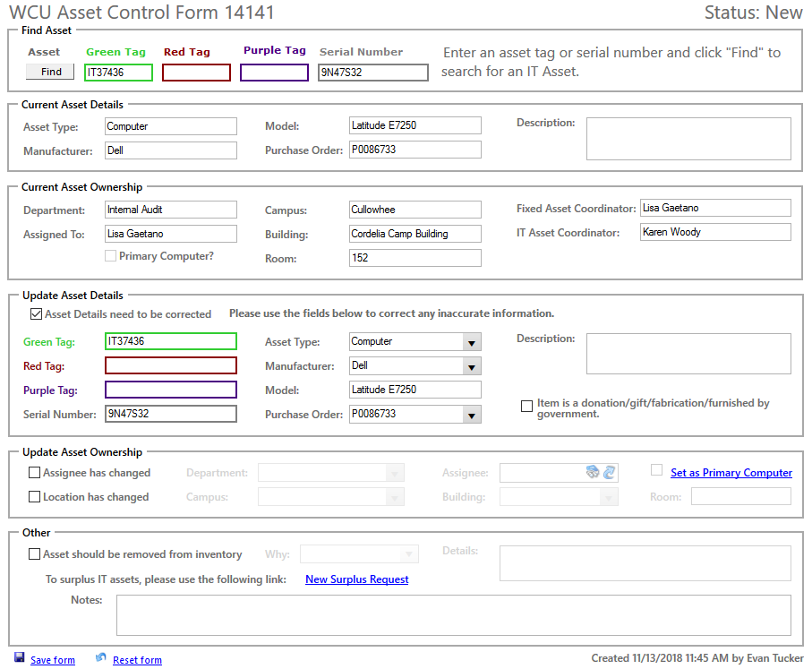
After updating assets’ information, click Save form to save changes to asset.

Slide 58
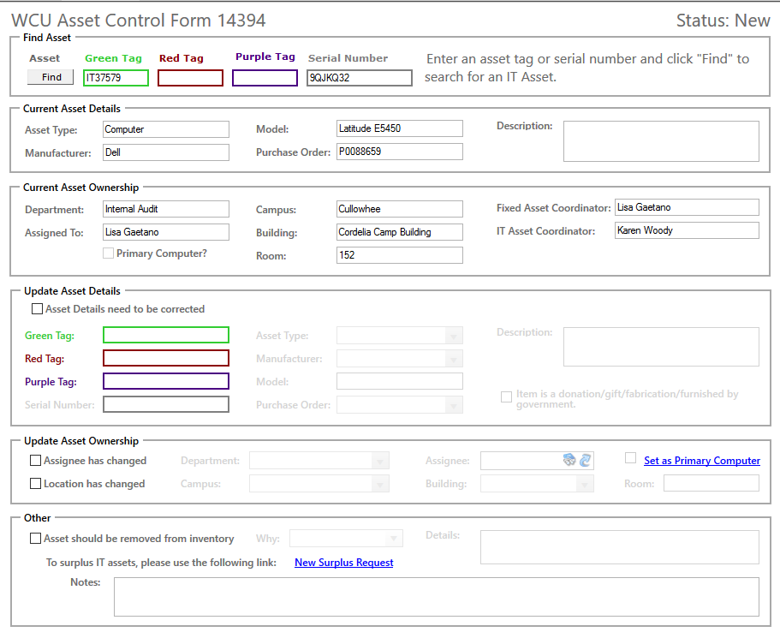
To report an asset lost or stolen, first enter the appropriate tag number and click find.
Next, check “Asset should be removed from inventory”.

Slide 59
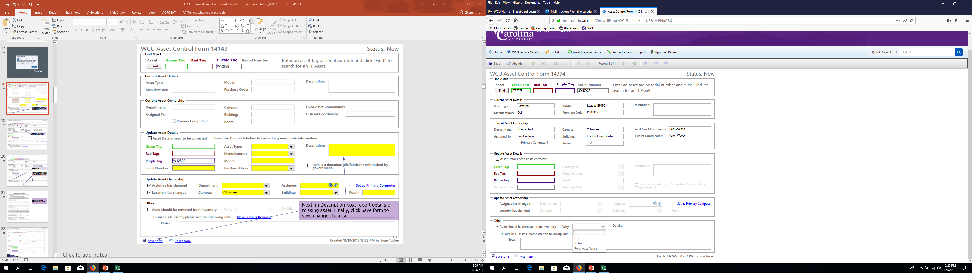
Next, use the drop-down menu to select either Lost or Stolen, and provide details about the missing asset’s status in the Details text box.
When finished, click Save form to save changes to the asset.

Slide 60
Retire Assets
Reallocation and Surplus:
Use the Asset Control Form if you need to move an asset.
Any time an asset is switching over to a new assignee, please call the Help Desk. They can help setup the user and delete prior data.
All assets to be surplused will be submitted through the IT Self-Service Portal on-line form.

Slide 61
Surplus Request Form
Staff/Faculty should be able to create an Surplus Request Form
Go to Help.WCU.edu

Slide 62
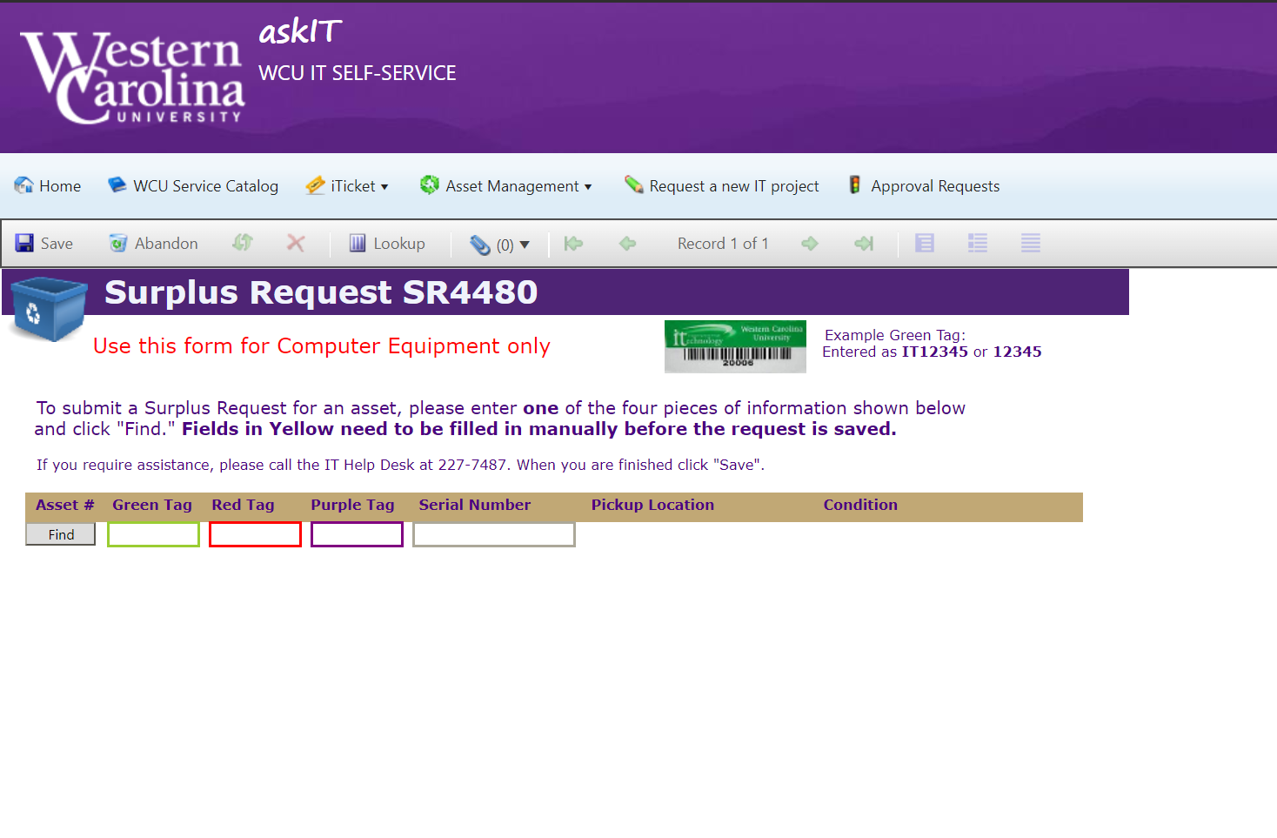
Enter your Tag Number, and click Find

Slide 63
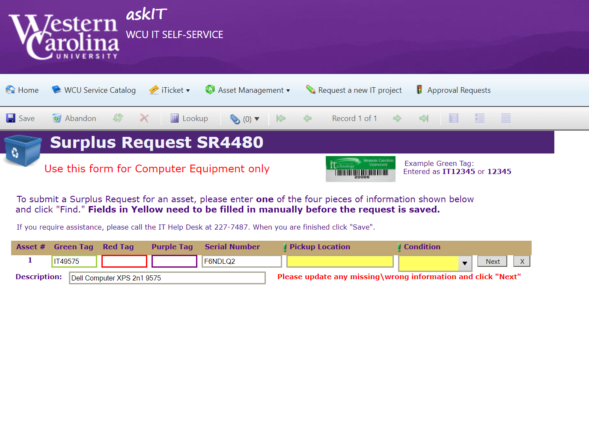

Save Here
Fill in a Pick up location where the items will be kept (securely) and enter a condition. Click Next. You can enter up to 5 Items. Once all have a ( ) in the upper right of the listing, click Save.

Slide 64
You can attach Pictures or Supporting
documents here
If you have a box of cables or something without a Tag, you can put text into these fields, ex. ITCables, and then add a description

Slide 65
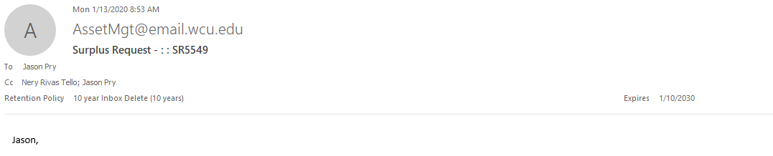
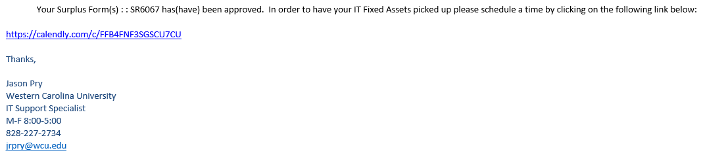
Only Your approved forms will show here

Slide 66
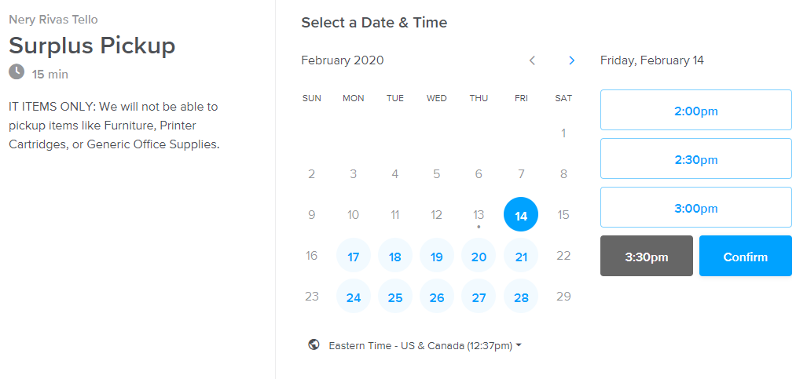
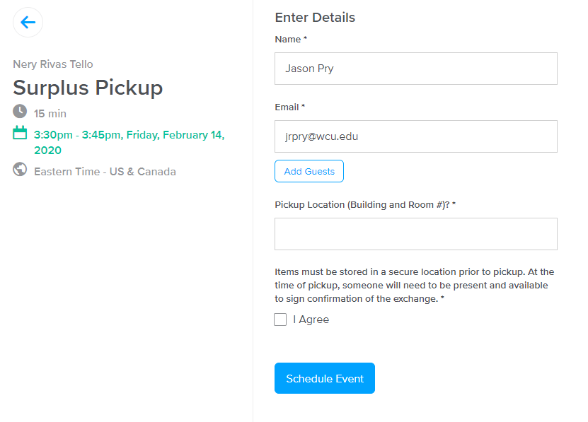
Pick a Time, it looks at both calendars
Confirm your details and please
be prepared to be present for the
chosen time slot
If you have had to add a bunch of non-tagged items
(keyboards, wires, etc.) please provide a courtesy
email by selecting “Reply All” on your initial schedule email
so that we can be prepared to handle your request.
We will retain the right to reschedule if we cannot pickup
all items due to additions or items left off initial request.

Slide 67
Plan Assets
What is your need?
Can a Laptop Fulfill this need?
Do you have existing hardware that can do this?
Will you need specific software with the hardware?
  Can the Virtual Environment help?
Does every computer have to be “High-End”?
Do you have a One-in, One-out or does this need constitute an additional Asset Fee per device when billing time comes?
  If you don’t have a One-in, One-out, will this be approved?
Are existing items able to be securely handled, are there enough staff for tracking the devices?
Can the Technology Commons help with your need?
Are your department’s assets up to date?

