Slide 1
Department of Intercollegiate Athletics
2024-2025 Budget Hearing

Slide 2
FY24 Budget
Expenses
Salaries & Benefits 47%
Operating Budgets 29%
Scholarships 24%
Revenues
Student Fees 49%
Self-Generated 31%
Institutional Support 13%
NCAA/SoCon 7%
Student Fees + Institutional Support = 62%
Southern Conference AVERAGE is 70%

Slide 3
Budget Pressures & Challenges
Revenues
Enrollment/Student fees
Sports Wagering
Expenditures
Market fluctuations in travel and equipment
Deferred maintenance in facilities and operations
FY22 & FY23 legislative increase - $220,271
FY24 & FY25 legislative increase - $427,188
Evolving NCAA legislation (i.e. COA, NIL, Alston)

Slide 4
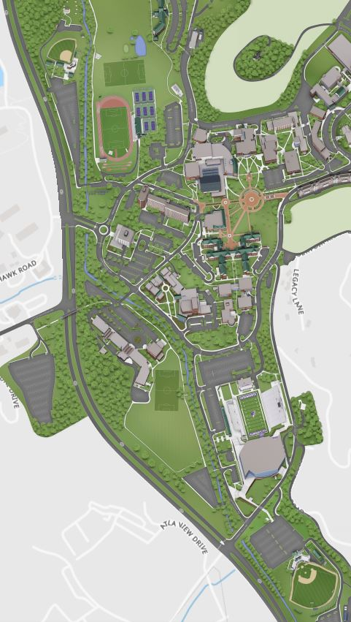
2023-2024 Facility Enhancement Priorities
Phase 1
Strength & Conditioning Center
EJ Whitmire Stadium West
Football Stadium Press Box
Football Coaches Offices & Meeting Rooms
Field Sports Complex
Phase 2
Football Locker Room
Sports Medicine Suite
Grand Entry “Hall of Champions” Area
Athletics Equipment
Additional Priorities
Baseball Clubhouse
All Sports Indoor Training Facility
Ramsey Renovations

Slide 5
2024-2025 Non-Recurring Budget Requests

Slide 6
2024-2025 Recurring Priorities
Assistant Director of Compliance
Countable Coach Allotments
Continue to invest in our people by allocating funds to address wage and salary needs to align with the University wide initiative.
Continue to invest in our people by allocating funds for professional development activities.

Slide 7
Thank You

