Slide 1
University Budget Forum
Administration & Finance
April 2024

Slide 2
AGENDA
WCU Budget Update
2023-24 Division Presentations
Administration and Finance
Academic Affairs
Student Affairs
Athletics
IT
Advancement
Chancellor’s Division

Slide 3
WCU
Budget Update

Slide 4
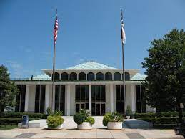
Allocations made at WCU in 2019-20 and 2020-21
2019-20
No increases from legislative action
WCU released $2.5 million from enrollment
growth funds for faculty/staff increases to
address compression/inversion,
additional positions
2020-21
No recurring increases from legislative action
One-time funds released in February 2021
for strategic purchases

Slide 5
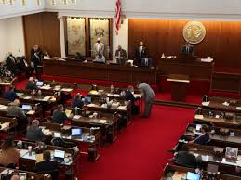
Appropriations to WCU in 2021-22
2021-22 Funding
2.5% legislative increase to salaries and wages
$1000-$1500 one-time legislative bonuses in December 2021
$6 million in enrollment growth funds
$8 million in one-time funds released in Spring 2022 for strategic purchases
$3.4 million O&M legislative funding for Apodaca Science
$35.5 million for Moore Renovation
$12 million for various R&R projects
$6.7 million in one-time funds carried
forward for R&R projects

Slide 6
Appropriations to WCU in 2022-23 and 2023-24
2022-23
3.5% legislative increase to salaries and wages
Funds were allocated from the Chancellor’s reserve for additional Advising positions
Earlier (August) release of non-recurring funds, with additional releases in February and April
2023-24
4% legislative increase to salaries and wages
$95.3 Million for New Engineering Facility + $3.5 million recurring for Engineering expansion
$1 million non-recurring for Athletics
WCU received a budget reduction (from enrollment decline) of $2.5 million. $3 million had been set aside in reserves from previous enrollment growth funds for this expected reversion.
The new funding model added summer credit hours and performance weighting of $1.2 million, making the actual reduction only $1.3 million. The remaining reserve ($1.7 million) was allocated to summer operations and adjunct pay, now that summer is on the funding model, rather than self supporting.
Early release of non-recurring funds was withheld to support R&R needs due to construction cost escalation

Slide 7
Outlook for 2024-25
A 3% legislative increase is expected in the 2024 session.
WCU will receive a budget reduction (from enrollment decline) of $1,262,032, which had been set aside in reserves from previous enrollment growth funds
$700k+ for Athletics, non-recurring
No expected ability to fund new positions or compensation allocations from existing WCU funds without reallocation of resources.
Expect early release of non-recurring funds in August 2024

Slide 8
Questions?
University Budget Forum
8

Slide 9
Administration and Finance
Division Presentation - April 2024
9

Slide 10
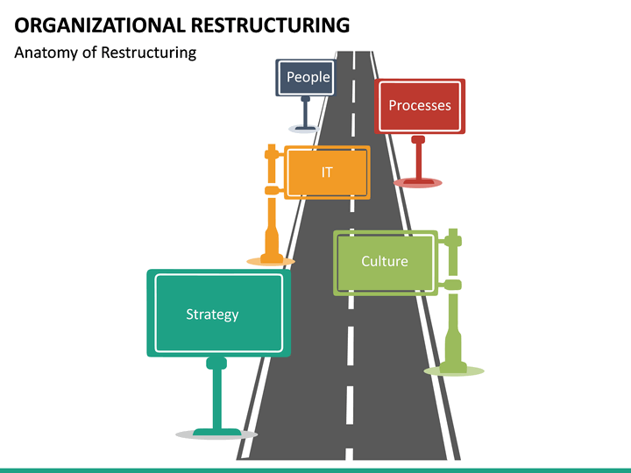
2024-25 A&F Budget Priorities
Reallocated Resources
Repurpose of Existing Positions vs. New
Restructuring and reconfiguration within Facilities Management and Human Resources allowed those areas to adapt to emerging needs without adding personnel.
Reallocation of Savings from Efficiency
Reduced the number of PawPrint machines and benefit from print volume, allowing units to stay within the current budget.
Natural Gas usage is down as new plant steam plant comes online (35% more efficient). Savings used to offset higher electricity costs
Renegotiation of existing service/vendor contracts
Recognized year over year cost savings which have been redirected to increased/inflationary costs in other supplies and services.

Slide 11
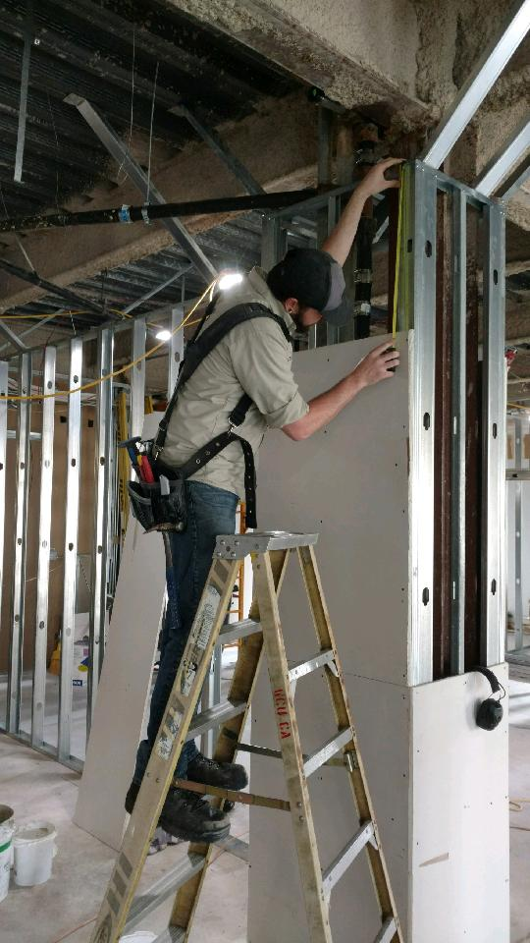
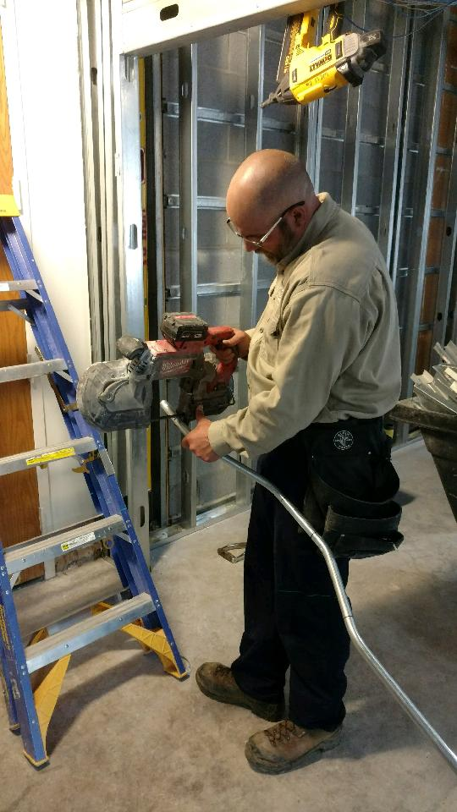
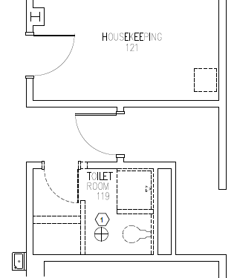
2024-25 A&F Budget Priorities
People
In-house Construction Crew
To offset rising construction costs, many small informal construction projects can be performed with in-house labor. This proposal adds additional laborers (carpentry, electrical, plumbing, HVAC, & administrative support) to provide labor cost savings, scheduling efficiencies, a higher quality work product, and trade employee development.
$775,000 or Self-Funding
Reid 119 Toilet Renovation
56 sq ft space
Low Bid = $170,460 (next lowest bid = $231,715
$3,044 per sq ft
HFR Suite 420 Renovation
2923 sq ft space
Low Bid = $800,829 (next lowest bid = $922,300
$274 per sq ft
Decision to Self-perform
Cost of work = $380,825
$130 per sq ft

Slide 12
Law Enforcement Accreditation $100,000+
2024-25 A&F Budget Priorities
People – Law Enforcement

Slide 13
2024-25 A&F Budget Priorities
Unfunded Mandates & Inflation
Many Supply and Services costs have been paid from non-recurring funding. These costs need to be paid from recurring funding to ensure continuity of operations.
Annual Licenses, Maintenance Agreements, Software, Equipment, Training, Programming
Inflationary Increases
Electricity cost increase (20%....$725k)
Supplies and material cost increases
Software Annual Maintenance Fee Increases

Slide 14
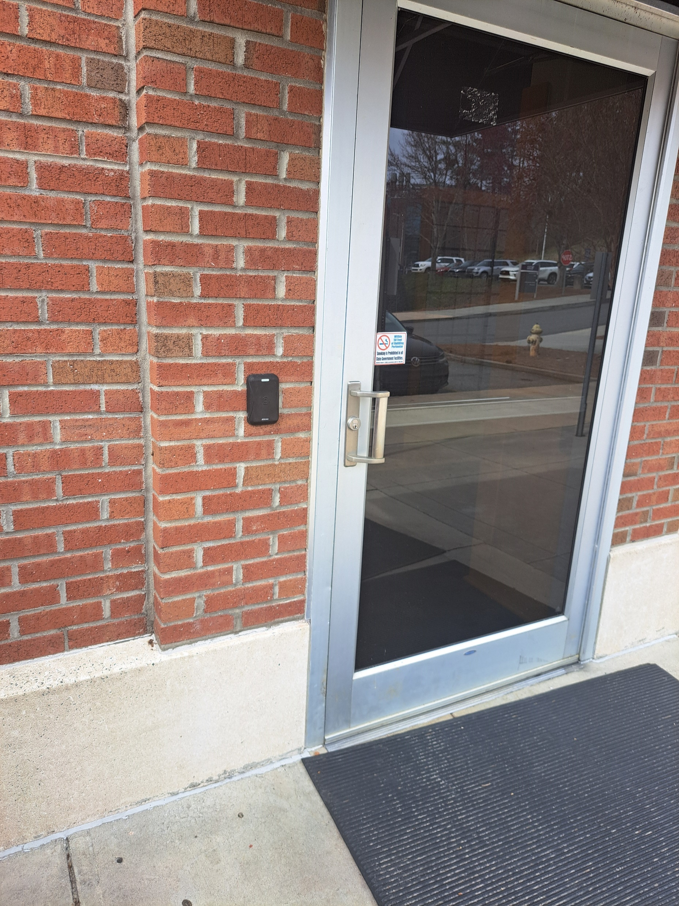
2024-25 A&F Budget Priorities
Support for Campus-Wide Investment
The ability to electronically lock all exterior doors on all buildings.
Need to place electronic locks on 71 remaining exterior doors.
Estimated $2 million to complete.
Staff Senate Proposal:
External Professional
Development Fund
$20k

