Slide 1

Western Carolina University Purchasing Department
WCU
Travel
Card
Program
2019
“The Way of the Future!”

Slide 2

YOUR t-CARD STAFF
Bruce Barker
bbarker@email.wcu.edu
828-227-7203

Slide 3
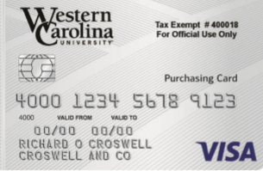
A “T-CARD” IS……
Short for Travel Procurement Card (may also be referred to as T Card)
Corporate VISA credit card
For business use only
Issued in employee’s name
Charges are billed to the University

Slide 4

PURPOSE....
Rapid turnaround on Travel Accommodations
Reduce paperwork
Reduce processing time and costs
Save you frustration!

Slide 5
PURPOSE - Continued…..
REPLACES Most Travel Advances and Travel Reimbursements
Strongly Suggested purchases on T-Card: Registrations, Air Line tickets, hotel/Motel Accommodations, Car Rental, etc.
For these reasons, every department needs at least one cardholder

Slide 6

University Benefits….
REDUCES:
  Forms
  Data entry
  Number of invoices and checks processed
  Need for reimbursements
CONTROLS:
  Merchant categories (MCC codes) can be restricted/blocked
  Spending limits are set for each card
  Reconciler oversight
  Department head/supervisor review
  Audit
Notes:
We will cover some of the unauthorized purchases in a few minutes.
Our local vendor community should find their cash flow situations improve if they accept the ECU p-card. They receive payment within 2-3 days versus 30-60 days under the old requisition system.

Slide 7
Travel Spend Limits
Most Travel Cards are set at a $5,000 Dollar limit
However, this limit can be either increased or decreased at the request of the card holder and the approval of the department head. The maximum single transaction limit allowed per memo from the State Purchasing Officer, is $25,000. Any Single Travel Transaction over $25,000 must be approved by Purchase and Contract in Raleigh. Please contact Bruce Barker 828-227-7203 for instructions.

Slide 8
Examples of Splitting to avoid P-Card spending limits.
One should ask themselves, “If I didn’t have a limit on my T-Card, would I purchase all of the items required in one transaction?” If your answer is yes then you are splitting transactions to avoid the card limits.
It is obvious that purchasing a single item by using two transactions against the card that the total exceeds the card limits is splitting to avoid the card limits
Examples:
If you are purchasing $27,000 worth of airline tickets and your limit is $25,000 per transaction, do not split the transaction or tell the vendor to charge the card for $20,000 and then charge the remaining $7,000. This is considered splitting the transaction to avoid spending limits.

Slide 9
University Requirements
All transactions are uploaded to Banner Monthly (Accounting System of record); posted to the GL; and payments issued to the bank monthly
The University conducts an on-going audit of purchases to insure a high degree of integrity and confidence in the system
University must pay the bank within 20 days after close of the monthly billing cycle
Charges are paid in full each billing cycle
Notes:
(Refer to the News & Observer article here)

Slide 10

Vendor Benefits & Requirements
Improves vendor’s cash flow
[Bank pays vendors within 2-3 days]
The vendor has a higher confidence level in VISA than a Purchase Order
Card eliminates need for additional Travel Auditor processing
Requires no special enrollment
[If vendor accepts VISA, not restricted]
Vendor pays a transaction fee to VISA
Notes:
No need for the vendor to send out invoices, statements or pursue collection on past due bills. They DO pay a small 2-3 percent fee to VISA for each card transaction.

Slide 11

Cardholder Benefits
Easier to make Travel Arrangements
Most merchants accept VISA
Does not require use of personal funds
Allows rapid purchase and receipt of travel related services
No fee for card use

Slide 12

Cardholder Requirements
View transactions electronically [WORKS Payment Manager]
Report fraudulent charges to your T-Card Staff
Process then sign & date all monthly hard copy statements
(see attached statement)
Keep all receipts and good records
Notes:
The WCU account number is electronically associated with each card. The obect code is a function of something called a merchant category code. The ECU card team sat down with the VISA MCC listings and assigned the object code that seemed to best apply to purchases with that type vendor. It will not be 100% accurate for all purchases. Example ---- You can go into Harris Teeter and purchase household cleaning supplies but the bulk of your purchases will most likely be food items. Therefore, the object code tied to the grocery stores is 2200 for food. The object code will not always be an exact fit. You will have to have some flexibility. The ITCS card support team is finalizing some enhancements to the reconciliation screens that will allow cardholders and reconcilers to change some of the accounts in the near future.

Slide 13
Cardholder Requirements - Continued
Must provide vendor with BILL TO address of
301 HFR Administration Building
Cullowhee, NC 28723
Must reconcile monthly (when notified by email)
Protect and secure your card and paperwork at all times
Example: locking file cabinet

Slide 14

Policy and Procedures
Who should have a Travel card? Responsible individuals who have regular Travel needs
Cardholders must be WCU staff or faculty with “permanent” employment status.
Department Head approval and selection of a spending limit is required
The Travel Card must be used ONLY by the named cardholder!
Only one Travel card per person (There are NO “departmental” cards) NO SHARING!

Slide 15
Policy & Procedures – Continued
State & Trust funds are allowed, Grant and Special funds are allowed with appropriate approval
NO FOUNDATION funds allowed (ex: 9XXXXX)
NO PERSONAL purchases allowed
Cardholders sign a “Cardholder Agreement” at the end of Travel Card training (or when you receive your p-card)
Cards must be cancelled immediately when transferring to another department OR if you leave the University
Card must be turned in to Travel P-Card Manager to be held during a Leave of absence (for more than 6 weeks) until the employee returns to work
Cards must be returned to the Travel P-Card Manager to be cancelled and destroyed (University property)

Slide 16
Policy & Procedures – Continued
Never accept cash or gift cards for returns
Original, priced, itemized receipts or invoices are required for each transaction
Splitting transactions to avoid spending limits is strictly prohibited

Slide 17

Sample Purchases Allowed
Hotel/Motel Reservations
Registrations (can be either Travel Card or regular P-card)
Airline Tickets
Baggage charges
Parking fees
Rental Cars
Taxi
Gasoline for rental cars
Meals for students only NOT Staff (Meals can be in a restaurant)

Slide 18
Paying Registrations
P-Card not used: (note on: Check Request Form)
  Merchant does not accept VISA
  Foundation Funds
  Additional functions-use Check Request Form
ONLY registration fees can be paid
NO add-on luncheons, banquets, etc. (does not apply to meals that are automatically included in your registration fees)
DO NOT request reimbursement for items paid on a Travel Card
Registrations over the spending limit ($25,000) must be approved by P-Card Manager prior to purchase

Slide 19
Paying Registrations Continued..
Documentation for registrations should include a registration form, pamphlet, brochure, or printed materials from the internet that describes who is attending, what the conference is, where/location, dates of conference.
All WCU travel policies apply
Violations (travel and P-Card)
https://www.wcu.edu/discover/campus-services-and-operations/controllers-office/for-faculty-and-staff/index.aspx

Slide 20

UNAUTHORIZED PURCHASES
NO purchases for personal use
NO entertainment
NO Cash Advances
NO Gifts/ Contributions, Gift Certificates, or Gift Cards, Prizes or Awards
No meals for employee (employee meals are per diem and must comply with Travel Policy)
No meals for university guests, speakers, etc.
Notes:
We don’t allow purchases from University storerooms for the sole reason that the storerooms would have to pay the VISA transaction fee.

Slide 21
Audits
Transactions may be audited by Purchasing, Internal Auditor, Office of the State Auditor, and the Purchase & Contract Compliance Team
P-Card Manager and WCU Travel Auditor reviews all transactions
Cardholders may receive an email requesting additional information
Must make every effort to resolve any issues
Constant problems and errors may result in card cancellation
See section 7 under 8.0 Compliance from the WCU Purchasing Travel Card (T-Card) User’s Guide

Slide 22
Your Card
Issued by Bank of America
User info provided to BOA by Travel Card Manager
Call to activate
Activation code 92 #
Call the Travel Card Manager if you have problems

Slide 23

Cardholder Responsibilities & Processing
The CARDHOLDER has made a reservation on their Travel Card :
1 - Review all new purchases online and signoff in Works (BOA)
2 - Report any fraudulent charges to Travel Card Staff
3 - Match itemized receipts and staple behind a printed hard copy bank statement
4 - Sign & Date statements in ink (full signatures required)
5 - Forward (sign & dated) Statement and receipts to reconciler by the 18th
6. Due to Purchasing office the 1st of the following month
Notes:
These steps are designed to protect both you the cardholder and the department from misuse or abuse of the card or the departmental funds.

Slide 24
Cardholder Responsibilities & Processing - Continued
Cardholders may edit FOAP codes (what you’re charging the transaction to) or should notify their Reconciler prior to the 18th of the month if changes are needed
Cardholders must work closely with their reconcilers and/or accounting personnel to set up appropriate departmental procedures to ensure proper oversight and processing of card transactions
Charges are not encumbered in advance; do not over-spend your budget

Slide 25
Cardholder Responsibilities & Processing - Continued
Lost or Stolen Cards
Report to Bank of America immediately 1-888-449-2273
Notify Travel Card staff
227-7203
Review transactions carefully and notify Travel Card staff if there are any fraudulent charges. Report Immediately 1-866-500-8262.
Disputes must be submitted within 30 days of the transaction date
Returns
Credit must be issued back against your card
Never accept cash or cash equivalents
Handle with vendor and follow return instructions

Slide 26
Statements
Cardholders must print (around the 13th of each month) a hard copy of their monthly statement from Works after the close of each cycle; ONLY if the card has been used for the most recent billing cycle.
A hard copy of the card holder’s Billing Statement is sent to the Travel Card Manager by mail or hand delivered by the 1st of the following month

Slide 27
Documentation
Statements
Must attach a receipt for each transaction
Redact Credit Card # from receipt
Requires a minimum of three signatures (cardholder, reconciler & dept. head) and date
Tape corners of small (fast food restaurants, Gasoline etc) receipts to an 8 ½ x 11 piece of paper; also attach a copy of original receipt
Due to Purchasing by the 1st of the month following the close of the billing cycle
Receipts
Original, itemized receipt or invoice for each transaction
  Vendor
  Description
  Unit Price
  Extended Price
  Total

Slide 28
Record Retention
Original statements and receipts ~ Travel Card Office
Archived for a period of 5 years in Purchasing Archives
WCU Internal Auditor has recommended: Departments should maintain copies of all documentation long enough to be assured T-Card Administration has the original documentation and to cover an adequate audit cycle, which is suggested to be three years for cardholders.
Keep files secure and confidential as card account numbers may be visible
Shred all discarded T-Card documentation

Slide 29

Reconciler
Responsibilities & Processing
Reconciler over-sees Travel Card transactions and verifies FOAP (Fund) information. A Reconciler can be an Administrative Assistant, Budget person, Cardholder, Department Head, or person authorized to approve purchases.
The Reconciler is a pivotal point of oversight for T-Card transactions.
The RECONCILER must:
1- Review and approve each transaction on-line monthly (recommend when notified by email)
2- edit FOAP codes as needed to ensure transactions are charged to the appropriate budget codes in Banner
3- Review and match all Statements with receipts
4- counter-sign & date statements and obtain Dept. Head’s signature & date on statements
5- forward all statements and receipts to Purchasing by 1st of the month following the cycle

Slide 30
Reconciler Responsibilities &
Processing – Continued
Reconciler must report any changes in employee status to the Travel Card Manager
Reconciler must report any unusual cardholder spending activity
Reconciler must monitor card spending levels closely to ensure sufficient funds are available to cover departmental charges
NOTE: DEPARTMENTS ARE RESPONSIBLE FOR ANY CARDHOLDER SPENDING BEYOND THE SET BUDGET LIMITS
Notes:
CHANGE IN DEPARTMENT/NAME CHANGES/SEPARATION
BANK PROVIDES MONTHLY TRANSACTION REPORTS TO THE DEPARTMENT.

Slide 31

Processes ~ Credit Lines
CREDIT LINES are not restored until transactions are signed off in the Works system by
  Cardholder AND
  Reconciler (Manager/Approver)

Slide 32

Processes ~ FUND Security
Banner FUND security is based on the cardholder
Transactions can only be charged to FUNDS the cardholder has access to
Each card is setup in Works with only those FUNDS specified by the department head

Slide 33

Works Payment Manager
Online system provided by Bank of America
  Help manage your charges and budget
  Review charges and transaction details
  Edit FOAP codes
  Add online comments
  Online reporting
  Electronic approval / Sign off on transactions

Slide 34
Works System Features
Charges can be reconciled (approved) and FOAP codes changed as soon as the transaction posts in Works
System generated email notifications
Sign off on charges daily or when notified by email
Charges can be split coded
Comments can be added online
Transactions can be flagged for dispute

Slide 35


Getting Started
All participants will receive a “Welcome email” from Works Payment Manager once we’ve activated you
Email will contain your username, password validation steps, and instructions on changing your password

Slide 36
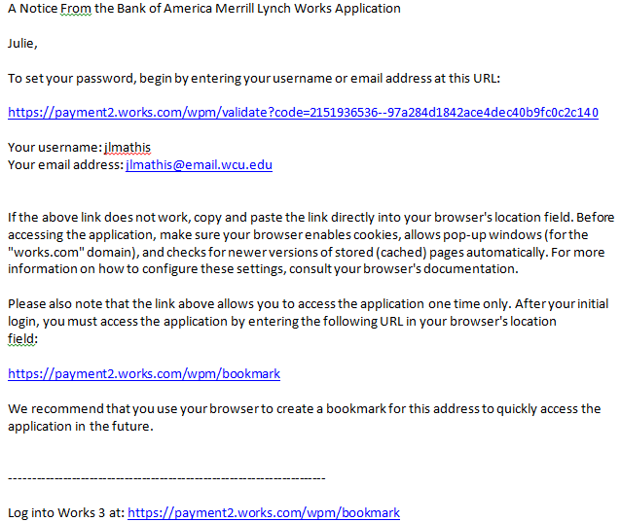
Section 6 – Page 5

Slide 37
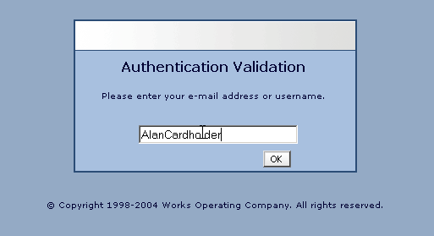
lisaross

Slide 38
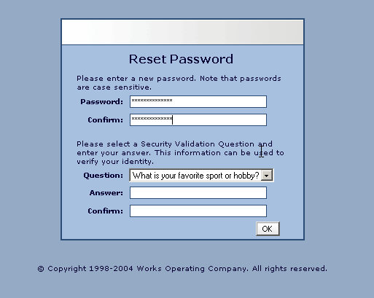

Slide 39
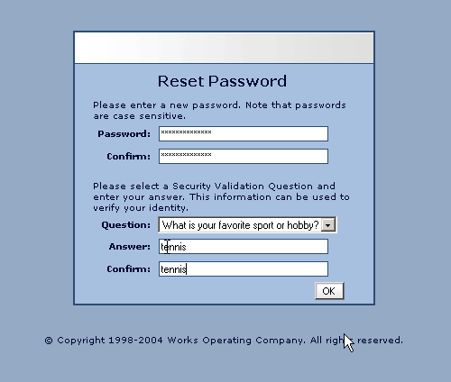

Slide 40
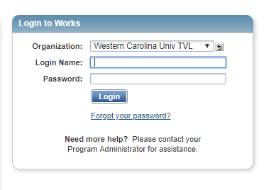
Example of Works Login Screen

Slide 41
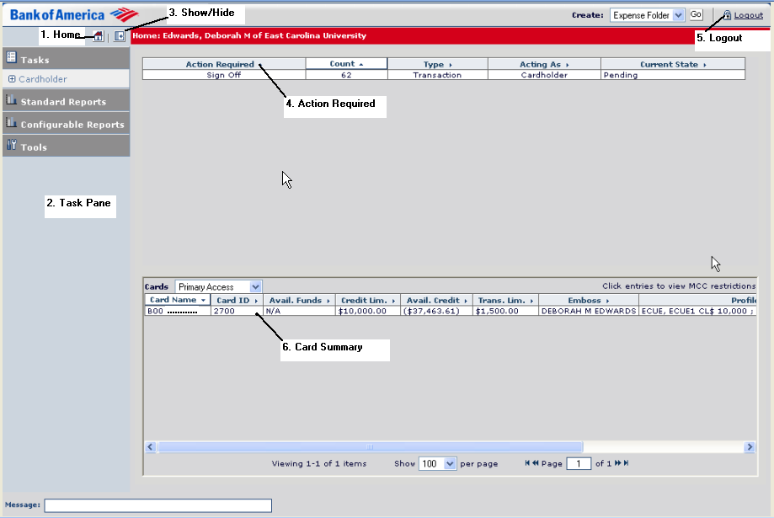
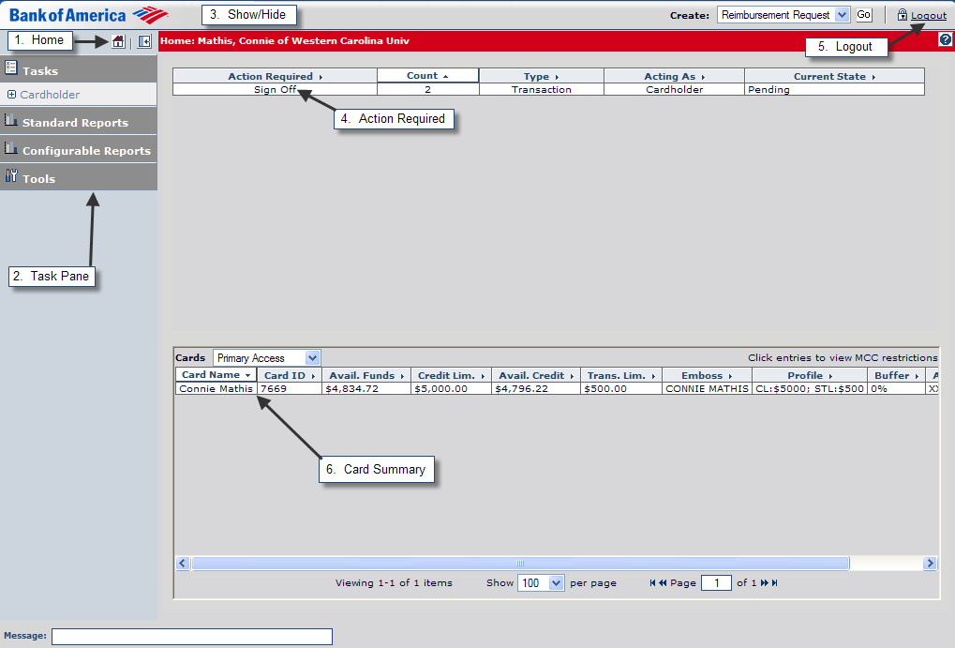
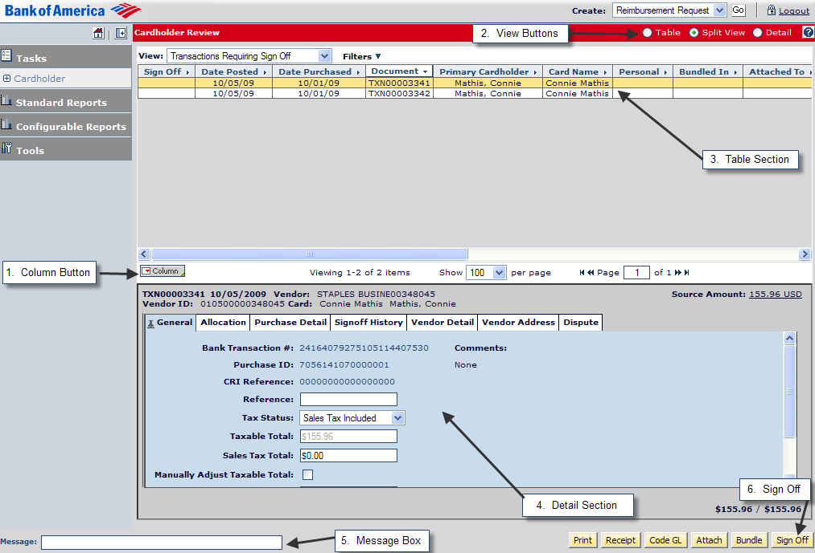
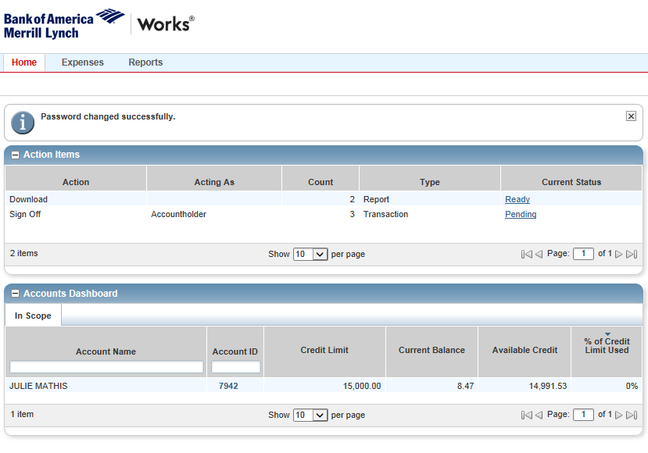
Western Carolina University
WCU

Slide 42
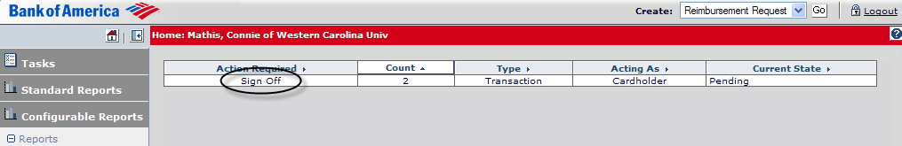
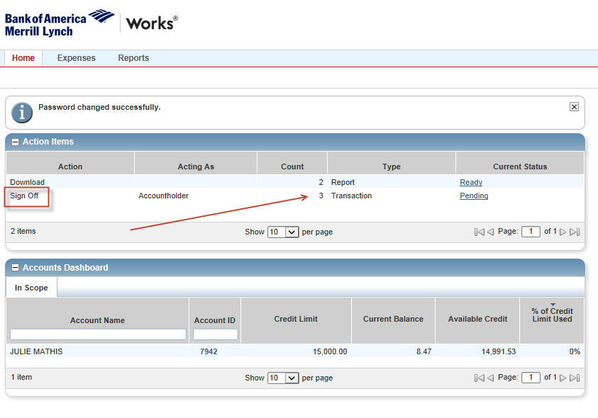
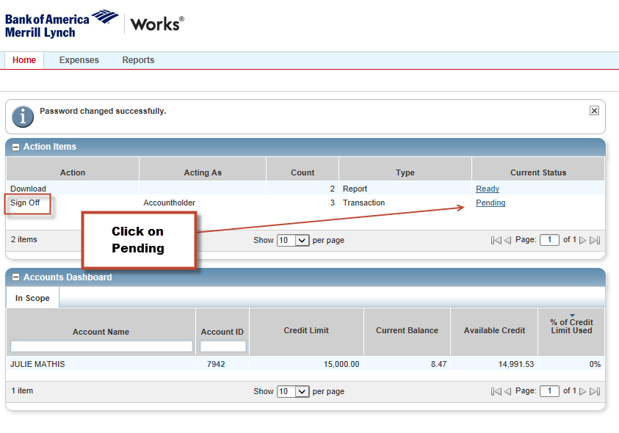
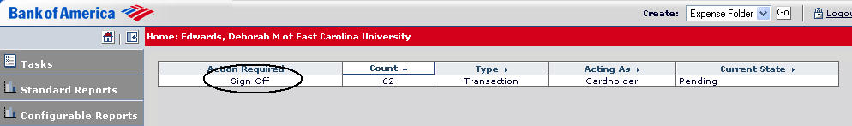

Slide 43
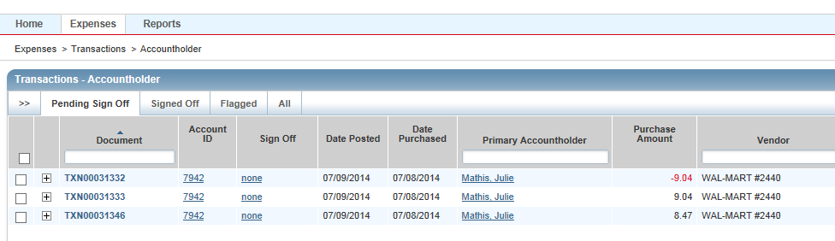

Slide 44
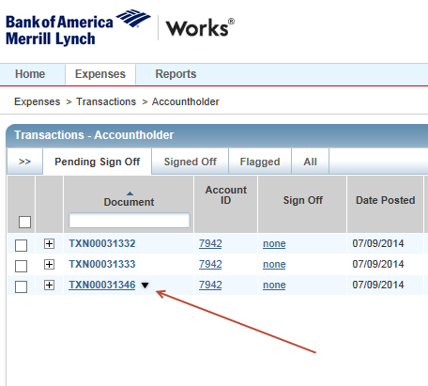

Slide 45
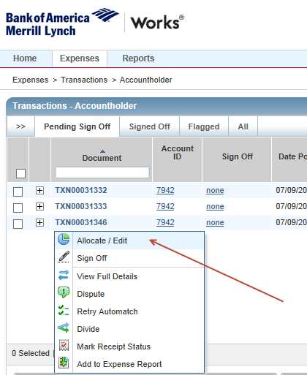

Slide 46
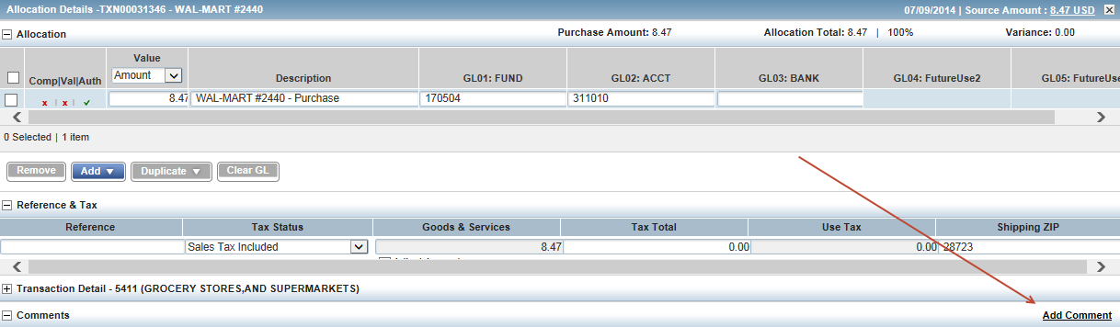
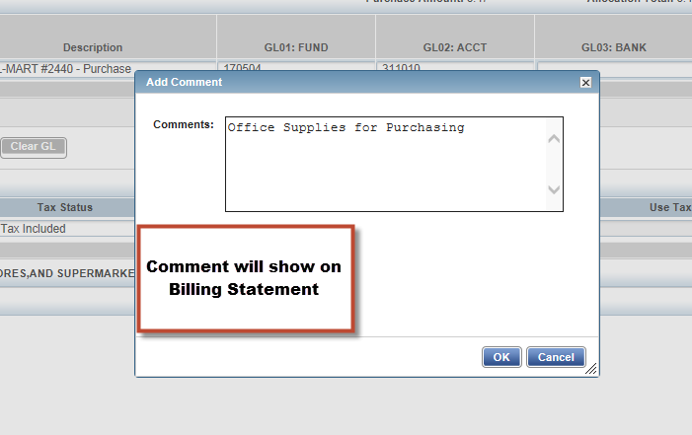

Slide 47
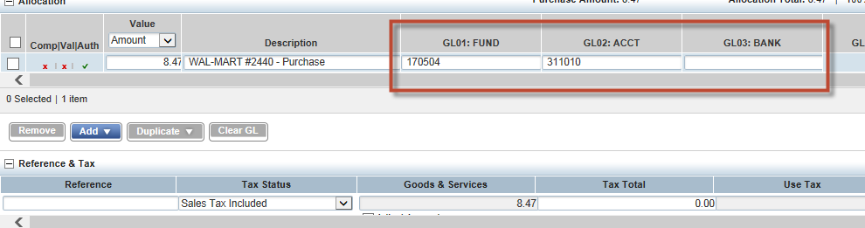

Slide 48
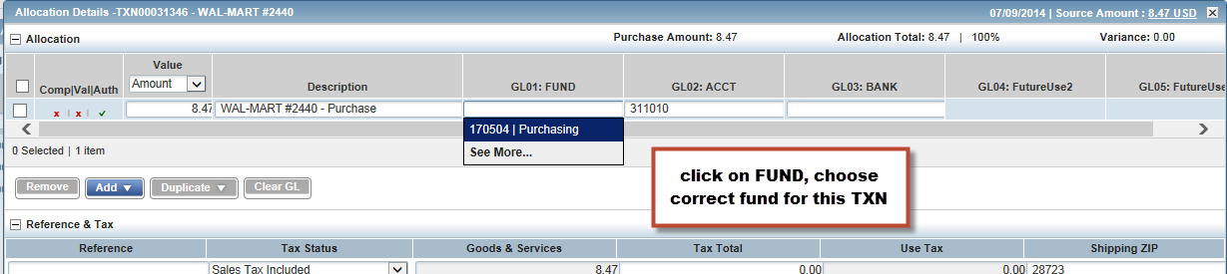
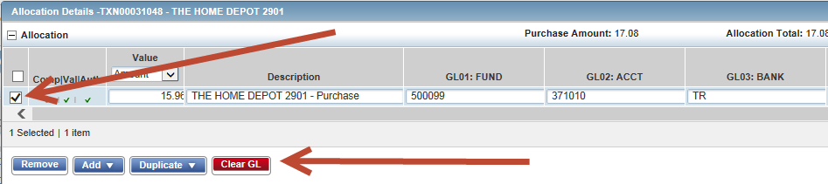
If your funds do not show up, choose “Clear GL” or Clear out the Fund, Acct and Bank. Search again.

Slide 49
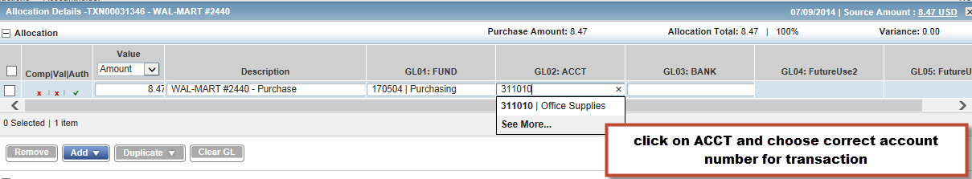

Slide 50
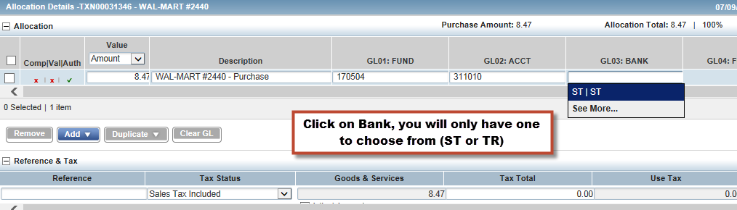

Slide 51
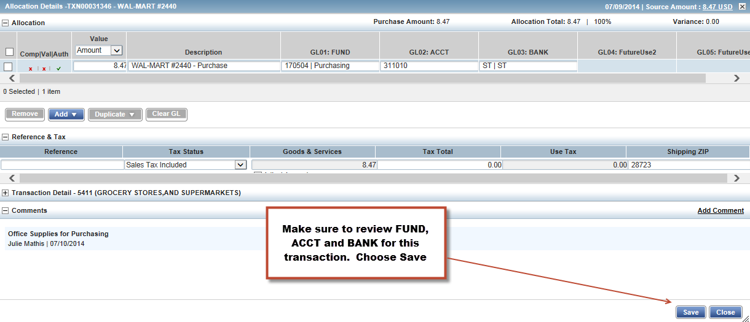

Slide 52
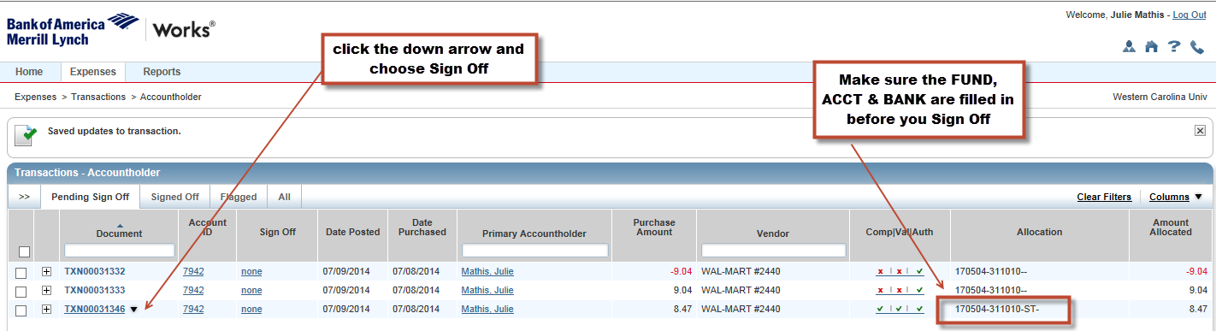

Slide 53
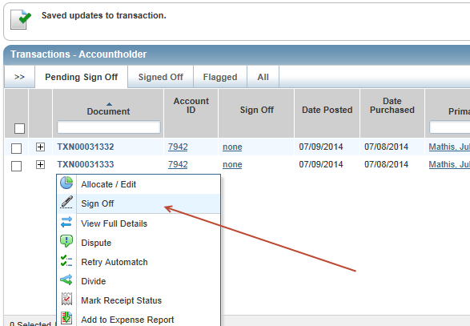

Slide 54
Split Coding

Slide 55
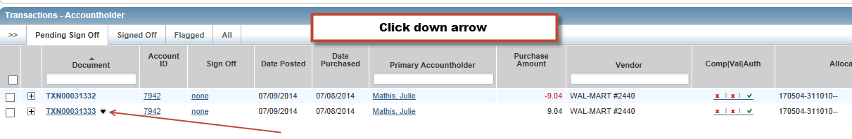

Slide 56
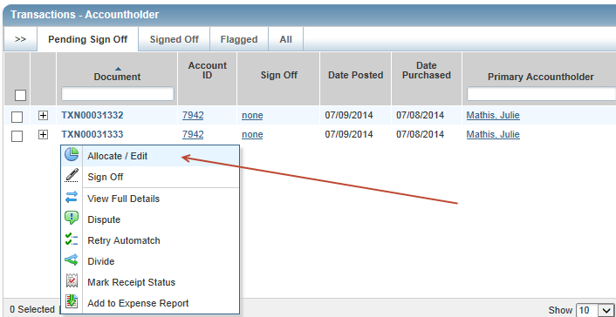

Slide 57
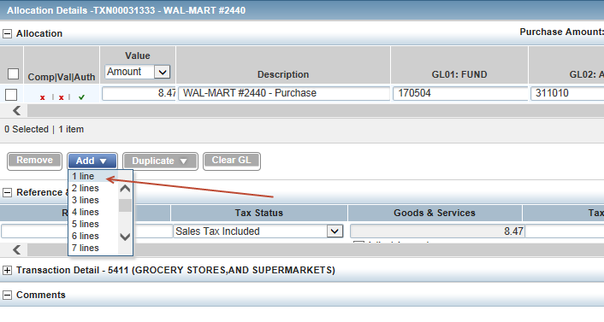

Slide 58
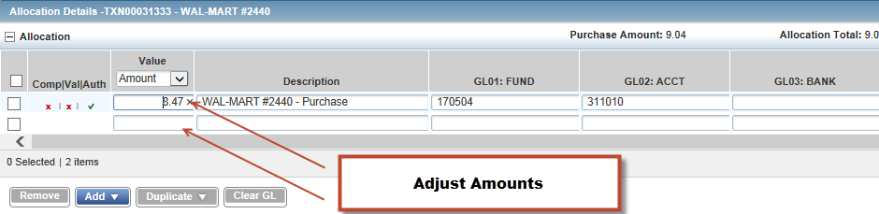
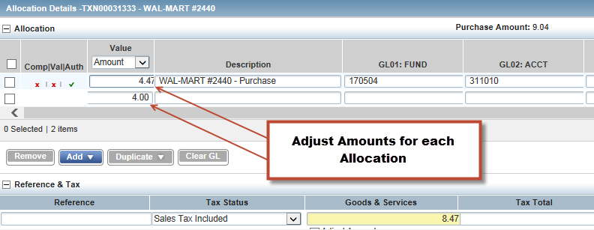
**Be sure to reallocate each GL to the correct Fund/Acct/Bank**

Slide 59
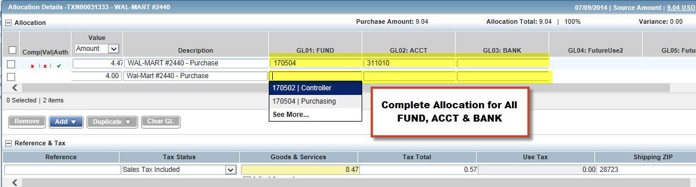

Slide 60
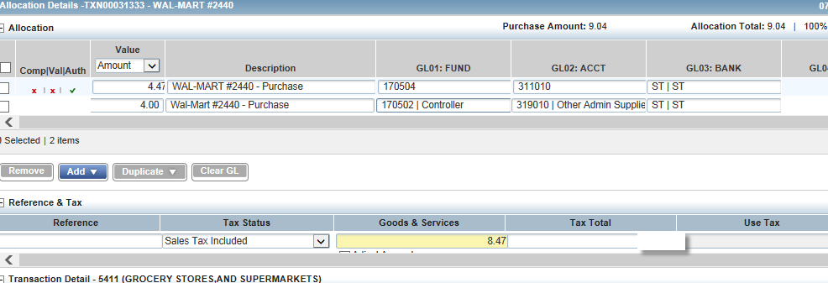

Slide 61
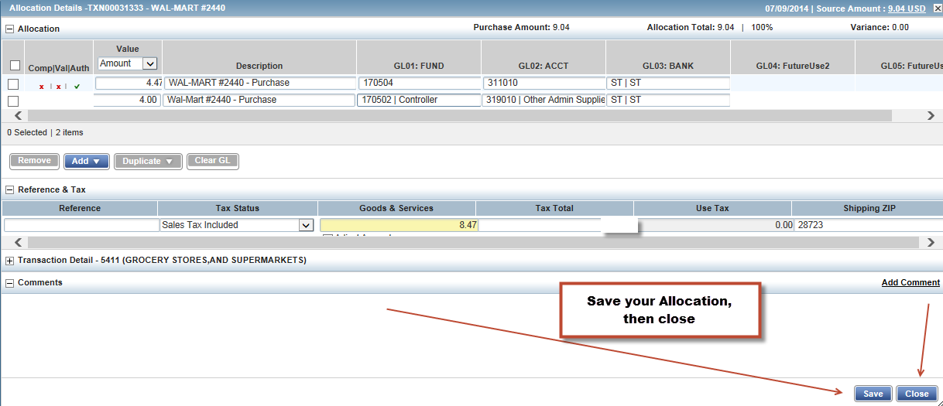

Slide 63
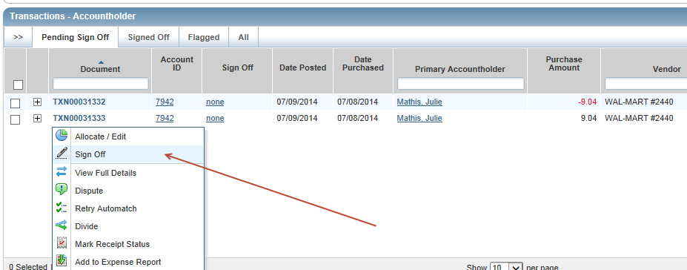

Slide 64
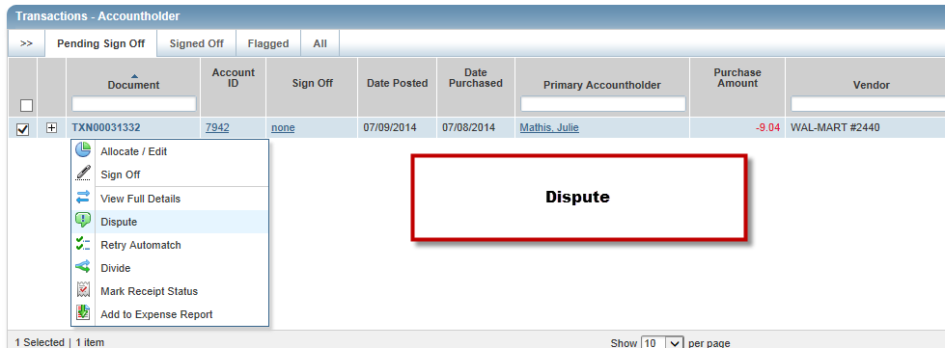
Disputing Transactions
Dispute

Slide 65
Monthly Process
Cycle ends on the 10th of each month
Cardholders and Reconcilers have 8 days to process approvals and complete FOAP (Fund) reallocations not already completed
On the 18th or next business day following that date charges are “locked” so that no further FOAP updates can be made
RECONCILERS need to complete approvals to restore credit lines
Statements should be printed 3 business days after cycle ends

Slide 66
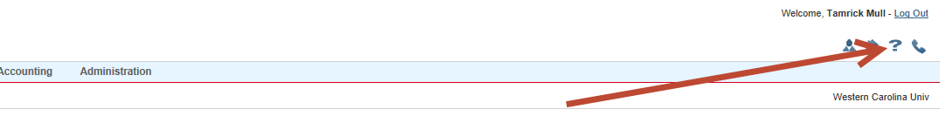
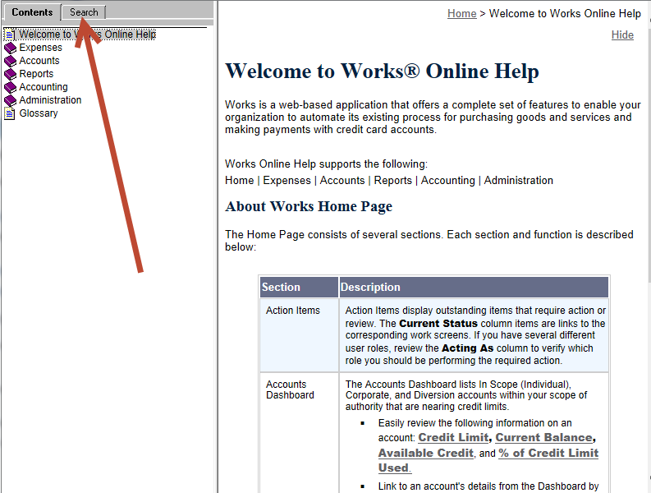

Slide 67
Your Card Has Been Declined
Single transaction limit
Monthly limit
MCC code
Invalid information (cvc/cv2 number)
Call Purchasing, 227-7203

Slide 68

Suggestions
Make a folder
Be sure your internet
sites are secure (https: or padlock locked)
Mark your calendar
Review your transactions
Don’t be scammed
Keep the Purchasing Travel Card User’s Guide and Training Guide handy!
If unsure, ask!

Slide 69

Purchasing Pointers
DOES IT VIOLATE WCU OR STATE POLICY?
(Check the WCU TRAVEL Manual/Contact Purchasing)
HAVE I REQUESTED AN ITEMIZED RECEIPT?
YOUR CARD IS LIKE CASH - KEEP IT AND YOUR PAPERWORK SECURE
Notes:
You will want to familiarize yourself with the general purchasing regulations. You can find assistance via the Materials Management home page (http://www.ecu.edu/purchasing). You will probably want to bookmark this site for future reference. You may also contact the purchasing agent that handles the specific commodity you are considering purchasing if you have a question about policy or state regulations. I will show you some purchasing sites that you may find helpful in a few minutes. You will want to keep a record of the transaction because the item is paid within 2-3 days and you will need to confirm that you do actually receive the merchandise.

Slide 70

REMEMBER
What you can purchase has not changed - all State of NC Travel rules and WCU Travel policies still apply.
ONLY the method of payment has changed.
Is it allowed by your funding source?

Slide 71

Conclusion
Questions?
Comments?
Look for new things to come!
Thank you for your support!

