Slide 1
SAI Response Rate
Draft of Proposals for 2010-2011

Slide 2
Focus Group Findings
What’s in it for me?
I forgot.

Slide 3
Proposals
Early grade notification dependent upon completion of CoursEval for that course
Countdown emails: 2 days, 24 hours, 3 hours.
Modify or extend the open window to include the last week of class, until midnight before exams start.

Slide 4
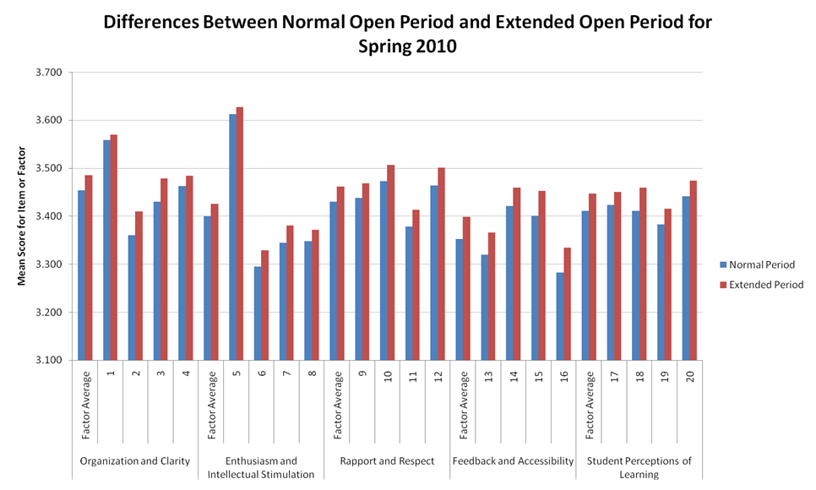

Slide 5
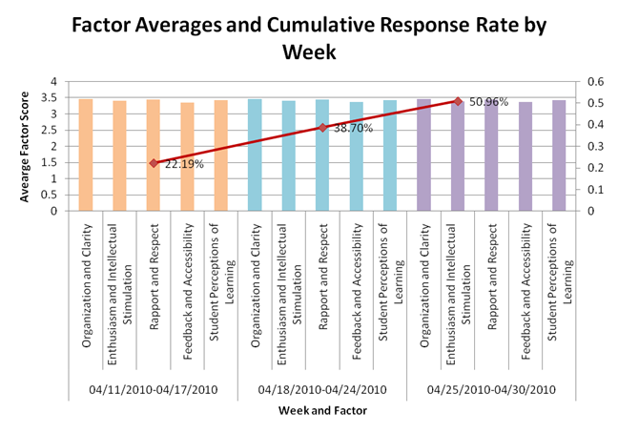

Slide 6
Breakdown by college

