Slide 1
Western Carolina University
Controller’s Office
Capital Assets

Slide 2
Governing Standards
Office of the State Controller
UNC Business Process Standards

Slide 3
Controller’s Office Responsibilities
To maintain and control the university’s inventory records
To update the asset records in the accounting system for information submitted on various forms
To assure each department verifies and certifies the annual departmental inventory
To perform quarterly audits

Slide 4
Fixed Asset Policy
Fixed Asset Coordinator (FAC) Procedures and Responsibilities
Fixed Asset Coordinator Powerpoint Presentation
Information and forms available here: https://www.wcu.edu/discover/campus-services-and-operations/controllers-office/fixed-assets.aspx
WCU’s website
Click magnifying glass and type, “Fixed Assets”
Select first link listed as, “Fixed Assets”

Slide 5

Fixed Assets
FIXED ASSET POLICY
FIXED ASSET COORDINATOR (FAC) PROCEDURE AND RESPONSIBILITIES
FIXED ASSET COORDINATOR POWERPOINT PRESENTATION
WCU LOCATION CODES

Slide 6
Fixed Asset Policy
Fixed Asset Coordinator (FAC)
Tracking of Equipment
  Controller’s Office – “Capital Assets” (IT/Non-IT =>5,000)
  Information Technology (IT)

Slide 7
Fixed Asset Coordinator (FAC)
The FAC will serve as the liaison between the unit and the University’s Fixed Asset Accountant (Controller’s Office) for items recorded in the University’s Fixed Asset System and as the liaison to Information Technology for data processing items tracked by Information Technology. The FAC will become the unit’s resident fixed asset expert.
Pursuant to WCU Policy # 75, accountability for property purchased by (or for) a department, college, or other unit of the university is the responsibility of the department/administrative head of that unit.

Slide 8
FAC’s Responsibilities, Cont.
Complete the Asset Control Form when:
Updating asset’s location, condition, serial number, etc. (timely manner)
Missing asset (steps taken to locate)
Vandalized/Stolen asset
  Campus Police
  Fixed Asset Accountant (Controller’s Office)

Slide 9
Fixed Asset Policy
Fixed Asset Coordinator (FAC) Procedures and Responsibilities
Fixed Asset Coordinator PowerPoint Presentation
WCU LOCATION CODES
FORMS AND REPORTS LIST OF FIXED ASSET COORDINATORS
WCU Asset Inventory Control
WCU Asset Inventory Control Form
Whenever a qualifying asset is permanently moved, missing, or stolen, the department is required to complete this form (an asset qualifies if it is $5,000 or greater, or an IT tracked asset). If you have questions about whether an asset qualifies, please contact Lacy Ensley (227-2583) or Nick Jones (227-2511). Instructions

Slide 10
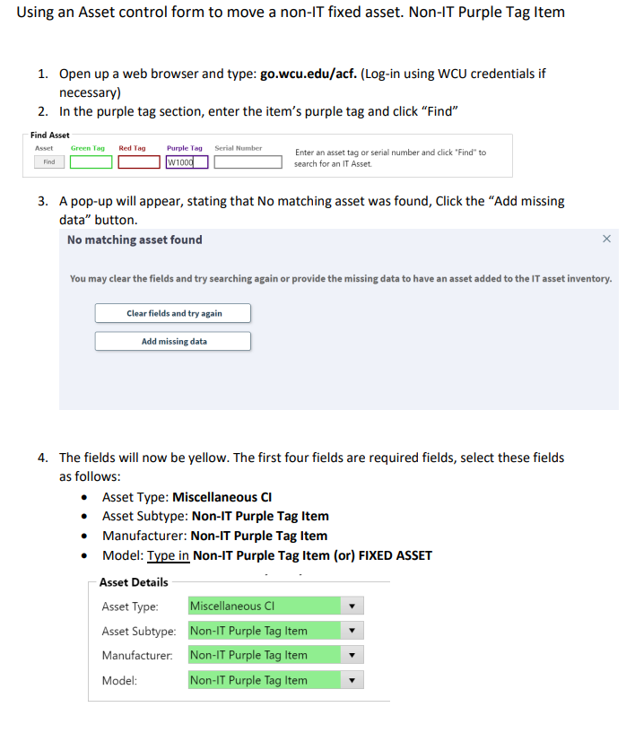

Slide 11
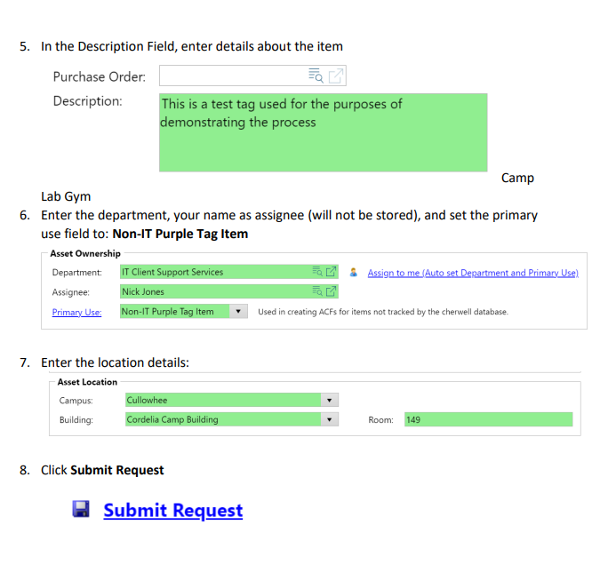

Slide 12
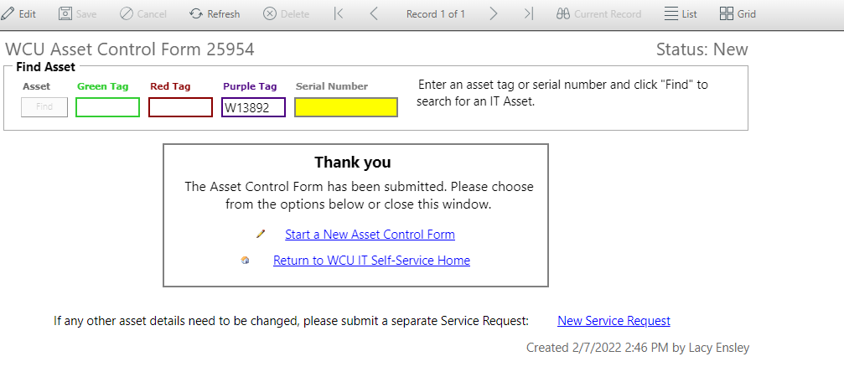
Once your request has been submitted, you will receive this notification, along with an email.

Slide 13
Gifts, Donations, Fabrications
Gift/Donation
  Prior to acceptance & receipt, contact Office of Development
  Fixed Asset Accountant (Controller’s Office)
Fabricated assets (by assembly)
For gift/donation or fabricated assets, go on-line to the WCU Asset Inventory Control Form. Go to, “Other” and check the box beside “Item is a donation/gift/fabrication/furnished by government.” In the “Details” field, give detail information. Then, go to “Asset Details”, “Asset Ownership” and “Asset Location” to complete assignee and location information. Click, “Submit Request.”

Slide 14
Trade-Ins / Returns to Vendor
Trade-Ins (used as partial payment on new equipment and/or not under warranty)
  Notify Surplus Property Manager (Regina Cowan)
  Surplus Property Manager contacts State Surplus Office
  If approved, Surplus Property Manager contacts department; purple/red tag(s) removed - sent to Fixed Asset Accountant, Controller’s Office, HFR 300-O; green tag removed-sent to IT Asset Coordinator, Nick Jones, Camp 149
Asset returned to vendor (i.e. insufficient funds)
  WCU tag(s) removed and sent to appropriate personnel

Slide 15
Trade-Ins / Returns to Vendor – Continued
  ▪ For trade-ins and assets returned to vendor, complete the Equipment Return Form
    The Department/Administrative Head’s signature is required. Please print, receive signature and send (or email) the form to Fixed Asset Accountant, Controller’s Office, HFR 300-O. Retain a copy in the department.

Slide 16
Equipment
Return
Form

Slide 17
Transfer of Fixed Assets
ON-Campus Transfers
Assets transferred to another department on campus
  For assets transferred, complete the Equipment Transfer Form_WCU Campus. The Department/Administrative Head’s signature is required. Please print, receive signature and email the form to Fixed Asset Accountant (lensley@wcu.edu) . Retain a copy in the department.
  Note: Department transferring asset to another department on campus should complete the Equipment Transfer Form. Then, the receiving department should complete the WCU Asset Inventory Control Form, so the correct organization and location is updated in the Banner Fixed Asset Module.

Slide 18
ON-Campus
Equipment
Transfer
Form

Slide 19
Transfer of Fixed Assets - Continued
OFF-Campus Transfers (UPDATED)
Assets permanently transferred to another University or State Agency
  When making a transfer of surplus personal property between constituent institutions of the UNC System, the originating (transferring) institution and receiving institution must complete and sign the UNC System Personal Property Transfer Requests form (Equipment Transfer Form_UNC System). Once the form is completed and signed by representatives for both the originating and receiving institutions, the receiving institution shall forward the completed and signed form to Robby Terry via email at rwterry@northcarolina.edu for review.
  After System Office staff review the request, it will be forwarded to the Chief Financial Officer for final review and approval. The UNC System Office will send all approved forms to the originating and receiving institution contacts.
  Note: Please always include both Lacy Ensley and Nick Jones when making these changes if they are Fixed Asset or IT related.

Slide 20
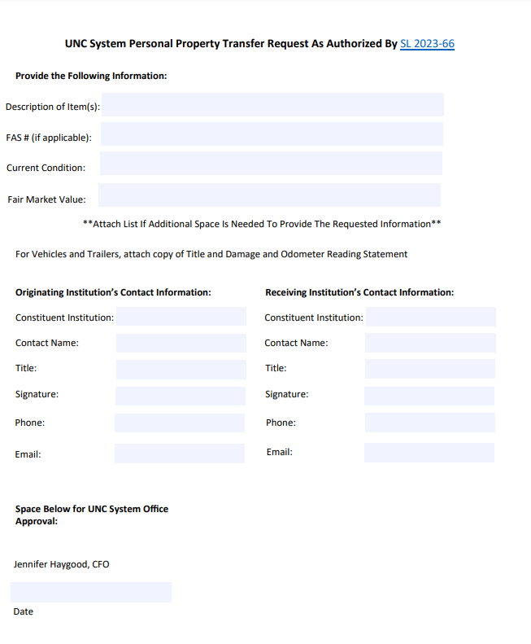
OFF-Campus
Equipment
Transfer
Form

Slide 21

FAC’s Responsibilities
Surplus
Disposals
Cannibalization

Slide 22

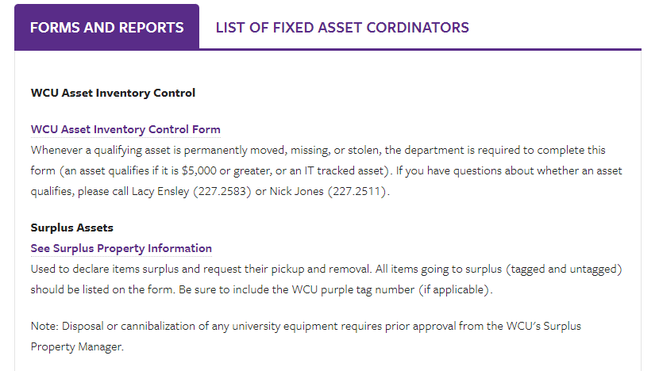

Slide 23


Slide 24
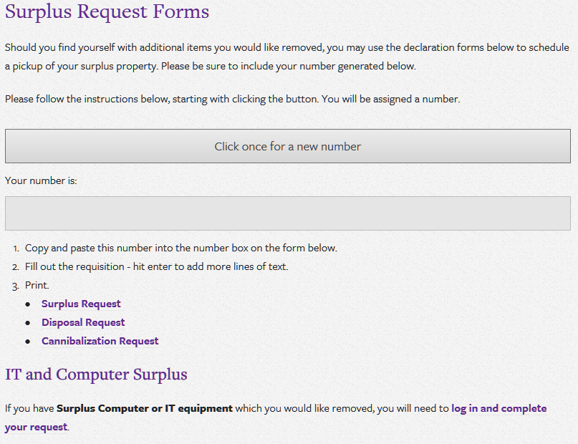

Slide 25
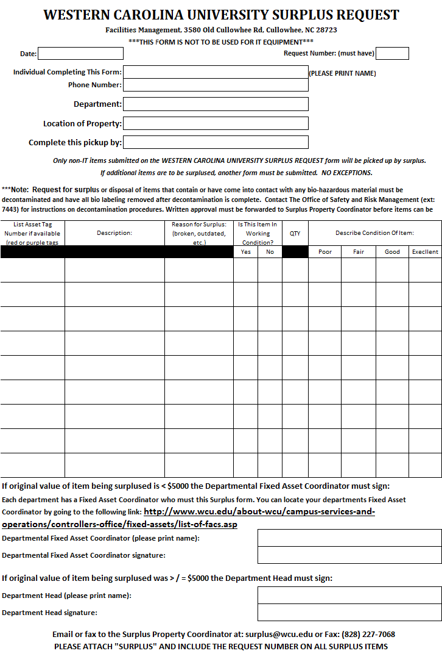
Surplus Request Form

Slide 26
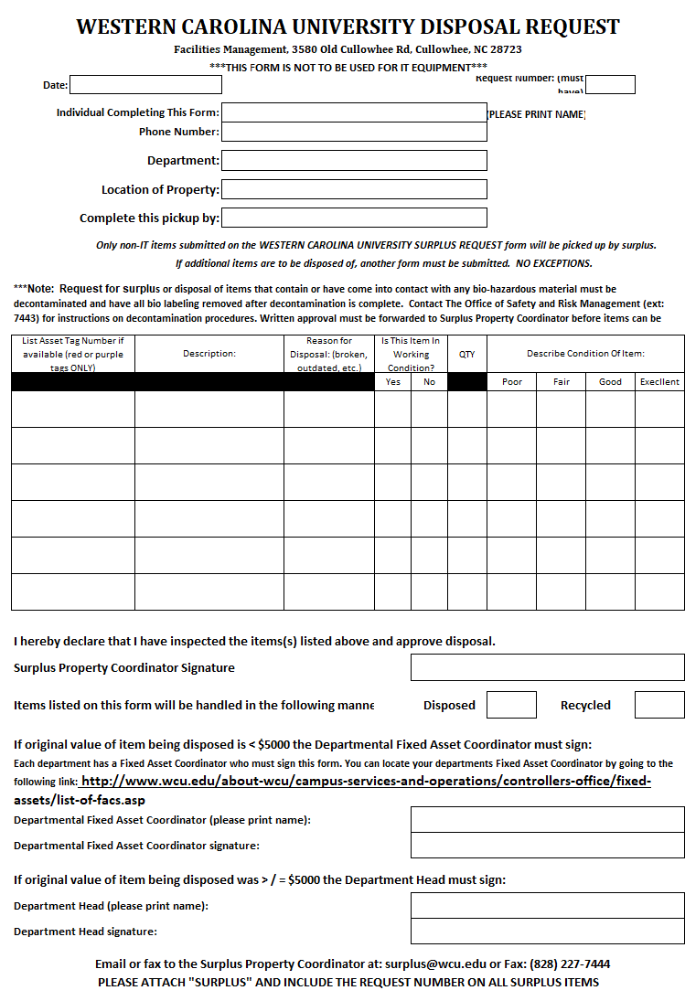
Disposal Request Form

Slide 27
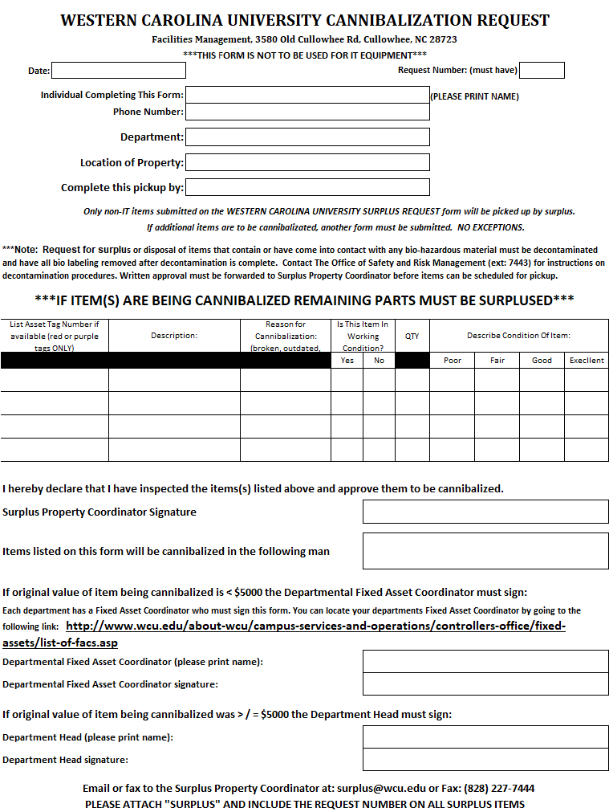
Cannibalization
Request Form

Slide 28
Annual Departmental Fixed Asset Inventory
  Visual verification of asset – place “Y” in Y/N column
  Note any asset updates in “Comments” column (if updates are needed, complete correct fixed asset form)
  List – IT tag (green) on spreadsheet if applicable
  Remaining useful life of six months (will be in RED)
    Appropriate departmental individual evaluates and recommends extension of useful life (in years) and notes in “Comments” column
  Completed inventory spreadsheet, with 2 signatures, should be sent to Lacy Ensley, lensley@wcu.edu or to Controller’s Office, HFR 300-O
  Copy retained in department

Slide 29
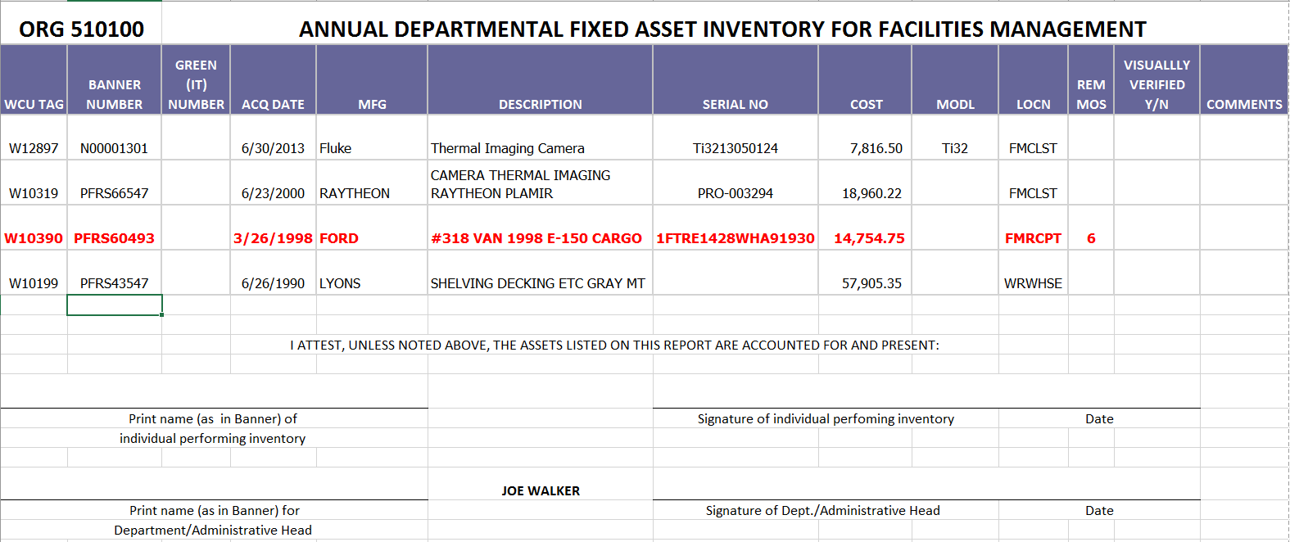

Slide 30
Capital Assets - Impairments
Impairment – An asset’s service utility has declined significantly and unexpectedly
Common Indicators
▪ Evidence of physical damage (e.g., fire or natural disaster)
▪ Changes in legal or environmental factors (e.g., asset does not
meet certain requirements)
▪ Technological change or obsolescence (e.g., asset outdated and
newer asset provides better service)
▪ Changes in manner or duration of use (e.g., asset no longer
used with remaining useful life due to safety reasons)
▪ Permanent construction stoppage prior to completion of an asset
▶ GASB Statement 42

Slide 31
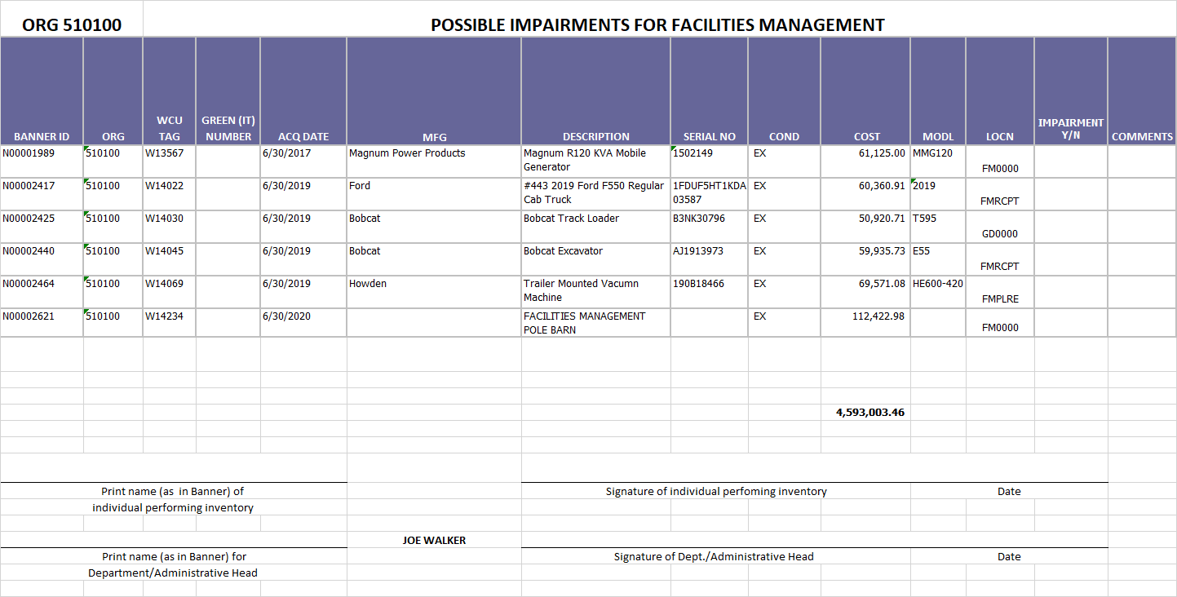

Slide 32
QUESTIONNAIRE FOR CAPITAL ASSET IMPAIRMENTS
1) Please list any impaired WCU capital asset as of February 12, 2024. A capital asset is considered impaired when its service utility has declined significantly and unexpectedly. Please refer to the information on GASB 42 provided in the email’s attachment and limit your listings to major, significant impairments.
2) Please provide a general description of the impairment.
3) For any listed impaired capital asset, is the impairment temporary or permanent?
4) For each listed impaired capital asset, what is the gross amount of the impairment loss?
5) For each listed impaired capital asset, what is the amount of any insurance recovery?

Slide 33
Fixed Asset Policy
Custody and Control
  Each department is responsible for maintaining inventory controls and safeguarding all assets regardless of cost. Department/Administrative Head is required to follow the university’s policies and procedures.
  Equipment purchased through the university is property of the state and cannot be donated, traded-in (if used as partial payment on new equipment and/or not under warranty), sold, scrapped, or otherwise disposed of by the department who has custody of the equipment without prior approval from WCU’s Tagging Specialist and Surplus Property Manager (Regina Cowan).
GRANTS: Generally (rare exception), unless terms are more specific, when equipment is purchased from grants, ownership of asset belongs to the university, thus becoming state property; not individual or departmental property.
  Contact Grants Accountant (ext. 2498) or Fixed Asset Accountant (ext. 2583) with any questions concerning assets purchased from grant funding.

Slide 34
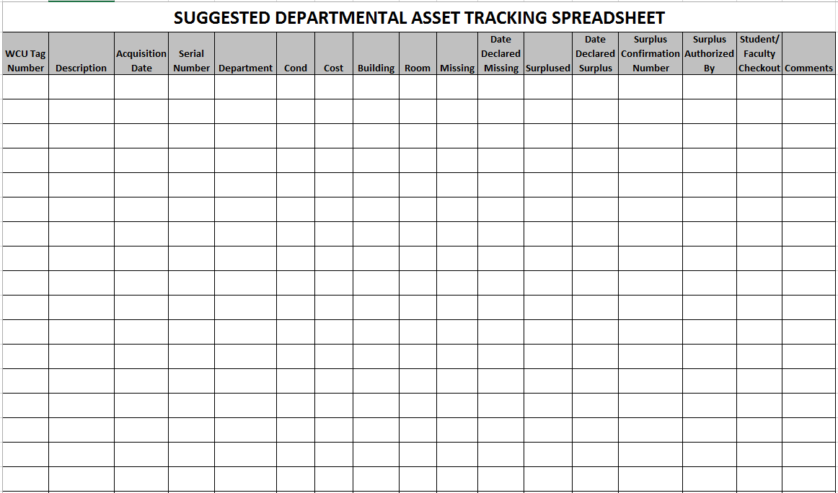
It is recommended that departments have internal tracking procedures for equipment not being tracked in the University’s Fixed Asset System or by IT.
Non-Fixed Assets
Example
Tracking Template

Slide 35



Western Carolina University
Division of Information Technology Asset Management
Nicholas Jones
IT Asset Manager
ndjones@wcu.edu

Slide 36
IT Assets
IT Assets
Non- IT Assets
(Departments Responsibility)
Assets $5000
&
Above
Division of Information Technology (DoIT) charged with asset management for all IT assets that belong to WCU.
Active Computers
2019 - 6,011 2022 – 5,656
2020 – 5,809 2023 – 5,470
2021 – 6,241 2024 – 4,672
Computers Older than 5 Years
2019 - 1,636 2022 – 1,314
2020 – 1,688 2023 – 1,247
2021 – 1,455 2024 - 680
Computers Out of Warranty
2019 - 3,338 2022 – 2,659
2020 – 2,898 2023 – 2,748
2021 – 3,103 2024 – 2,008
Computers Older than 2010
2019 – 190 2022 - 187
2020 – 87 2023 - 85
2021 – 112 2024 -16

Slide 37
IT Assets
Computers
a. Laptops & tablets
b. Desktops
Printers
Servers
Enterprise level networking
a. Switches
b. Routers
c. Wireless Access Points
Smart boards
Data projectors installed in classrooms
All technology assets purchased by DoIT

Slide 38
All IT items $5,000 and greater will be tracked by the Controller’s Office and the Department via IT database
Please do not remove any old tags.
Best Practice to Check for all tags
Report All Tags: red, green, purple.
Try to Capture Serial Numbers
Verify all information

Slide 39
It is highly recommended that departments track assets of significant value to their unit and highly mobile such as listed below.
Scientific equipment (including computer if needed)
Portable hard drives (use server space)
Docking Stations
Monitors
Cameras of any kind
Keyboards / Mice
Portable CD drives
GPS systems
Smart devices - PDAs, phones, etc..
Label makers / Scanners
Audio equipment
Specialized digital equipment - HVAC control systems, check writing machines, etc…
This list is not intended to be all inclusive

Slide 40







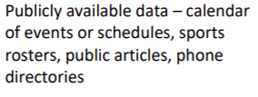

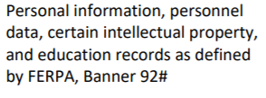
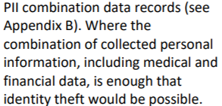
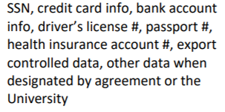
Portable Storage – Everyone’s Responsibility
Flash Drives, External Hard Drives, SD-Cards, Removable Internal Drives, etc.
https://www.wcu.edu/webfiles/itsecuritymanual/Data-Handling-Procedures.pdf

Slide 41
Basic IT Asset Lifecycle
Acquire
Assets
Deploy
Assets
Manage Assets
Retire
Assets
Plan Assets

Slide 42
Plan Assets
What is your need?
Can a Laptop fulfill this need?
Do you have existing hardware that can do this?
Will you need specific software with the hardware?
  Can the Virtual Environment help?
Do you have a One-in, One-out?
  If you don’t have a One-in, One-out, will this be approved as an exception?
Are existing items able to be securely handled, are there enough staff for tracking the devices?
Can the Technology Commons help with your need?
Are your department’s assets up to date?

Slide 43
Policy 67 – Definite Lifespan
“Endpoint device” shall mean a university-owned information technology asset that includes, but is not limited to, a desktop, laptop, notebook, or tablet computer.
All devices have a definite end-of-life, which may be based upon, but is not limited to, in-service date of 5 years, end of vendor support, security vulnerabilities, or any other factor that may require that the device be decommissioned. Any device that exceeds end-of-life may be subject to one or more of the following: increased annual asset fee; limited or no IT support; limited network access; and/or other appropriate considerations.

Slide 44
Acquiring IT Assets
Quotes:
Request quote at go.wcu.edu/quote
Answer Questions for all endpoint devices ordered:
1. Whom will the asset be assigned to?
2. What asset will we be picking up as a One-in, One-out?
3. Whom should the cart be assigned to?
4. What fund code should the device be billed to?

Slide 45
Policy 67 – One-in, One-out
“Endpoint device” shall mean a university-owned information technology asset that includes, but is not limited to, a desktop, laptop, notebook, or tablet computer.
The University maintains a one-in, one-out model. At the time of purchase of a new endpoint device, an existing endpoint device will be designated for surplus. This designated device will be picked up for surplus at the time of the new installation is made. To minimize unintentional data loss, IT will hold systems that are picked up for surplus for 45 days before proceeding with the surplus process. If the endpoint device being replaced does not fit into any of the end-of-life indicators mentioned in item 5, the device may be requested to be repurposed and reallocated to another faculty or staff member within the unit, following the Division of IT’s procedure for doing so. However, this redeployment may only occur one time for each new endpoint device.

Slide 46
Policy 67 – Exceptions
Exceptions include but are not necessarily limited to:
One-in, One-out Exceptions
  New Position? New Project/Grant?
Purchasing Exceptions
  Android Tablet? Vendor Required model?
End of Life Exceptions (new approvals yearly)
  Vital system device?
All exception requests must be approved by the University Computer Exception Committee
or approved by the CIO, depending on exception type. Exceptions must be submitted via
the Endpoint Device Exception Form.
See Policy 67

Slide 47
Acquiring IT Assets
Purchasing:
Department submits requisition to the Purchasing Department for purchase.
Your Purchase isn’t made until your department processes the Cart in Catamart
Purchasing places order for asset with “ship to” address specified by IT (currently warehouse). If you purchase directly from vendor make sure the asset is processed by IT.
Asset arrives at WCU and is processed by IT

Slide 48
Deploy Assets
Endpoint Services:
Assets are tagged and information is recorded into Cherwell.
If asset is a computer, it is prepped for WCU standards (imaging, deployment).
Asset must be setup with intended end-user.
One-in, One-out Device is picked up and held for 45 days

Slide 49
Manage Assets
The Division of Information Technology uses an inventory management system to track university owned technology assets called Cherwell.
All IT assets that are being moved from one location to another must have an Asset Control Form completed for the move.
Old IT assets may not be prepped for new asset processes. These are being manually tagged and entered when they are discovered.
IT assets that are stolen or lost should be reported immediately to DoIT (helpdesk) and proper authorities, and an ACF must be submitted.

Slide 50
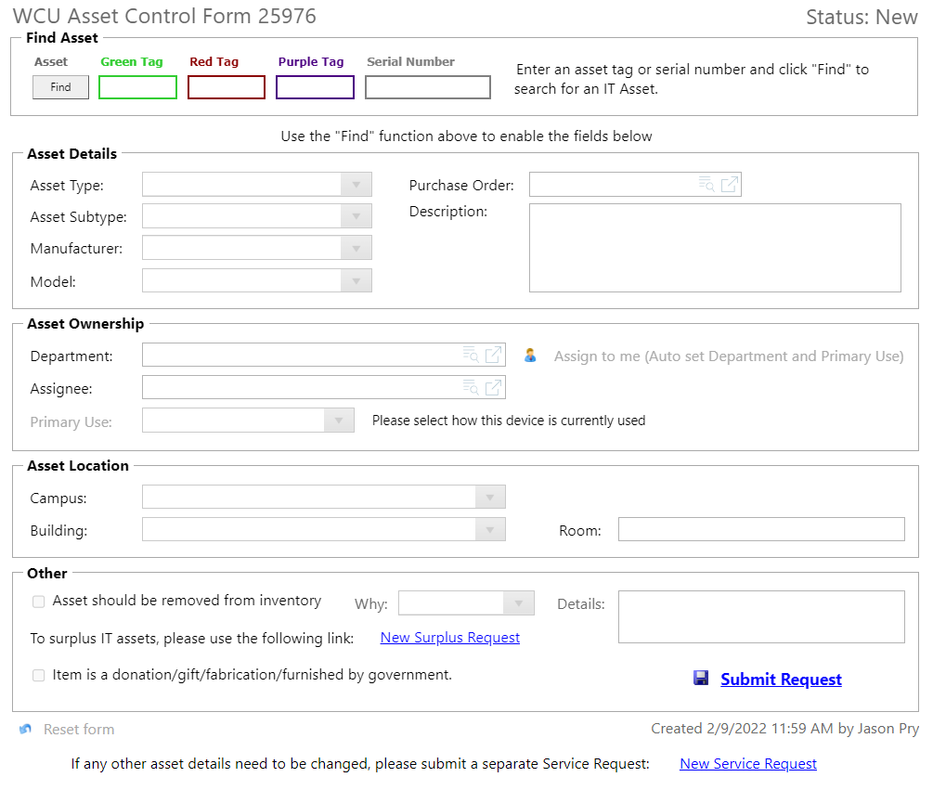
Asset Control Form
Staff/Faculty are able to create an Asset Control Form
Go to go.wcu.edu/acf

Slide 51
IT
WCU
W
To locate an asset, first enter appropriate tag number here and click find.

Slide 52
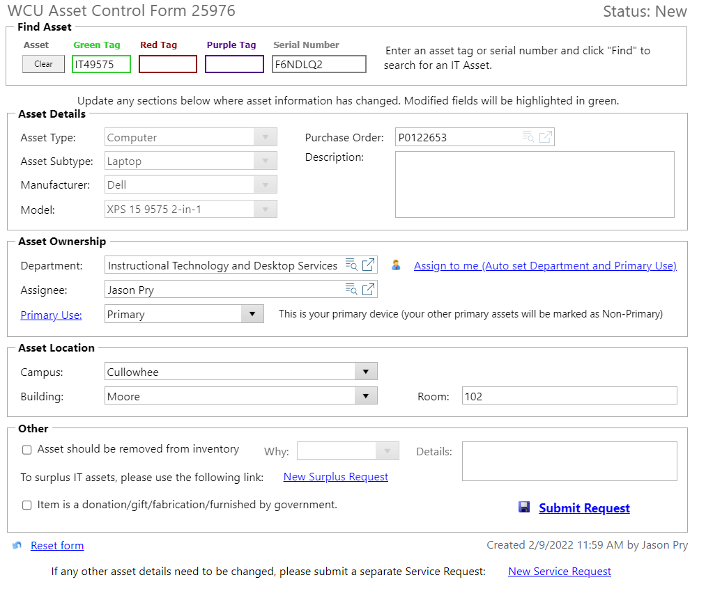
Current information regarding asset is now displayed. If Blank, it likely did not attach to an asset in our system.

Slide 53
To update an asset’s information or ownership, simply replace the current information displayed.

Slide 54
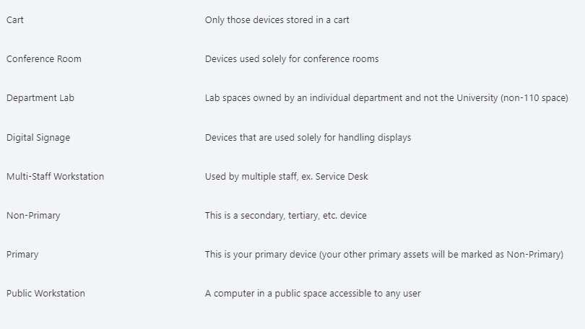
The Primary Use field helps designate the intended use for the device. Clicking on the blue “Primary Use” text will help you with determining what the device is.

Slide 55
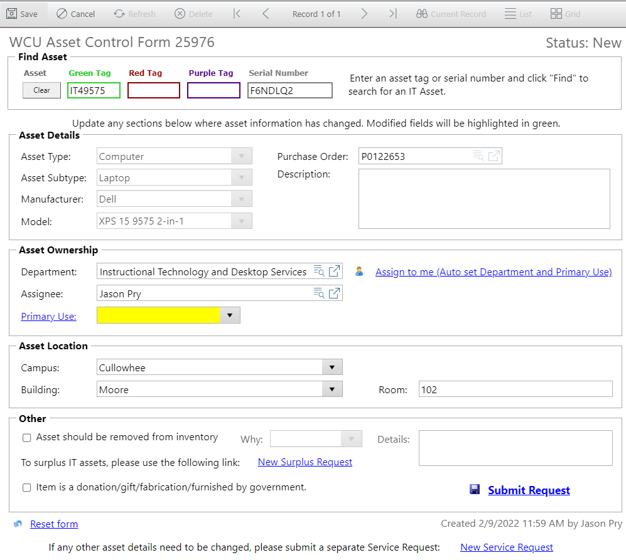
After updating assets’ information, click Save or Submit Request to save changes to asset.

Slide 56
To report an asset lost or stolen, first enter the appropriate tag number and click find.
Next, check “Asset should be removed from inventory”.

Slide 57
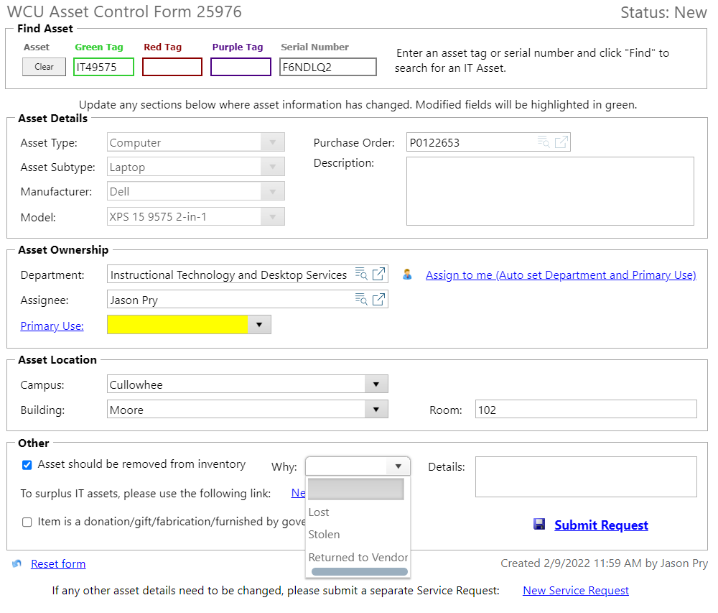
Next, use the drop-down menu to select either Lost or Stolen, and provide details about the missing asset’s status in the Details text box.
When finished, click Save or Submit Request to save changes to the asset.

Slide 58
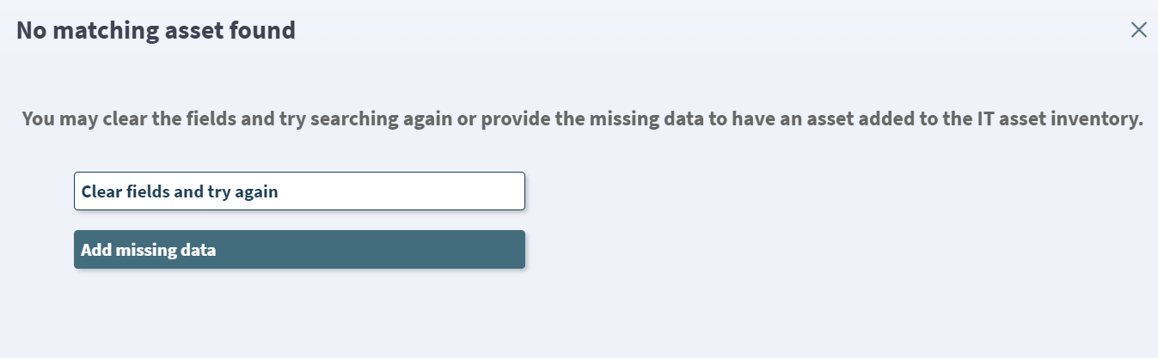
The Asset Control Form and Non-IT Assets

Slide 59
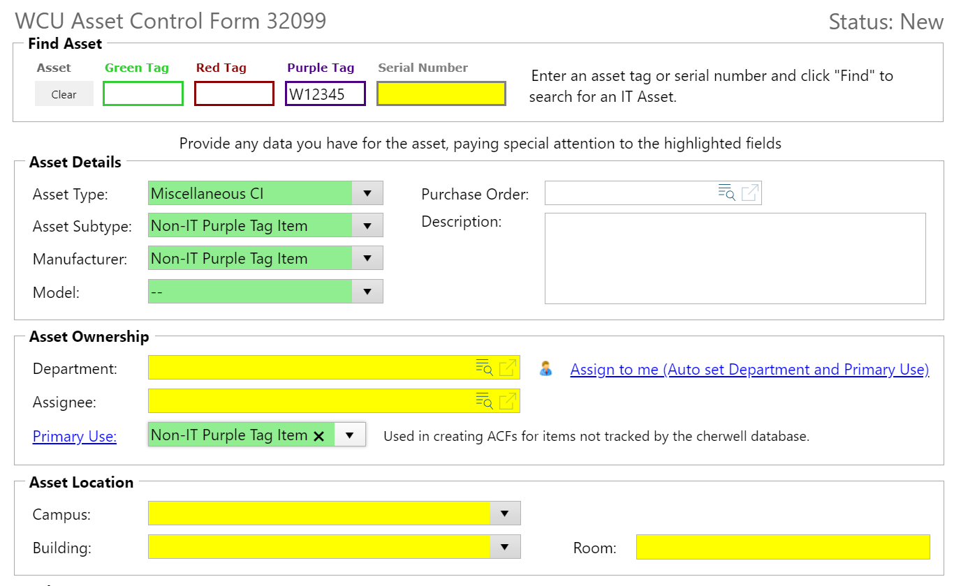
The Asset Control Form and Non-IT Assets

Slide 60
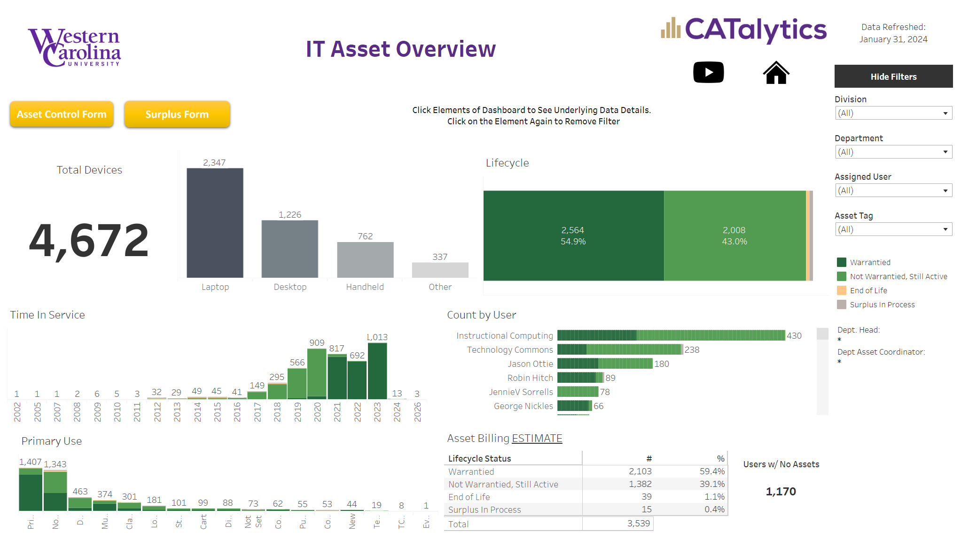
The IT Assets Dashboard

Slide 61
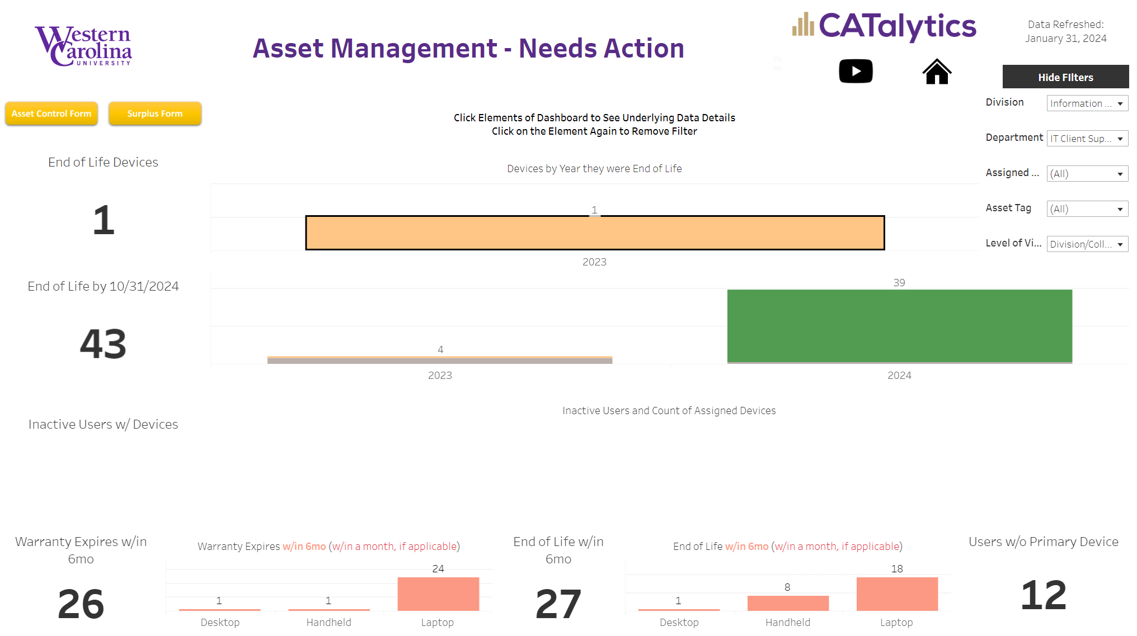
The IT Assets Dashboard

Slide 62
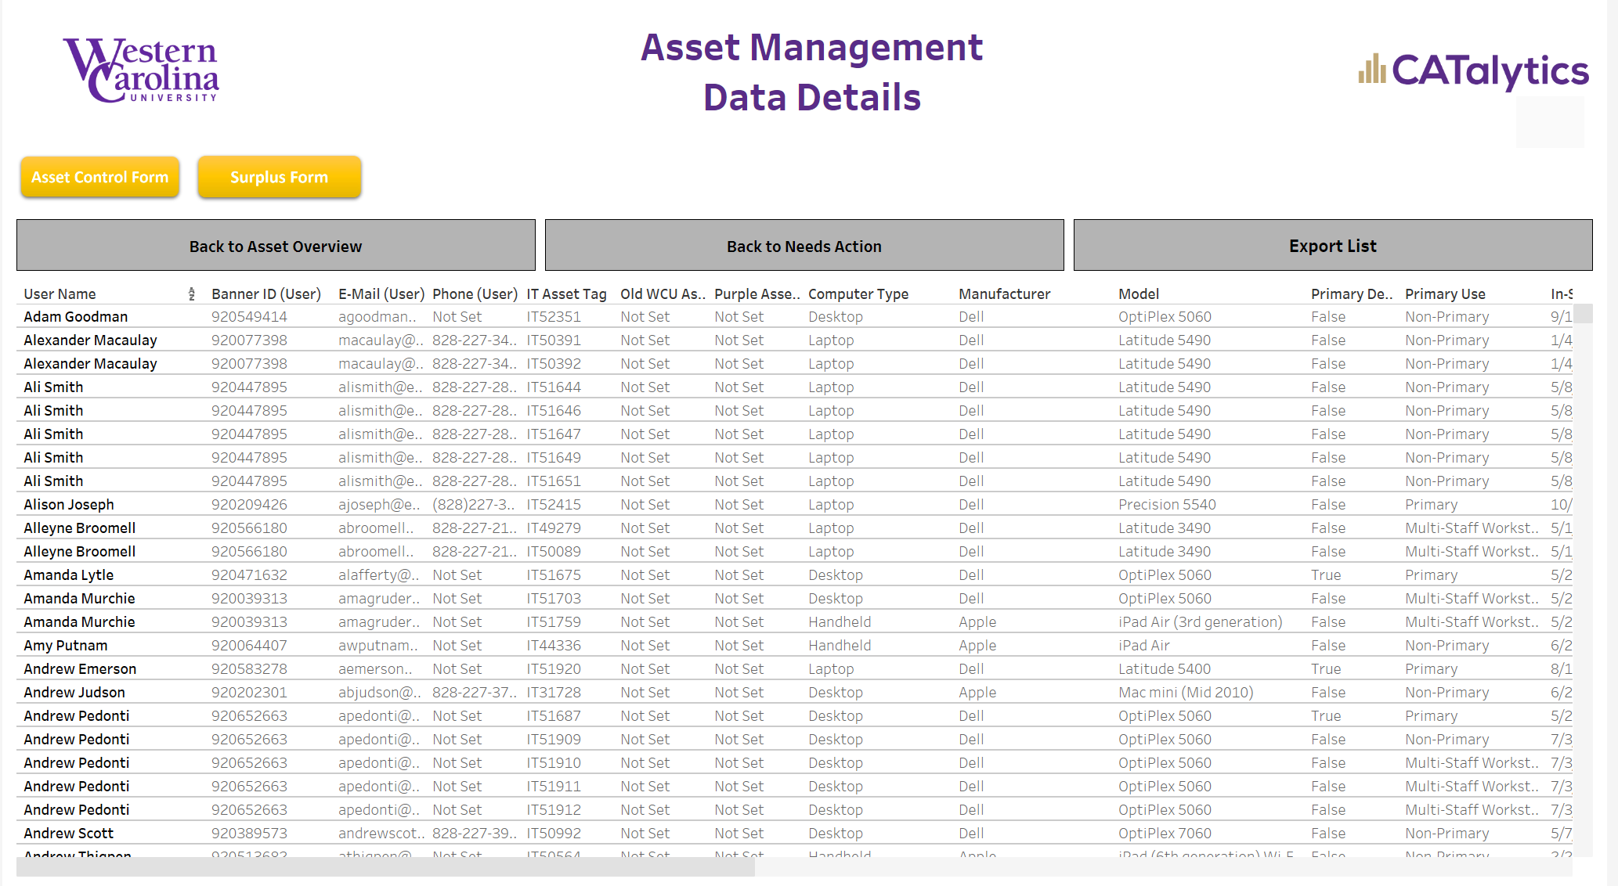
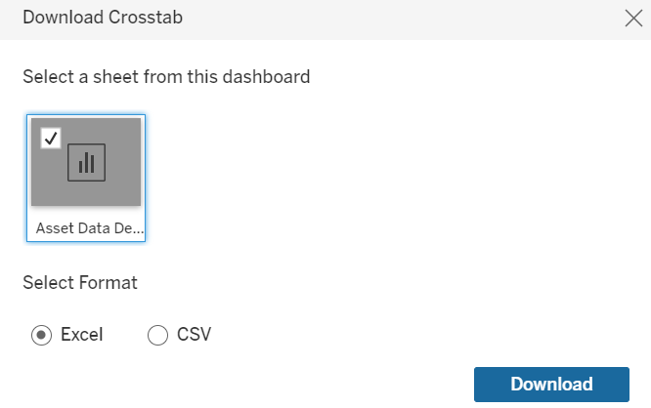
The IT Assets Dashboard

Slide 63
The IT Assets Dashboard

Slide 64
End of Life Process
End of Life Process Introduced in 2023
Once the date reaches 10/31 of the year a device goes EOL, it is subject to the process.
Asset Coordinators will be emailed and contacted about the status of their EOL Devices. Emails will be sent more frequently as the deadline nears.
The dashboard will have each department’s EOL data.

Slide 65
End of Life Process
A device that has Reached End of life can:
Be sent to surplus or be used as a 1in1out for a new computer.
Be approved for an exception until the next year using the exception form.
Otherwise, a device that does not meet either of the above will be removed from the network at the time it expires that year.

Slide 66
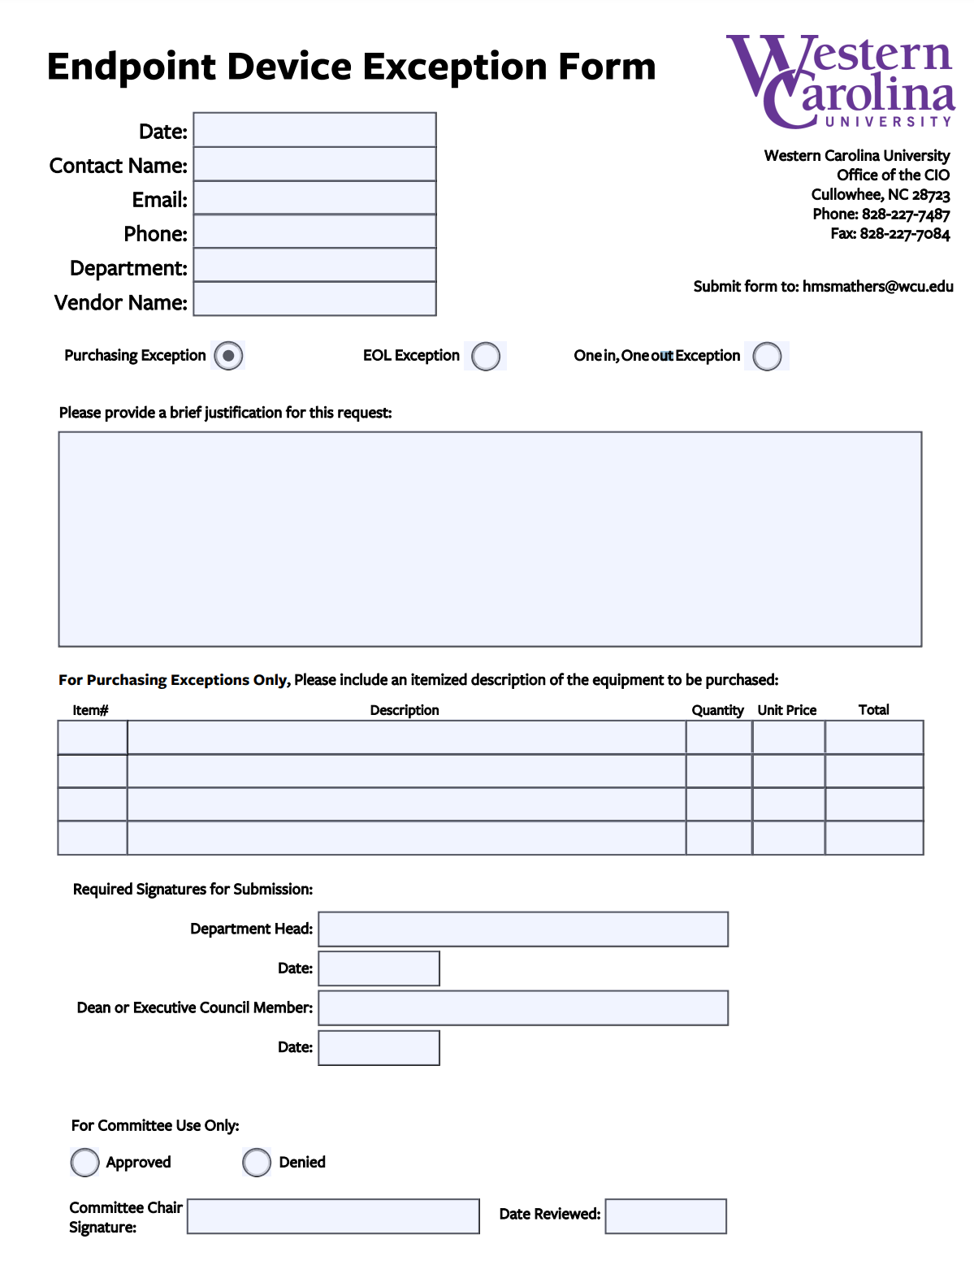
Endpoint Device Exception Form
Can be used for all 3 exception types:
Purchasing
EOL Exception
One in, One out Exception
Send form to Heath Smathers: hmsmathers@wcu.edu

Slide 67
Retire Assets
Reallocation and Surplus:
Use the Asset Control Form if you need to move an asset.
Any time an asset is switching over to a new assignee, please call the Help Desk. They can help setup the user and delete prior data.
All assets to be surplussed will be submitted through the IT Self-Service Portal on-line form.

Slide 68
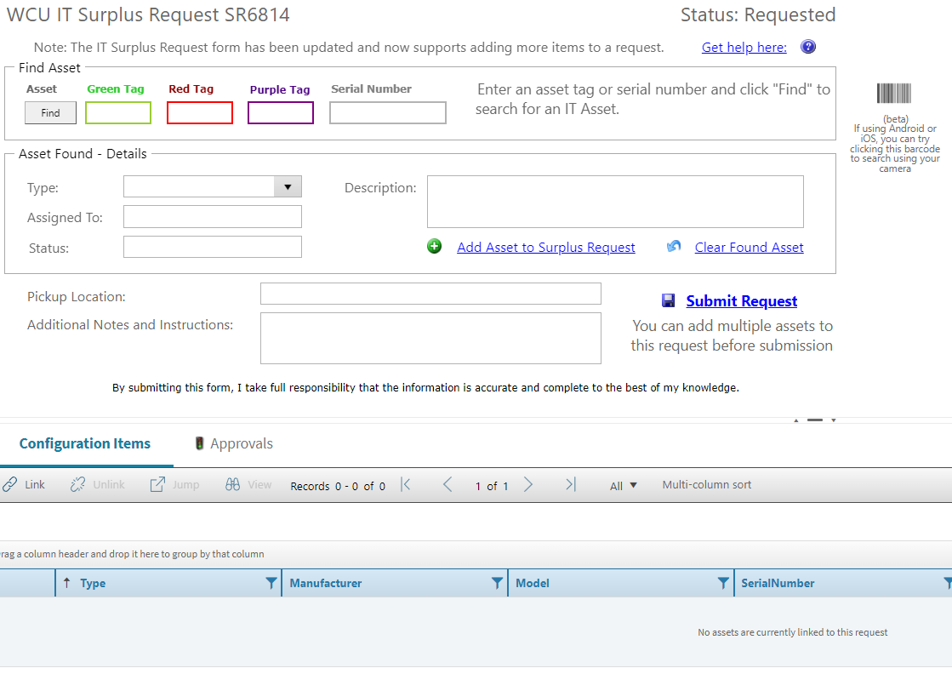
Surplus Request Form
Staff/Faculty should be able to create a Surplus Request Form
Go to go.wcu.edu/surplus

Slide 69
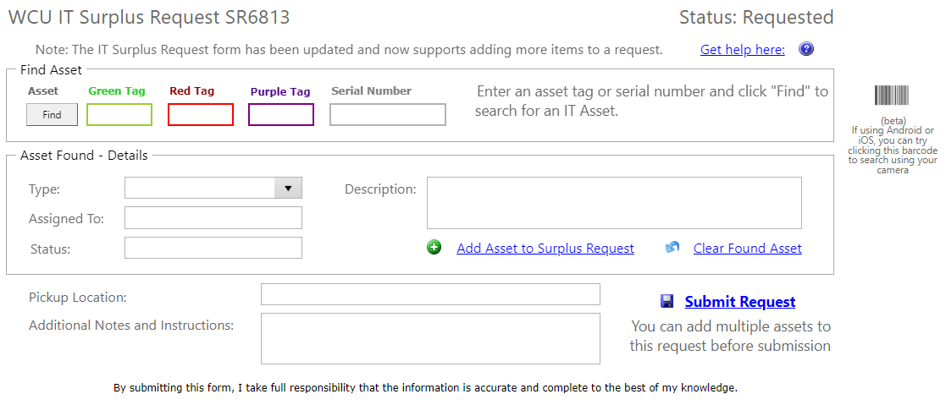
IT
WCU
W
Enter your Tag Number, and click Find

Slide 70
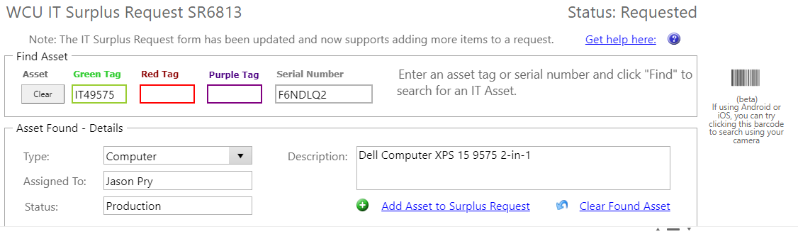
Verify the information and if correct, add the asset to Surplus
If incorrect, clear the asset and re-enter

Slide 71
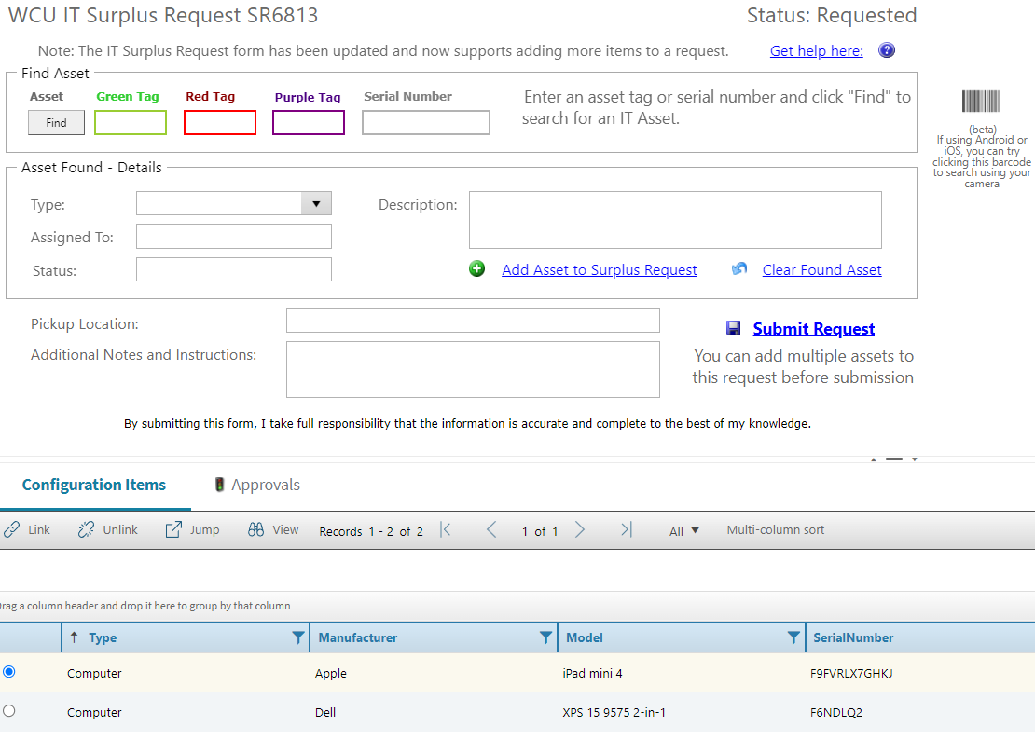
You can continue to add devices until you are finished, there is no longer a (5) asset limit

Slide 72
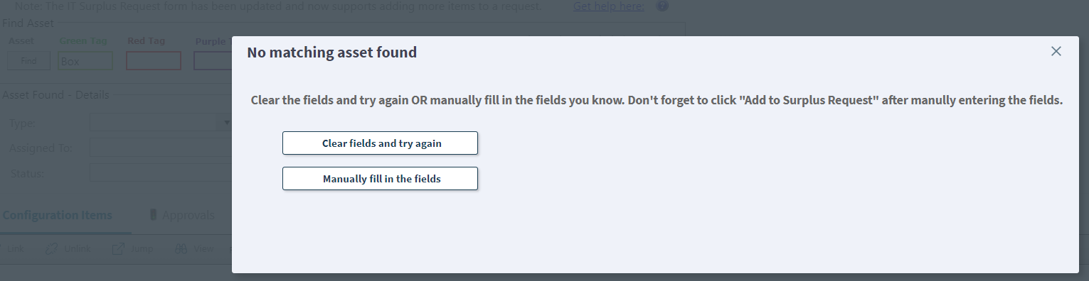
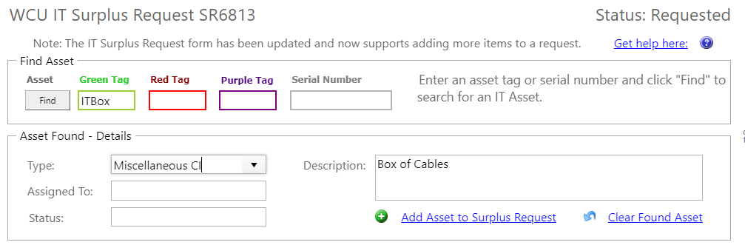
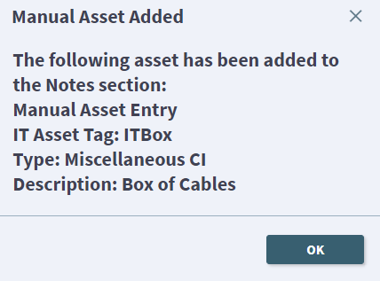
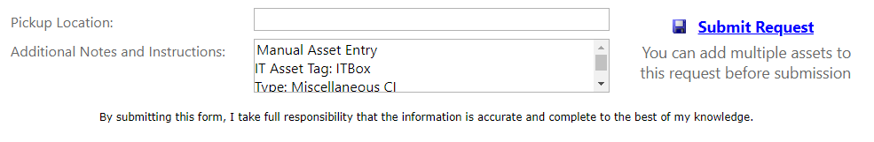
If your item is not found, you can manually enter the details
Enter the details and pick a type that best suits, then “Add Asset to Surplus Request”
You can verify the details that will be added to the request

Slide 73
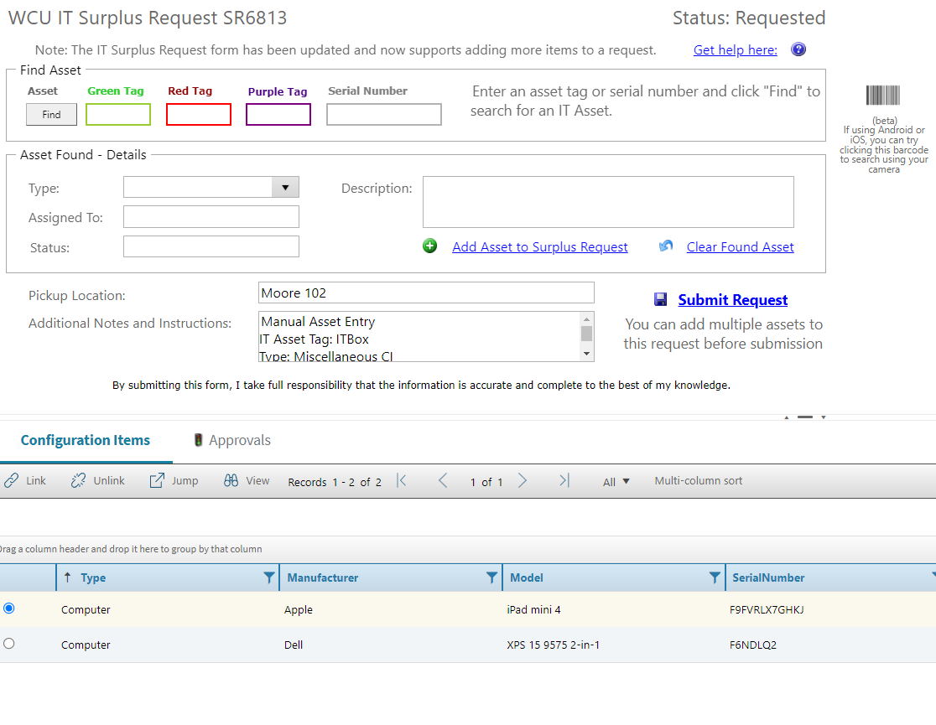
When you have finished entering assets into the request, enter a pickup location and submit request

Slide 74
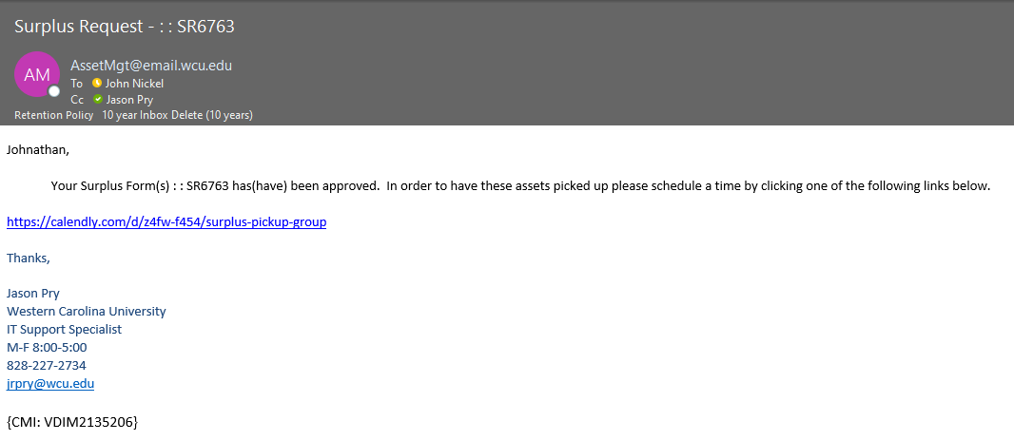
Only Your approved forms will show here

Slide 75
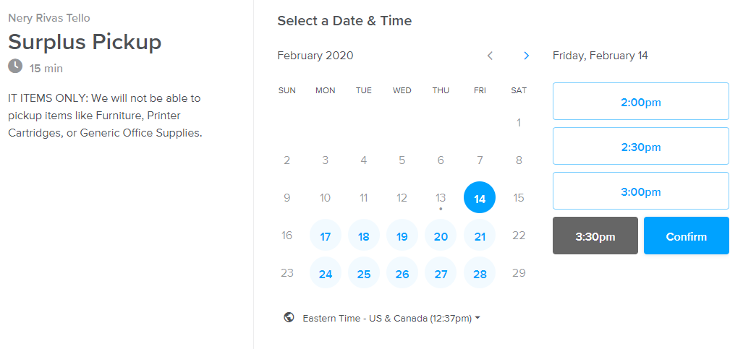
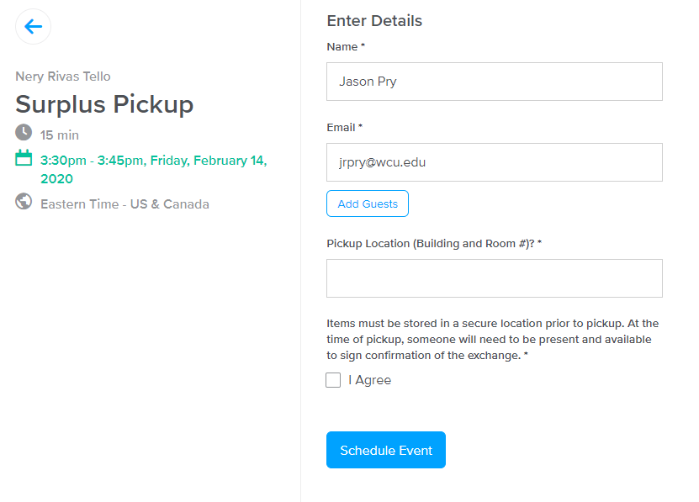
Pick a Time, it looks at both calendars
Confirm your details and please
be prepared to be present for the
chosen time slot
If you have had to add a bunch of non-tagged items
(keyboards, wires, etc.) please provide a courtesy
email by selecting “Reply All” on your initial schedule email
so that we can be prepared to handle your request.
We will retain the right to reschedule if we cannot pickup
all items due to additions or items left off initial request.

Slide 76
Useful Links
Departmental Asset Dashboard: https://insight.northcarolina.edu/#/views/ITAssetManagement/AssetOverview
Asset Control Form: go.wcu.edu/acf
Surplus Form: go.wcu.edu/surplus
Endpoint Device Exception Form: https://www.wcu.edu/WebFiles/Legal-Policy67-EndpointDeviceExceptionForm.pdf

