Slide 1
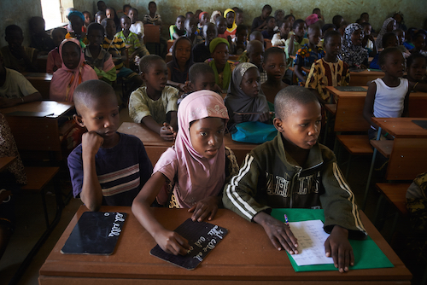
Education in Mali: Funding, Quality, and Reform Ashton Paulson Western Carolina University, International Studies Department
Projected Funding Needed
Target Amount of Aid: US$131 M
Current External Aid From OECD: US$111 M
Need US$ 20M from non-traditional donors
The Most Profitable Businesses make over US$250 B annually in profits alone!
Overview
Mali has been unable to recover from various internal issues, such as drought, famine, national insecurity and violence, etc.
There is a lack of access to educational facilities, resources, and trained teachers.
The Educational Sector suffers from improper finance management, lack of funding, and unstable policy enforcement.
Investment in basic education is beneficial for all. It leads to concepts like self-sufficiency in economics and social stability.
Education sector in Mali can receive the proper support for education through the combined effort of NGOs, OECD aid, traditional donors, and non-traditional donors.
Non-Traditional [World’s most profitable businesses] donors are the key to reaching projected funding goals by donating a small portion of their profits
Mali only needs about US$20M more in aid to recover from their teacher crisis and humanitarian crises.
Using non-traditional & traditional aid to focus on building educational facilities and providing materials will allow Mali’s education sector to focus their budget on supporting teachers.
48%
52%
Percentage of Students Enrolled in School
Primary School Student to Teacher Ratio:
Overall
1: 51
Public Schools
1:64
(Trained Teachers Only)
Overall
1:105
(Trained Teachers Only)
Public
1:81
1:100 in some cases
*Chart Data credited to OxFam International
*Picture: UNICEF/Phelps

