Slide 1
Interviewing Strategies
Notes:
Briefly introduce this topic and why you are including it in your curriculum or meeting

Slide 2
If you could ask candidates one question, what would it be?
Notes:
Ask students if they were going to hire somebody for a job but could only ask one question, what would they ask and why. Have them gather into pairs or small groups depending on the size of your class to share their interview question and reasoning, and select one question as their final one. Have each pair/group share their selected question and why they chose it.

Slide 3
Application components and purposes:
Resume: Can they do this job?
Cover letter: Can they do this job well for us?
Interview: Do they fit with our needs and our people?
Notes:
Each component of the job search process fulfills a different question from the employers. Resumes are a skimmable, comprehensive answer to the question, can this candidate do this job? They are looking for critical skills and experiences necessary to fulfill the role. Cover letters deepen the answer to this question by not just demonstrating their qualifications for the position, but also their connection to that particular role with that particular employer. An interview gets into the often hard to define area of “fit.” Interviewers may inquire about the extent of experience and expertise in certain areas necessary for the role, but they are also getting to know the candidate: What are they like? How do they process answers? Are they put together and able to answer our questions well? Do they seem to have similar values as our organization? Would they work well with the current team?

Slide 4
Interviewing Goals
Effectively market yourself
Get acquainted with employer
Explore possibility of working together
Notes:
Interviews are meant to be a two way conversation during which the interviewer evaluates the candidate, but the candidate is also determining if this position and company fits their needs and wants. This can feel challenging for students to understand, as they are often so focused on their own performance. However, students should be paying attention to company culture, the insights gleaned from the interview questions asked, etc.

Slide 5
The Interview Process
Preparation: before the interview
Presentation: during the interview
Protocol: after the interview
Notes:
Many individuals just focus on presentation/during the interview. However preparation is arguably the most important step – especially for individuals just starting their careers or pivoting into a new field. For many, interviewing becomes easier and more natural as they gain more professional experience.
Emphasize to students that all three pieces of the process are important and that preparation is key to feeling confident and performing well in an interview.

Slide 6
Interviewing Strategies: Preparation

Slide 7
“One important key to success is self-confidence. An important key to self-confidence is preparation.” Arthur Ashe

Slide 8
Prepare for the Interview
Know the JOB:
If necessary, ask the employer for a full job description
Know the ORGANIZATION:
Mission & Vision
Types of Clients
Current Goals/Initiatives
Funding Sources
Community Involvement
Collaborators & Competitors
Know YOURSELF:
Know your resume and skill set inside and out!
Know the FORMAT:
Be sure to ask the format of the interview, if you weren’t told
Notes:
The successive slides will go over these in detail.

Slide 9
Types of Interviews
Phone Interview
Often a screening interview
Positive: You can have notes to yourself available
Negative: Can be awkward without visual cues
TIP: Find a quiet space and be mindful of the length of your answers.
Video Interview
Sometimes a screening interview, but frequently replacing in-person
Positive: Can have a few notes, visual cues
Negative: Technology issues
TIP: Be prepared for delay between receiving sound and image. Hesitate to make sure question is over before answering.
TIPS for both: Establish what to do should you get disconnected. You can book an interview room with the CCPD if you need a private space.
Notes:
Note: Timing-wise, don’t spend too much time going into detail about the different interview formats. The goal is to make sure students realize there are multiple formats so that they will be sure to ask and prepare accordingly.
Phone and videos afford the candidate an opportunity to have notes in front of them, but these notes should be short, key words. They might have a post-it with keywords/buzzwords from the job description or company mission statement. They might have a second post-it of key stories they want to share or skills they want to highlight. Finally, they might have notes to self such as “smile” or “slow down” (if they talk fast when nervous) or “be specific” (if they are vague).

Slide 10
Types of Interviews
Screening Interview
Often conducted by HR Representative or search committee to determine if minimum requirement is met
TIP: Emphasize succinctly and directly that you possess the desired skills for the position
Second Interview
Longer, more involved interview to ensure that you have the necessary skills and will blend well in the organization's culture.
TIP: Shift focus from specific skills to entire package – qualities, values, etc.
Interview Over a Meal
Assess your abilities in social situations
Follow dining etiquette
TIP: Carefully select meal - something light & not messy
Notes:
Not all organizations will use a screening and second interview. Screening interviews tend to be 15-30 minutes long, and second interviews can vary based on organization.

Slide 11
Types of Interviews
One-on-One Interview
Asked questions to assess your skills, knowledge and abilities pertaining to position
Feel of the interview will vary based on interviewer’s style
TIP: Sell key strengths while asking supervisor about current goals and challenges for the position
Peer Group Interview
Often used when hiring multiple candidates
Introduction to potential co-workers to see how you will “fit in” the current culture and group
TIP: Focus on being agreeable and approachable
Panel Interview
Three or more interviewers asking questions
TIP: Provide direct answers to whomever asked the question, however maintain eye contact with everyone on the panel
Notes:
Note: not all people make good interviewers and interviewers can have different styles, often connected to company culture. Some interviews may feel more formal, some high pressure, some more casual and conversational.

Slide 12
Preparation: Know the Employer
Five Steps to Research Employers
Research the company web site including main page, about us, meet the team, careers, and pages relevant to your division or project
Check their social media accounts (don’t forget LinkedIn and YouTube in addition to Instagram, Facebook, and Twitter) for news from the organization and to get a better sense of their culture
Search Google News for the company name (news.google.com) for recent public news
Research competitors and industry leaders to see what others in the field are doing
Ask your network if they are familiar with the organization or any of your interviewers
Notes:
It’s critical to understand the clients, products and/or services, as well as the mission and vision of the organization. Reading the about us will help students see the big picture of the organization and possibly pull out some key words. Learning about the team will help them understand the structure, and learn more about their interviewers. The careers page might provide more information on the employee experience and benefits. The better informed they are about the organization, the better they can tailor their interview answers.
Social media accounts helps students see current news from the organization, and to get a sense of their culture by seeing the tone of their posts – formal/casual, reserved/playful, etc.
See other news about the organization from a broad perspective – get a sense for their reputation, current affairs, and more.
It’s important for students to have a professional understanding of their field – they should find out who the organization’s competitors are, as well as the industry leaders. They can do some research to find out what sets their organization apart as well as opportunities for growth.

Slide 13
Preparation: Proper Attire
Dress professionally based on organizational culture.
Business Professional: business suit – black, gray, navy, or other neutral tones
Business Casual: slacks or skirt, button down or blouse, optional jacket or cardigan
avoid distracting jewelry and fragrances
be well-groomed with natural looking make-up and nails.
be mindful of clothing fit and hem length
wear close-toed shoe with heels under 3”
use a portfolio to carry extra copies of your resume
when in doubt … dress conservatively
try on your interview clothes at least 3 days before the interview – just in case things don’t fit the same
Notes:
*When discussing professional dress, the CCPD encourages gender neutral language. We avoid guidelines for men versus women, and ask that you do the same.
If there are clear and consistent expectations for your field, please emphasize them here. If students are entering different fields or expectations vary across organizations, encourage students to do research. Review the organization’s web site and social media to get a feel for their dress expectations. As stated, when in doubt be conservative and more formal. Employers will assume that students will feel comfortable in casual dress, and so students need to demonstrate that they feel comfortable in professional clothing.

Slide 14
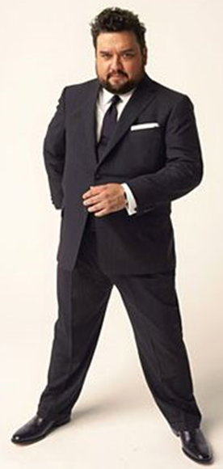
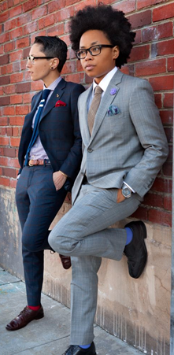
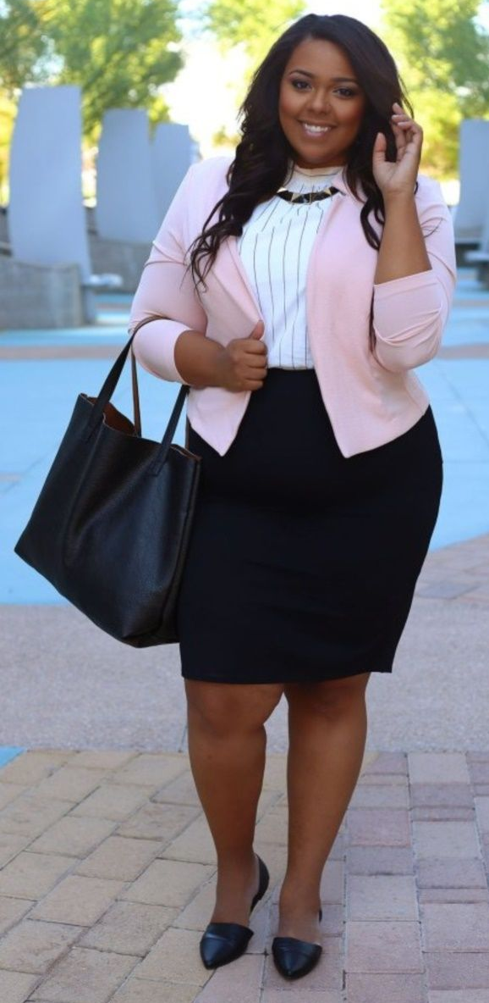
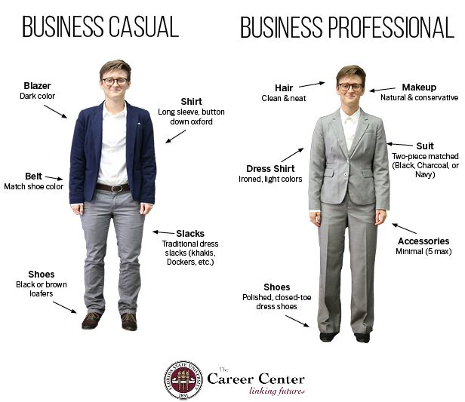
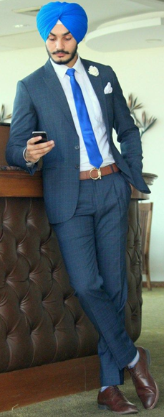
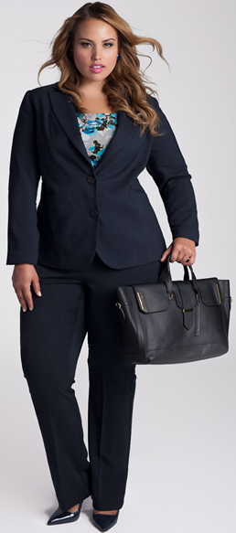
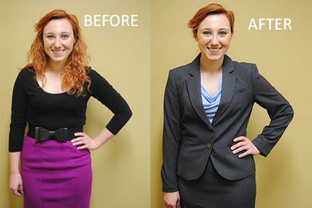
Notes:
*When discussing professional dress, the CCPD encourages gender neutral language. We avoid guidelines for men versus women, and ask that you do the same.
In these images, point out that matching suits are more formal, colors and patterns are generally subtle. Shoes are closed-toe, and heels are 3” or lower.

Slide 15
Preparation: Know yourself
Plan 3-5 things you want the employer to know about you before you leave.
Skills
Experiences
Education
Stories
Values
Connection to mission
Notes:
Student should always practice answering questions – however, they shouldn’t dedicate time attempting to memorize answers. Instead, they should identify 3-5 things they want to make sure they share during the interview based on their knowledge of the job and the organization.
Have each student think of one thing they would want an employer to know about them and ask a couple to share. If your class is longer than 50 minutes, consider having students write down 3 things they would want to tell an employer, then have them pair up and share their lists with another student.

Slide 16
Final Preparation Tips
Test your technology
Drive/commute to the interview location in advance, if possible
Review your application materials and notes on the organization right before the interview
Arrive 5-7 minutes early for the interview
Anticipate and research questions they might ask
Develop thoughtful questions for the employer
PRACTICE! CCPD offers mock interviews and Big Interview software (wcu.biginterview.edu)
Notes:
Students should test their technology or their commute before the interview to make sure everything works as they expect and to help calm day-of jitters
We recommend that students arrive to the interview location (or are seated at their desk) 10-15 minutes early, so they can review their materials and take a few deep breaths before entering the building around 5-7 minutes early or signing on a few minutes early.
Students can try to anticipate questions an interviewer may ask by analyzing the job description for key skills and experiences, and researching about the organization. Often good practice questions can be found by googling the job title and interview questions. Additionally, students might find previously used interview questions on Glassdoor.com.
Developing interview questions for the employer is a critical step to demonstrate interest in the position, there are some sample questions on the next slide.

Slide 17
Questions to Ask the Interviewer
How would you describe an average day on the job?
What is the history of the position? Why is it vacant?
What aspects of the job would you like to see improved?
What are the key challenges facing the person in this position?
Is there room for professional growth and upward mobility?
How would you describe the ideal candidate?
How do you measure job performance?
What are the company’s values? What characteristics do you look for in employees in order to represent those values?
How important is diversity to you, and what value does it bring?
I’ve read about the company’s current goals, could you tell me more about….?
Notes:
Share any go to questions you use on interviews and ask students to share any they may have asked in the past.

Slide 18
Interviewing Strategies: Presentation

Slide 19
During the Interview
Be confident: have a firm handshake and make eye contact.
Be assertive: show energy and enthusiasm for the position.
Be on your game: be polite and friendly to everyone you meet.
Be present: stay focused on each question asked, don’t distract yourself by critiquing yourself as you go.
Ask questions: consider asking questions during the interview at the end of your answers, as well as at the end to show your depth of interest.
Do not:
be late or arrive unprepared.
be negative – even when asked questions like “Tell me about a time when you worked with a difficult customer.”
discuss money or vacation time.
Notes:
Be confident: Consider having students practice their handshake! (If not feasible to do in class because of COVID or if this is a remote class, encourage them to practice shaking hands with room-mate or family members)
Be assertive: encouraged engaged body posture like leaning in, making eye contact, smiling
Be on your game: employers often ask for feedback from everyone at the organization who came in contact with the candidate Discussion of money and vacation time happens during the negotiation phase after an offer. If asked about salary expectations during an interview, students should be vague and offer a range. There is a helpful article in the lesson plan.

Slide 20
During an interview…
Interviewers Assess Behavior
Eye Contact
Body Language
Use of your hands (don’t fiddle with your papers)
How you speak (talk easily; don’t be a robot!)
Balance between speaking and listening
Use the Reversal Technique
Attaching a question at the end of your answer
E.g.: “What is the greatest contribution you can see yourself making in this position?” Answer, and then add “How does this correlate with what you are looking for in a candidate?”

Slide 21
Acing the Questions
Answer the question asked of you
Be strategic with your answers
Pull from various experiences (work, internship, class, student orgs, volunteer, etc.)
It’s okay to think through your answer before responding
Focus on appearing:
Committed to employer’s goals and mission
Willing to work hard
Able to fit in with work environment
Notes:
We can all lose track of our thoughts from time to time, it is critical that candidates pay attention to the question asked and answer that specific question. It seems obvious, but many folks struggle with this on a question or two during their interview.
Being strategic means thinking proactively about the skills they can highlight, ways they can align their answer with the goals or mission of the organization beyond just their role, and think critically about why this employer might be asking this question
Students will often only share examples from previous work experience, though sometimes their experiences in different settings actually provide a stronger example
It’s okay to occasionally pause before answering or repeat the question to give yourself a little time. Part of the interview is seeing what a candidate is like, and it can be refreshing to know that someone will take a minute before responding when they need to do so. It’s best not to have silence before each answer, but taking a few seconds when needed is okay.

Slide 22
Tricky Questions
Tell me a little about yourself
Keep it focused on the position
Highlight key skills and experiences
End by talking about the position
What is your greatest weakness?
Name it once
Talk about how you are working on it
Why should we hire you?
Be well-versed in your skills and the needs of the position
Use your research of the employer
Notes:
Tell me about yourself: Candidates should tell a story with a clear arc to the position for which they are applying. Answers should not focus on personal information (age, where they are from, number of siblings, etc.) unless it is highly relevant to the position. Answers also shouldn’t be a repeat of everything on the resume. Instead candidates should focus on a summary of information that lead them to/prepared them for the position, and end their answer stating why they are interested in the role. Hobbies and personal interests should only be included if they are sure it fits with the culture of the organization.
What is your greatest weakness – First, candidates should listen carefully for the wording on this question. Many people get hyper focused on answering this question when preparing and might dive into a preplanned answer without listening. There are several versions of this question: What is your greatest strength and weakness? (singular) What are your greatest strengths and weaknesses? (plural) What are your greatest strengths (plural) and weakness (singular) as they relate to this position? And more. When discussing a weakness, candidates should name the weakness one time and focus on how they are improving. “I can struggle with tunnel vision when I get focused on a project. I have been working on this by taking time at the end of each day to make a to do list for the following day as well as blocking my calendar with time dedicated to my various projects. I have already seen improvements in my time management, but ensuring that my focus is being spread across my various priorities.”
Why should we hire you – Not as many employers ask this question as people think. However, it is GREAT preparation to have a solid answer to this question. It acts as a confidence boost for candidates and can help them focus on the key things they want to keep in mind during the interview.

Slide 23
Behavioral questions: Tell me about a time when
STAR Method
Situation – Provide context
Task – What you needed to accomplish
Action – The steps you took
Result – What happened as a result of your actions

Slide 24
STAR Method Example
Tell me about a time you performed well under pressure
(Situation) In my current job, one of my coworkers left for personal reasons. They had been assigned an important and complex project that our office was counting on but was left unfinished.
(Task) My supervisor asked me to take on the project with a week until the deadline, though it normally would have taken several weeks to complete.
(Action) I agreed to take on the project without hesitation and worked with my supervisor to reassign the projects and tasks already on my plate to some of my teammates. I was also able to work extra hours that week to focus on the project.
(Result) I completed the project on time and received positive feedback from my supervisor on the quality of my work as well as my attitude in approaching this project. I was given more high-profile projects as a result of this experience.
Notes:
This is one example. If you have a longer class period, consider having students write their own STAR answer to this question and share with a partner.

Slide 25
Practice
Tell me a little about yourself.
What are you majoring in and why?
What experiences have best prepared you for this particular position?
Tell me about a time when you worked as part of a team to accomplish a goal.
Where do you see yourself in 5 years?
What is one thing you would do differently if given the chance?
What is your proudest accomplishment?
What causes you stress and how will we know you are stressed?
What is your greatest strength and weakness when it comes to this position?
Why should we hire you?
Notes:
**If time allows, have students partner up to practice their interview answers. If teaching remotely, students could meet virtually to practice, write answers to these questions to submit, or record a video of themselves answering.
Feel free to add more targeted questions to this list – it is very broad.
If in class, have students partner up and take turns being the employer and the candidate. Have each “employer” select at least two questions – their question from the opening activity and one from the list to ask their candidate and have each candidate choose a potential job of interest to gear their answers towards. Have the candidate share their job with the employer, then conduct the mini-mock interview, and swap roles.
Bring the class back together and ask how they felt answering questions. Also ask what it was like to be the employer evaluating the candidates answers. Maybe ask for students to share particularly strong answers or questions they struggled with and have the group think of strategies to answers.

Slide 26
Interviewing Strategies: Protocol

Slide 27
Assess
Assess the “fit” of the job:
Does the job description match your ability?
Did you like the management style?
Were the employer’s culture and values a match?
Is there anything that causes you hesitation about the position?
Assess your performance:
Any improvements you would like to make
Any questions that stumped you
Any questions you want to ask in future interviews

Slide 28
Follow-Up
Send an impactful thank you within 24 hours – this is your final impression on the employer
Thank them for the opportunity to speak, add in details that show you were paying attention during the interview, add a statement or two about the value you will bring to the organization, and close by stating that you look forward to hearing from them
To phone or not to phone?
At the end of the interview, be sure to ask about their hiring timeline to give you a sense of when you might hear back
If you have not heard back in the given time frame, you can follow-up once to check in on the process
Notes:
We are often asked if students should send a thank you email, handwritten note, or typed letter. Though the answer may depend on the culture of the industry and organization, employers have varying preferences. When in doubt, an email works though some prefer the handwritten touch.

Slide 29
"I can count on one hand the number of people who wrote me a thank you letter after having an interview, and I gave almost all of them a job.” Kate Reardon

Slide 30
The Interview Process
Preparation: before the interview
Presentation: during the interview
Protocol: after the interview

Slide 31
Next Steps
Notes:
This slide is optional for your use. Please feel free to enter in any assignments, next steps, or reminders for your class

Slide 32
Visit the Center for Career and Professional Development
careers.wcu.edu
careerservices@wcu.edu
828.227.7133
We can help with resumes, interviews, career fair prep, job searching, internships, selecting a major, and more!

