Slide 1
Maximizing Your Virtual Career Fair Experience
Created by:
The Center for Career and Professional Development

Slide 2
All Fall 2020 career fairs will be offered virtually via JobCat.wcu.edu
Fairs are free to attend and all students are welcome at each fair
Government, Law, and Social Justice Fair | Sept 9, 11am-3pm
Featured Industries: Criminal Justice, Crime Labs, Forensic Science/Anthropology, Emergency Disaster Management, Emergency Medical Care, Environmental Health, Law, County Municipalities, US Military, and Social Justice
STEM Fair | Sept 23, 11am-3pm
Featured Industries: Science (Biology, Chemistry, Geological Sciences, Environmental Science), Technology (Computer Science, Computer Information Systems, Data Analytics), Engineering, and Math
Graphics, Business, and Writing Fair | Oct 7, 11am-3pm
Featured Industries: Graphic Design, Marketing, Sales, Management, Finance, Entrepreneurship, Business Admin, Hospitality & Tourism, Sport Management, English, Technical Writing, and Communication
Construction and Interior Design Fair | Oct 21, 11am-3pm
Featured Industries: Construction and Interior Design
Notes:
Emphasize the fair(s) you are encouraging/requiring your students to attend and why

Slide 3
Purpose of Fairs
1) Career exploration
Learn more about the world of work by researching and speaking with representatives of familiar and new organizations. Be open to learning about new organizations that might not initially seem like a good fit for you.
2) Find job and internship opportunities
Organizations are here to recruit and build their relationships with students. Organizations come from the local community, southeast region, and a few from across the US.
3) Network with professionals
Take time to expand your network by speaking with representatives about opportunities with their organization, as well as their insights into your industry of interest.
Notes:
Many students assume career fairs are just for graduating seniors and consider only short-term goals for fairs, i.e. a post grad job or a spring or summer internship. Though these opportunities certainly exist, this is only one of the goals of the fair. Many employers are also interested in building connections with students for future opportunities. In fact, we occasionally have employers at our fairs that aren’t recruiting for current opportunities but want to build their connection with WCU students for future jobs/internships. Finally, we want to encourage students to use fairs as a way to practice and grow their professional networking skills. This is a time for students to dress professionally and engage others in conversations connected to their career interests and goals.

Slide 4
What will the fair be like?
Students will be speaking face-to-face in video calls with employers.
Employers may have one or multiple employers on-screen at a time. They may be conversational or more informative, possibly with a brief presentation. Be ready to adapt to differences in employer meetings.
Students can see employer profiles, locations, and other provided information during the fair.
Students will login and select the employers they want ‘visit’. If an employer is unavailable, students will be placed in a queue and will meet with employers as they become available.
Employers can see who is waiting to meet with them and view their resume if they’ve uploaded one.
Be sure to upload your resume before the fair!

Slide 5
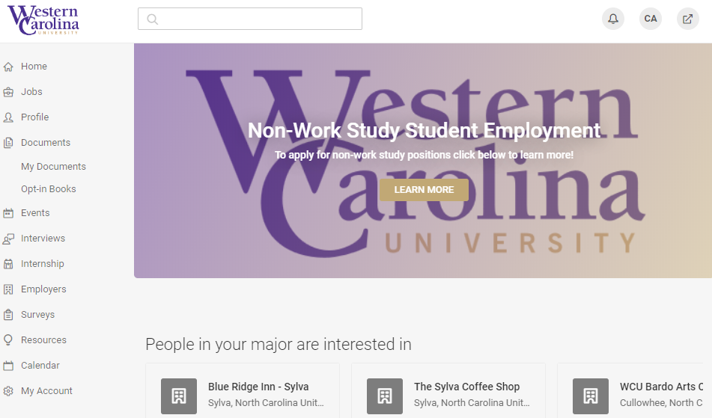
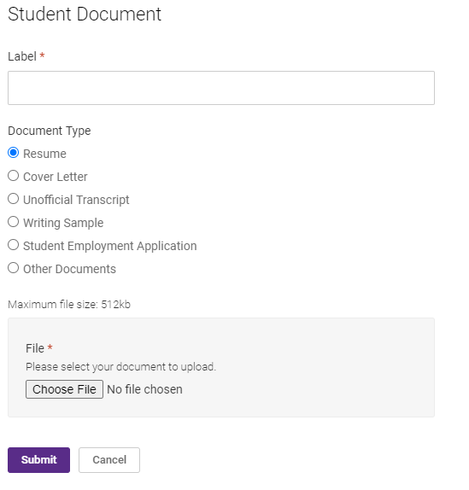
1
2
3
Uploading Your Resume
Jobcat.wcu.edu
Notes:
To upload a resume students should: Log into their JobCat account through: jobcat.wcu.edu
Click the arrow beside documents on the left-side
Click My Documents
Click Add New
Enter a document name, select the type of document and select the appropriate file from their computer
*Note: our system will automatically convert documents to PDFs

Slide 6
Employer Research
1

Slide 7
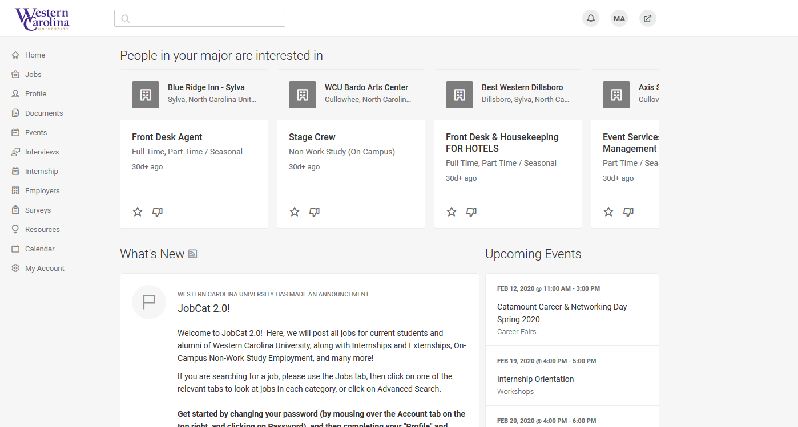
See who’s coming
Jobcat.wcu.edu
Notes:
To see the list of employers students should: Log into their JobCat account through: jobcat.wcu.edu
Select the event on the right side under “Upcoming Events”

Slide 8
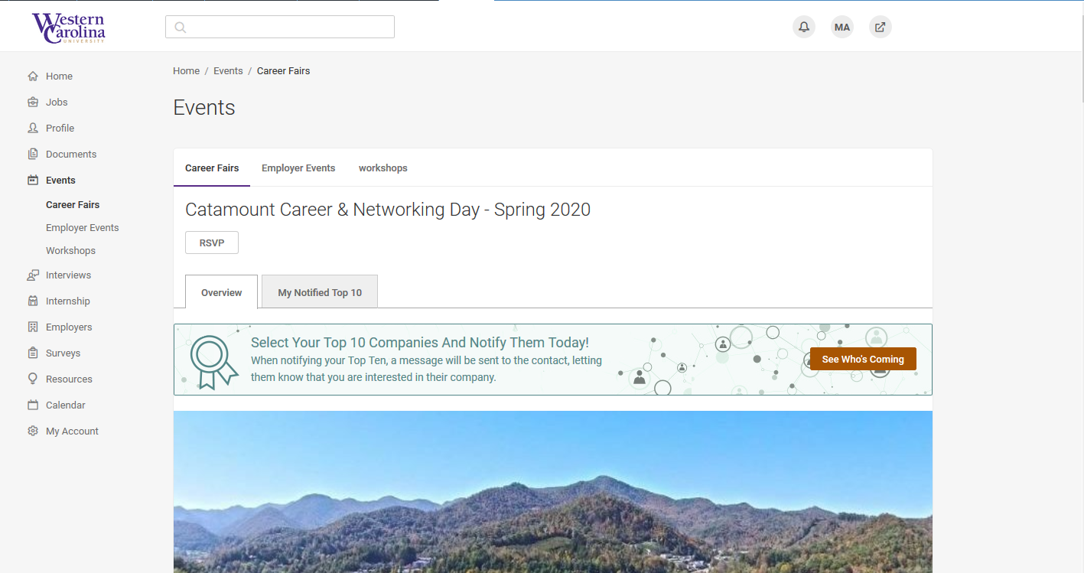
See who’s coming
Jobcat.wcu.edu
Notes:
click “See Who’s Coming” or scroll down

Slide 9
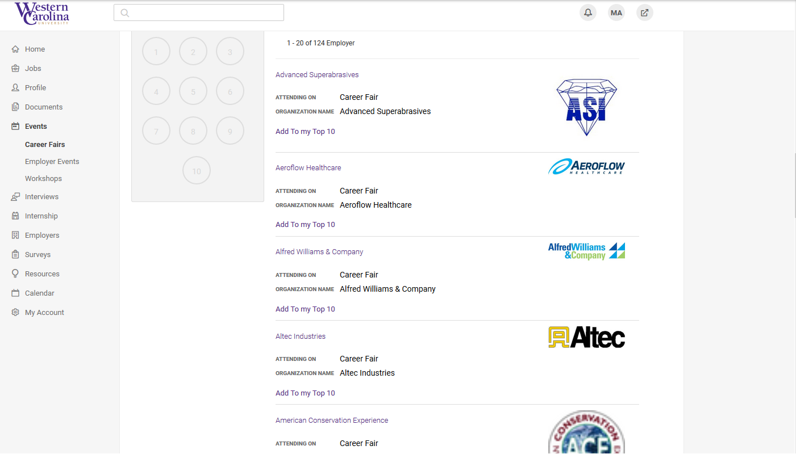
Sample of employers from Spring 2020
See who’s coming
Jobcat.wcu.edu

Slide 10
About section provides a brief overview of organization Use links to learn more:
Link to company web site
Link to full provide, which provides an overview of the organization
View all positions – shows any positions employer has posted in JobCat
Research Employers
In JobCat
Notes:
Information in JobCat provides a synopsis of the organization. Students are encouraged to use this information as a starting place to learn about organizations, and as reminder before contacting them at the career fair
**Note: not all employers choose to list their opportunities in JobCat. Encourage students to also look at company websites and speak with employers during the fair.

Slide 11
General Info
-mission/vision -organizational structure -size of organization -areas of specialization -current priorities
Staff
-divisions of staff
-types of positions within organization
-notice short-term and long-term possibilities
Opportunities Available
-search for current openings
-keep an eye out for pages dedicated to internship or entry-level opportunities
Research Employers
Organization’s Website

Slide 12
Optional
Make note of top organizations in JobCat
Notes:
**Note: Screenshot is from Spring 2020 fair and does not necessarily reflect the employers attending Fall 2020 fairs** Students can create a top 10 employer list of employers they want to be sure to visit. The employer receives a note that the student interested in them.

Slide 13
Get Ready
2

Slide 14
Prep Tips
Draft what you plan to say:
Opening greeting and ice breakers
Elevator pitch
Update and polish your resume
Develop a list of questions for employers
Select your business casual or business professional outfit
Decide the best location to be on video chat

Slide 15
Prep Tips
Draft what you plan to say
Opening greeting and ice breakers
Elevator pitch
Keep opening greeting and ice breaker short and simple.
Develop an elevator pitch to tailor for each employer. Elevator pitches are 30 second ‘commercials’ about yourself. Focus on what you want the employer to know about you: your year/major, your career goals and interests, key skills and experiences, and relevant coursework or trainings.
Be sure to share what interests you in their organization!
Notes:
Some people are natural at small talk and others are not. Career fairs, virtual or in person, can cause even more stress for students. Consider sharing a few openings, such as “good afternoon, how is your career fair so far?” or “hi I’m (name), I hope you are having a good afternoon so far.” We have separate materials available on crafting elevator pitches. Please see the career fair or networking modules if you would like to include more information in class or as an assignment!
Most employers will look for general, get-to-know you conversations. If students are uncomfortable talking about themselves and their experiences. If they want additional practice, recommend Big Interview, our online interview preparation system that include educational videos and practice questions (students can record their answers and receive AI feedback.) Access at: wcu.biginterview.edu

Slide 16
Prep Tips
Update and polish your resume
Make sure your resume is up-to-date with your current and most recent experiences.
Be sure to target your resume for the fair. Consider the key skills and experiences the industry is seeking and highlight them on your document.
The Center for Career and Professional Development is here to help:
Use the Professional Handbook: wcu.edu/WebFiles/Professional_Handbook_2018.pdf
Schedule a one-on-one appointment in myWCU > Advising/Tutoring Quicklink
Work with a Peer Mentor by emailing careerservices@wcu.edu
Notes:
We have separate materials available on resume writing. Please see the resume module if you would like to include more information in class or as an assignment! Link to our professional handbook (consider sharing in Blackboard): https://www.wcu.edu/WebFiles/Professional_Handbook_2018.pdf

Slide 17
Prep Tips
Develop a list of questions for employers
Prepare 5 questions you can ask of various employers.
Be sure to listen to their answers and tailor your questions based on the information they share.
A few sample questions include:
I notice you have an intern program. What are some of the key things the interns learn in this program?
What are your goals for the fair today?
What makes a candidate stand out when applying for your company?
What does a typical day look like for an engineer at (name of company)?
I’m curious what you enjoy most about working with (name of company)?
How would you describe the culture of (company name)?
What are the top values of (company name)?
Notes:
The last question is a great one for students to listen for value and culture fit – note if employers talk about innovation, client-focus, diversity, professional development, customer service, etc. If you have additional class time, students might brainstorm questions as a class or in small groups. Additionally, you might allow them to use their phones or laptops to research sample questions and share a few favorites with one another.

Slide 18
Prep Tips
Select your business casual or business professional outfit
Most organizations make note of how students are dressed at career fairs. Though they understand that the vast majority of students do not wear professional attire day-to-day, they want to know that students made an effort for their first impression.
Be sure you are well-groomed, rested, and dressed professionally for your video conversations.
Wear a polo, button up, or blouse with a cardigan or blazer. If wearing a button up, consider adding a tie or bow tie for extra polish.
Keep accessories minimal to avoid distraction.

Slide 19
Photo Collage
Notes:
These photos show a range of business casual to business professional. Each of these looks would be appropriate for a career fair.

Slide 20
Prep Tips
Decide the best location to be on video chat
Find a quiet location with a neutral background. Consider taking down posters, photos, etc. during the fair so that the focus is on you and not your background.
If possible, be somewhere that you can close the door and let any family or room-mates know not to disturb you.
Have your computer and camera at eye level.
Be sure you have space for your notes, a notepad, pen, and water.

Slide 21
After the Fair
3

Slide 22
Follow-Up
Connect with employers via email or social media to stay in touch.
Be sure to briefly reintroduce yourself and remind them of where you met and your conversation.
Include a ‘call to action’ – ask for more information on their organization or opportunities, or maybe ask for a connection to someone else.
Thank them for their time!
Double check spelling and names – get the individual and company names correct.
When emailing, always include a brief but informative subject line.
Don’t wait too long – aim to follow-up within 24 hours, 48 hours at the longest.
Notes:
It’s important that students act quickly and reintroduce themselves. Some of the representatives at the fairs are recruiters and may be attending multiple fairs with different schools around the same time as our fair.

Slide 23
Next Steps
Add in any assignments or next steps here.
Notes:
Enter your next steps here. See our module for assignment ideas!

Slide 24
Visit the Center for Career and Professional Development
careers.wcu.edu
careerservices@wcu.edu
828.227.7133
We help with resumes, interviews, career fair prep, job searching, internships, picking a major, and more!

