Slide 1
Starting Your Resume
Prepared by:
The Center for Career and Professional Development

Slide 2
A resume is
A self-marketing tool that highlights your skills.
It is a one-page document summarizing your experiences in an easy to read format.
The purpose of a resume is to get an interview by answering one very important question: can they do this job?
Notes:
We highly encourage undergraduate students to have a one-page resume, especially as first and second year students. Students with extensive relevant experience might have a two page resume.
Resumes should be tailored to meeting the required skills and experiences of each job to which they are applying.

Slide 3
A well written resume:
Is easy to read and visually appealing
Represents you in a positive and honest way
Makes good use of white space (margins should be between 1.25” and .5”)
Reverse chronological order in each section so employers can see what you are currently doing or the most recent experience first
Connects what you have to offer to the employer’s needs
Notes:
- It should be easy for an employer to find the information they want to see. Font sizes should be at least 10pt and students can use bold, italics, and underlining to help guide the readers eye to important information or new sections.
Students should never claim to have more experience than they actually have. However, more frequently, we see students undervaluing their own experiences.
Too much white space will feel like an empty document but too little will feel overwhelming to read
Typically resumes are tailored to each positions, as students are starting their first resumes and likely do not have a long list of experiences, they have less content to tailor. Encourage students to read the job description and do their best to highlight any relevant skills already gained or demonstrated in their previous experiences.

Slide 4
Clear | Concise | Consistent
Notes:
- Students should clearly explain their experiences in a concise way. They should use a consistent formatting throughout the document (same font, same format for dates, information presented in the same order).

Slide 5
Starting Your Resume
Content drives format
Avoid using a template
Notes:
When writing a resume, many people will use a template. Though we understand that urge – templates provide guidance on what a resume ‘should’ look like and feel like a timesaver with formatting – we encourage students to start with a blank page. Templates often prioritize design over function and we find students trying to cram their experiences into the sections listed in the template that aren’t a good fit for them (professional summary, though students don’t have extensive work history or an awards and accomplishments section where students will list one, not relevant achievement, such as an honor’s org or honor roll/dean’s list which they could put in their education section). Starting with a blank sheet of paper or document and listing their experiences and skills prevents filtering out their experiences and allows them to add in design and format elements based on the amount of content.

Slide 6
Resumes include things like:
Educational institutions
Full-time, part-time, summer jobs
Internships
Community service
Committee involvement
Student organizations, athletics, theatre, band, & Greek life
Leadership activities
Relevant coursework, research, study abroad
Language, lab, computer skills
Trainings and certifications
Professional associations & conferences
Presentations
Honors and awards
Notes:
If you used the suggested warm up activity have students look back over their list and add in any additional types of experiences they may have left out.
If you did not use the warm up, have students begin writing a list of all the things they have been involved in in the past or are currently involved in.
*If students have no experiences yet, encourage them to write down a list of experiences they are considering such as joining a student organization or getting a part-time job.
If your class is longer than 50 minutes, consider having student share some of the items in their list.

Slide 7
Use smart section headings
Education/Academic | Education Certifications | Relevant Coursework Research
Experience | Experience Work History Relevant Experience | XYZ Experience (such as Field Experience, Tutoring Experience, Customer Service Experience)
Skills | Skills Areas of Expertise | Technical skills Lab skills
Other | Honors and Awards Leadership Campus Involvement Community Involvement | Volunteer Experience Conferences Presentations
Notes:
Once students have a list of experiences, they should consider the sections that will work best for them. Their first section should be their education, but everything after that depends on their experience. Since each section is in reverse chronological order, it can help to have a “Relevant Experience” section filled with their most relevant work, volunteer, student org, etc. experience. If they don’t have lots of experience, they might choose headings based on the experience type: Work Experience, Campus Involvement, Volunteer Experience, etc.
A skills section should only be used for field specific skills such as computer programing languages, foreign languages, equipment, software programs, laboratory instruments. Transferable skills, such as teamwork, time management, initiative, should not go in a skills section and should instead be demonstrated through their bullet points in the experiences where they gained or demonstrated these skills. We often say “show don’t tell” for transferable skills.
The headings on this page are meant to help students realize that they have options and can choose what works best for them!

Slide 8
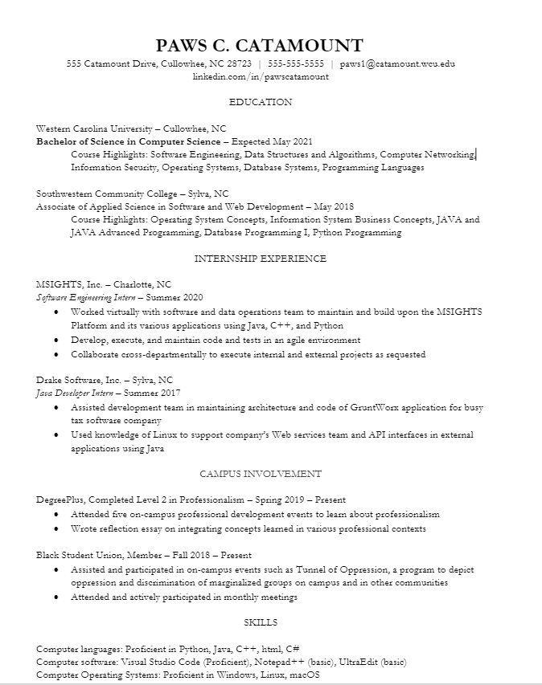
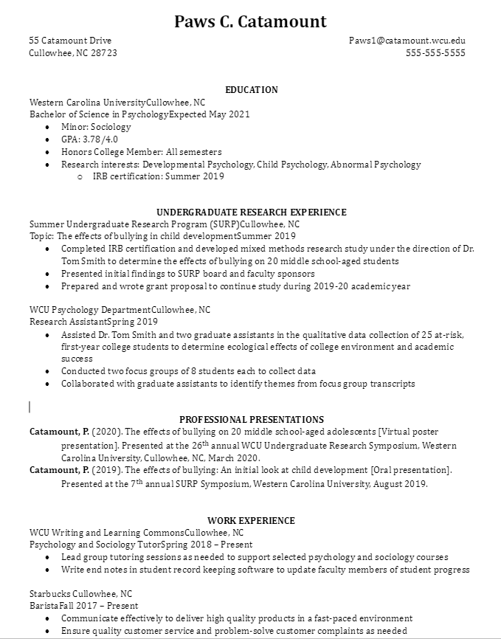
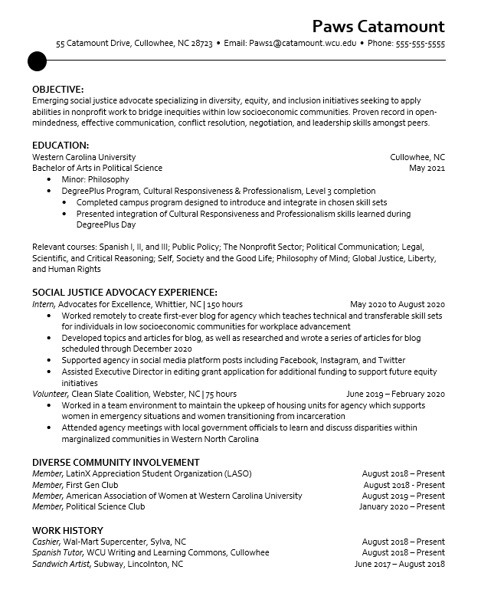
A few resume layout examples
Notes:
There are 100’s of layouts and designs for resumes. There is no one right way for it to look - the key are following the best practices. With these resumes, point out the different styles (header styles, font, spacing, left align vs centered headers).The first resume intentionally uses a name/contact info header that takes up more space and blank lines before and after section headings so that the design elements help the content fill the full page. The third resume’s name and contact info takes up much less space and they only use a blank like before their headers. This resume format is much tighter allowing for more information to fit on the page. Highlight that some experiences have 2-4 bullet points and others have no bullet points, based on how relevant those experiences are to the employer.
Invite students discuss the resumes: share out if they have a favorite or least favorite, and what they like about the styles.

Slide 9
Your resume layout
Education/Academic | Education Certifications | Relevant Coursework Research
Experience | Experience Work History Relevant Experience | XYZ Experience (such as Field Experience, Tutoring Experience, Customer Service Experience)
Skills | Skills Areas of Expertise | Technical Skills Lab Skills
Other | Honors and Awards Leadership Campus Involvement Community Involvement | Volunteer Experience Conferences Presentations
Notes:
Have students revisit their list of experiences and begin to determine the sections for their document.

Slide 10
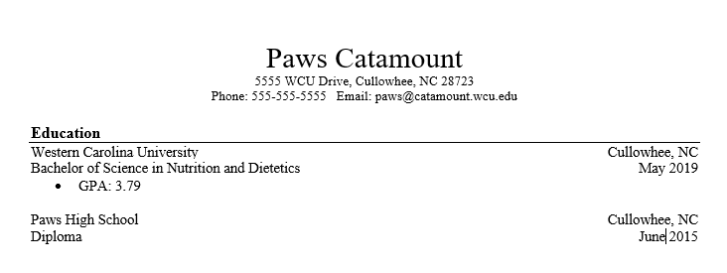
Anatomy of a great resume
Reverse chronological order
Only put if above a 3.0
First and second years can put high school experiences down; but delete once you become a junior
Notes:
There are lots of different ways to format a header and section headings. Encourage students to look at the professional handbook for examples and ideas.
https://www.wcu.edu/WebFiles/Professional_Handbook_2018.pdf

Slide 11
Anatomy of a great resume
Use bullet points instead of paragraphs so it is easier to skim
Start bullets with an action verb to keep it concise yet impactful
Notes:
The next section on their resume after education should be their most relevant experience. In this example, their most relevant experience comes from volunteering.
Students should not write in complete sentences nor use “I” in their bullet points.

Slide 12
Anatomy of a great resume
Use “Present” if you are currently in the position or organization
Think about the end goal in mind – what are some skills the employer or program will want you to have in order to be successful?

Slide 13
Anatomy of a great resume
Include less relevant experience towards the end of the resume. This experience is still important but may not warrant bullet points explaining what you did.

Slide 14
Bullet point formula
(action verb) + (job responsibility) + (how/why/results)
MEH: Stocked shelves
BETTER: Maintained well stocked shelves
BEST: Proactively monitored aisles to restock shelves when needed and tidy store to ensure customer satisfaction
MEH: Demonstrated excellent customer service
BETTER: Provided a prompt greeting to customers and checked in to assist with any questions
BEST: Provided prompt and friendly greeting to customers, answered questions and provided information on products and current sales
Notes:
Many students leave off the how/why/results in their bullet points. Adding in these extra details showcase values and skills like initiative, customer service, dedication and more. Writing bullet points can be tricky and it takes practice. Not every bullet point needs to be long and expanded, but encourage students to add detail to their most relevant bullet points.

Slide 15
Example action verbs
LEADERSHIP - administered, maintained, implemented, incorporated, motivated, reduced
ORGANIZATION - advised, collaborated, scheduled, consulted, increased, restructured
PROMOTION - convinced, launched, represented, generated, marketed, promoted
RESEARCH - analyzed, investigated, theorized, inspected, interpreted, surveyed, examined
PROBLEM SOLVING - accomplished, determined, identified, proposed, strengthened
INTERPERSONAL - counseled, instructed, presented, demonstrated, moderated, prepared
INITIATIVE - arranged, invented, produced, innovated, reshaped, resolved, developed
MANAGEMENT - administered, directed, organized, analyzed, evaluated, improved
COMMUNICATION - addressed, convinced, edited, mediated, publicized, negotiated, spoke
TECHNICAL - assembled, devised, upgraded, remodeled, maintained, repaired, operated
Notes:
There is a list of action verbs in the Professional Handbook. Though this isn’t an exhaustive list of verbs, it helps students begin to brainstorm new options.
If your class is longer than 50 mins, have students select two or three action verbs that are skills they have and share one. For additional time, have them draft two bullet points using the formula on the previous slide. Students could share their bullet points in pairs or small groups and give feedback.

Slide 16
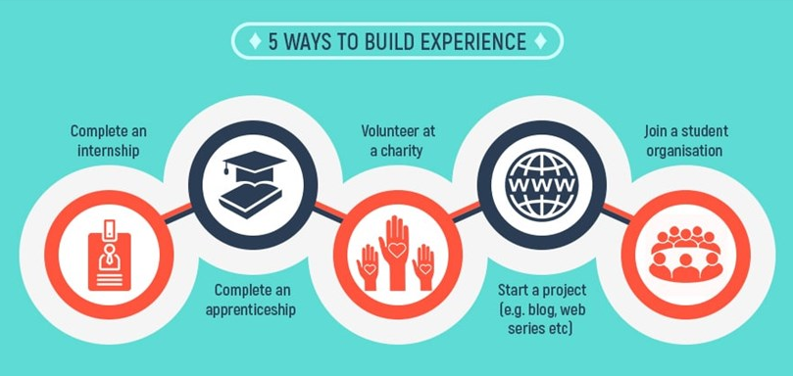
Build your experience From: Vault.com
Notes:
If students are feeling concerned about a lack of experiences to add to their resume, it’s okay! We all have to start somewhere. Here are 5 easy ways for them to start gaining experience to explore their interests and have something to include on their resume.

Slide 17
Compose and format
Choose a format you like based on your content
For experiences include the name of they organization,your title, the city and state, and dates
For your action verbs:
Use current tense for current positions
Use past tense for previous positions
Objective statements are optional, but generally discouraged
Do not include “References Available Upon Request”
Notes:
- If they didn’t have a job title, they can try and use an honest one that best fits their role. If it was for a job or internship, students should get approval from their supervisor to use the title.
- Dates just need to be Month and Year to Month and Year or they can put a semester (Spring 2020)
- Objective statements are often discouraged because they tend to use vague statements that do not add content or power to the document
- References go on a separate page that has the same name/address header as the resume and format/layout. Students should have 3-5 references.

Slide 18
Final tips
Before you send
Edit, edit, edit
Get a second pair of eyes
Change to a pdf
Title appropriately: First Initial Last Name Resume
CGauthier Resume

Slide 19
Next Steps:
Notes:
This slide is for any next steps or assignments you want to share with students

Slide 20
Need help with your resume? The Center for Career and Professional Development is here for you.
Location: Reid 150 (Backside of Reid, entrance faces metered parking long near Cat Tran hub.
Appointments scheduled through myWCU > Advising/Tutoring quick link > Get Assistance Button Drop-Ins with Peer Mentors email careerservices@wcu.edu
Notes:
Appointments vs Drop-Ins: Resume appointments are schedule for 30-minutes with one of our counselors and drop-ins are 15 minutes first come, first serve model with trained student Peer Mentors. Drop-ins are great to get first draft resumes looked over or for quick questions. Appointments are great for students who need more detailed or in-depth support.
During the Fall 2020, our services will be offered virtually including drop-ins students can simply email their document and questions for support.

Slide 21
Visit the Center for Career and Professional Development
careers.wcu.edu
careerservices@wcu.edu
828.227.7133
We can help with resumes, interviews, career fair prep, job searching, internships, selecting a major, and more!

