Slide 1
Developing
PROFESIONALISM
The complicated world of professionalism in the workplace.

Slide 2
When do you demonstrate professionalism?

Slide 3
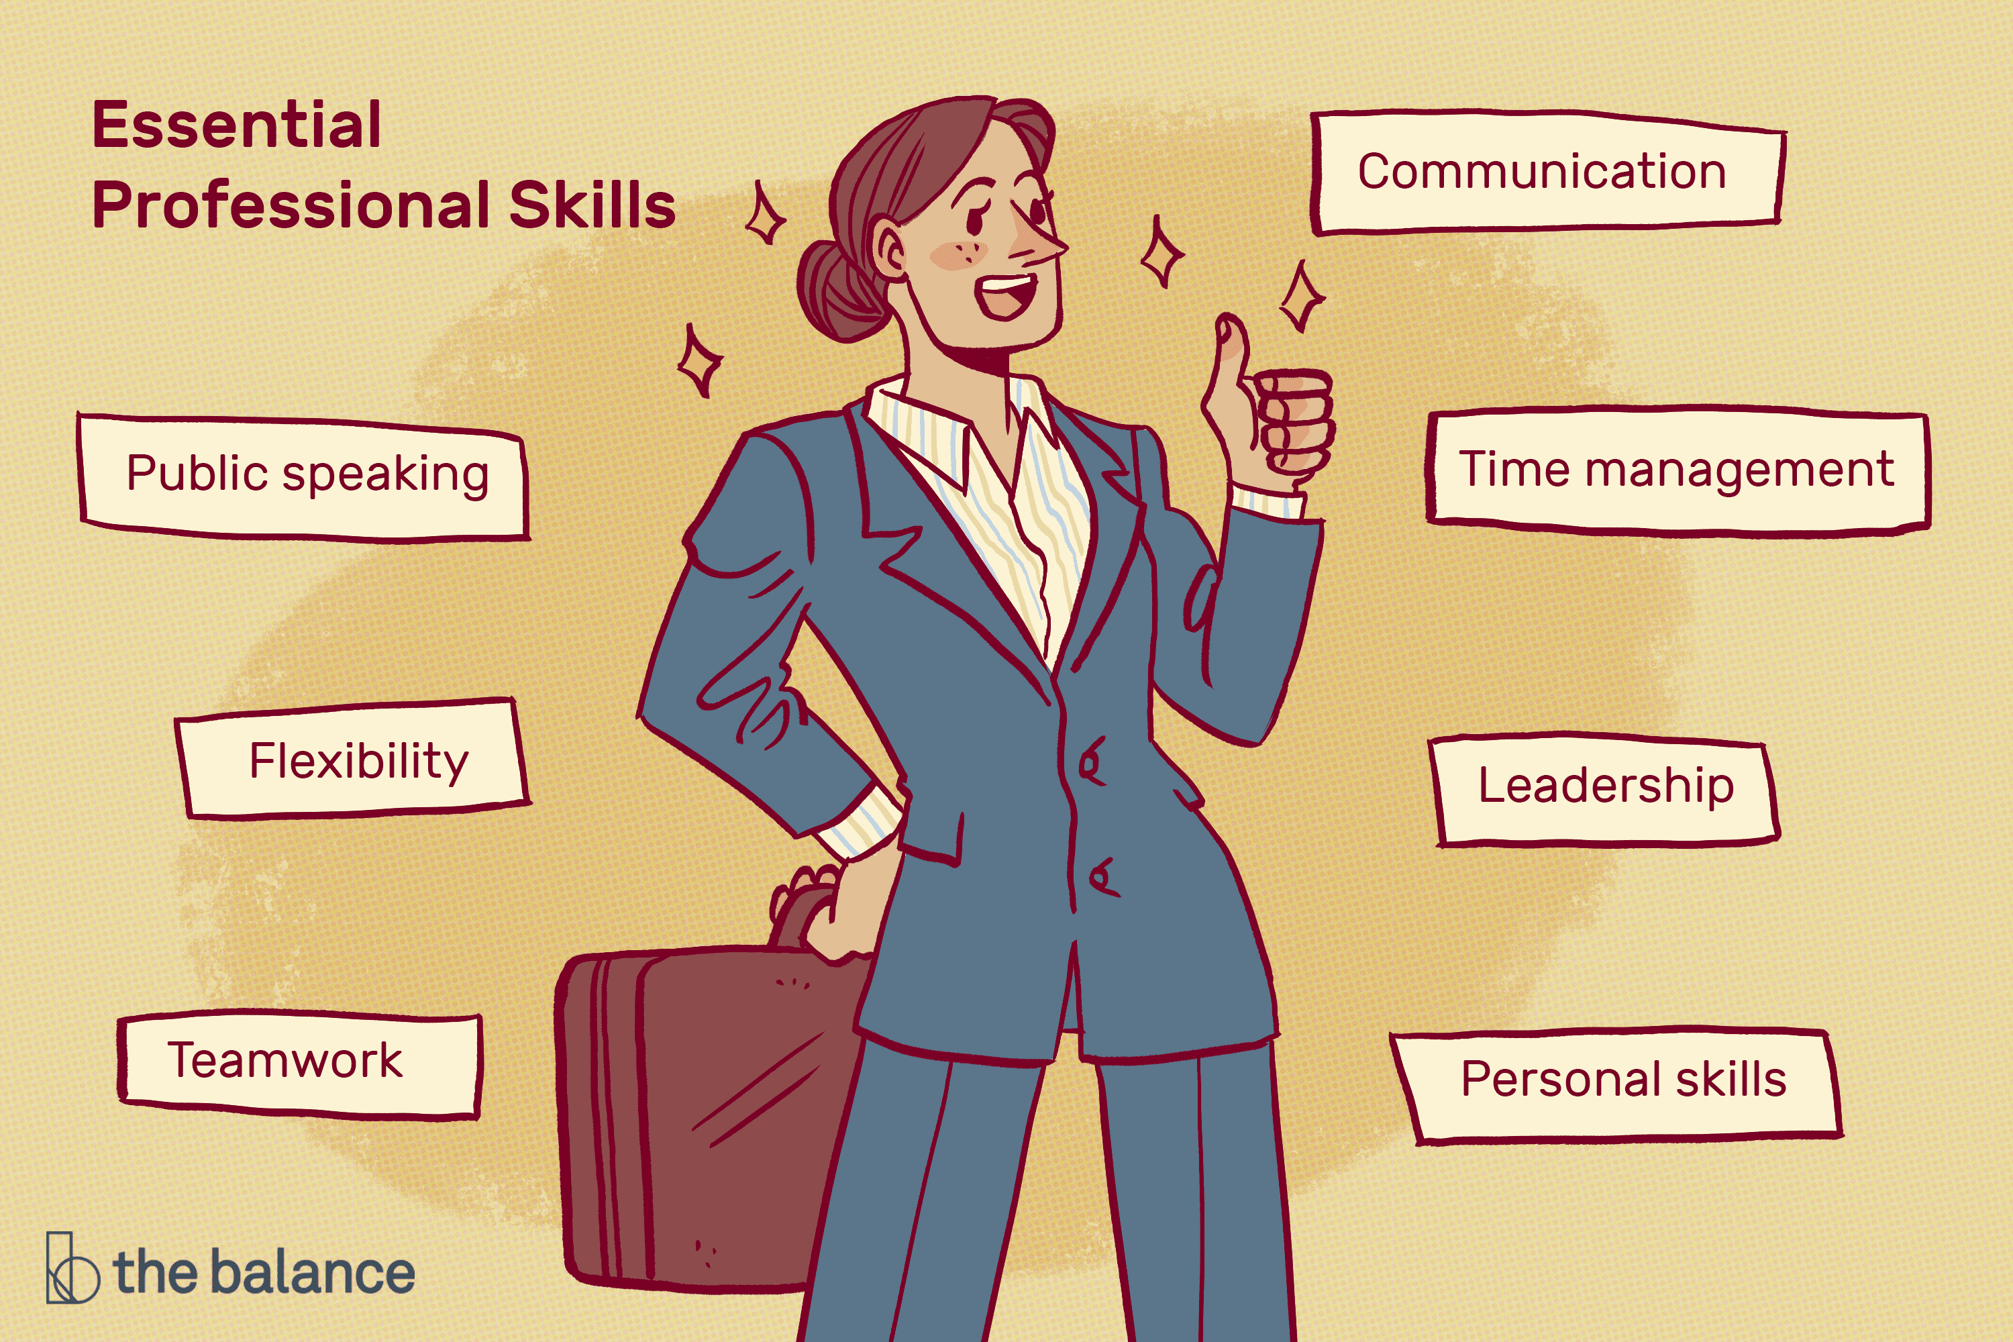
WORKPLACE PROFESSIONALISM
Note: Professionalism may take different forms based on context and culture. It’s important to be attune to the environment you are working in and understand their context of professionalism.
What is professionalism?
Professionalism is defined as an individual’s
conduct at work.
Core Attributes to Professionalism.
Accountability
Cultural Awareness
Adaptable
Compassion & Self-Regulation
Effective Communication
Honesty & Integrity
Dress & Image

Slide 4
ACCOUNTABILITY
On time
Meet deadlines
Deliver results
Owning results (positive or negative)
Being reliable
Be present → Avoid looking at your phone/watch too much
Notes:
Professionals hold themselves accountable for their actions and words. They show up in the workplace. That means they are present, engaged and on time with project deadlines. They arrive on time and communicate when they will not. People who have accountability are reliable employees. The people they work with feel like they can rely on that individual and they are consistent in their work.

Slide 5
Cultural Awareness
Effectively work with those with varying beliefs.
Able to learn from others that are different.
Able to respect cultural values from others.
Employees ensure they do not engage in discrimination, jokes, or harmful behavior to others.

Slide 6
Adaptable
Able to take in new information
Capacity for improvement and growth
Thoroughly listen to feedback
Act on feedback
Notes:
Students with the ability to engage in new behaviors and take constructive feedback in the workplace are considered to be professional. It’s important to notice how you are responding to feedback and taking in new information EVEN if you do not like or agree with your boss 100%. Try to implement the feedback you receive. If you have different ideas be sure to present those in a professional way and listen to the person speaking - without interrupting, eye rolling or making faces- before responding back. How you listen to others and adapt to the work environment you are in says a lot about your ability to showcase professionalism in the workplace.

Slide 7
—JANE GOODALL
“Empathy is really important… Only when our clever brain and our human heart work together in harmony can we achieve our full potential.”
Notes:
The ability to show care or empathy and understanding toward coworkers demonstrates a level of professionalism. Try to put yourself in your managers shoes and imagine the types of deadlines they are trying to meet. Compassion means that a student will demonstrate a motivation to alleviate and be empathetic to the challenges others may be facing in the workplace.
Empathy in the workplace means that you listen to your coworkers, communicate effectively, you send clear communication via email and talk in-person when necessary. For example, if you notice yourself sending an upset email. Save and come back to it later or maybe try to meet that coworker in-person rather than emailing them.
Be polite and understanding with your coworkers. Be receptive to their ideas, like we talked about.

Slide 8
EFFECTIVE COMMUNICATION & REGULATION
Communicate clearly and avoid slang / curses.
Avoid viewing things that are NSFW in memes / videos and don’t share these at work.
Keep your self disclosure professional.
Avoid snapping at or lashing out if you are upset, try to regulate your emotional and deal with the effectively.
Avoid talking about topics that could produce conflict or share personal views that should be avoided in the workplace. (Politics, religion, money, etc.)
Be aware of confidentiality within your organization and what needs to be kept confidential.
Avoid gossip in the workplace.
Notes:
You want to be aware of how you are communicating and what you are communicating in the workplace. Like wearing a mask, you want to filter some of the things you share. It’s okay to share elements of your personal life, but you just don’t want to over share. Example, you could share that you went to a wedding last weekend. You could leave out the part about getting drunk and doing karaoke afterwards.
In general, avoid sharing your personal views if you feel they could bring about conflict and especially if they are not relevant in your workplace.
Be aware of what you are sharing via email – some memes and videos do not have a place in the workplace because they are inappropriate.
If the workplace (especially corporate workplaces) had a rating it would be PG and you don’t want to share anything beyond that.
It takes practice and you might not always get it right the first time, so notice where you can do better and apologize when necessary.
Try to regulate your emotions so you can communicate calmly, clearly and effectively. If you do not understand

Slide 9
PROFESSIONAL WRITTEN COMMUNICATION
Always address an email by name – don’t start with “hi” or hello” – Use “Hi Mr. Smith”
Be concreate and clear in your written communication
Turn spell check on in our email
Make sure your voicemail is professional
Avoid abbreviations and informal lingo in emails
Notes:
Be aware of your email, phone and online communication in the workspace. Be sure it is professional.
Addresses emails formally until you see how that person responds and you can address it based upon their response. Always include a name.
Make sure your voicemail is professional and cleaned out, so your work can leave you voicemails.
Have a professional email address you use to correspond with people when you are in the interviewing process.
What your online presence – LinkedIn, social media, etc. If it’s public, your future manager or current manager can see your social media. You don’t want your TikTok to give your manager reasons to be concerned about how you carry yourself in the professional world.

Slide 10
Honesty & Integrity
Trust
Values
Truth
Build trust by keeping your word.
Uphold your own values and the workplace values.
Be honest if something goes wrong or you can’t meet a deadline.
Notes:
Professionals exhibit qualities such as honesty and integrity. They keep their word, and they can be trusted implicitly because of this. They never compromise their values, and will do the right thing, even when it means taking a harder road.
More than this, true professionals are humble – if a project or job falls outside their scope of expertise, they're not afraid to admit this. They immediately ask for help when they need it, and they're willing to learn from others.

Slide 11
DRESS & IMAGE
Hygiene
Clothes
Do you have that just woke up & didn’t shower look every day?
Dress for the job you want and notice the company culture.
Modesty
Buttoned up
Dress modestly until you are aware of what’s appropriate for your company/industry.
Are your clothes neat, ironed and do they match?
Notes:
Talk to a professional in the field or company that you want to go into to see how people dress. Prepare for dressing professionally in your field in advance so you don’t have to purchase clothes last minute. This allows time to hit the sales and visit consignment stores as well.
Make sure clothes are wrinkle free and fit appropriately.
If you are wondering if something is too revealing, too short, etc, it probably is. You shouldn’t have to wonder that. It’s better to start out dressing modestly, especially if you present as a more entry level individual in the workforce.
It’s okay if you roll into work tired one day, it happens to all of us, but be sure that’s not how you are consistently showing up each day. You want your overall image to look put together. Putting time into your appearance shows that you respect the place you work in.
Note, we know there is some bias wrapped up in professional dress, but we try to prepare students for the professional world as best as possible. It’s important to look the part to move up in an industry. With that said, banking and counseling look different, so there is some variance by industry in what is acceptable for professional dress.

Slide 12
Center for Career & Professional Development
Visit Us
Resumes, job searching, internships, interview help and more.
Careers.wcu.edu
Contact
Make appointments in MyWCU
828.227.7133
careerservices@wcu.edu

