Slide 1
JOB SEARCHING FOR GRADUATING STUDENTS

Slide 2
overview
Job search process & strategies
Determining the employer “fit”
How to deal with rejection & other frustrations

Slide 3
JOB SEARCH STRATEGIES
1

Slide 4
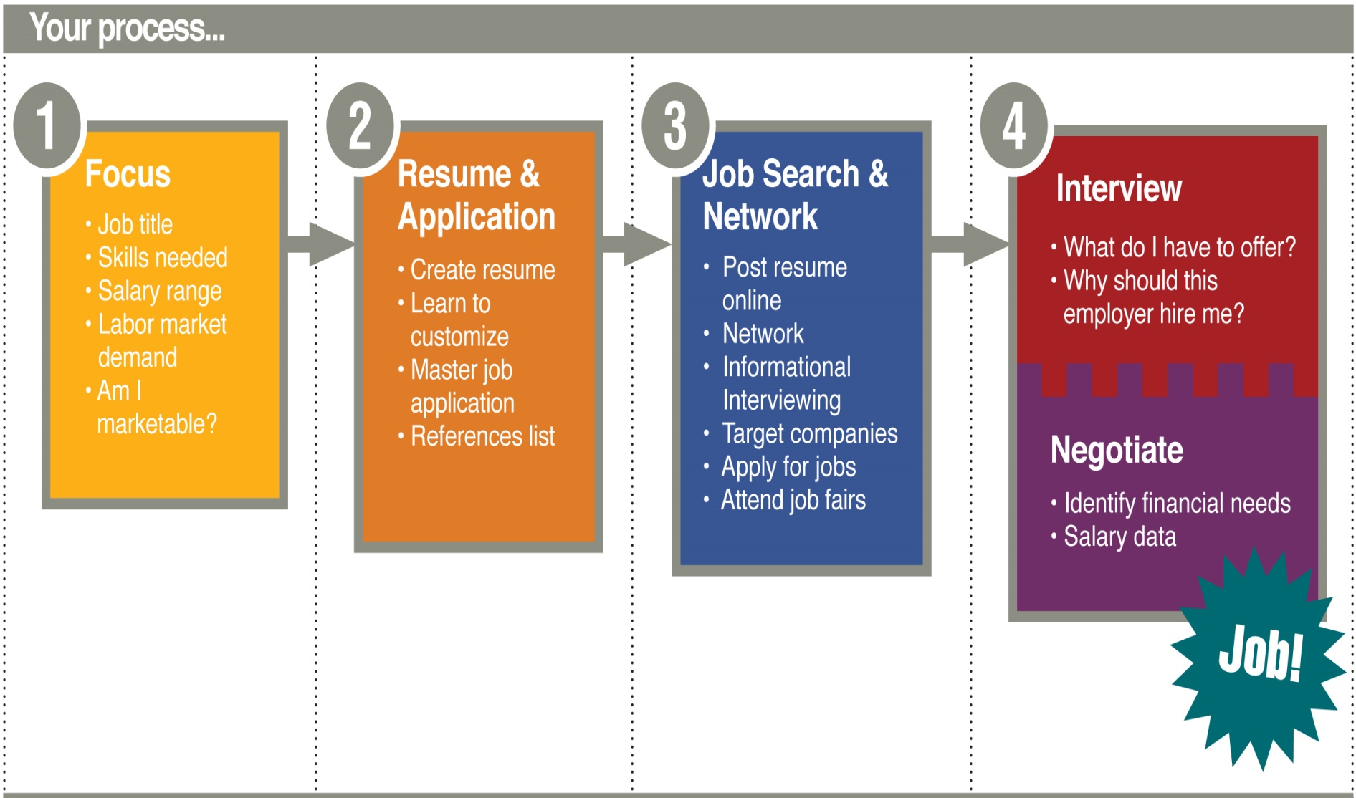
JOB SEARCH PROCESS
Notes:
INSTRUCTOR’S NOTES: Every job search begins with a focus or position title in mind. Once they have a job ad, they’ll craft their resume (tailoring the resume to the job ad as much as possible) and other materials, interview for positions and then negotiate the job offer.

Slide 5
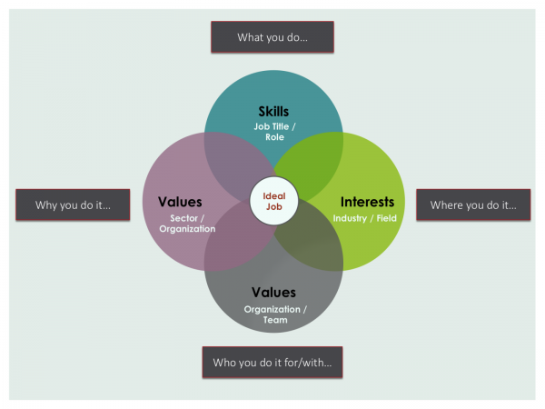
THINGS TO CONSIDER
Notes:
NOTES: Students will need to reflect on what it is they want from their first fulltime job – it’s way more than “Just a job!” Students will need to think about where they want to live, how far they’re willing to commute), the minimum salary they’re willing to take, benefits they’d like to see in an offer, the values they hold and what they’re looking for in an employer in terms of professional development, work culture, etc.

Slide 6
DID YOU KNOW….
80% of vacant positions are never posted online?
You are 5 times more likely to be hired if you are referred by someone?
Notes:
NOTES: For these reasons, students should be implementing a variety of job search strategies

Slide 7
80/20 JOB SEARCH STRATEGY RULE
Passive (20%)
Active (80%)
General job search sites
Targeted job search sites
Generic resumes and cover letters sent in batches
Applying to ‘anything and everything’
Networking
Connecting with professional organizations
Proactively contacting organizations
Customizing resumes and cover letters for each employer
Creating a personalized job search and career path strategy
Notes:
NOTES: Many students will gravitate towards passive job search strategies; and while these strategies sometimes work for some students, we recommend spending about 80% of their time in the job search using a more active approach through networking (via contacts, conferences, professional organizations, networking events on campus, virtual networking options, etc.), reaching out to employers via LinkedIn or email/ phone calls, customizing job application materials and crafting a job search strategy (engaging in one networking event per month, applying to X number of jobs per week, reaching out to X number of employers per week, etc.)

Slide 8
Sample 80/20 Job Search Strategy (~10 hours/ week)
PASSIVE (Approx 2 hours) | ACTIVE (Approx 8 hours)
Spend 10 minutes/ day reviewing job alerts & job boards Apply to 1 – 2 jobs per day via job boards | Identify and get in contact with 3 – 5 new contacts Plan and conduct 3 networking meetings (informational interviews, for example) Log in daily to LinkedIn and complete 2 – 3 actions (ex: posting or responding to relevant topics, reaching out to employers or WCU alum in your field, following potential employers and their pages, etc.) Attend 1-2 networking events (webinars, online conferences, etc)
Notes:
NOTES: Many students will gravitate towards passive job search strategies; and while these strategies sometimes work for some students, we recommend spending about 80% of their time in the job search using a more active approach through networking (via contacts, conferences, professional organizations, networking events on campus, virtual networking options, etc.), reaching out to employers via LinkedIn or email/ phone calls, customizing job application materials and crafting a job search strategy (engaging in one networking event per month, applying to X number of jobs per week, reaching out to X number of employers per week, etc.)

Slide 9
POSITION TITLES
ACTIVITY:
1) Visit www.onetonline.org
Think of a position title you are exploring in your field (ex. Health educator)
Review the list of position titles that generate and choose one
Review the Sample Reported Titles listed. Do they vary?
Notes:
NOTES: Searching for position titles can often be the hardest part of the job search. Give students about five minutes to complete this activity

Slide 10
PROFESSIONAL ORGANIZATIONS
List organization here
List organization here
List organization here
Notes:
NOTES: Each field will have its own professional organizations – which often will have its own specific job boards and networking opportunities. Enter any relevant professional organization related to your field here for students to explore. Suggest specific conferences or networking events common in your field.

Slide 11
JOB SEARCH BOARDS AND RESOURCES
General Job Search Boards:
JobCat
Indeed.com
Monster.com
LinkedIn
Glassdoor
Field-specific job boards:
Enter job board here
Enter job board here
Enter job board here
Search for “Top _____ Job Boards”
Notes:
General job boards are easy to use, but there could also be specific job boards students may not know about. Include any field-specific job boards here (ex. Higheredjobs.com or socialworkjobs.com)

Slide 12
ACTIVITY
Complete Career Search Strategy worksheet (Part one only) – 10 minutes
Then discuss answers to the worksheet with a partner – 5 minutes

Slide 13
RESEARCH POTENTIAL EMPLOYERS
2

Slide 14
HOW DO I KNOW IF THE JOB IS A GOOD FIT?
Notes:
No job is going to be perfect, but researching employers and the values they hold, plus knowing ourselves and what is important to us, give us key insights into the kind of “fit” we are looking for. Do you want a team-oriented environment or would you rather work independently? Structured work time vs. flexible hours? Inside/ desk work space vs. outside and open space? What type of management style do you prefer? How do you prefer to be held accountable for the work that you do? These are things to think about and possibly ask about in an interview to gauge how you will “fit” into the employer’s culture and how the employer/ position will “fit” with you. INSTRUCTOR: If you feel comfortable, share examples of how you have navigated the job search process in searching for an employer that fits with what you were looking for.

Slide 15
RESEARCH, RESEARCH RESEARCH!
Research employer websites
Read their mission/ values statement, # of employees, scope of the practice, etc
Google for employee reviews, if applicable
Search LinkedIn for current employees and network
Notes:
INSTRUCTOR NOTES: Search for an employer (or use Western as an example) and show students where they might search for an employer’s mission/ value statements, number of employees. Then show your students how to search for employers on LinkedIn and show them the People tab on the employer’s page. LinkedIn will also show who working for that employer is a WCU alum with a WCU logo beside their name.

Slide 16
ACTIVITY: 15-20 minutes
Search for an employer you would be interested in working (use a job search engine if you need help)
Review their website (About Us, Our Services, etc), do a quick Google review search or search for the employer on LinkedIn
Discuss with a partner your initial thoughts on the employer, their values, their services, and any kind of assumptions you have on the work culture based on their online presence. Would you be interested in applying for their position? What resonates or does not resonate with you?

Slide 17
HOW TO DEAL WITH REJECTION
5

Slide 18
THINGS TO CONSIDER
Realize it’s part of the process
Don‘t overanalyze, but do reach out to the hiring manager
Build stronger confidence in your abilities
Know you aren’t alone
Keep a positive attitude
Keep to a schedule – don’t let the job search consume you
Exercise, eat well, engage in self care
Notes:
NOTES: The average person gets 24 rejections to a job before they get a yes. Rejection is often part of the process. It’s OK to thank the employer for the update and inquire as to the reasons you didn’t get the job and ways you can improve to be a more competitive candidate next time. Be professional and polite! If students are continuously getting passed up for a job, it’s time they objectively analyze their resume and experiences to see where their weakest points are and then work to bridge that gap. That could come in the form of professional development opportunities, additional certifications, webinars, volunteer work, etc. Keeping a positive attitude is essential, and so is keeping a schedule during the search. Don’t let the job search consume you

Slide 19
“I’ve missed more than 9,000 shots in my career. I’ve lost almost 300 games. 26 times, I’ve been trusted to take the game winning shot and missed. I’ve failed over and over and over again in my life. And that is why I succeed.” -- MICHAEL JORDAN

