Slide 1
Enhancing Your Resume
Prepared by: The Center for Career and Professional Development
Notes:
This presentation will cover a few resume basics but focuses primarily on strengthening resumes by tailoring them to specific jobs and deepening the content included in bullet points. Students can reference our Professional Handbook, as well as work with counselors or peer mentors in the CCPD for one on one support for their resumes (and more).
Access our Professional Handbook here: https://www.wcu.edu/WebFiles/Professional_Handbook_2018.pdf

Slide 2
A Resume is
A self-marketing tool that highlights your skills.
It is a one-page document summarizing your experiences in an easy to read format.
The purpose of a resume is to get an interview by answering one very important question…
Notes:
We highly encourage undergraduate students to have a one-page resume, however, students with extensive relevant experience might have a two page resume.

Slide 3
Can they do this job?
Notes:
Resumes should be tailored to meeting the required skills and experiences of each job to which they are applying. Resume decisions should be tied to this question. When students wonder how much information they should include about a certain experience or where to place experience on their resume, we look back to this question. How strongly did your work in that job or internship prepare your for this position? If not much, then only include the most relevant bullets. What experiences best prove that you can do this job? Those go at the top.

Slide 4
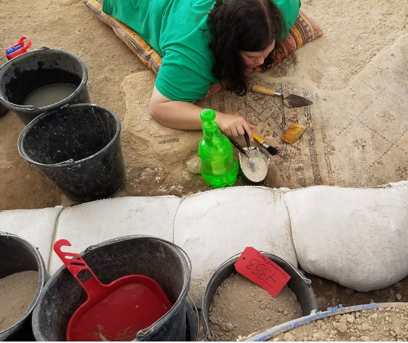
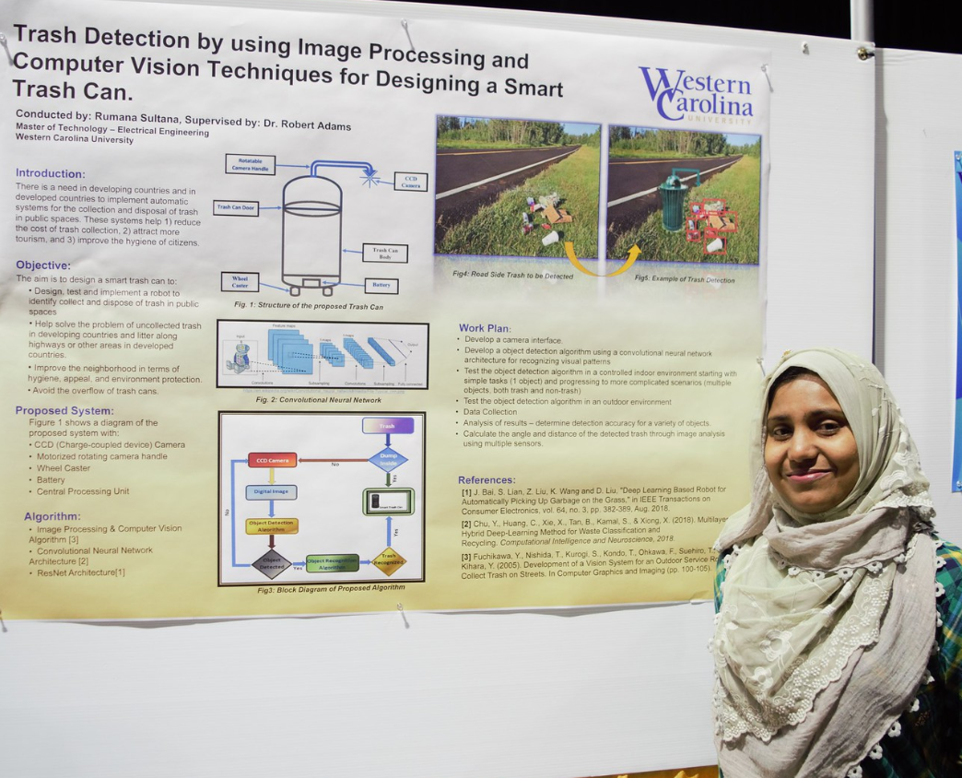
What skills and experiences are key for your field?
Think about field specific and transferable skills
Notes:
For this learning activity, have students work in groups/pairs if there are similar career goals and, if not, then have students work solo and brainstorm a list.
Ask a few groups or individual students to share out the career they are interested in and some of the field specific and transferable skills.

Slide 5
Refresher on Resume Basics

Slide 6
A Well-Written Resume
Is easy to read and visually appealing
Makes good use of white space
(margins should be between 1” and .5”)
Uses reverse chronological order in each section so employers can see what you are currently doing or the most recent experience in that section first
Connects what you have to offer to the employer’s needs
Notes:
- It should be easy for an employer to find the information they want to see. Font sizes should be at least 10pt and students can use bold, italics, and underlining to help guide the readers eye to important information or new sections.
- Too much white space will feel like an empty document but too little will feel overwhelming to read.
- Typically resumes are tailored to each position. Encourage students to read the job description and do their best to highlight any relevant skills already gained or demonstrated in their previous experiences – there is an activity to do this later in this PowerPoint.
- If you have experience on search committees or hiring employees, consider sharing a bit about your experience and how you and others reviewed applicants.

Slide 7
Resumes Include Experiences Like:
Educational institutions
Full-time, part-time, summer jobs
Internships
Community service
Committee involvement
Student organizations, athletics, theatre, band, & Greek life
Leadership activities
Relevant coursework, research, study abroad
Language, lab, computer skills
Trainings and certifications
Professional associations & conferences
Presentations & publications
Honors & awards
Notes:
If you used the suggested warm up activity have students look back over their list and add in any additional types of experiences they may have left out.
If you did not use the warm up, have students begin writing a list of all the things they have been involved in in the past or are currently involved in that they don’t already have on their resume.

Slide 8
Want big impact?
Use big image.
Including Relevant Academic Experience
Employers appreciate that for many students their most relevant experience might come from academic coursework including:
Courses
Research
Field Work
Academic Projects
Lab Work
Capstones
And more
Notes:
Have students pair up to discuss one academic experience each that connects to their career of interest. If there isn’t a particular experience that aligns, have them talk about skills they have gained in their major that will translate to the world of work.
Ask 3-4 students to share examples.

Slide 9
Use Smart Section Headings
Education/ Academic | Education Certifications | Relevant Coursework Research
Experience | Experience Work History Relevant Experience | XYZ Experience (Field Experience, Customer Service Experience, Tutoring Experience)
Skills | Skills Areas of Expertise | Technical skills Lab skills
Other | Honors and Awards Leadership Campus Involvement Community Involvement | Volunteer Experience Conferences Presentations
Notes:
Once students have a list of experiences, they should consider the sections that will work best for them. For most students, their first section should be their education, but if they have significant relevant experience and want to de-emphasize being a current student/recent grad, then they can move their education section further down. Since each section is in reverse chronological order, it can help to have a “Relevant Experience” section filled with their most relevant work, volunteer, student org, etc. experience.
A skills section should only be used for field specific skills such as computer programing languages, foreign languages, equipment, software programs, laboratory instruments. Transferable skills, such as teamwork, time management, initiative, should not go in a skills section and should instead be demonstrated through their bullet points in the experiences where they gained or demonstrated these skills. We often say “show don’t tell” for transferable skills.
The headings on this page are meant to help students realize that they have options and can choose what works best for them!

Slide 10
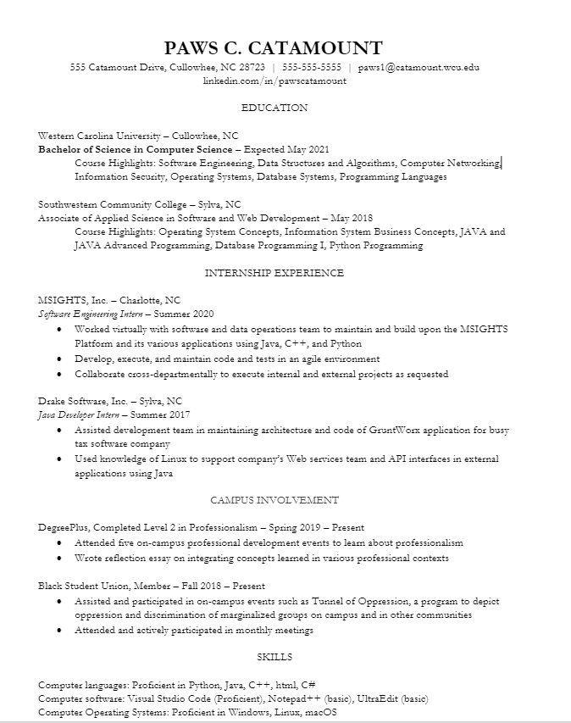
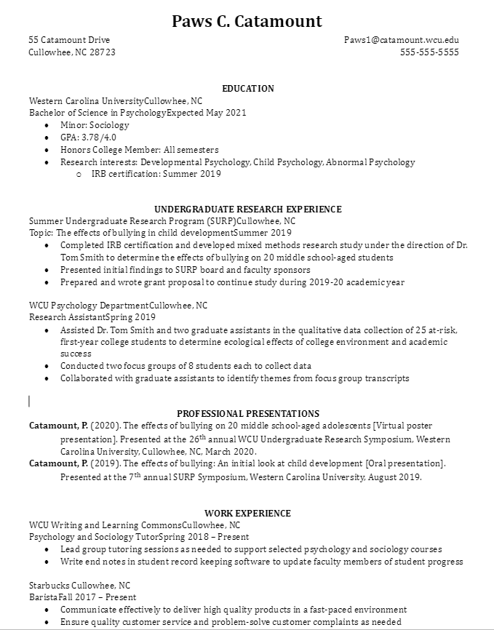
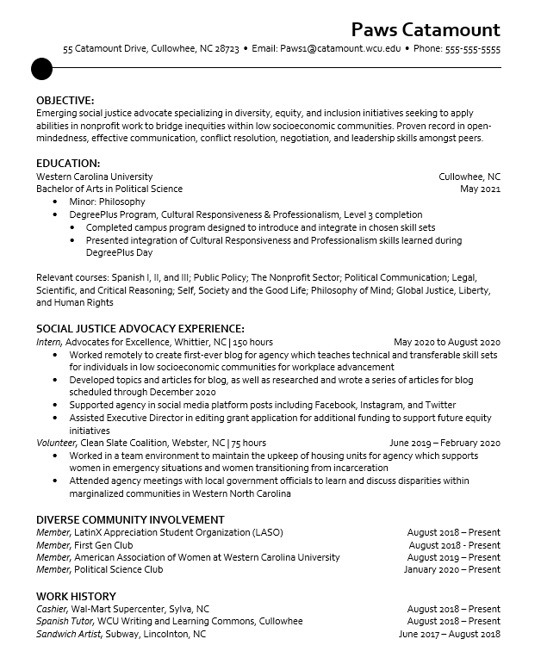
A few resume layout examples
Notes:
There are dozens of layouts and designs for resumes. There is no one right way for it to look - the key is following the best practices and choosing a format that works best for their experience. With these resumes, point out the different styles (header styles, font, spacing, left align vs centered headers). Highlight that some experiences have 2-4 bullet points and others have no bullet points, based on how relevant those experiences are to the employer.
Invite students discuss the resumes: share out if they have a favorite or least favorite, and what they like about the styles.

Slide 11
Notes:
From Business Insider
Two notes: in the first critique, the reviewer says that education should go further down because this person has relevant professional experience. As we’ve already discussed, for current students and recent grads, education most often is the first section under their contact information. Additionally, she says she would like to see a period at the end of bullets. That is a personal preference. Students can choose to use or not use periods, they just need to be consistent.

Slide 12
Enhancing Your Resume: Make your resume stand out 1) Align your resume with the position 2) Write stronger bullet points

Slide 13
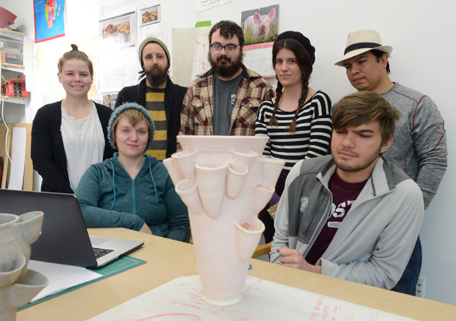
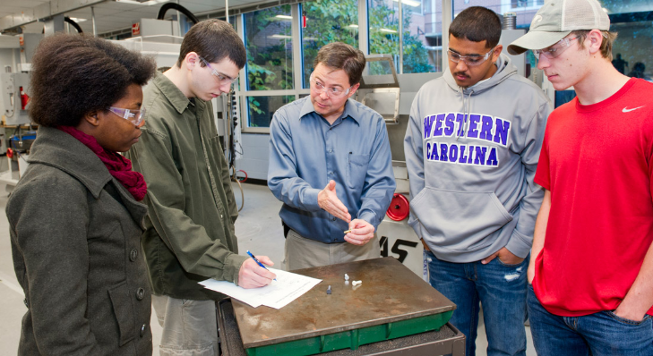
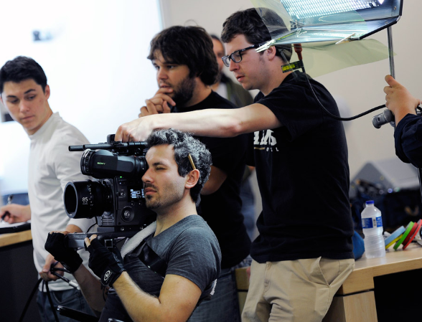
Create a comprehensive resume focused on the key skills and experiences for your field.
Make your resume stand out from the stack by targeting it to each position.
Notes:
Students should have a comprehensive resume with all their experiences included. If they are searching for a few different types of jobs/internships, they can create an overall resume for each type of opportunity. As they apply for positions, particularly ones of high interest, they should take the time to edit their document based on the position description. These edits are much less time intensive than creating the other versions of their resume but are critical to having their resume stand out to employers.

Slide 14
Mining a Job Description
The best way to have your resume stand out from the rest is to clearly demonstrate that you have the skills necessary for this position
Read job descriptions closely for key skills and experiences
If the job description is minimal, reasearch similar jobs with other organizations, on O*NET, or by networking with professionals to fill in gaps of what is most important in this position
Circle, highlight, or write down what stands out
This same process will help with writing cover letters and preparing for interviews

Slide 15
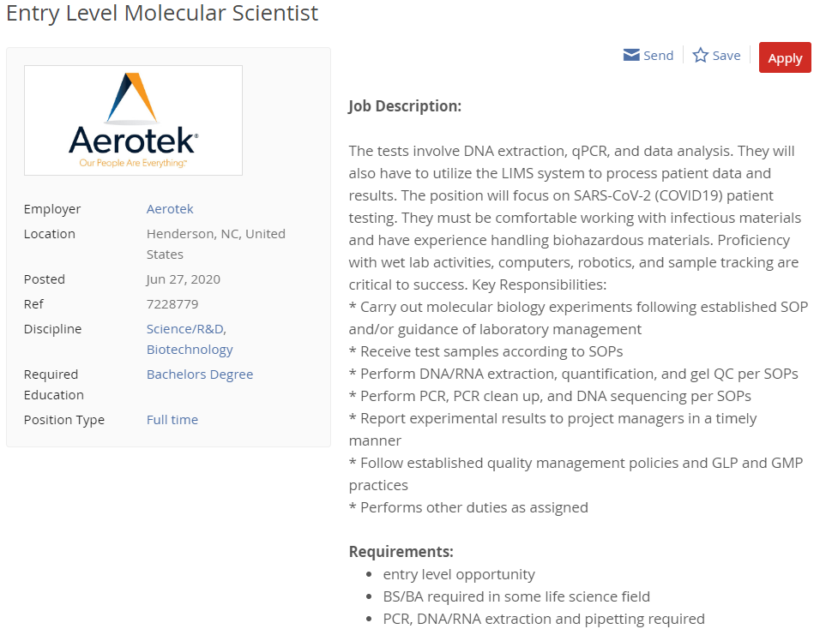
Entry Level Molecular Scientist
Notes:
*Please feel free to change these to jobs in your field
This is a good example of a dense job description with lots of specific skills that could be listed in a skills section as well as in relevant coursework or research providing context to where/how they used those skills.

Slide 16
Editorial Assistant
Notes:
*Please feel free to change these to jobs in your field
This example includes values-based language in the description (support, inspire, professional, dynamic) in addition to clear skills in the gig and requirements sections, as well as additional experiences in the bonus section. Students could also use the first two bullet points in the gig section (weekly upload and ongoing writing assignments) to note transferable skills of consistency and adaptability.

Slide 17
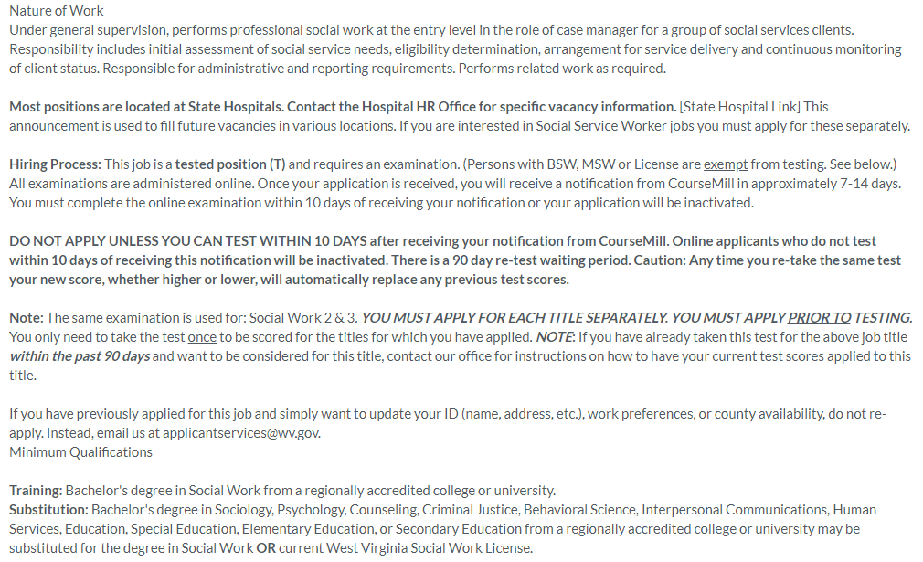
Social Worker 1
Notes:
*Please feel free to change these to jobs in your field
This is a good example of a very surface level job description. The opening paragraph outlines responsibilities and the training/substitution area focuses on degrees. Students would need to consider the field specific and transferable skills necessary to complete the responsibilities listed. For example, “arrangement for service delivery” could be showcased in leadership roles where they coordinated guest speakers or visits to organizations for shadowing, tours, or volunteering. Additionally, “continous monitoring of client status” requires time management, task tracking, and consistency. Students could show this through a variety of experiences. Finally, for this example, it would be helpful for students to research social worker as a job title on other sites (such as O*NET, other job boards, and professional associations) to get more potential details for this position.

Slide 18
Aligning Your Resume
Review the annotated job description and identify which skills and experiences you can showcase
Prioritize this information on your resume
Make sure your most relevant experiences are at the top of your document (remember the section heading options!)
Move the most relevant bullet points to the top of the list under each experience
Parallel their language where appropriate (be sure to add details to make it signature to you)
Look at what’s left on your resume and keep things that add breadth/depth and delete what feels like a distraction
Notes:
If your class is longer than 50 minutes, consider having students search online for a job description of interest to them, analyze it for key skills and qualifications, and then note which of those skills they have and where on their resume they would demonstrate that (relevant coursework, previous jobs, internships, extracurriculars, skills section). This is also included as an optional homework assignment.

Slide 19
Strong Bullet Points
Bullet points are the heart of the resume. They express the breadth and depth of your experiences.
Strong bullet points are concise yet detailed, and paint a clear picture of your experience.

Slide 20
Bullet Point Formula
(action verb) + (job responsibility) + (how/why/results)
Example 1: Made a documentary
Example 1A: Produced 7-minute documentary using the Canon c3000 camera and Adobe Premier Elements editing software (how)
Example 1B: Produced 7-minute documentary on the traditional crafts of Western North Carolina for exhibit at Mountain Heritage Center on preserving Appalachian craftsmanship (why)
Notes:
*Feel free to change for bullet points specific to your field
The length and amount of detail to add are dictated by the question “Can they do this job?” Students would use example 1A if they want to highlight the camera and software experience. 1B is great to show knowledge in a particular area. If the bullet isn’t highly relevant, then keep it short.

Slide 21
Bullet Point Formula
(action verb) + (job responsibility) + (how/why/results)
Example 2: Contacted alumni to solicit donations
Example 2A: Called alumni on provided contact list to fundraise for the annual campaign (how & why)
Example 2B: Raised a total of $14,500 for the institution by targeting solicitation to individual alumni interests, developing a strategy for use by peers (how & results)

Slide 22
Bullet Point Formula
(action verb) + (job responsibility) + (how/why/results)
Not creating documentaries or fundraising but those tasks were big pieces of the work you did? Highlight the relevant skills:
Collaborated with colleagues to create a 7-minute documentary highlighting the overarching goals and message of the exhibit
Strengthened institution’s relationship with alumni by fostering engaging conversations when calling for the annual campaign fundraising efforts
Notes:
Often the main focus of students jobs aren’t directly relevant to the position to which they are applying. If this is the case, focus on transferable skills. The first bullet focuses on collaboration while focusing on a shared goal. The second bullet focuses on relationship building and communication skills. The skills highlighted in these bullet points would connect to a broad range of employers.

Slide 23
Bullet Points: Adding Details
Use the 5 W’s
WHO Who did your job help? The organization? Clients? Customers?
WHAT What happened as a result of your position? How did the organization benefit because you were there? What positive feedback did you receive? If you did research, are you published? If you did a report, what was done with that information?
WHEN When did this happen? Daily, weekly, monthly? Talking about how often you did something is an easy way to show productivity in your job.
WHERE Where did your duties occur? Did you travel? Were you responsible for interacting with people outside of your organization?
WHY/HOW Why did you do this? How did your job duties help or add to the success of the organization or its ability to function?
Notes:
Sometimes students can struggle with expanding their bullet points. Using these questions can help them identify important skills, experiences, and quantifiable information.

Slide 24
Bullet Point Tips:
Diversify your action verbs to show a strong array of skills. You can look up lists online and find one in our Professional Handbook:
wcu.edu/WebFiles/Professional_Handbook_2018.pdf
Quantify wherever possible – numbers pack a punch by adding clarity and detail
Use a variety of lengths – keep some short and only use longer bullets for highly relevant tasks

Slide 25
Final Tips
Have a comprehensive resume, then tailor to each position
Objective statements are optional, but generally discouraged
Do not include “References Available Upon Request”
Edit, edit, edit
Get a second pair of eyes
Change to a pdf
Title appropriately: First Initial Last Name Resume
JAiken Resume

Slide 26
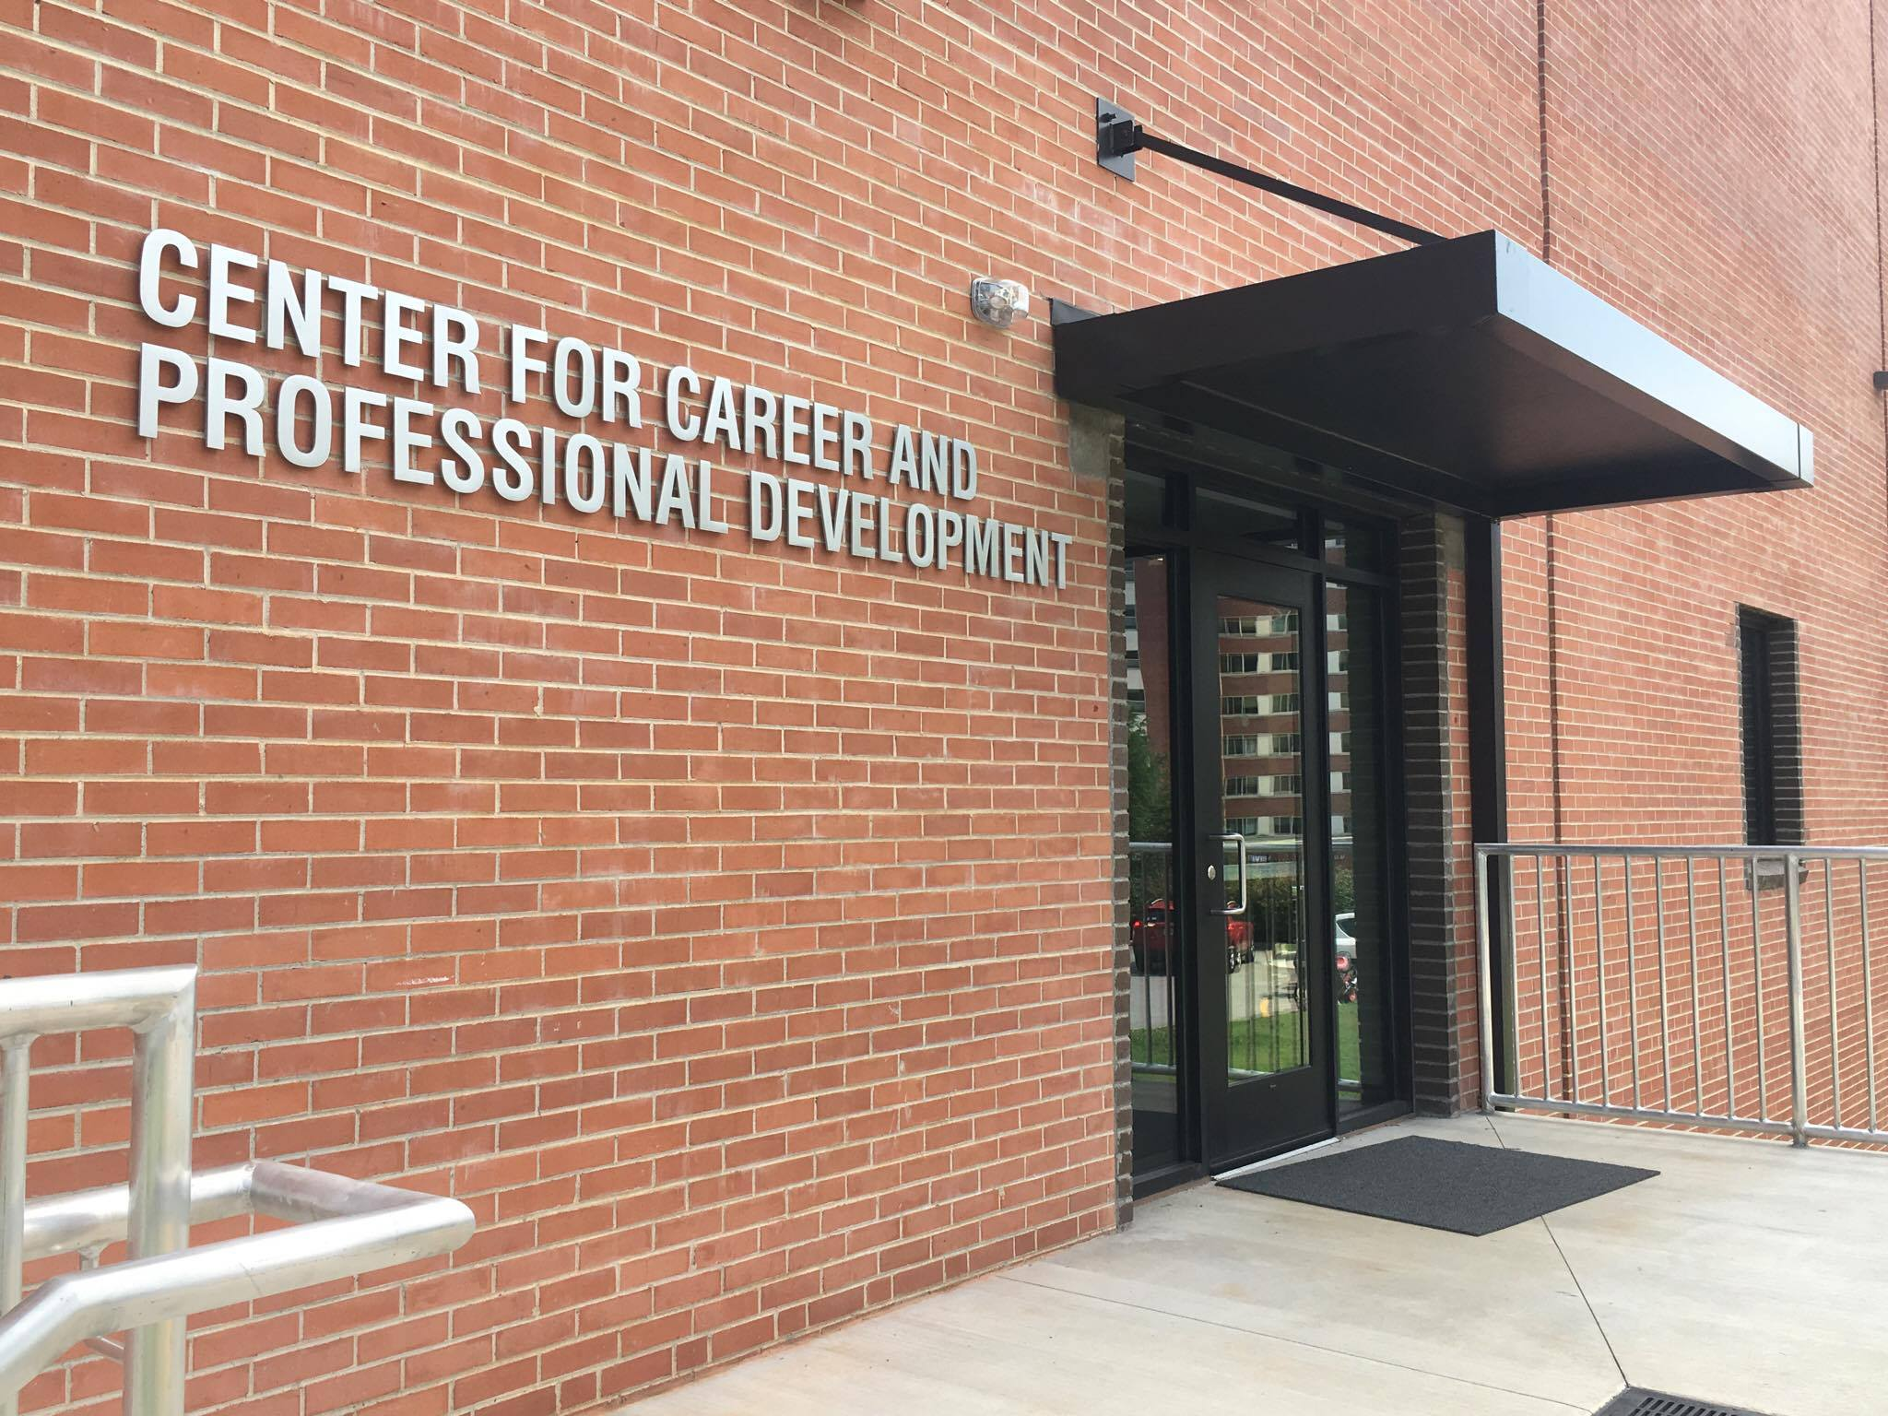
Work with the Center for Career and Professional Development:
Schedule an appointment with a counselor via myWCU > Advising/ Tutoring > Get Assistance.
Meet with a Peer Mentor for a drop-in review. Normally offered in our office, drop-ins are virtual via careerservices@wcu.edu for Fall 2020.
Notes:
Appointments are with our counselors and last around 30 minutes. These are great for in-depth discussions about resumes. We can help students with starting, updating, or targeting resumes. Peer Mentor drop-ins are 10-15 minute meetings for quicker reviews or to help students get started writing a resume.

Slide 27
Next Steps
Use this slide for any assignments or reminders for your class

Slide 28
Visit the Center for Career and Professional Development
careers.wcu.edu
careerservices@wcu.edu
828.227.7133
We can help with resumes, interviews, career fair prep, job searching, internships, selecting a major, and more!

