Slide 1
Career Exploration, Development & Planning

Slide 2
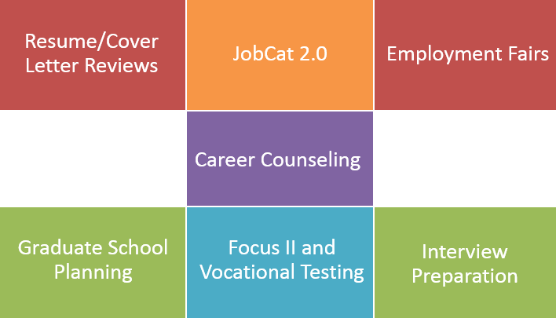
CCPD services
NOTE: These services are available to you as a student and as an alum of WCU!
Notes:
INSTRUCTOR NOTES: We offer appointments through Navigate (MyWCU → Advising/ Tutoring → Get Assistance → CCPD) as well as drop-in hours 2 to 4 p.m. Monday through Friday via Zoom (at least through Fall 2020) or 6 to 8 p.m. Tuesdays. The CCPD is located at the very back of Reid Gym; our entrance faces the metered lot. Students can GPS Lot #30 and it’ll take them right to us. A note about JobCat – that’s where they go to find student employment, as well as internships, part-time local work, and full-time opportunities. Our employment fairs also include our volunteer fair and graduate school fair – virtual only for Fall 2020

Slide 3
Overview
Career development (Planned Happenstance)
Career planning process
Ideas on what to do while you’re here
Assignment

Slide 4
Notes:
NOTES: Play from beginning to 5:13. Invite students to discuss their thoughts on this video (they can watch the full video later if they wish – it’s a great video!) do they feel confident they have one true calling or do they feel pressure to choose when they don’t necessarily have a clear vision? It’s important that you point out (as Emilie does later in the video) that if you don’t have one true calling – that’s OK. But if you DO have a clear vision for your career and life’s work, that’s great, too!

Slide 5
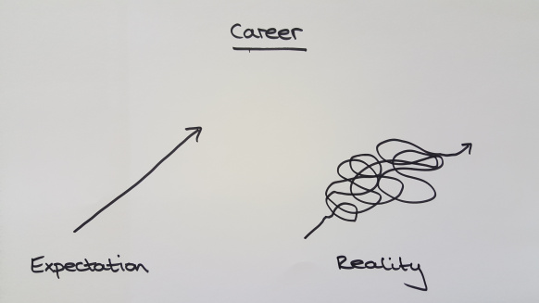
Notes:
INSTRUCTOR’S NOTES: Society puts pressure on us from a very early age to figure out what our career will be and to be in that career throughout our lives. In reality, though, for most people, our career interests change over time. This generation of students will have more than 40 years of career development before they’re able to retire (most likely); to think someone has to stay in that same career path for that long is not realistic. It’s also extremely important to point out that not all majors will equal linear career paths. Sometimes students major in something simply because they’re interested in the subject. The skill sets a particular major teaches and integrates can always be transferred to any number of career paths. NOTE: If you are someone who has changed careers over time, or has altered your career path over time, share your story with your students. Some questions you might use to share your story include: What was your major in your undergraduate experience? Did you change majors, and if so, how many times? If you changed majors, what were the majors you had declared? What brought you to make those decisions? What was your first job after your undergraduate experience, or did you go to graduate school right after your undergraduate experience? Did your graduate degree directly correspond with your undergraduate degree, and if so how? If not, how did you come to obtain a master’s or higher level degree in the field you chose? How many jobs/ careers have you held before now?

Slide 6
Planned Happenstance
1
Because things just happen – or do they?
Notes:
Introduce Planned Happenstance, which is a fundamental career development theory.

Slide 7
What is Planned Happenstance
It’s OK to not know
Planned Happenstance encourages a positive career exploratory viewpoint.
Planned and Unplanned events can shape our futures, including our career decisions
Notes:
INSTRUCTOR’S NOTES: It’s important for students to understand if they don’t have their life figured out by now – it’s really OK. Most people don’t. 75% of incoming first-year students will change their major at least once. If you changed your major in college, you might share your story about what you initially started with, what you changed it to, and why you made those decisions. ASK: Ask a student or two share planned or unplanned events they have seen in their lives so far and the results of these events; these planned or unplanned do not have to be tied to career, major, or college decisions. The idea is to brainstorm types of planned or unplanned events.

Slide 8
Objectives of Happenstance
Indecision is the new Decision
Indecision is desirable and sensible as it enables one to use unplanned events to make career decisions.
Indecision = open-mindedness
Change – it’s going to happen
Managing life transitions is essential to career management.
"An optimistic outlook can help turn serendipity into opportunity“
Flexibility is key
Not just “luck,” either
This is where the "planned" part comes into play: The more opportunities one takes, the more doors that are open to them.
Notes:
INSTRUCTOR’S NOTE: Unlike other career development theories where you take a test and it populates linear career choices, Planned Happenstance focuses on having an open mind throughout our lives. While it’s great that some students have a clear vision for what they want to do, we challenge our students in this way: How do you know that’s what you want to do until you’ve explored other options? We encourage students to keep an open mind when it comes to their career interests, at least at this stage of their college experience. Life is full of changes – some events are planned (like getting married for example, or starting a family) and some are unplanned and they just happen (hello, global pandemic! or a company downsizing, or winning the lottery) that might affect our careers over a lifetime. ASK: What are some other planned or unplanned events that might change a person’s career path? It’s imperative that we look at these planned/ unplanned events as opportunity rather than set backs, and to be as flexible as possible. But our career paths aren’t just luck either – one opportunity could lead to several different paths one might take. The more opportunities and activities we engage in, the more people we connect with and the more opportunities we might have later on. NOTE: You might share, if you haven’t already, the types of experiences you engaged in while in college that led to bigger and greater things. For example, an internship might have led to your first full-time job. A college job might have altered your career interests. Volunteer work may have allowed you to discover new passions, etc..

Slide 9
Traits of Happenstance
Curiosity
Exploring new learning opportunities and new ideas
Persistence
Exerting effort despite setbacks
Persevere through hard times
Flexibility
Adaptive to the unknown ; able to go with the flow and change courses when needed
Optimism
Viewing new opportunities as possible & obtainable
Setbacks = opportunity
Risk Taking
Taking action in the face of uncertainty
Healthy risk-taking can lead to new and greater paths, generate new ideas
Notes:
INSTRUCTOR’s NOTES: Instead of only focusing on career-related skills, Planned Happenstance says we should be developing these 5 traits throughout our lives. ASK: Ask a student to share one example for each trait, not related to careers or majors. ASK: Ask a student to share one example for each trait, not related to careers or majors. You might share how you see Planned Happenstance traits in yourself. How did planned or unplanned events shape your career and/or personal life? Were you optimistic during changes? Did you persist even through hard times? Or were you flexible and willing to change courses? What risks did you take to get to where you are today?

Slide 10
Small group discussion (5-7 minutes):
Get into groups of 2 or 3 and answer the following:
Reflect on an unplanned or planned experience (or a “lucky break”) that impacted your career/ education journey so far. Briefly describe the situation. (e.g.: why do you want to major in _____? What influenced you? Or how you came to enroll at WCU?)
Reflect on which of the 5 traits of Planned Happenstance (Curiosity, Perseverance, Optimism, Flexibility, Risk-Taking) were evident in your situation.
How did the planned/ unplanned experience shape your career interests?

Slide 11
Career Development Process
2
Notes:
NOTES: Transition from happenstance to career planning. Now that we know we need to be developing curiosity, flexibility, persistence, optimism and risk taking throughout our lives, we’re now going to be talking about the career development process.

Slide 12
Explore
Notes:
Although Planned Happenstance celebrates curiosity, flexibility, risk taking, etc. we do need to be taking the first steps in exploring and developing our career paths – or our first career path, as the case may be. Ask students ways they might explore their career interests. Start a discussion on types of ways they can explore careers before the next slide. (Try to plug DegreePlus as well so that students know that’s also an option – degreeplus.wcu.edu) NOTE: the career development process can often happen simultaneously. A first-year student could focus on exploring, or they could be developing and connecting at the same time that they’re exploring and reflecting. In general, though, we recommend first- and second-year students really devote the bulk of their time in figuring out who they are or want to be, their skill sets and interests, etc – so focusing on Exploring and Reflecting; third- and fourth-year students usually focus more on developing and connecting.

Slide 13
Explore
Volunteering/ student employment
Job shadowing
Taking a variety of classes
Vault*
YouTube (search: A Day in the Life of ______)
LinkedIn – informational interviews
Focus 2 assessments/ Visit a career counselor
DegreePlus
Notes:
Ask students for examples of things they have done so far to explore their career interests. Invite them to share how their example(s) have altered or strengthened their initial career interests.

Slide 14
Reflect
Notes:
Same as previous – ask students how they might go about reflecting on the things they’ve explored?

Slide 15
Reflect
Journaling/ blogging
Assignments
Talking with a friend or family member
Reflecting with a faculty member/ career counselor/ advisor/ other students in program
Notes:
Same as previous

Slide 16
Develop
Notes:
Same as previous

Slide 17
Develop
Internships
On-campus employment
In-class assignments
Community engagement/ Service learning/ volunteering
DegreePlus
Notes:
Same as previous

Slide 18
Connect
Notes:
Same as previous.

Slide 19
Connect
Professors
On-/ off-campus supervisors
Family members
Friends
Classmates
Alumni via LinkedIn
Employers at career fairs
Specialized job boards (apply between 4 and 6 months before graduation)
Notes:
Same as previous.

Slide 20
Explore
Volunteering/ student employment
Job shadowing
Taking a variety of classes
Vault*
YouTube (search: A Day in the Life of __)
LinkedIn – informational interviews
Focus 2 assessments
DegreePlus
Join club/s organizations
Reflect
Journaling/ blogging
Assignments
Talking with a friend or family member
Reflecting with a faculty member/ career counselor/ advisor/ other students in program
Develop
Internships
On-campus employment
In-class assignments
Community engagement/ Service learning
DegreePlus
Connect
Professors
On-/ off-campus supervisors
Family members
Friends
Classmates
Alumni via LinkedIn
Employers at career fairs
Specialized job boards (apply between 4 and 6 months before graduation)
And more! This is not an exhaustive list!
20
Notes:
NOTES: Lead a discussion on how being engaged in all these activities ties back into happenstance; creating more opportunities to spark interests, grow skills, etc.
OPTIONAL: Have students start filling out a professional development plan. Students should choose a few activities they want to achieve or do each year they are here at WCU. It’s better if students do this with a career counselor, but if you wanted them to do this on their own as a brainstorming activity before visiting a career counselor, that’s an option as well.

Slide 21
Assignment Instructions
3
Notes:
NOTES: Remind students that what they should be doing now is exploring their interests, skills, values, etc (first pie slice in the career development cycle). Introduce the FOUCS 2 assignment as a way for them to begin doing that by completing FOCUS 2 assessments and meeting with a career counselor to go over those results.

Slide 22
Assignment:
Step 1: Create an account on Focus 2 (Access code: Catamount (with a capital C)) and complete the Work Interest, Personality, Skills, and Values assessments. This should take about 15 to 20 minutes to do.
Step 2: Review your results. Read through what it says about you and any suggested careers it generates. Think about why you might be getting some of your results (NOTE: If you don’t see your intended career path listed, don’t worry; This is just a list to get your started – it won’t list every single career available)
Notes:
INSTRUCTOR’S NOTES: If you decide to have your students complete a different assignment, please change these instructions to reflect. See the Career Exploration Lesson Plan for other ideas

Slide 23
Assignment:
Step 3: Identify at least 2 career options Focus 2 is suggesting for you and the corresponding majors it lists. Read about those career options in Focus 2 (you can also search online, or search on onetonline.org or Vault through careers.wcu.edu)
Step 4: Do a bit of research on the possible majors (or your declared major) on WCU’s website and complete the Career and Major Exploration worksheet. Pay close attention to the 8-semester plan, or any required or elective courses you’ll be taking.

Slide 24
Assignment:
Step 5: Write a 2 – 3 page reflection on what you’ve learned through Focus 2, the careers you selected, and the majors you could declare. To help you with your reflection, choose at least 4 questions on the next slide to answer

Slide 25
Reflection Questions
What aspects of the Focus 2 assessment pieces surprised you?
Do you think the assessments accurately reflect who you feel you are? What areas of the assessments did you disagree with? Agree with?
What career paths did you further explore? What did you like or not like about the descriptions of the careers?
What majors might correspond with some of the career paths you selected? What did you discover through your research of that major and any required or elective courses you would take in that major?
What transferable skill sets will you need to have in order to be successful in the careers you selected? (e.g. communication skills, time management, customer service, etc). Through what activities on or off campus can engage in to start developing those skills? (for example, holding a position within a student club, organization or Greek life could help you develop leadership and communication skills)
Are there certain areas of employment you’re now considering as a result of having taken the assessments?
In thinking about our class discussion on career planning (Exploring, Reflecting, Developing, and Connecting) and the importance of engaging in a variety of activities, what are some actions you can do today/ near future that will help you with your career plan?
What questions do you have about narrowing career options?
What questions do you have in general with regards to thinking about your future career?

