Slide 1
State Employees Credit Union Project

Slide 2
Team Introduction
•CWV Construction
•Aaron Welch Scheduler/Project Manager
•Joe Coker Chief Estimator/ Superintendent
•Austin Vanhoy: Assistant Project Manager/ Project Engineer

Slide 3
Contract and
Bid Information.
•Completion Date: Three Hundred (300) calendar days
•Bid Type: Lump sum, Pre-qualified General Construction bidders
•Bid Time and Date: 3:00 PM on Friday, May 7th, 2021
•Bid Location: SECU’s Administrative Office, 1000 Wade Avenue, Raleigh, NC
•Bid Opening: Bids will be opened and read in the presence of those submitting a bid
•Bid Security: 5% bid bond
•Performance and Payment Bond required for 100% of contract amount
•Payment Applications submitted on the 15th each month

Slide 4
Owners
And
Partners
•Owner: State Employees’ Credit Union
•Owner’s Geotechnical Testing Service: GeoTechnical, Inc
•Owner’s Geotechnical Testing Service: WPC
•Lead Design Professional: William L O’Brain Jr
•Architect, Interior Designer, Landscape Architect, Mechanical and Electrical Engineer: O’Brien/Atkins Associates, PA
•Structural Engineer: GKC Associates, PA
•Civil Engineer: McKIM & CREED

Slide 5
Project Information:
•Location: The State Employees’ Credit Union is being constructed on a site at the corner of Providence Road Office Corner of Providence Road Allison Woods Drive Charlotte, North Carolina
•The SECU is a single-story credit union office with a building area of 7,768 Square Feet plus the canopies of 2,031 Square Feet covering a four-lane drive-up area and front entry
•Bella Rea Road is also included in the project, Bella Rea Road will be completed within the first 120 days of the project

Slide 6
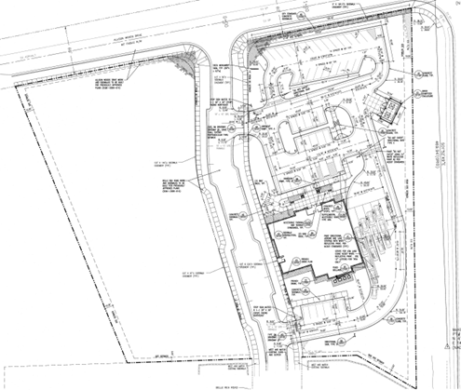
Site Layout Plan

Slide 7
Roadway Improvement
Plan.
Phase 1 begins with the actual demolition of some existing pavement.
Along with old curb and gutter removal to prep for road improvements.

Slide 8
Road Improvement
Completion.
New Asphalt Installed
New Curb and Gutter Installation.

Slide 9
Bella Rea Road:
Roadway Improvements
411’ of New Roadway
Curb and Gutter Installation on both sides.
Corresponding Sidewalks for Pedestrian travel
Roadway Complete and ready for travelers after 40 days.

Slide 10
Front & Rear Elevation View

Slide 11
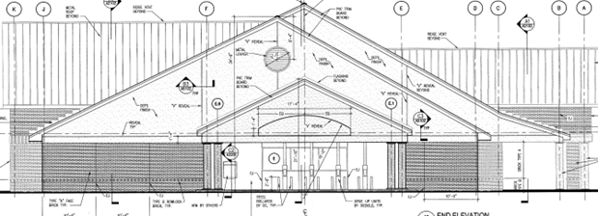
Left & Right Elevation View

Slide 12
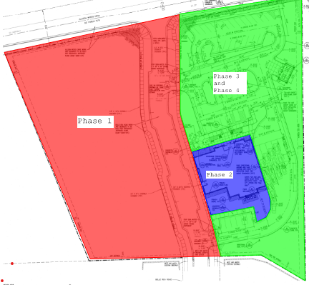
Site Work Phasing Plan
Phase 1: All work pertained to Belle Area Road which does include curb and gutter installation, sidewalk installation, and Asphalt installation. Sediment Basin Installation will take place in Phase 1 as well.
Phase 2: Will pertain site work that includes rough grading and column and spread footing excavation.
Phase 3: Site work will include rough grading of the parking lot areas along with gravel install to eliminate mess on the jobsite and layout.
Phase 4: Once the building is near completion we will go back out and finish installation of sidewalk, curb and gutter, asphalt installation, along with the dumpster enclosure.

Slide 13
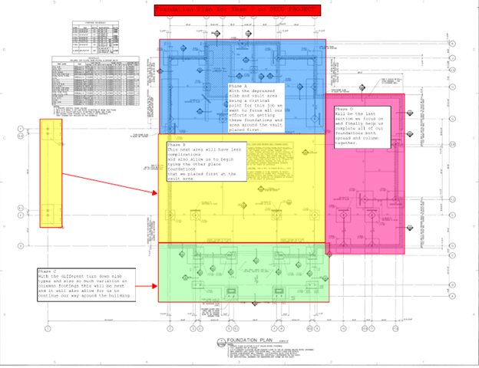
Column & Spread Footings
Phase A: Focuses strictly around the vault area getting these column footing and spread footing in the ground will allow us to begin steel erection done around the vault area
Phase B: This area is a wider area with less complications that we will begin placing after completion of Phase A.
Phase C: The far East side of the building will allow us to completely close out the building except for our entrance way.
Phase D: Will be the last placement and is relatively small both in column or continuous footings.
Pump truck will be onsite for both Column and Continuous footing placements.

Slide 14
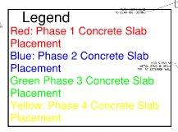
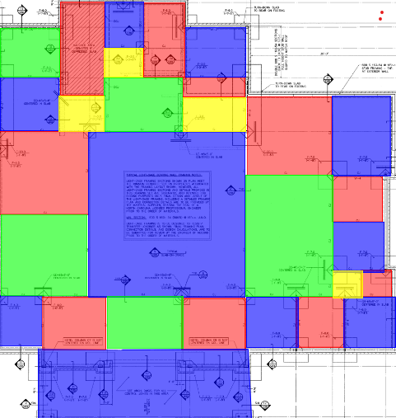
Slab Plan
Broken down into 4 Phases for Construction Joint Installation.
100 CY of concrete for the entire slab.
7850 SF WWF to be installed
7850 SF Vapor Barrier to be installed
872 SY of crushed stone
825 SFCA of Formwork.

Slide 15
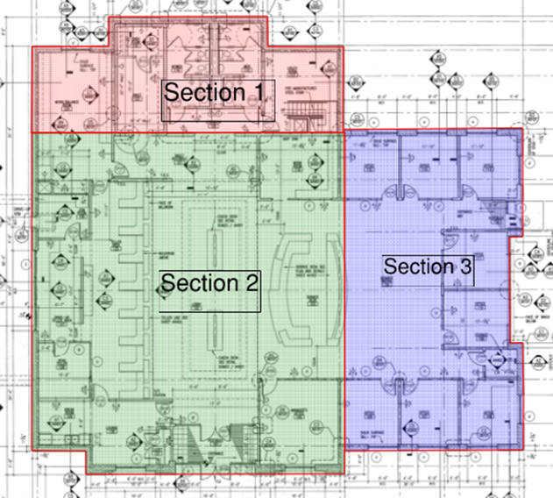
Exterior Framing Plan
Phase 1 was chosen so the vault area could be prepped due the vault having to be placed before when can go up with the structure. 108 LF is placed in this section
Phase 2 will follow allowing the masonry crews to begin prep for the brick veneer. 138 LF is placed in this section.
Phase 3 will round out the exterior framing and the masonry crew will follow when they finish with phase 2. 120 LF is placed in this section.

Slide 16
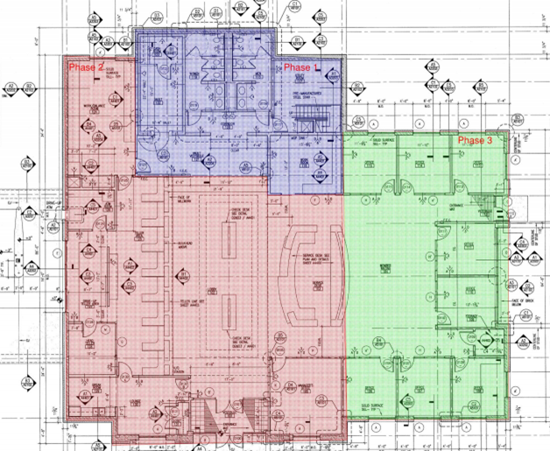
Interior Framing Plan
Phase 1 We will start with the interior framing/walls in the cash and vault rooms. The reason we are starting in these rooms is because the precast concrete bank vault walls will need to be in place so the roof trusses can be set and the building enclosed
We will then began framing the bathrooms and working to the right to the utility until phase 1 is completed
Phase 2 will began with the work/balance room and will work down and to the right until we reach the service desk and Managers Office.
Phase 3 will finish up the rest of the interior walls starting in Office 115 working to the right to finish offices 115-113. Once the 3 offices have been completed, we will start in the member waiting area and work down and to the right until we reach office 108 which will complete

Slide 17
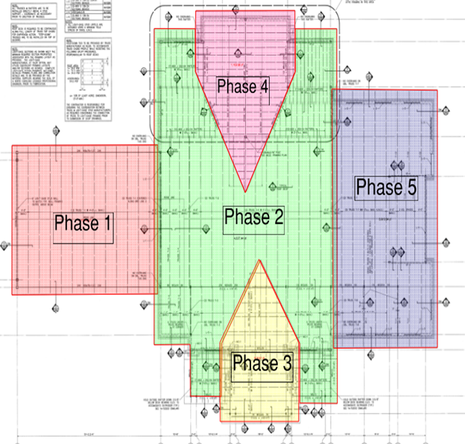
Roof Framing Plan
Phase 1 is the drive through area and is offset form most of the building leading it to be set first.
Phase 2, the main section of the roof will be set to allow the over framing for phases 3 & 4 to begin.
Phase 3 will begin after the beams in phase 4 are set.
The beams for phase 4 for will be set prior to the trusses in phase 3 so that both dormir roofs will be developing simultaneously.
Phase 5 trusses will be set following phase 3.
Important to note that phase 4 area uses rafters instead of trusses.
The trusses and rafters should take 14 days to complete.

Slide 18
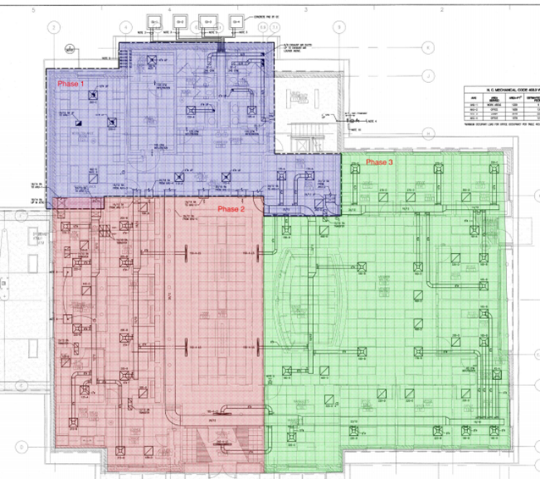
Mechanical HVAC Plan
Phase 1 will start in the Cash and Vault rooms because this is one of the most important task to complete
The plan is to work to the right until reaching the utility room then will will move down into the corridor until completion of phase 1
Phase 2 will start in the ATM room and move down to the Breck and Lounge rooms. Once thats complete we will began working to the right into the lobby and entrance of SECU until completion of phase 2
Phase 3 will start in Office 115 moving to offices 144 & 113. After completion of the 3 offices the plan is to start in the service desk area and work down to Manager's office
Once these tasks are completed we will work to the right until all necessary HVAC work is completed in Phase 3

Slide 19
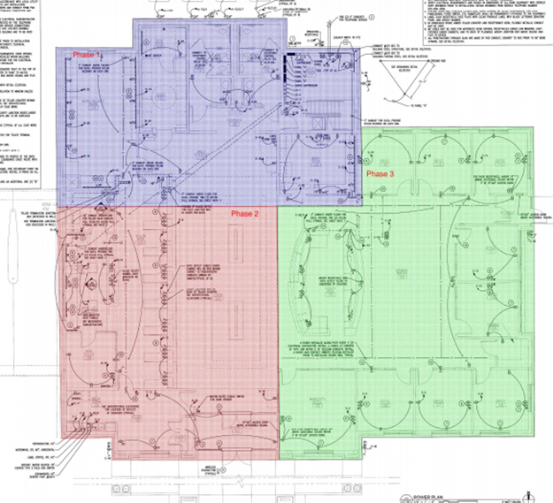
Electrical Plan
Phase 1 will start right after the mechanical/HVAC is completed in the Cash Room and Vault. We will began in the Vault room because it one of the most important tasks to complete
Phase 2 we will start in the ATM Room and flow to the break room and lounge.
Once all electrical is installed from the ATM room to the Lounge area we began working to the right until we get into phase 3
Phase 3 will start in office 115 and flow right until the office 114 & 113 are completed
Then we will work our way down throughout the rest of the building until the electrical is complete

Slide 20
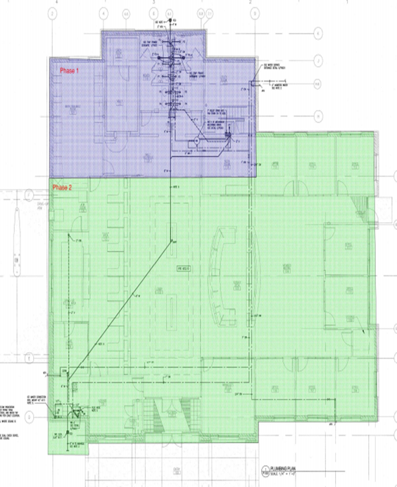
Plumbing Plan
Phase 1 will began in the Womens & Mens bathroom
After completion of this area we will move into the corridor to finish out plumbing in phase 1
Phase 2 will began in in the lobby and will move down to the break room and lounge area
After completion of this area we will continue installing what's left of phase 2 until all necessary plumbing is complete throughout the building

Slide 21
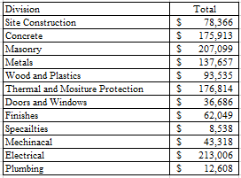
Cost Estimate - Division
Cost Broken Down By Division
Masonry and Electric are our most expensive divisions for this project.
The electrical price is high due to the security systems and wiring for the computer systems.
Masonry is high due to the large volume of brick required.

Slide 22
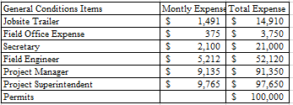
Cost Estimate- Job Overhead
For this project, there is not much overhead required when compared to a larger commercial project.

Slide 23
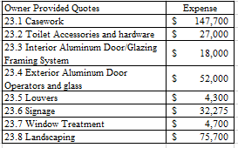
Cost Estimate- Owner Quotes
These expenses are owner provided and located in Division 00 of the contract.

Slide 24
Cost Estimate- Cost Breakdown
The cost breakdown for this job shows that material is the most expensive component to this job.
Caused by the jump in prices during the pandemic

Slide 25
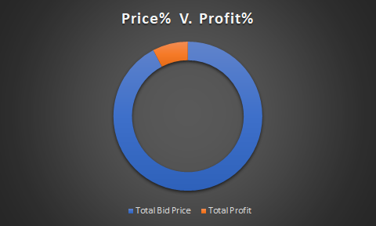
Cost Estimate
Total Price
Total Bid Price - $2,700,000
Profit Expected - $225,000

Slide 27
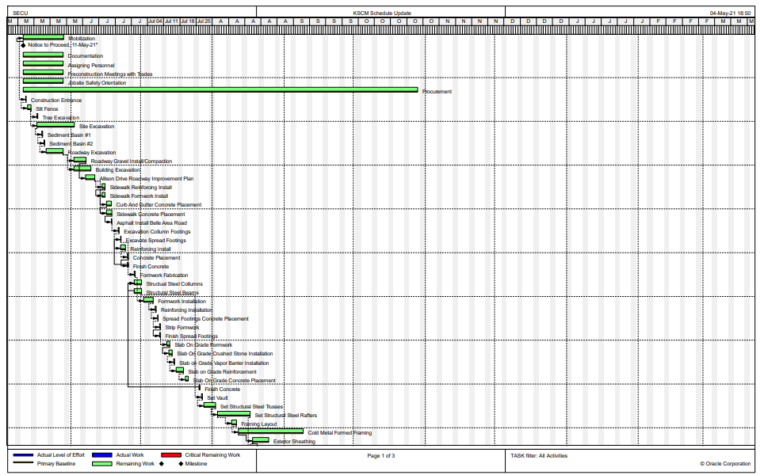
Project Schedule

Slide 28
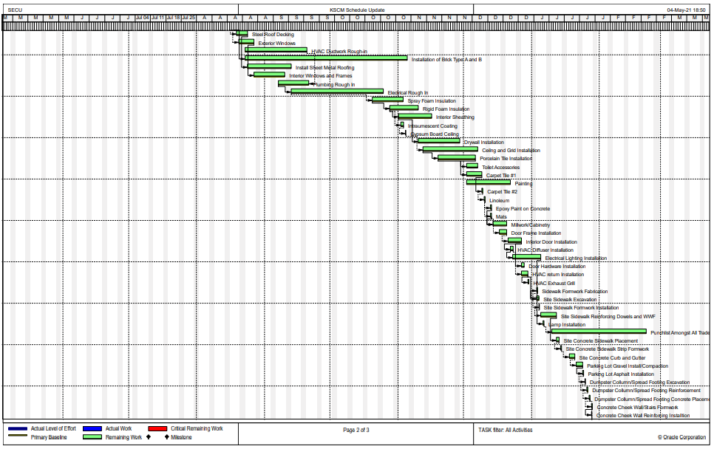
Project Schedule

Slide 29
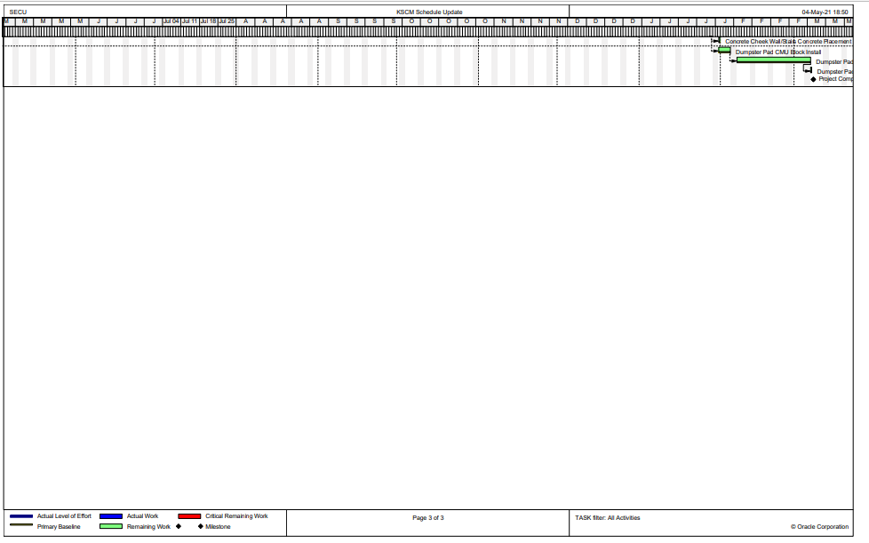
Project Schedule

Slide 30
SECU Project Schedule Critical Path
Belle Area Roadway.
Column and Spread Footings.
Steel Columns and Beams.
Precast Vault.
Masonry Work.
Electrical Rough in.
Dumpster Enclosure.
Dumpster Concrete Pad.

Slide 35
Conclusion
Bid Price for this project is $2,700,000 with an expected profit of $225,000.
We expect the project to take 10 months
As a team we believe the company should bid this project because it may open doors to build more SECU locations in the future.
To improve the project we recommend sawing constructing joints in the slab rather than having keyways in the slab. This will cut down up to 4 days on the slab pour

