Slide 1
State Employee's Credit Union
Project Bid by ACDC

Slide 2
Team and Responsibilities
Amber Garcia – Project Manager
Daniela Morales – Scheduler
Cody Lovelace – Estimator

Slide 3
Project Information
Key Points
State Employee Credit Union Information
Visual Components
Contractual Constraints

Slide 4
Project Information
ACDC's Project Team
Contractor: ACDC
Client: State Employee Credit Union
Design Team: O'Brien/Atkins Associates, P.A.
Structural Engineer: GKC Associates
Civil Engineer: McKim & Creed Engineers
Notes:
https://www.hmgeneralcontractors.com/blog/houston-design-construction-team

Slide 5
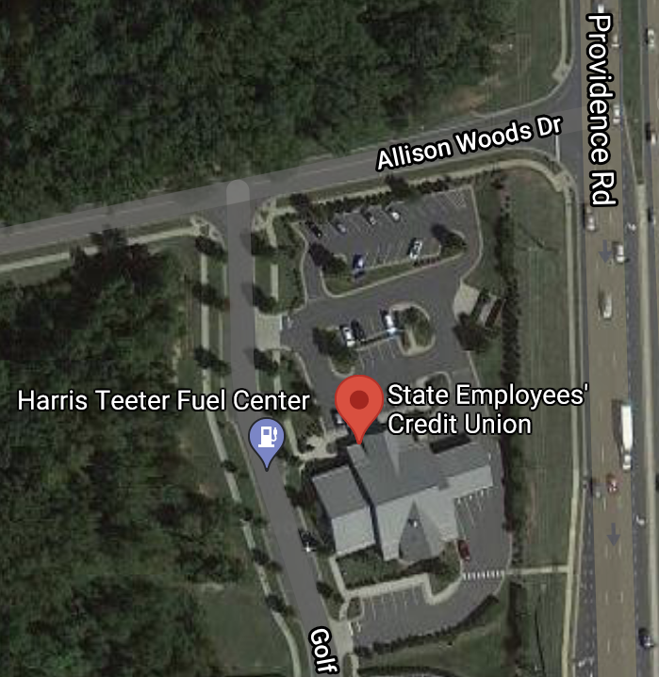
Project Information
Location
Providence Road Office
Corner of Providence Road and Allison Woods Drive
Charlotte, North Carolina

Slide 6
Brief Overview of Site Plan
New Belle Rea Road Addition
Erosion Controls
EROSION
CONTROL
EROSION
CONTROL

Slide 7
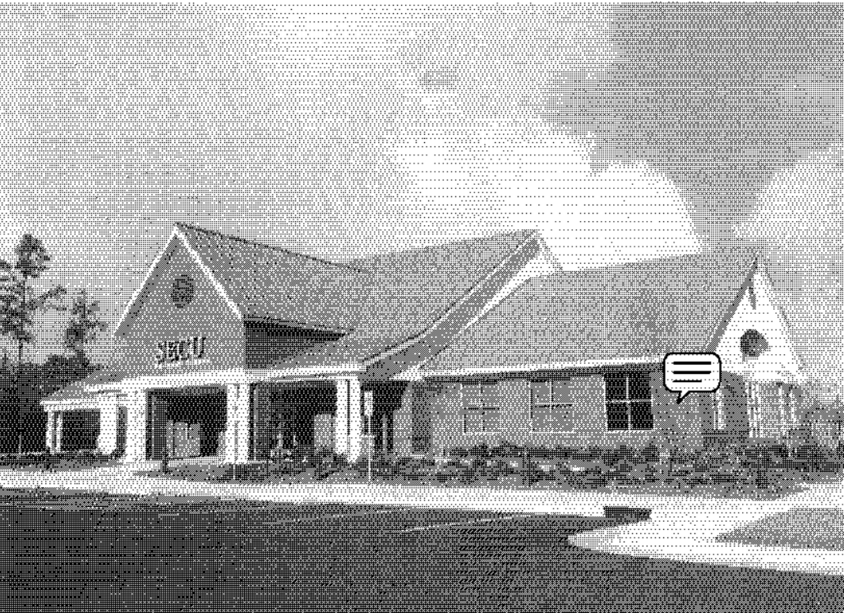
Scope of Work

Slide 8
Scope of Work
SECU Information
10,504 Sq. Ft.
Single-Story
Drive-Thru Access
Parking lot
Project Description
State Employee Credit Union is a new commercial construction building which will offer financial services and job opportunities for its hometown. Project will begin January 3rd and be completed November 20th.
Primary Materials
Cast-in-Place Concrete​
Light Guage Steel Framing​
Type A & Type B Brick​
Pre-manufactured Trusses​

Slide 9
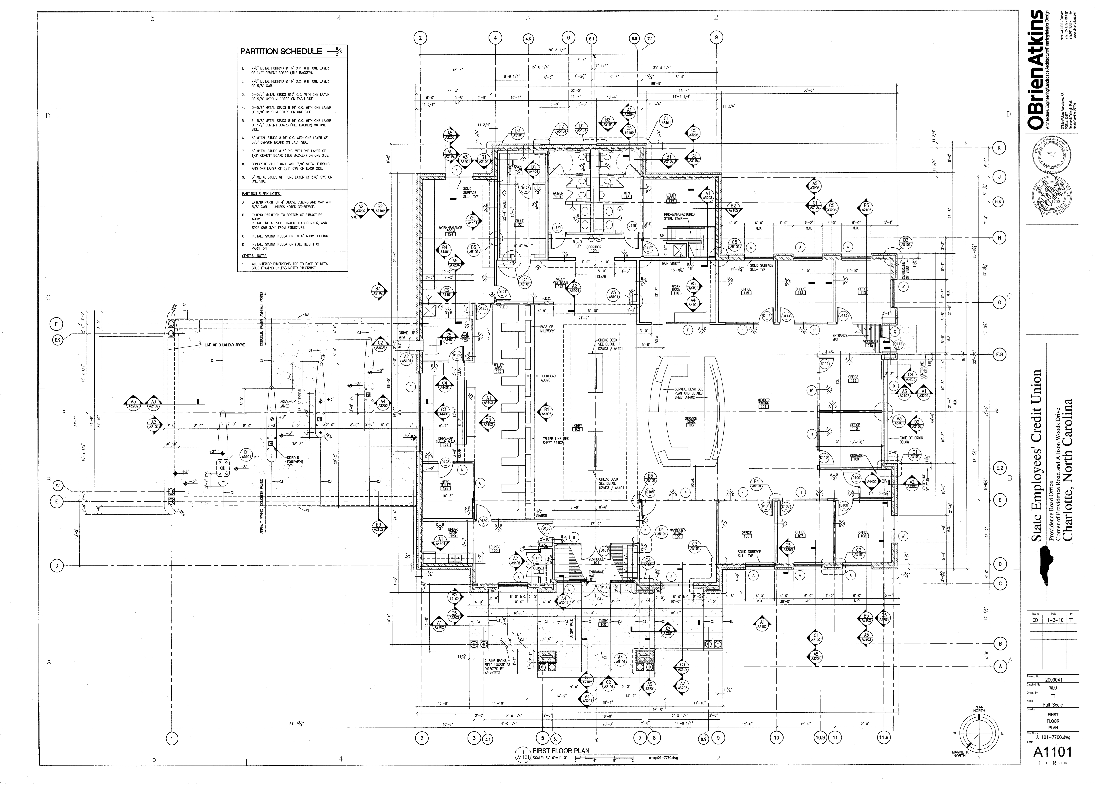
First Floor Plan

Slide 10
Elevations

Slide 11
Goals
To successfully build SECU Project on budget, on time, and efficiently
Scope of Work
Project Deadlines
Belle Rea Rode is to be constructed withing the first 120 consecutive days
Contract & Contractual Constraints
Progress payments shall be submitted once a month for payments to be made on the 15th of each month for work completed
Belle Rea Road Addition – 120 Days
Project Completion – 300 Days

Slide 12
Means and Methods

Slide 13
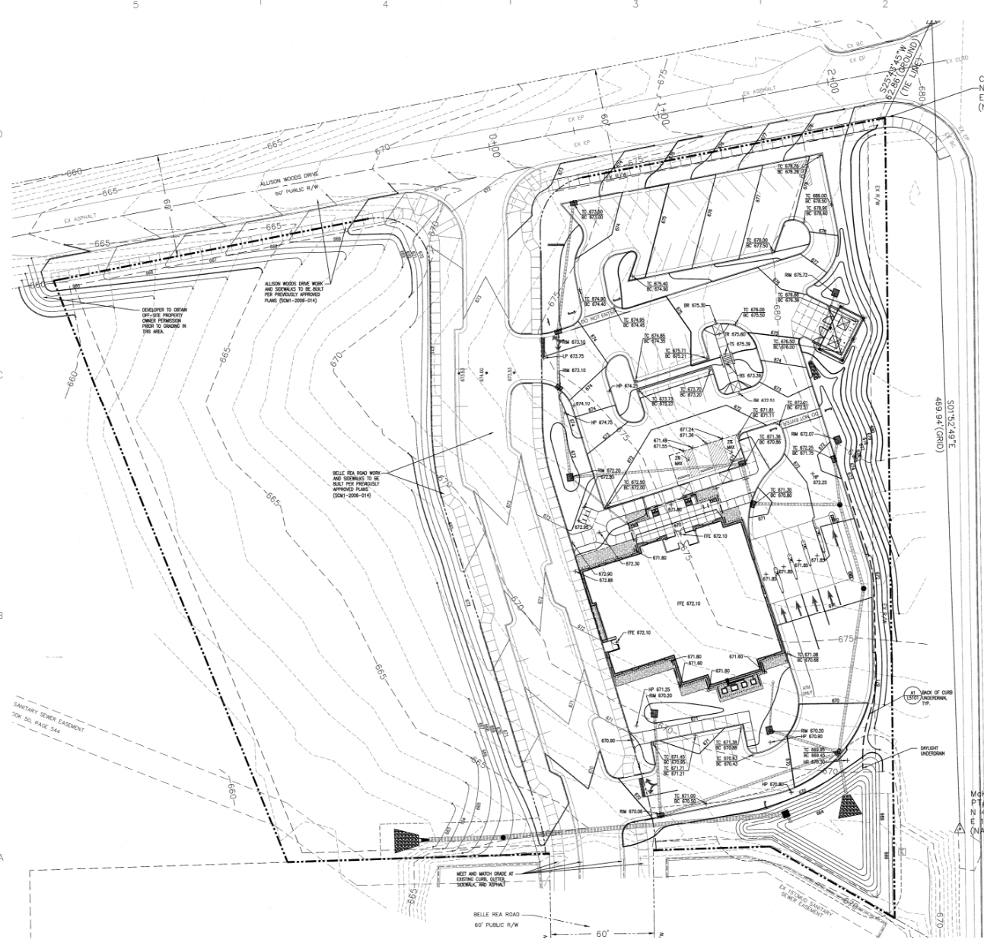
Site Layout
GATE 1
LAYDOWN
TRAILER
PARKING LOT
ENTRANCE
CRANE
Key:
Dumpster
Port-a-Johns
Flow of Traffic
Fence
MATERIAL
LAYDOWN
GATE 2
Notes:
LEGEND LEFT

Slide 14
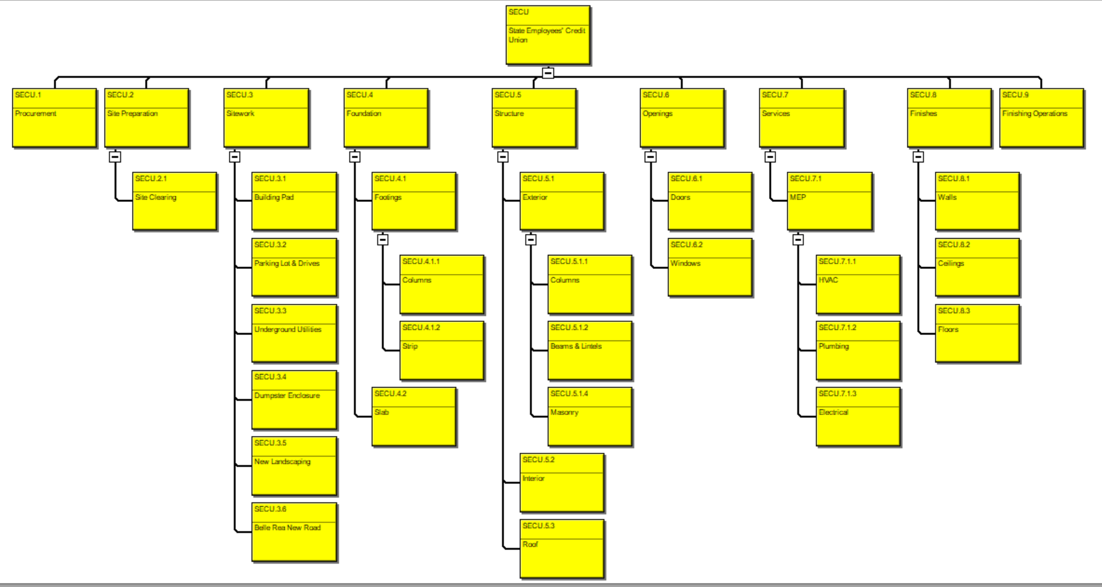
WBS

Slide 15
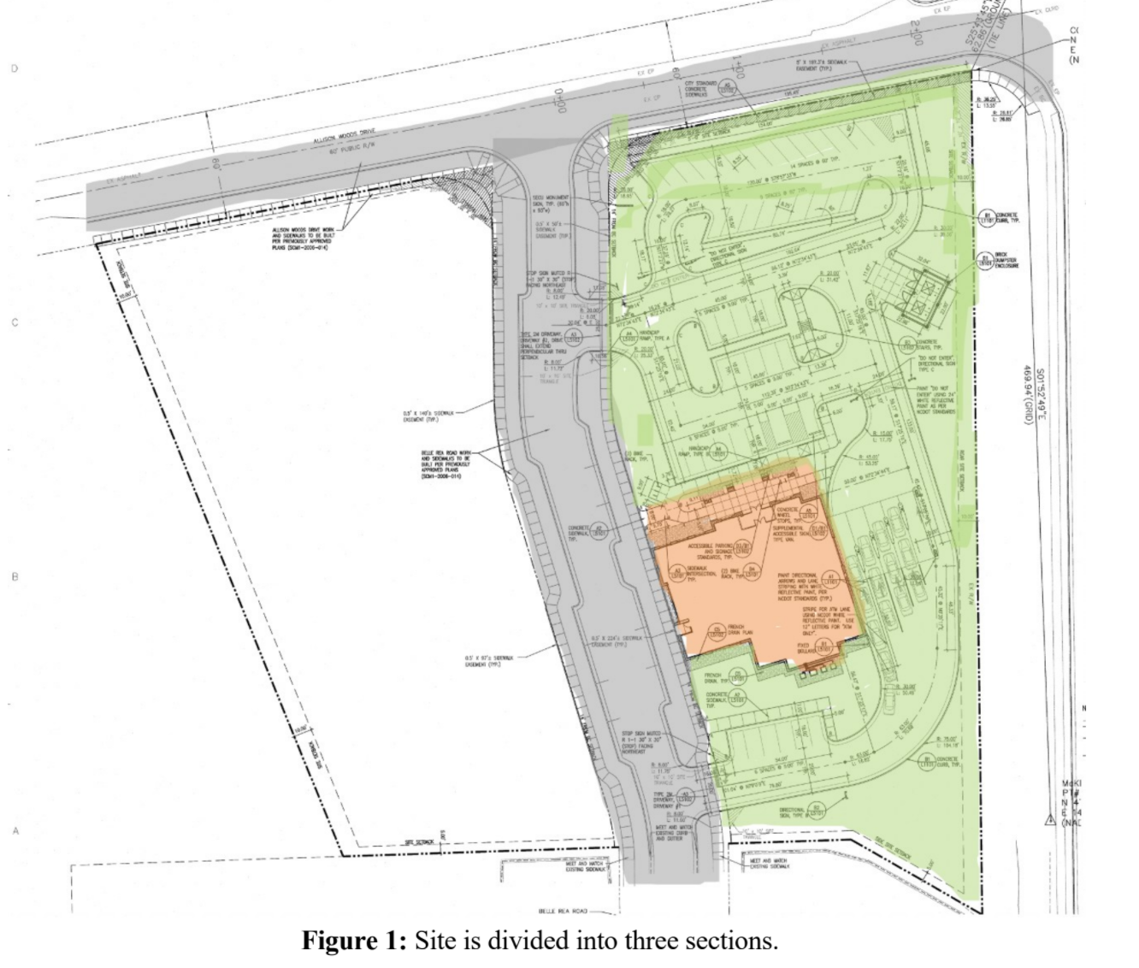
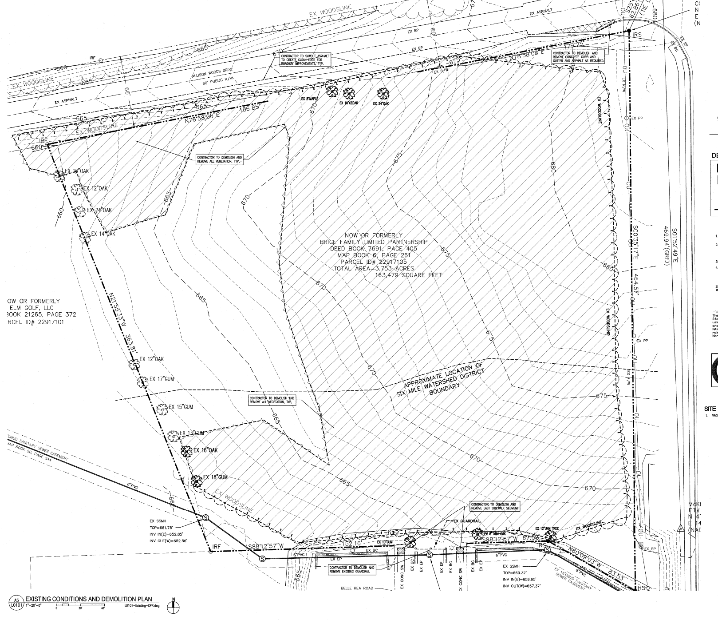
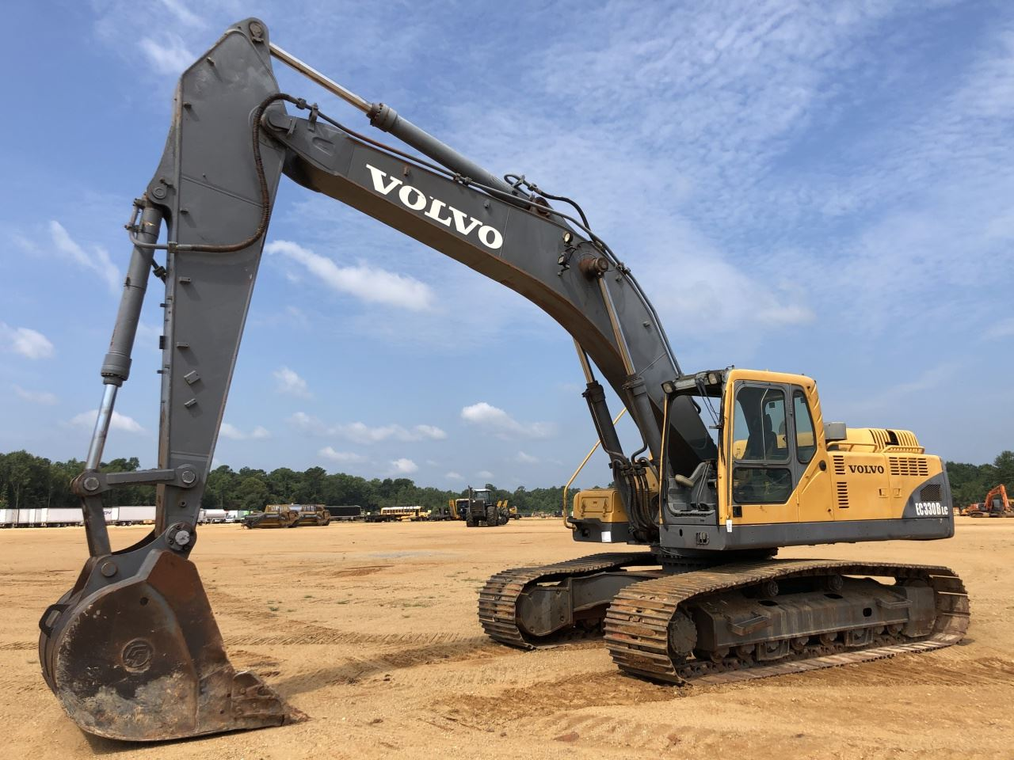
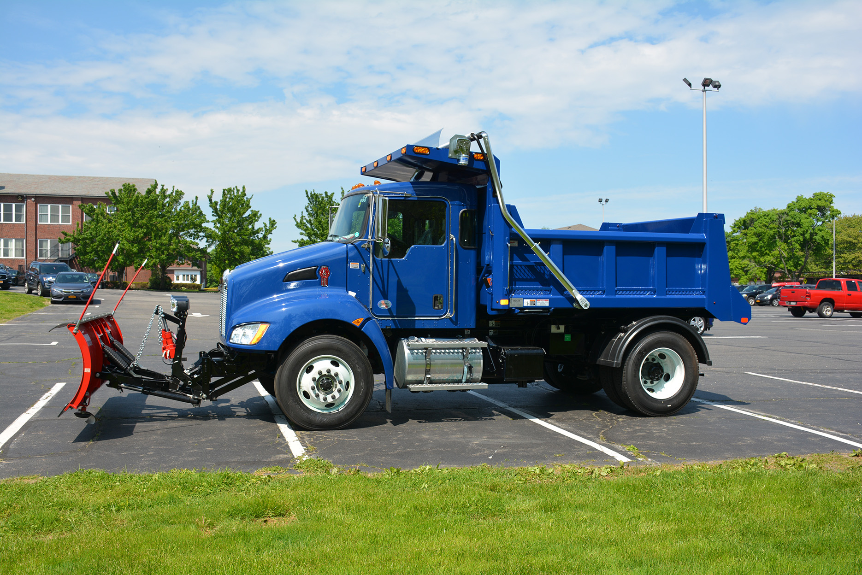
SECU 2. Site Preparation & 3. Sitework
Volvo EC330BLC 1.5 Cy Bucket Excavator
Rough Grading of Site
Prepare Building Pad
Belle Rea Road
Dejana Titan 8cy Dump Truck
Site Clearing
Notes:
Site Clearing
Rough Grading of Site
Belle Rea Road

Slide 16
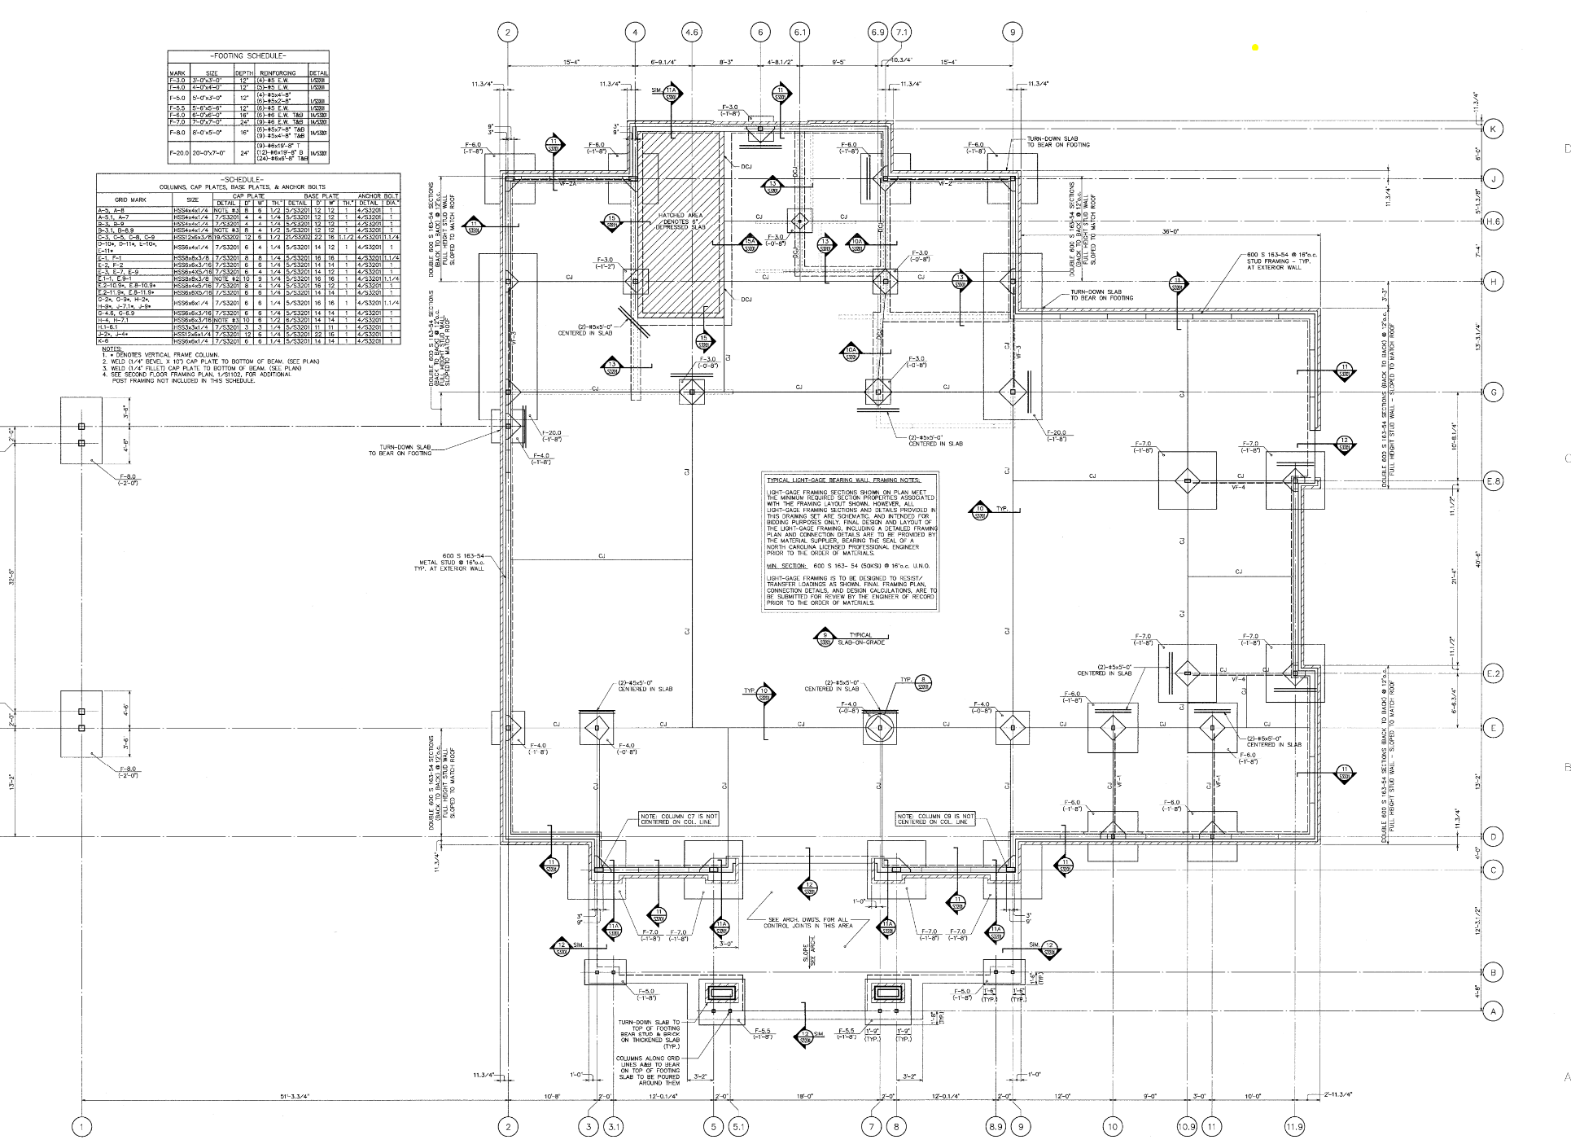
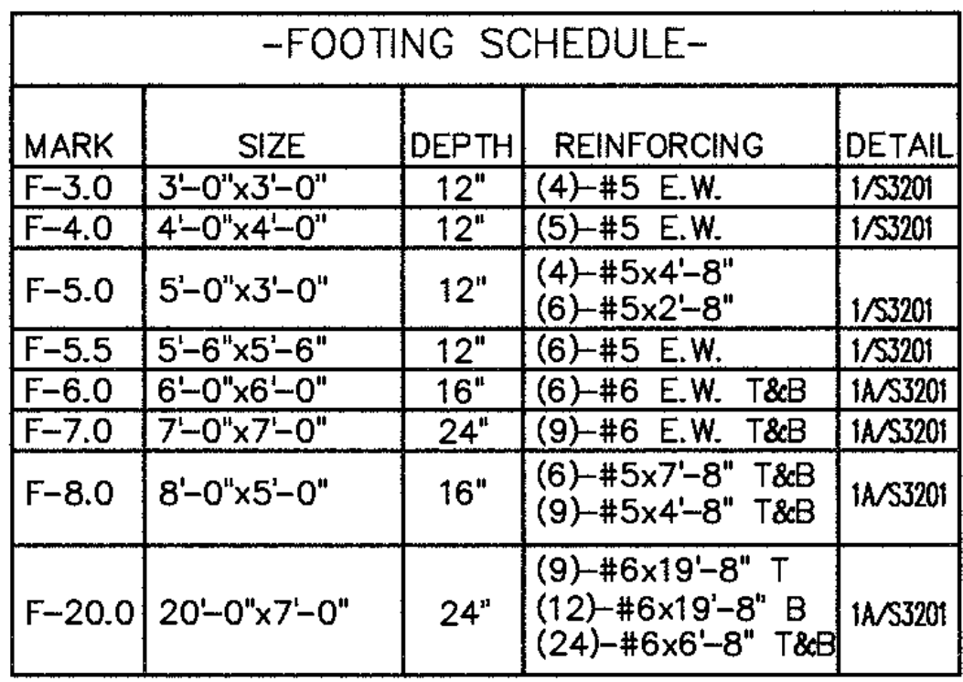
SECU 4. Foundation
N
W

Slide 17
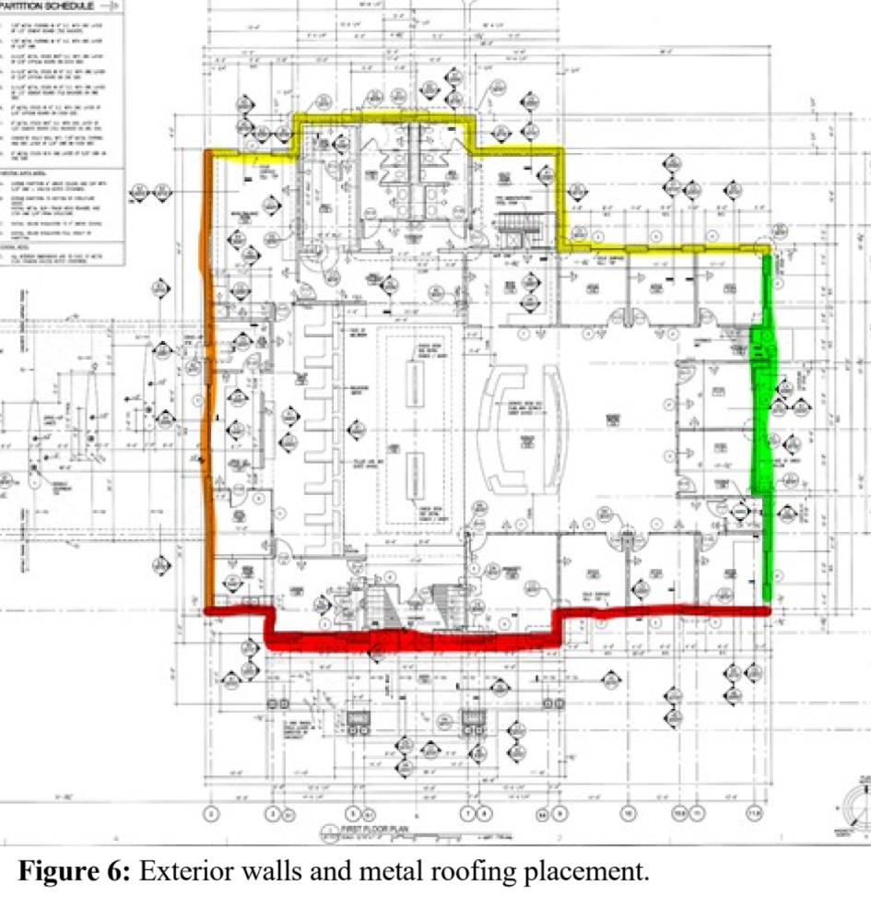
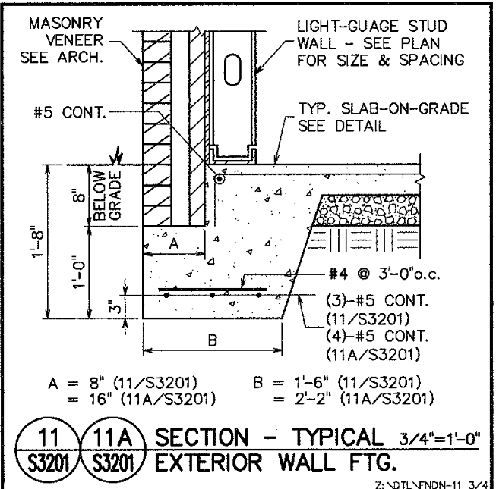
SECU 4. Foundation
N
W

Slide 18
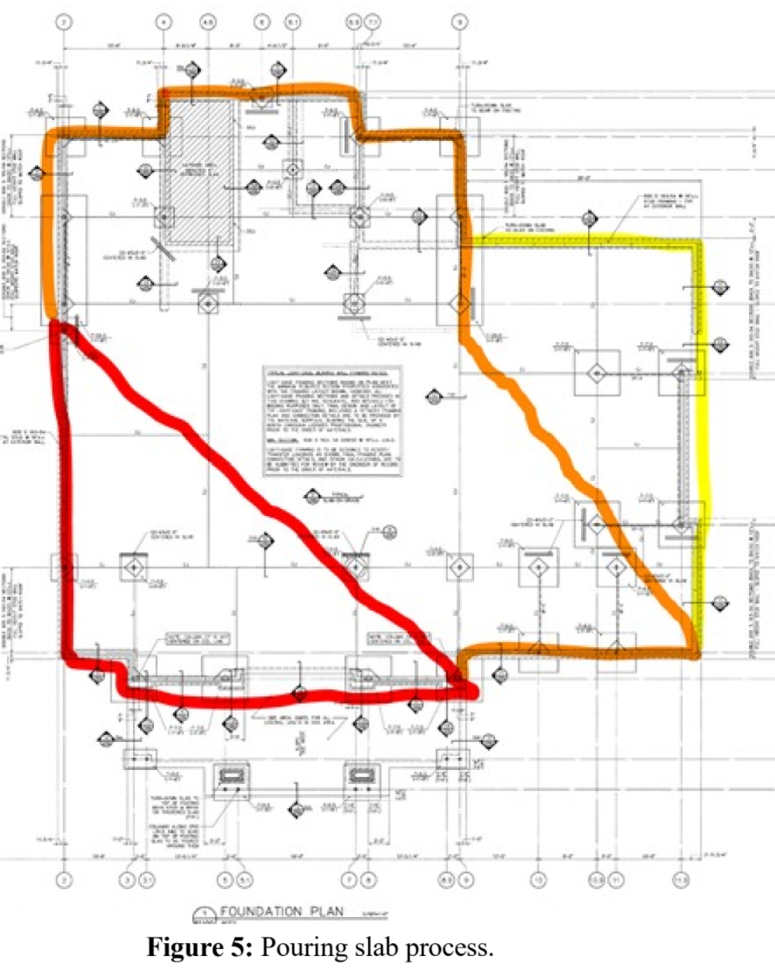
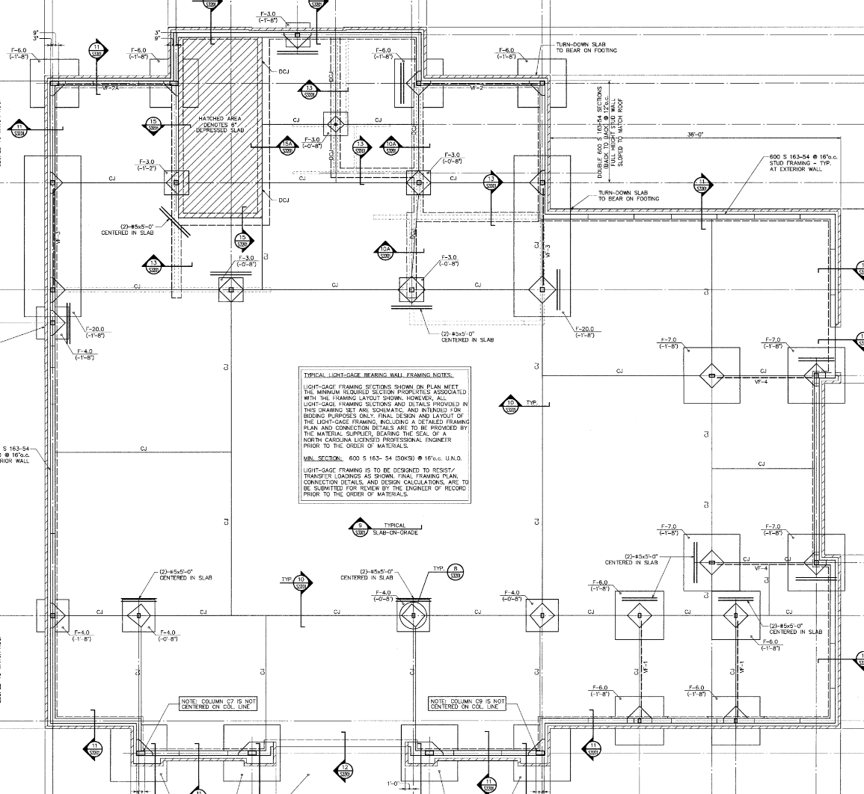
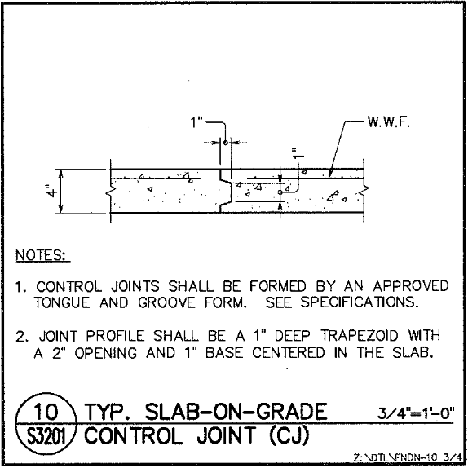
SECU 4. Foundation
N
W

Slide 19
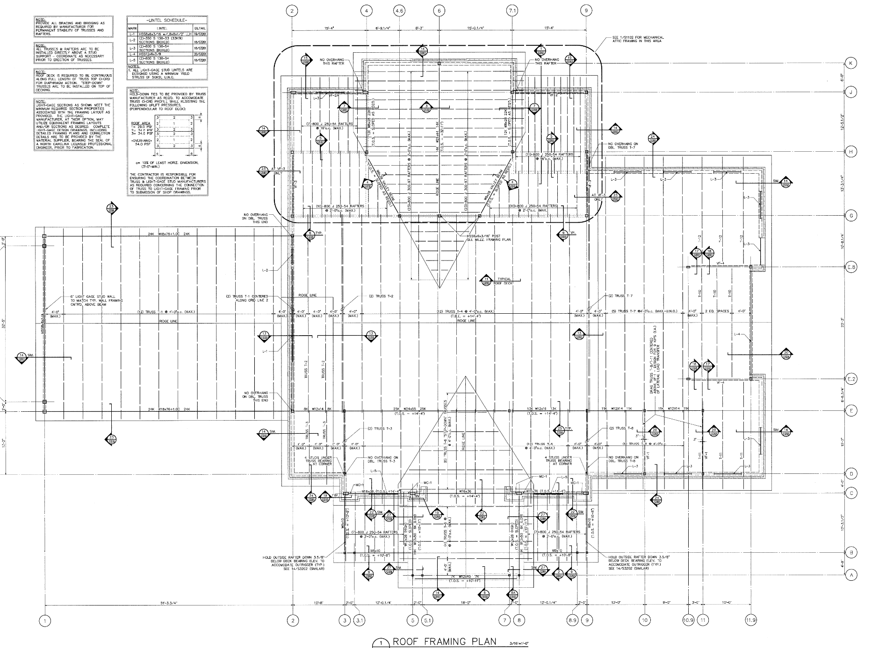
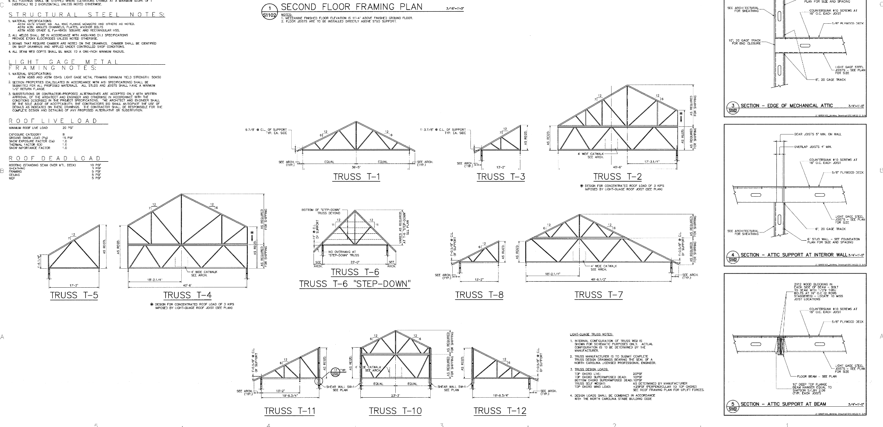
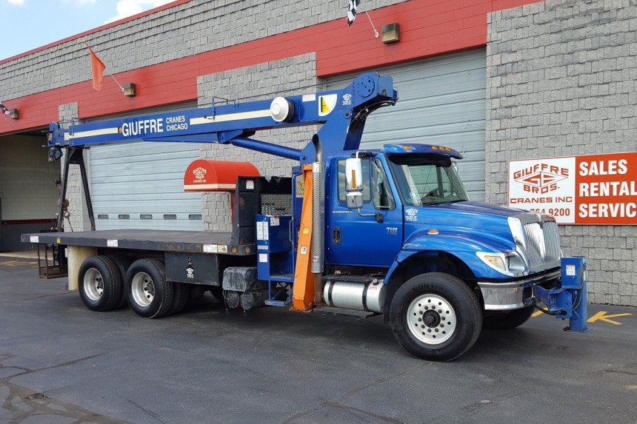
SECU 5. Structure
N
12 Ton Terex BT2463
W
Notes:
Beams, Steel Frame, Pre-Fab Vault, Pre-Fab Trusses

Slide 20
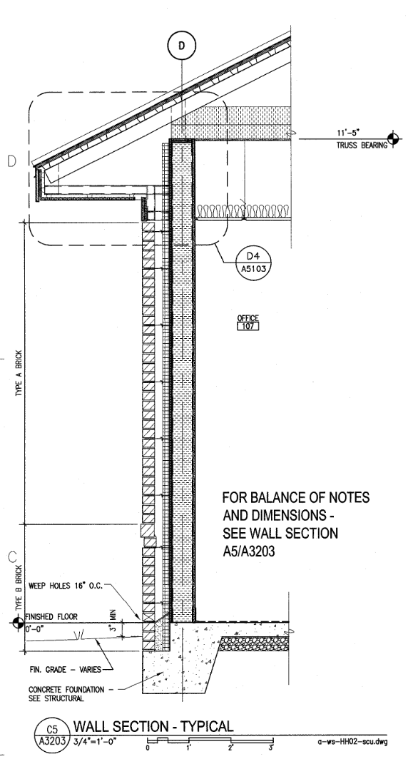
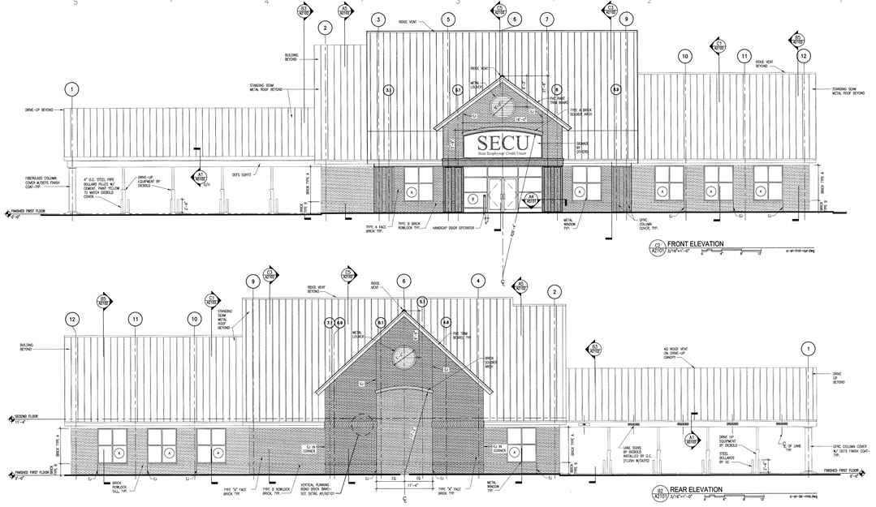
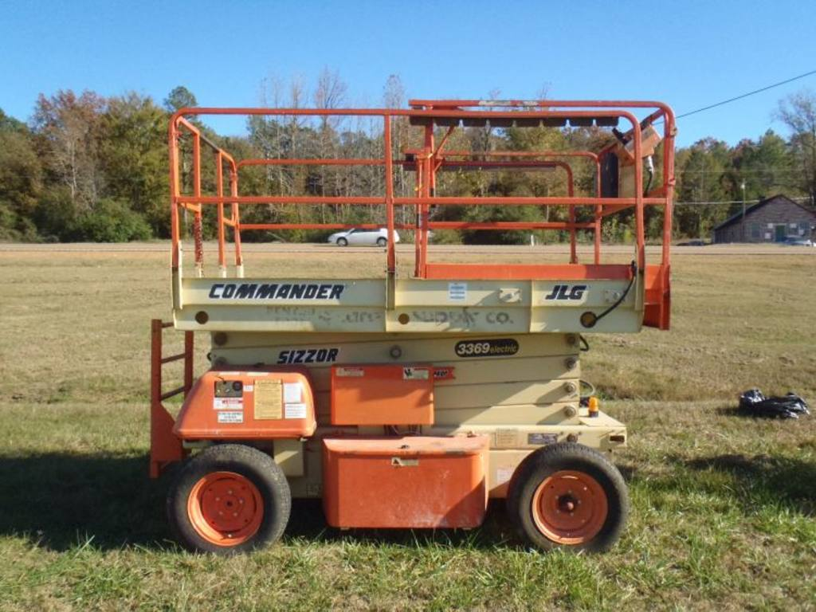
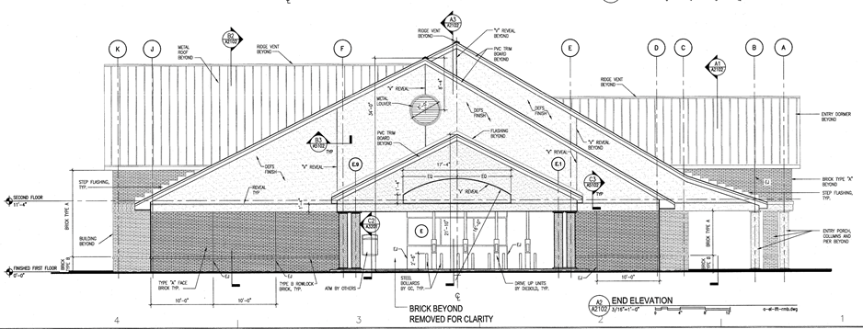
SECU 5. Structure
JLG RT3369 Scissor Lift
Notes:
SCAFFOLDING AND LULL

Slide 21
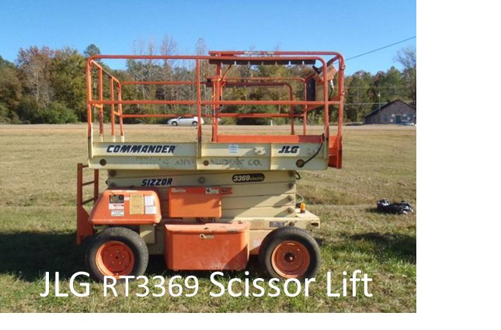
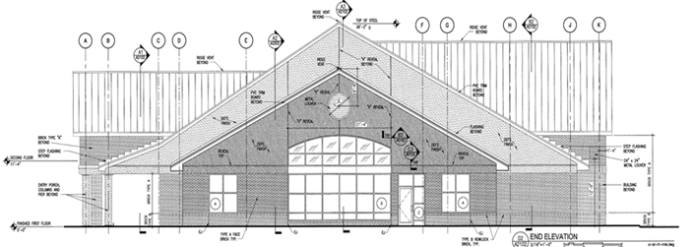
SECU 5. Structure

Slide 22
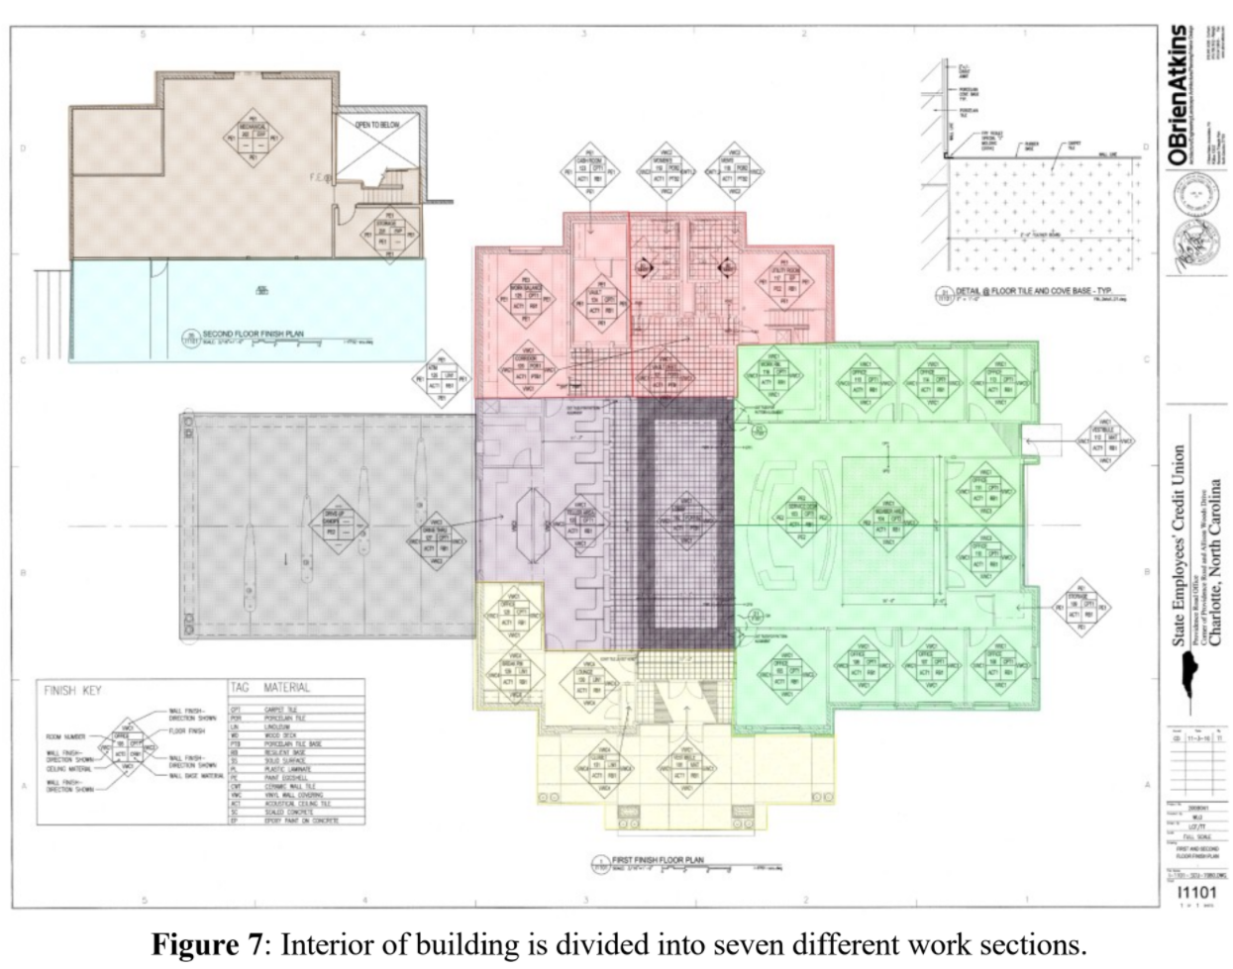
SECU 6. Openings, SECU 7. Services, & SECU 8. Finishes
Notes:
MEP SCISSORLIFT INSIDE

Slide 23
Project Estimate

Slide 24
Project Estimate Overview
Resources Used:
Construction Team's Quantity Takeoff
RS Means (Cost factors for Material, Labor, Equipment)

Slide 25
Cost Breakdown By Division
DIVISION | Direct Cost
Division 03 Concrete | $ 307,084.95
Division 04 Masonry | $ 59,947.63
Division 05 Metals | $189,309.56
Division 08 Openings | $ 78,302.00
Division 09 & 10 Finishes & Specialties | $ 295,305.78
Division 22 Plumbing | $ 78,042.75
Division 23 HVAC | $ 19,114.42
Division 26 Electrical | $ 38,077.78
Division 31 Earthwork | $ 144,652.65
Division 32 Exterior Improvements | $173,754.63
Division 33 Utilities | $ 109,025.32
TOTAL DIRECT COST | $ 1,492,618.47

Slide 26
Material, Labor, Equipment, & Allowances Total Costs
Division | Total Material Cost | Total Labor Cost | Total Equipment Cost | Total Allowances | Direct Cost
Division 03 Concrete | $ 93,901.28 | $ 204,342.51 | $ 8,841.15 | N/A
Division 04 Masonry | $ 15, 678.25 | $ 44,269.37 | N/A | N/A
Division 05 Metals | $ 139,908.94 | $ 44,542.36 | $ 4,858.26 | N/A
Division 08 Openings | $ 56,752.00 | $ 21,550.00 | N/A | N/A
Division 09 & 10 Finishes and Specialties | $81,980.39 | $ 32,685.32 | $ 205.08 | $ 180,435
Division 22 Plumbing | $ 40,342.45 | $ 37,700.30 | N/A | N/A
Division 23 HVAC | $ 10,083.62 | $ 9,030.80 | N/A | N/A
Division 26 Electrical | $ 21,927.00 | $ 16,150.78 | N/A | N/A
Division 31 Earthwork | $ 40,915.02 | $ 32,100.56 | $ 71,638.08 | N/A
Division 32 Exterior Improvements | $ 100,677.25 | $ 64,828.88 | $ 8,248.50 | N/A
Division 33 Utilities | $ 64,909.60 | $ 34,844.31 | $ 9,271.41 | N/A
Total | $ 667,075.80 | $ 542,045.20 | $ 103,062.47 | $ 180,435 | $ 1,492,618.47

Slide 27
Indirect & Overhead
Indirect Project Cost & Overhead:
$ 394,775.26
Field Personal
Office Overhead
Mobilization/Demobilization
Mobile Office Trailor, Port-a-Johns, Security fencing
Permits, Insurance, Bonding

Slide 28
Contingency
No Contingency Markup
All Architectural & Engineering Plans are 100% for Construction Documents
Addendums provided

Slide 29
Project Profit
Project Expected Profit
$ 335,839.16
Profit amount based on roughly 15% of Project Price

Slide 30
Project Price
When adding all Project Costs (Direct, Indirect, and Overhead) and Project Profit the Estimated Price for the SECU Project is
$ 2,223,232.89

Slide 31
Project Cost, Profit, & Price
The Total Cost of labor, materials, equipment, Indirect & Overhead (both project and office)
The Project Profit is accounts for 15% of the Projects Price
The Projects Price is the grant total for Direct costs, Indirect Costs, Overhead & Profit
Project Cost | Project Profit | Project Price
$ 1,887,393.73 | $ 335,839.16 | $ 2,223,232.89

Slide 32
Project Schedule

Slide 33
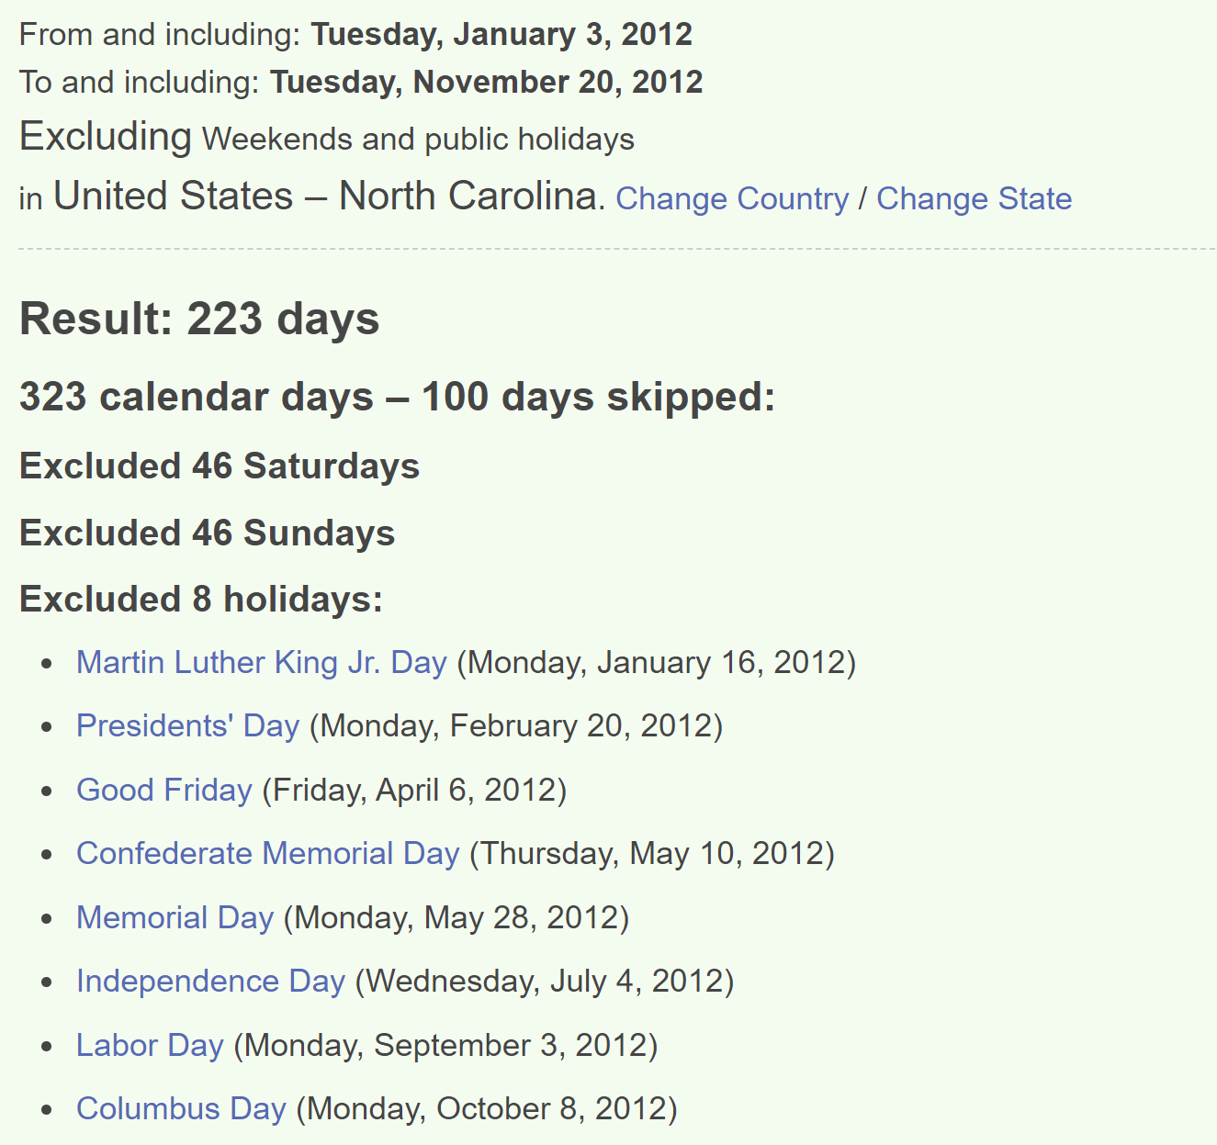
Project Schedule Overview
Owner Constraints:
300 Total Workdays
Complete Belle Rea Road First 120 Workdays
Weather Delays Past 5-Years Data for Charlotte, NC
46 days
Project Milestones:
Milestone 1: Notice to Proceed- Jan. 3, 2012
Milestone 2: Belle Rea Road Completion- Feb. 24, 2012
Milestone 3: Project Complete- Nov. 20, 2012

Slide 34
Critical Path Schedule
January –March
Mobilize: Jan. 03, 2012
Earthwork
Underground Utilities
April – June
Building Foundation
Building In the Dry
July – September
Exterior Wall Masonry
MEP Rough In
Spray-Foam Insulation
Hang Drywall
MEP Finish
October – November
Storefront Windows
Owner-Furnished Equipment
Install Flooring
Punchlist
Clean Up / Demobilize
Project Complete: Nov. 20, 2012
Mobilize Crane

Slide 35
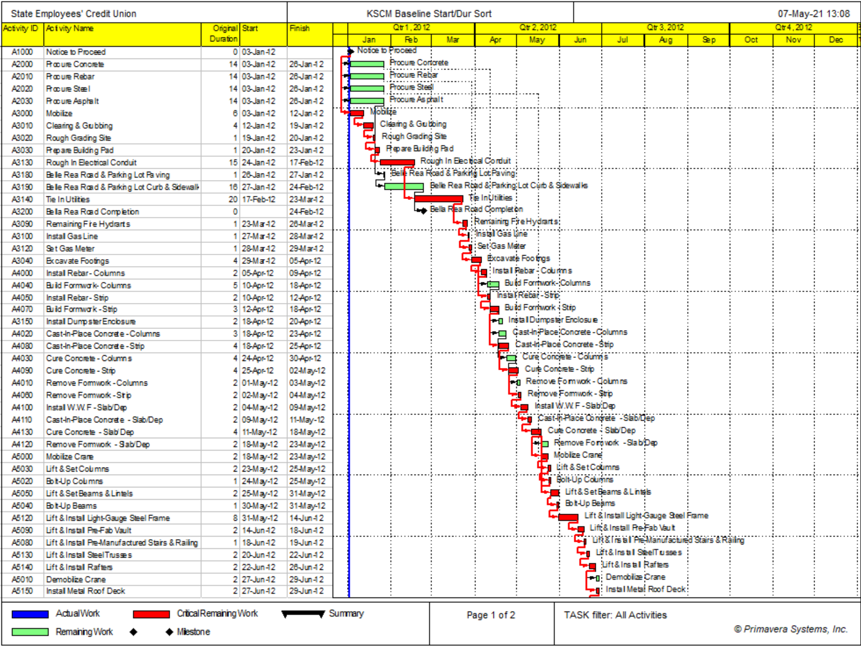

Slide 36
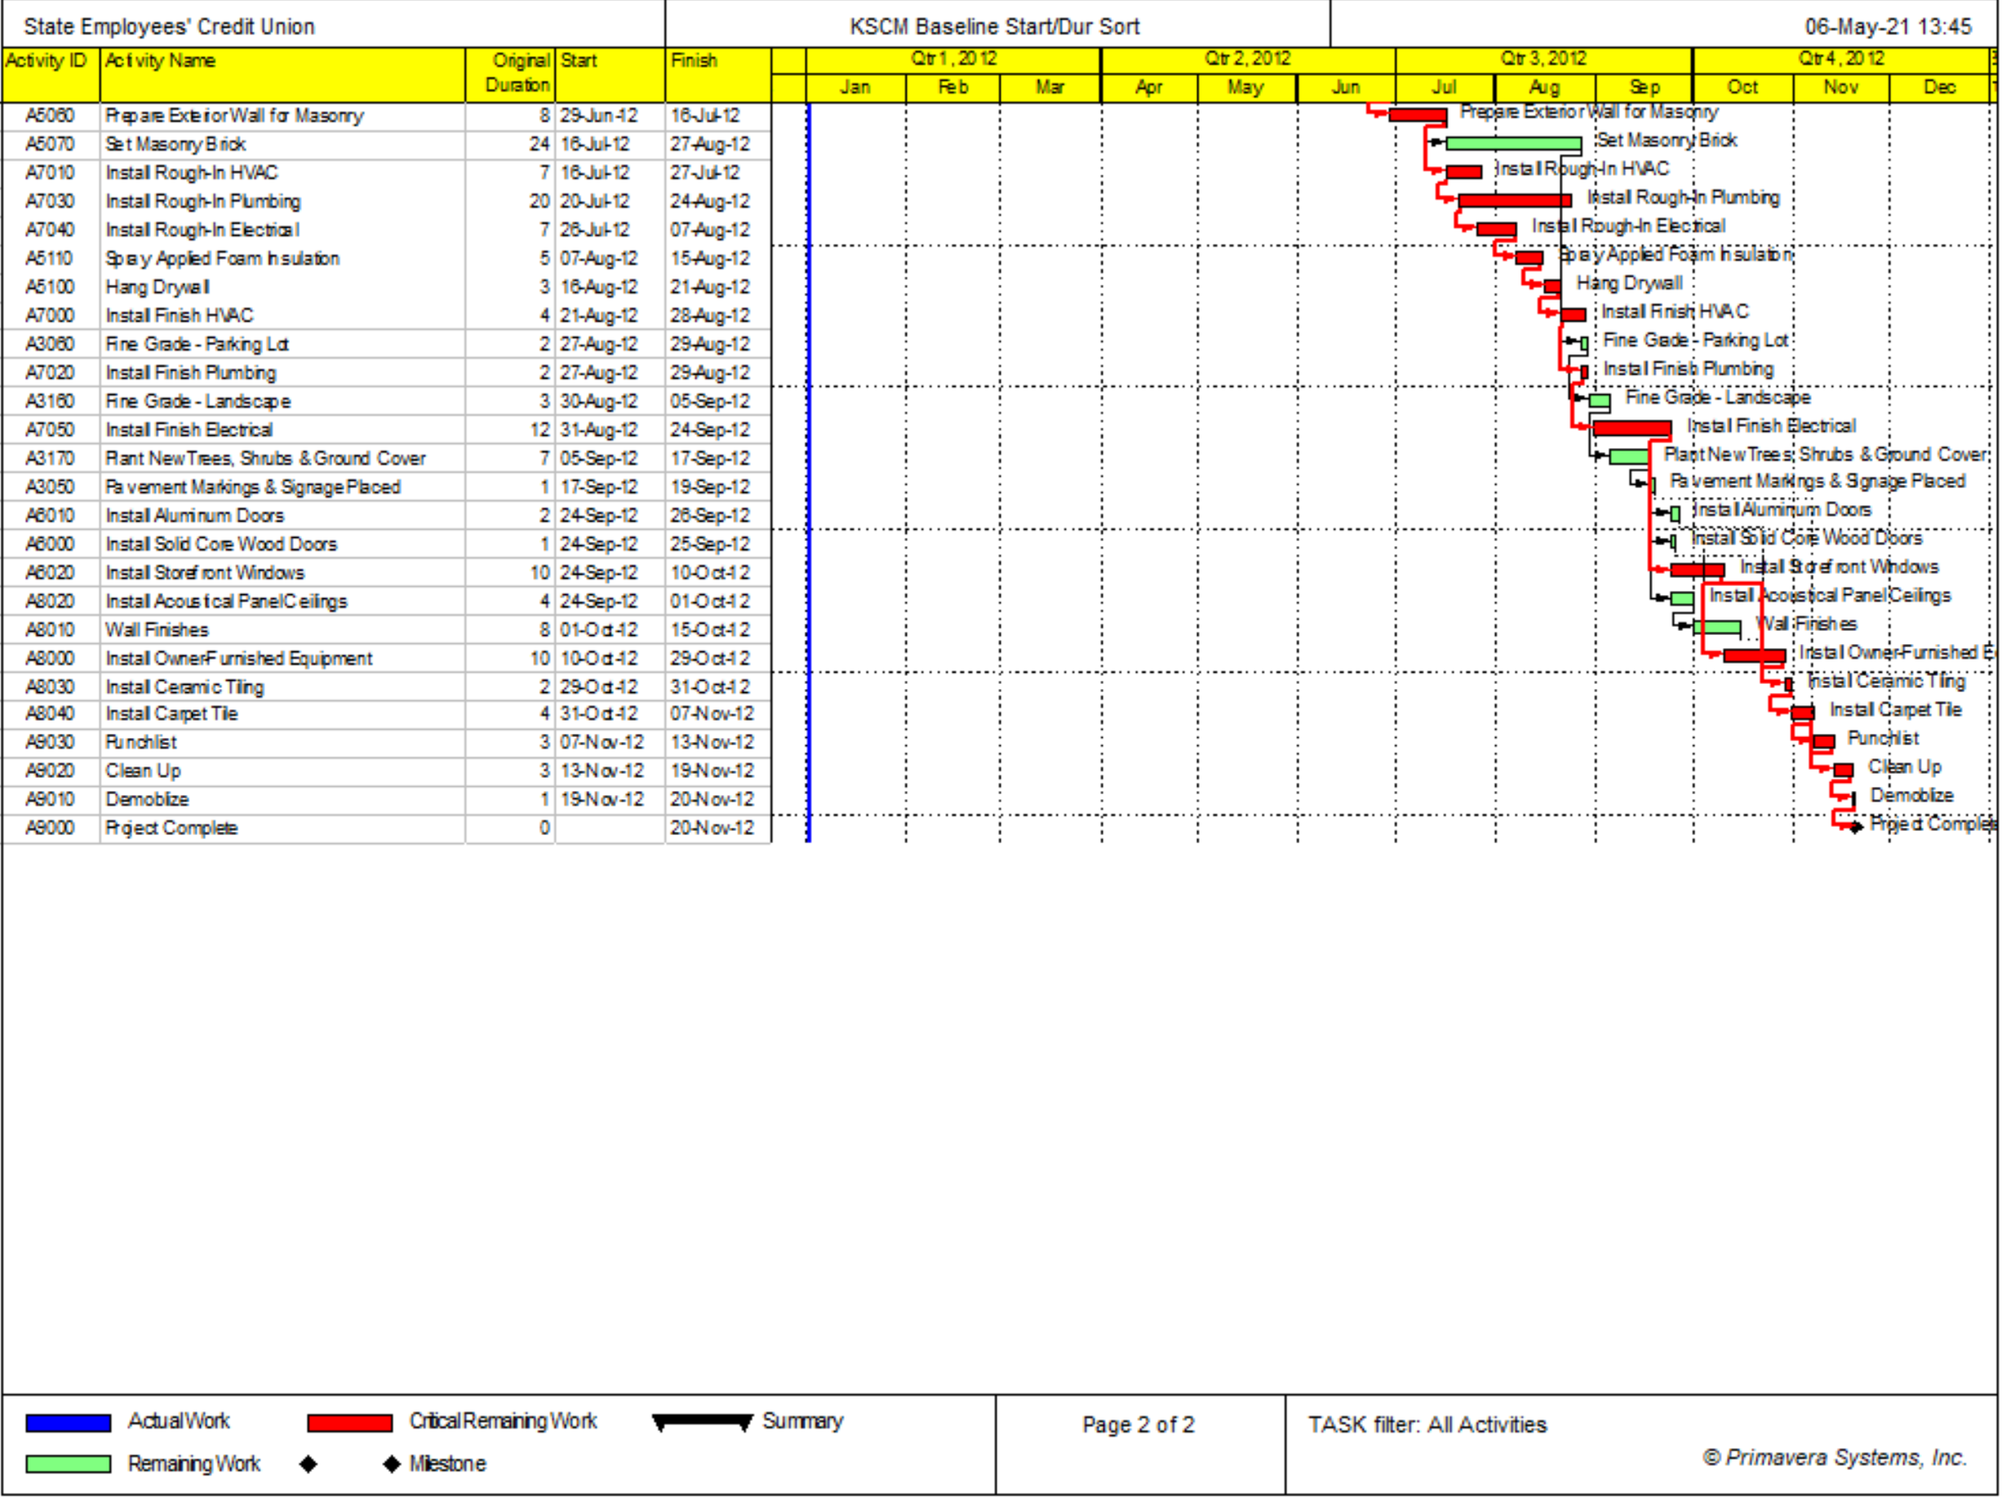

Slide 37
Analysis

Slide 38
Payment Terms & Requirements
Progress payments once a month
10% Retainage
15% Profit
Cost Loading Schedule
Cost Loading Schedule Calculations
 | January | February | March | April | May | June | July | August | September | October | November
Direct Cost | $ 210,203.95 | $ 130,431.70 | $ 59,012.66 | $ 136,777.96 | $ 145,207.34 | $ 112,245.04 | $ 80,079.52 | $ 129,596.76 | $ 129,730.75 | $ 224,563.28 | $ 975.00
Indirect Cost | $ 35,729.98 | $ 35,729.98 | $ 35,729.98 | $ 35,729.98 | $ 35,729.98 | $ 35,729.98 | $ 35,729.98 | $ 35,729.98 | $ 35,729.98 | $ 35,729.98 | $ 35,729.98
Total Cost | $ 245,933.93 | $ 166,161.68 | $ 94,742.64 | $ 172,507.94 | $ 180,937.32 | $ 147,975.02 | $ 115,809.50 | $ 165,326.74 | $ 165,460.73 | $ 260,293.26 | $ 36,704.98
Cumulative Cost | $ 245,933.93 | $ 412,095.62 | $ 506,838.26 | $ 679,346.20 | $ 860,283.53 | $ 1,008,258.55 | $ 1,124,068.06 | $ 1,289,394.80 | $ 1,454,855.53 | $ 1,715,148.80 | $ 1,751,853.78

Slide 39
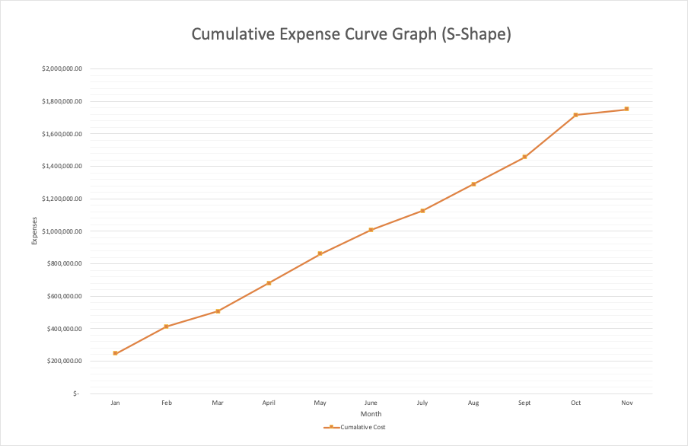

Slide 40
Payment Received Graph
 | Jan | Feb | March | Apr | May | June | July | Aug | Sept | Oct | Nov
Total Monthly Costs | $ 125,227.21 | $ 153,129.37 | $ 176,598.53 | $ 210,733.51 | $ 281,150.53 | $ 136,237.35 | $ 111,460.81 | $ 134,798.74 | $ 169,082.61 | $ 173,789.43 | $ 39,033.67
Total Monthly Profit (15%) | $ 18,784.08 | $ 22,969.41 | $ 26,489.78 | $ 31,610.03 | $ 42,172.58 | $ 20,435.60 | $ 16,719.12 | $ 20,219.81 | $ 25,362.39 | $ 26,068.41 | $ 5,855.05
Total Monthly Invoice | $ 144,011.29 | $ 176,098.77 | $ 203,088.31 | $ 242,343.53 | $ 323,323.11 | $ 156,672.95 | $ 128,179.93 | $ 155,018.55 | $ 194,445.00 | $ 199,857.84 | $ 44,888.72
Total Monthly Retainage (10%) | $ 14,401.13 | $ 17,609.88 | $ 20,308.83 | $ 24,234.35 | $ 32,332.31 | $ 15,667.30 | $ 12,817.99 | $ 15,501.85 | $ 19,444.50 | $ 19,985.78 | $ 4,488.87
Total Monthly Received | $ 129,610.16 | $ 158,488.90 | $ 182,779.48 | $ 218,109.18 | $ 290,990.80 | $ 141,005.66 | $ 115,361.94 | $ 139,516.69 | $ 175,000.50 | $ 179,872.06 | $ 40,399.85
Cumulative Received | $ 129,610.16 | $ 288,099.06 | $ 470,878.53 | $ 688,987.71 | $ 979,978.51 | $ 1,120,984.17 | $ 1,236,346.10 | $ 1,375,862.80 | $ 1,550,863.30 | $ 1,730,735.36 | $ 1,771,135.20

Slide 41
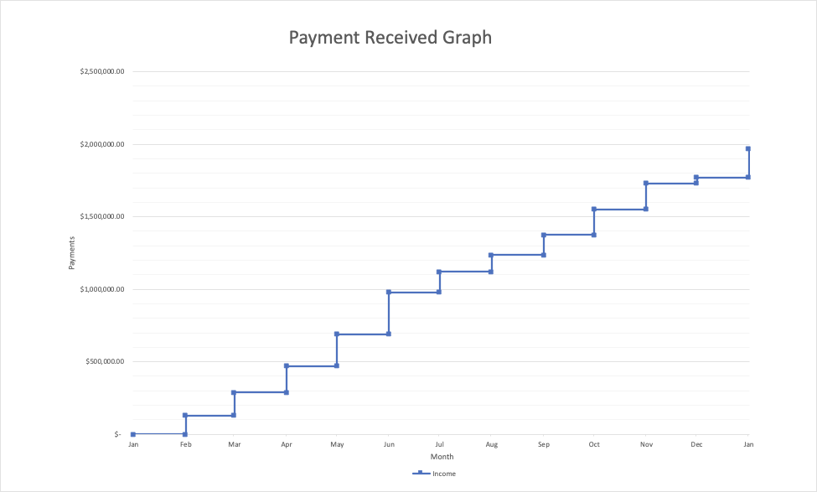

Slide 42
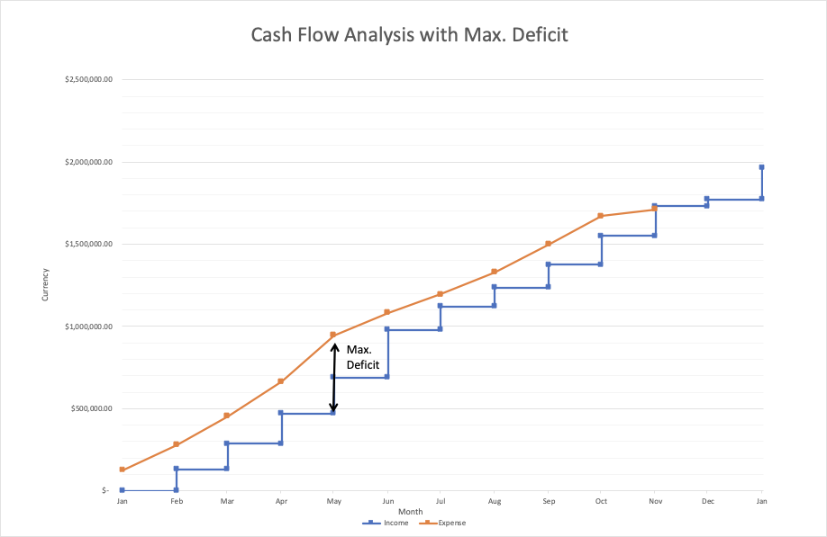
Highlight of Total Cash Deficit
Maximum Deficit
Expense = $946,839.14
Income = $688,987.72
Max. Deficit = $257,851.42

Slide 43
Conclusion
SECU Project Price: $2,223,232.89
SECU Project Duration: 223 Days (Start: Jan. 3 – Finish: Nov. 20)
Expected Profit: $ 335,839.16

