Slide 1
Graduate Programs in Cullowhee

Slide 2
Welcome Catamounts. . . . Engage!
Notes:
Although you are potentially far away, community is important. To us you are catamounts and part of a vibrant and rigorous academic community. A couple of folks who want to bring you some greetings: 1. Provost Richard Starnes—history professor, former Dean of College of Arts & Sciences and proud WCU alumni; 2. Graduate School Dean Dr. Brian Kloeppel 3. GSA Vp—Katie Ruffalo
Reach out, network, get involved with GSA

Slide 4

WCU Graduate School
Location: 110 Cordelia Camp Building
Cullowhee, NC 28723
Contact: grad@wcu.edu
828.227.7398
Hours: Monday to Friday, 8 am to 5 pm
WCU Website: wcu.edu
Graduate School Website: grad.wcu.edu
Facebook: WCUGradSchool

Slide 5

WCU Cullowhee Campus
Historical campus on the hill including Chancellor’s Residence
Campus center including clock tower and catafount
West campus including Health Sciences Building

Slide 6
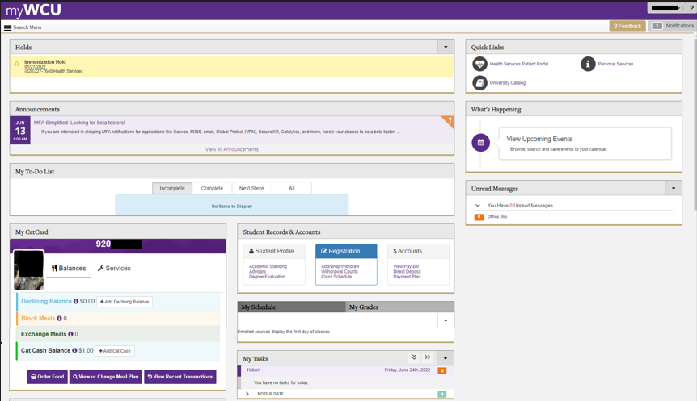
MyWCU Student Portal
https://www.wcu.edu/myWCU/index.aspx

Slide 7

Catamount Email brian1@catamount.wcu.edu
Official means of university communication
Check it frequently
Be cautious of forwarding it to gmail and work accounts
To activate your Catamount mail account:
1. Go to http://email.wcu.edu

Slide 8

Parking
Vehicles must be registered with WCU Parking Services to park on the Cullowhee campus
Please reach out to the WCU Parking Services Office at 828.227.7275
https://parking.wcu.edu

Slide 9

Safety *
In the event of an emergency, please call 8911 from a campus phone (kindly, please add 828-227-8911 to your cell phone now)

Slide 10
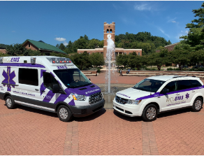
Emergency Medical Services
WCU has our own Emergency Medical Services that are part of Health Services and staffed by students with EMT certificates and higher resulting in quick response times to campus 8911 emergencies

Slide 11

Cat Card (ID Card)
WCU’s Cat Card is required to check out library books, to print and copy, to use the Campus Recreation Center, for student services, and to attend athletic and cultural events
Email 920#, selfie photo, and mailing address to catcard@wcu.edu

Slide 12

WCU Bookstore
  Students may purchase textbooks and graduation merchandise online at http://books.wcu.edu/.

Slide 13

IT Help Desk *
Contact the WCU IT Help Desk for support services and assistance:
- call toll-free: 1. 828.227.7487 between 7:30 am and 6:30 pm
- DoIt.wcu.edu
Wireless connectivity is available throughout campus
Utilize Eduroam

Slide 14

Paw Print
Black & white copiers/printers are located throughout campus
Students need money on their CatCard to make copies or print ($.05 per copy, $.25 for color). To put money on your CatCard, go to MyWCU or to citation.wcu.edu/bannerupay
Funds can be added online by use of a credit or debit card. On-line deposits to a CatCash account should be applied within one hour.

Slide 15

Hunter Library *
Access WCU databases, ebooks, etc. online at library.wcu.edu
You will need a valid WCU CatCard to check out physical books and to use materials placed on course reserve by your faculty.

Slide 16

WCU Writing and Learning Commons *
The WaLC provides both virtual and in-person services for graduate and undergraduate students
To make an appointment, call 828-227-2274 or login to Navigate by clicking “Advising/Tutoring” in your myWCU

Slide 17

Center for Career and Professional Development *
Career services assistance is available from the Center for Career and Professional Development (CCPD).
  careers.wcu.edu or call 828.227.7133
CCPD has a variety of virtual resources available and staff are trained to assist graduate students.

Slide 18

Counseling (CAPS) *
Virtual and in-person counseling for students is available on a short-term basis at no cost
For an appointment, please contact WCU Counseling and Psychological Services at 828.227.7469 or caps.wcu.edu

Slide 19

Health Services *
Health services are available to any university student at either Cullowhee or by tele-health
Hours are Monday to Friday from 8 am to 5 pm
To schedule an appointment, please call 828-227-7640

Slide 20
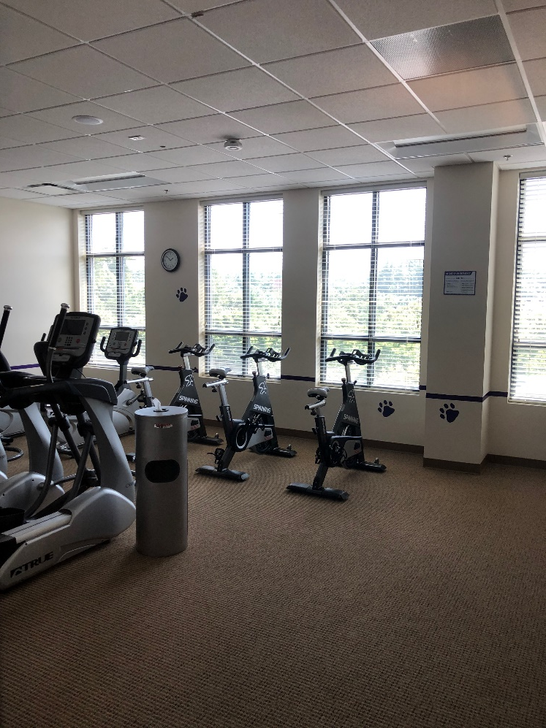
Recreation and Wellness *
With a CatCard, students have access to the Cullowhee Campus Recreation Center (CRC)
For additional information, please visit reccenter.wcu.edu

Slide 21

Food Pantry
Homebase Food Pantry and Student Support
Open and serving students and working on an on-call basis
For students in need of assistance,
please text Director Jim Dean at 828.508.0035
https://www.homebasewcu.org/

Slide 22

Academic Policies
Please email grad@wcu.edu or call 828-227-7398 for additional information about Graduate School policies.
We are here to help!
Dismissal Policy: 1 F will result in your dismissal
  3 C’s will also result in your Graduate School dismissal
  Some graduate programs have a more restrictive policy resulting in program dismissal if you earn 2 C’s
Transfer Credit
Stop Out Policy
Withdrawing from a course or from WCU
  Medical Withdrawals
  Military Deployment
  Extenuating Circumstances / Other Withdrawals

Slide 23

Student Conduct Modules
Catamount email on about 05 September 2022 in a system called Everfi
Educational Modules (3)
  Topics
    Sexual Assault
    Diversity & Inclusion
  Younger than 24
    Also Alcohol Education
    View the Code of Student Conduct on Student Community Ethics Page

Slide 24

Canceling Classes
Weather announcements will be placed on Western's website at weather.wcu.edu
Announcements will also be sent via e-mail
Check Canvas for further
information from your
instructor

Slide 25

Career Goals Reflection
Please take a moment to gather a Career Goals Reflection card on your table
Kindly, please close your eyes and envision:
What will your career will be?
Where will you be living?
What steps will you take each day to realize these goals?

Slide 26

Please Remember
The Graduate School is happy to assist you and can be reached at grad@wcu.edu or at 828-227-7398
Best wishes for a wonderful semester!
grad.wcu.edu

