Slide 2

2022 Faculty Scholarship
Celebration

Slide 3
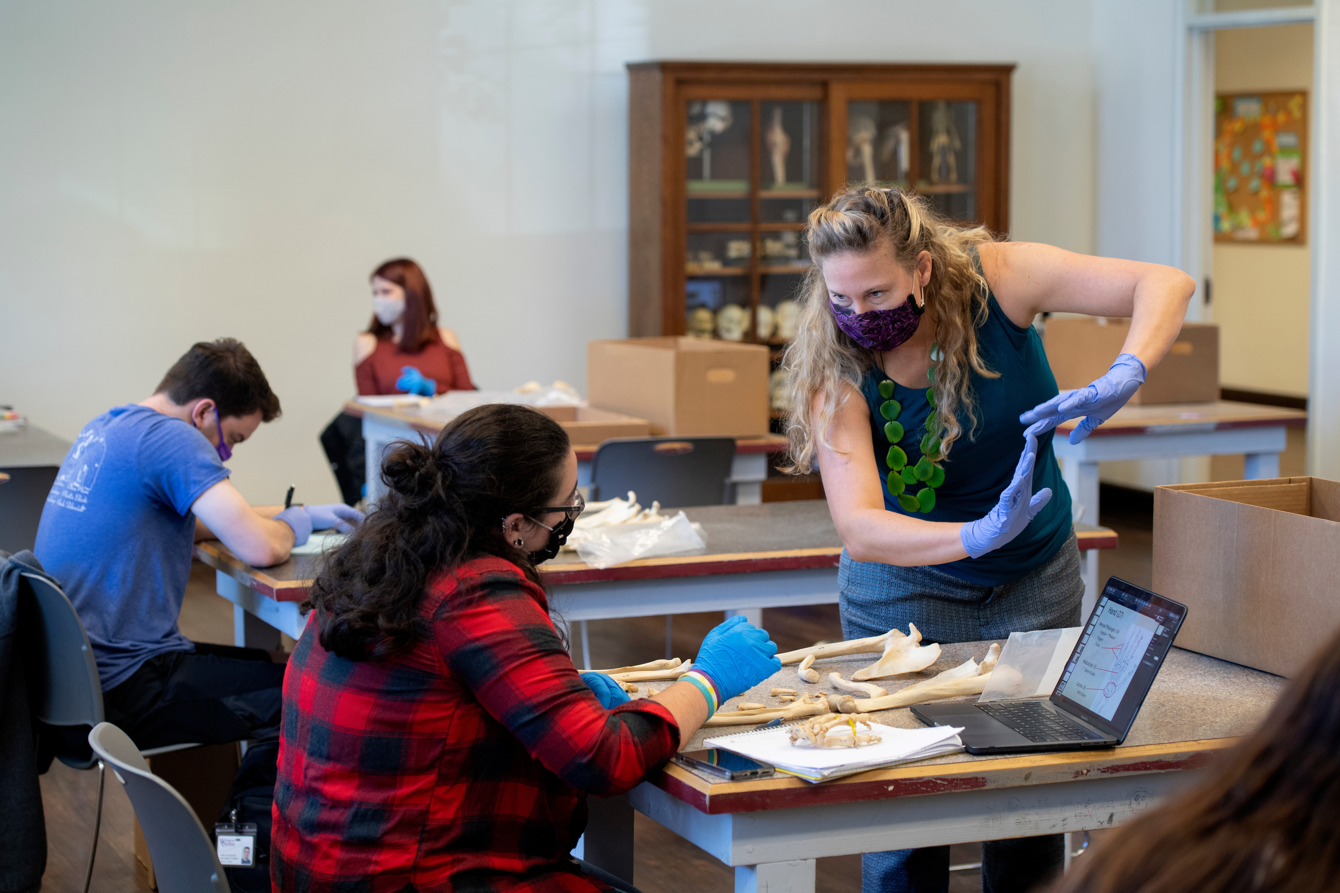

Slide 4

College of Arts and Sciences
194 submissions, including:
WCU’s College of Arts and Sciences provides students with a liberal arts foundation where they are taught to think critically, grow academically, and communicate effectively.
Publications
Presentations & Proceedings
Exhibits
Performances
Grants

Slide 5
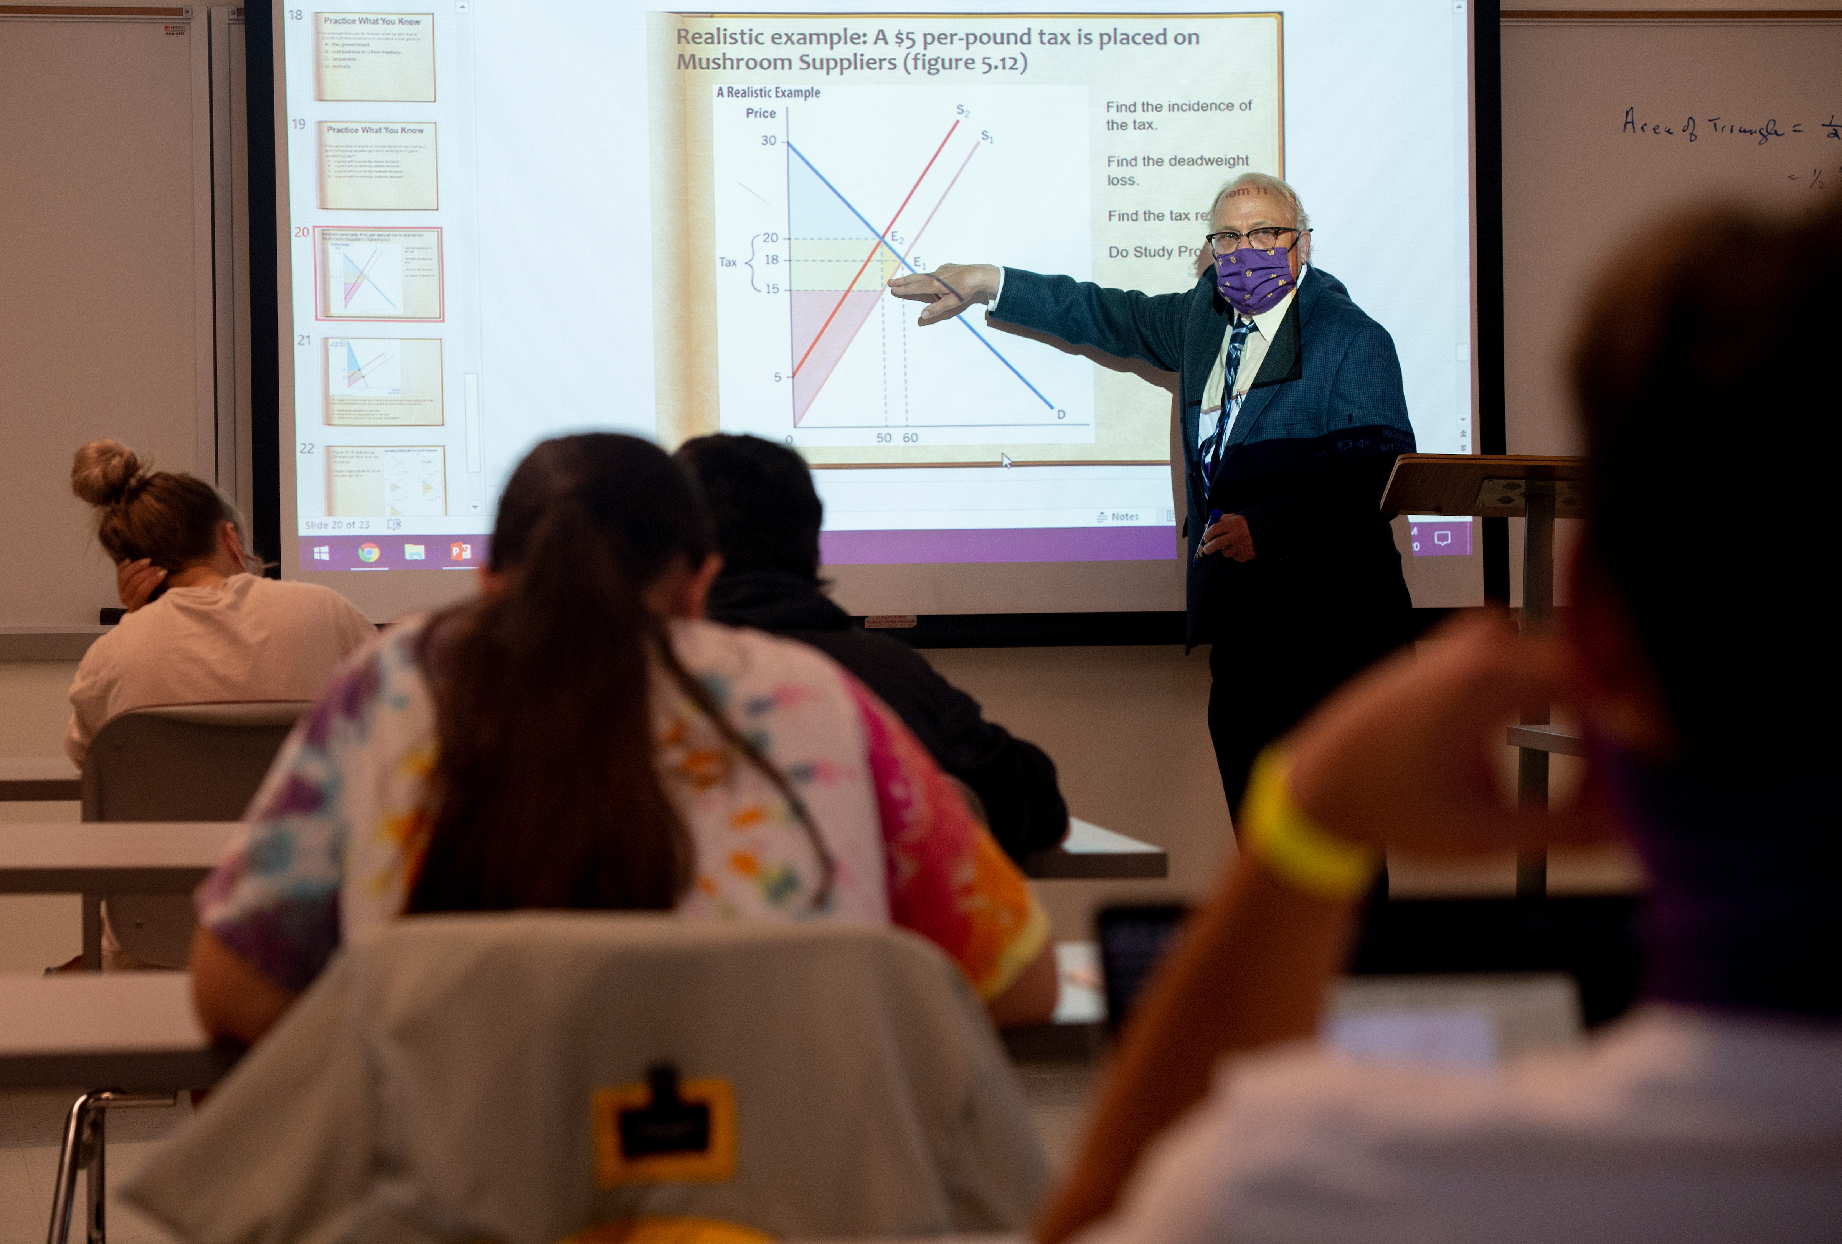

Slide 6

College of Business
WCU's College of Business is focused on providing high quality, student-centered education to prepare Business Ready® graduates.
113 submissions, including:
Publications
Presentations & Proceedings
Grants

Slide 7


Slide 8
College of Education and Allied Professions
WCU's College of Education and Allied Professions is home to leading programs in teacher education as well as numerous programs in human services.
215 submissions, including:
Publications
Presentations & Proceedings
Grants

Slide 9


Slide 10
College of Engineering and Technology
WCU's College of Engineering and Technology provides innovative programs in an environment that supports economic and professional development and involvement with businesses and industries.
59 submissions, including:
Publications
Presentations & Proceedings
Grants

Slide 11


Slide 12
David Orr Belcher College of Fine and Performing Arts
133 submissions, including:
WCU's David Orr Belcher College of Fine and Performing Arts brings together the traditions and resources of the region to serve as the heart of art and culture in western North Carolina.
Publications
Presentations & Proceedings
Exhibits
Performances
Grants

Slide 13


Slide 14

College of Health and
Human Sciences
WCU's College of Health and Human Sciences provides award-winning professional programs in a wide variety of health care fields.
98 submissions, including:
Publications
Presentations & Proceedings
Exhibits
Grants

Slide 15
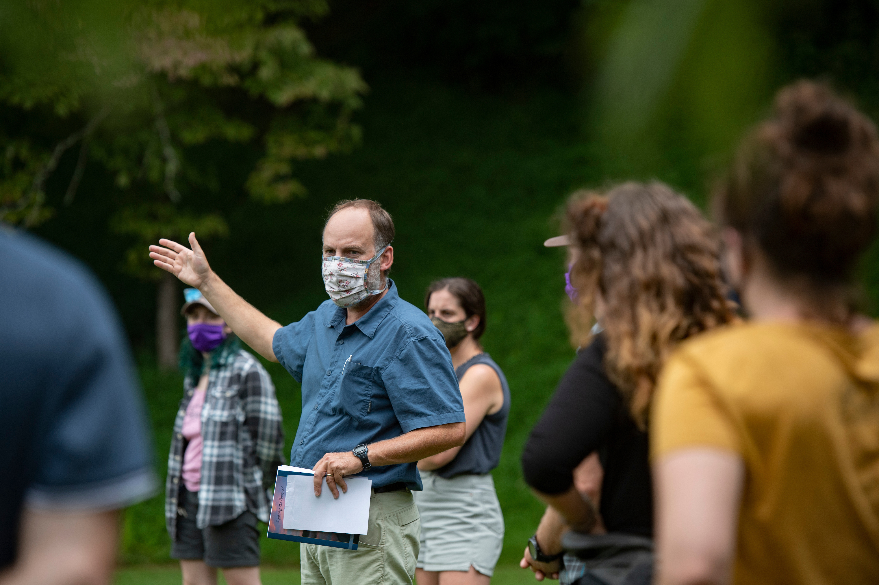

Slide 16
Hunter Library
WCU's Hunter Library provides high-quality intellectual content to support the teaching, research, and lifelong learning activities of the WCU community.
25 submissions, including:
Publications
Presentations & Proceedings
Exhibits
Grants

Slide 17
Credits
Photographs courtesy of WCU Photography Services
All icons created by Made x Made from the Noun Project
Submission counts determined by FAD entries

