Slide 1
Information Technology University Budget Hearing
2024-2025
April 8, 2024

Slide 2
Agenda
Current Environment
Reallocations
Funding Requests
Questions / Discussion

Slide 3
Current Environment
Vendors and Providers continue to embrace the fast-paced move to a subscription model for providing software and services
One-time expenses become annual recurring expenses.
IT technology continues to evolve rapidly, and Cloud Computing will have profound effects on how IT funds, delivers, and supports technology at WCU
Moving more expenditures to operationally recurring
We expect continued annual increases in licensing and services
The past few years have been 5-9%
IT Security items that were originally implemented via non-recurring funds are now coming up for renewal
With no increase in recurring funds, IT has used non-recurring funds, multi-year contract discounts, and reallocation of existing budget funds to meet the IT increases and needs for WCU
The end of the non-recurring train is near

Slide 4
Some Examples
Firewall vendor subscription changes
Vendor moving all customers to “Advanced capabilities with AI” subscriptions
New service bundles and pricing structures
3yr impact -- $300,000
Server virtualization licensing changes – 2-3x annual impact vs previous agreement
Acquisition of vendor leading to “value realignment”
New service bundles
Expected impact of an additional $100,000 to $250,000 annually over current agreement
Plus the “normal” escalations
Overall IT vendors and providers
Increases “absorbed” from 2019: $868,000

Slide 5
Reallocations
Evaluate and manage contract renewals
Adjustments based on usage
Multi-year contract discounts
Eliminate subscriptions that provide similar services
Implement software/tool review process
Reallocating existing budget for new acquisitions
Repurpose open positions to address strategic staffing concerns
Leverage the buying power of our sixteen-school system
$985,000

Slide 6
Fee Request
Residential Technology Fee
Per semester fee paid by Students living in the Residence Halls
Provides WiFi, internet, and student support to the 16 residence buildings
Fee has remained flat since 2016
Reserves have covered operational increases
However, with increasing people costs and significant EOL network equipment replacements, by FY2028 the residential tech fee will have a significant shortfall
Beginning FY26, will need to implement an annual fee escalation

Slide 7
Non-Recurring Requests
Data Center Backup/Disaster Recovery
EOL Hardware replacement
5-year hardware and maintenance $200,000
IT Closet Generators Phase 4
Remaining buildings targeted: Ramsey, Bookstore, Coulter, Reid, Stillwell
Not to exceed $300K
Cell Signal Improvements
A campus-wide cell signal survey was conducted over spring break
Results will enable WCU to identify those areas which do not have adequate cell service and prioritize areas of need into manageable phases.
Cost TBD
Cloud Computing Study – The Future Data Center
An external firm to vet our plans and further define how it transforms our environment
Anticipate $60,000

Slide 8
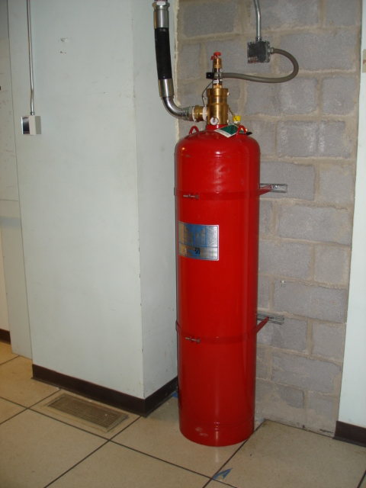
Non-Recurring Requests
Replace Fire Suppression System in Forsyth and HHS
Data centers require critical fire suppression equipment
Recently a failure in the FM-200 fire suppression system safeguarding one facility required repair
Due to the equipment age, there was difficulty acquiring parts and repair
Need to replace with current technology, as requested by WCU Facilities Management
$50,000
Cherwell ITSM System Replacement
Vendor has communicated 2026 EOL date
Funds needed for transition migration and services to new provider
Cost TBD
Technology Commons Redesign and Collaboration Initiatives
Most requested TC improvement -- (2) 5-Person Meeting Pods with Zoom
Technology Commons Power Users (students)
Steering (faculty/staff) Committees
Furniture moves / replacements to improve overall flow, visibility, and space layout
$135,000

Slide 9
Security Operations Center (SOC)
Remains a critical need and continues as a key objective
Services – improved threat detection and response
Staffing and knowledge – can’t afford expertise or 7x24 staffing due to huge market demand, amount of people
Infrastructure – constantly changing / increasing costs to maintain an onsite technical environment
Investigating less costly interim approaches and tools
Reviewed over 6 vendor offerings
Have implemented some capabilities
Planning proof of concept for a “less full featured” interim solution
Discussing with System Office potential system-wide opportunities and legislative asks
Interim solution funding TBD pending proof of concept

Slide 10
Recurring Requests - $1,218,000
$550,000 - Maintain the WCU security posture, including:
Vulnerability management tool
Network security detection software
Security awareness training
Secure access management software
Firewall software
Privileged access management
$668,000 - Incremental increases
Banner
Microsoft
Canvas
Tableau
Endpoint management
Identity management
Etc.

Slide 11
Questions?

