Slide 1
Division of Advancement
FY25 Budget

Slide 2
The Division of advancement
Office of the Vice Chancellor
Office of Development
Office of Engagement
Office of Advancement Services
Board oversight for:
WCU Foundation Board of Directors
WCU Alumni Association Board of Directors
Fill the Western Sky Campaign Steering Committee
Primary WCU strategic plan links:
Increase revenue for student support, colleges, and unit initiatives
Increase alumni engagement, WCU’s brand, and advocacy
Increase philanthropic growth and donor base
Decrease student debt load through scholarships
Notes:
The Division of Advancement tells the university’s stories and champions its mission. We are comprised of four units: advancement services, engagement, development, and the Office of the Vice Chancellor, and we oversee three leadership boards.
Our division depends heavily on our campus partners to advance WCU’s mission, we must collaborate with each other as well as with faculty, staff, students, alumni and friends to build and strengthen the university’s relationships with all of those important in the life of the institution.
Advancement is one of the university’s revenue generating divisions—as state financial support declines, philanthropic support becomes even more important in providing the resources needed for scholarships, programmatic support and capital projects. Our division priorities are directly tied to the university's strategic plan.

Slide 3
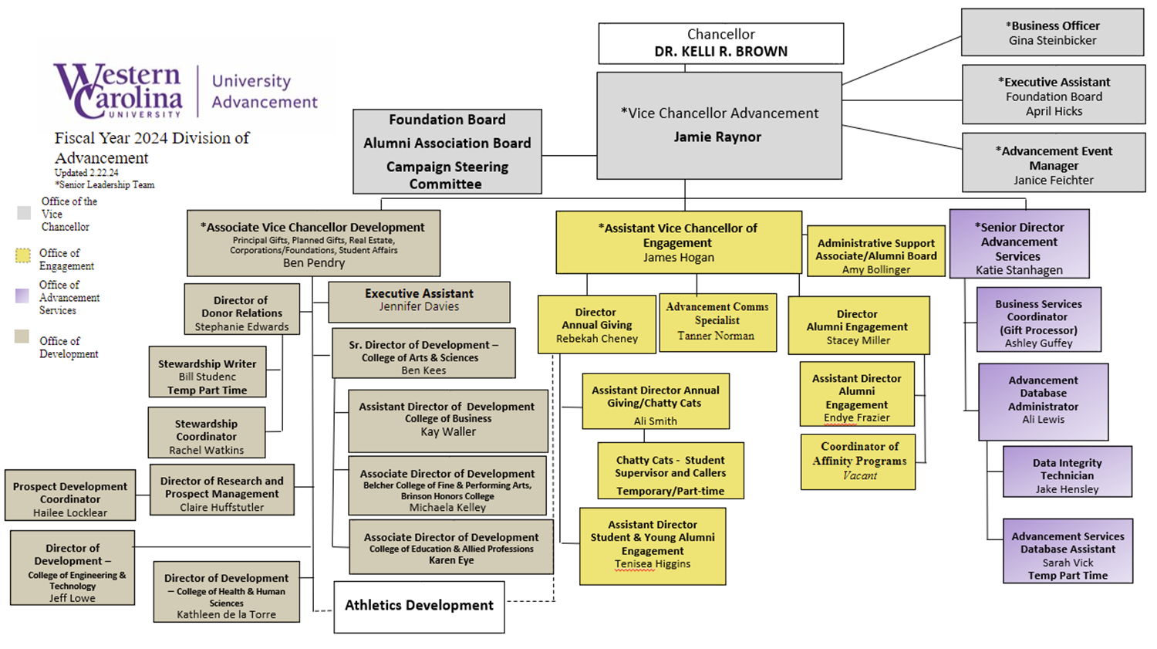

Slide 4
Advancement Budget vs. Fundraising
Budget: $3.5M all-in from all funds (personnel and operations)
ROI with fundraising results over the past 3 years:
FY22 - $9.6M from 3,024 donors
FY23 - $12.6M from 4,108 donors
FY24 - $33.2M to date from 2,921 donors

Slide 5
COntinued funding Shift To greater Foundation Support
New investments for the Division of Advancement will come primarily from endowment support.
Foundation Board controls investment in Advancement through annual operation fee on endowments.
Continuing to use vacancies, reclassifications, etc. to align staff and programming investments with priority needs.

Slide 6
Current FY24 State Investments
One-time funds:
Multiyear discounted subscriptions/renewals (ex. Brevo email platform), software, professional development
Equipment purchases for technology needs
Construction for additional office space
Contract addendums for cost savings, particularly for increased gift processing within Give Campus and increasing constituent volume in Raiser's Edge NXT.
Notes:
Let me first say a sincere thanks for nonrecurring funds that were received in FY24, which we are using to increase the sustainability of our current technology and to implement new tools for best advancement technology practices in research/reporting, annual giving, alumni engagement, and donor relations. We are also using these funds for one time campaign needs to set us up for success in the next phase of the comprehensive campaign.

Slide 7
Future Advancement State Recurring Needs
Increased alumni base and increased gifts
Heavy focus on growing the donor base
Cyclical state of higher education campaigns
Recurring Positions Needed in Near Future
Database and Reporting Support Staff (1 position at $60k salary)(Raiser's Edge NXT database has grown 30% since conversion in 2019)
Gift Processing Support to fulfill increased giving during campaign public phase, giving days, etc. (1 position at $40k salary)

Slide 8
FY25 state funded
campaign support Needs
The Fill the Western Sky Campaign is being supported with $280k in nonrecurring state funds for operations including the following FY25 campaign expenses:
Additional Campaign Events
Additional Travel Funds
Campaign Counsel (as needed)
Increased Print Materials
Raisers Edge Database Needs (data hygiene)
Staff and Volunteer Training
Equipment
Marketing and communications for print, video, graphic design, and writing
Partnering with University Marketing & Communications and Sinclair to make data-driven decisions and investments driving increased constituent engagement and new donors.
All donor stewardship needs are paid for with nonstate funds.

Slide 9
Questions?
Jamie Raynor, Vice Chancellor for Advancement
828.227.3052 (office)
803.640.7932 (cell)
jtraynor@wcu.edu

