Slide 1
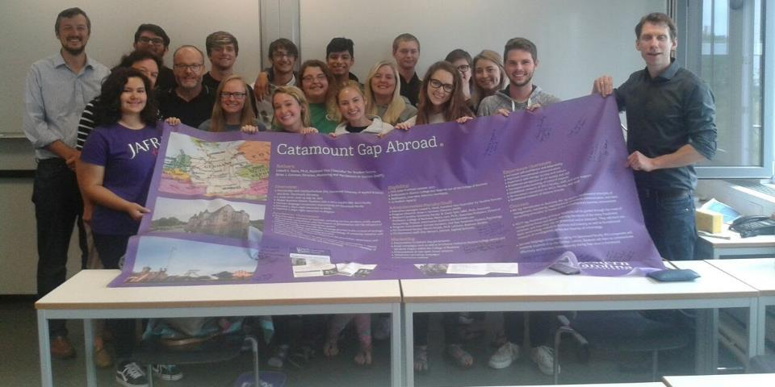
Catamount Gap Abroad
June 25 – August 1, 2018
Dortmund, Germany

Slide 2
“(Catamount Gap Abroad) has been the greatest experience of my life, thank you so much to everyone who made this possible. I rate this program and the professors involved 10/10, I would love to do this again.”

Slide 3
Agenda
Catamount Gap and Catamount Gap Abroad
Introductions
Academics and Engagement
Excursion and Day Trips
Goals and Outcomes
Logistics
  Schedules, cost, health and safety, communication, lodging, travel
Application Process
Q&A

Slide 4

Catamount Gap
June 25-August 1 catamountgap.wcu.edu

Slide 5
Catamount Gap and Catamount Gap Abroad
Unique early start opportunity for new WCU freshmen
Bridge the “Gap” from HS to college
Summer Living Learning Community model
Academic themes or “tracks”
ALL classes count toward graduation requirement
Academic, Social, Emotional programming
Coordinated field trips or excursions
Limited enrollment

Slide 6


Gap vs. Gap Abroad
Catamount Gap
  Cullowhee
  6-8 credits
  Themes:
    Honors College, Health Sciences, STEM, Pre-Nursing, Business, General Studies
  Intensive academic support:
    SI, tutors, case management
  Learn campus and community
Catamount Gap Abroad
  Dortmund, Germany
  6 credits
  Global Business theme
  Unique experiential learning opportunities
  Unique cultural experience
  Stand apart from peers

Slide 7

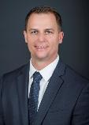
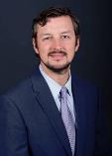
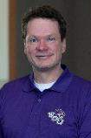

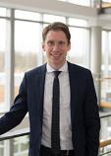
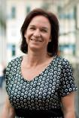
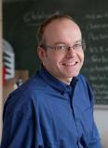
The People
Idea
Idea
Planning
Execution
Planning
Lowell Davis
Asst Vice Chancellor for Student Success
Brian Gorman
  Director, Mentoring and Persistence to Success
David Tyler
  Associate Professor
  College of Business
Marco Lam
  Associate Professor
  College of Business
Program Coordinator: TBD
Martin Kißler
Elke Meinert
Martin Kuhn

Slide 8
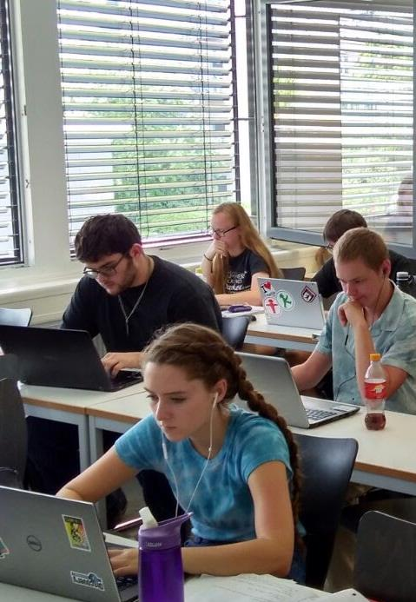
Program structure:
Classes
BA 133: Intro to Business
(Liberal Studies)
Acct 195: Tax Fraud
(Freshman Seminar)
German language & culture

Slide 9
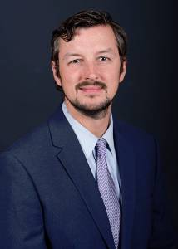
B. David Tyler, Ph.D.
Associate Professor, College of Business
Former business process consultant
Research specialty: consumer behavior, particularly among sport fans
Traveled to five continents; lived in Germany, Spain, and Australia
Led several student travel courses abroad
Dr. Tyler will teach BA 133: Introduction to Business
Notes:
David

Slide 10
BA 133: Introduction to Business
BA133 is an introductory course in business strategy. It applies fundamental principles of management, marketing, organizational structure, communication, and basic accounting principles to issues of the contemporary business environment.
International business & the global market for goods, services, intellectual capital, and labor will be emphasized.

Slide 11

Marco Lam, Ph.D.
Associate Professor of Accounting
School of Accounting, Finance, Information Systems and Business Law
Dr. Lam will teach ACCT 195: Accounting Seminar
Notes:
Brian

Slide 12
ACCT 195: Fraud Examination
An overview of occupational fraud, including fraud theory, prevention, detection and investigation. Emphasis on personal ethics, individual responsibility, and societal effects: past, present and future.

Slide 13
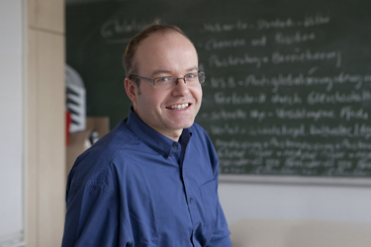
German Language Component
Fachhochschule (FH) Dortmund University of Applied Sciences and Arts
Prof. Martin Kuhn
  Teacher for special tasks
  Business and English

Slide 14
“The German course (was most beneficial), I spoke German for an entire night and they understood what I was saying so that definitely helped. The way Martin taught us was perfect, I have never been taught like that and I learned a lot very quickly.”

Slide 15
Program Coordinator: TBD
Constant communication with Director at WCU
Daily supervision and safety
Holds emergency contact and allergy information
Lead travel to and from FH Dortmund
Coordination of group activities: dinners, local excursions
Academic, social, and emotional coaching
General logistics
Notes:
Garrett

Slide 16

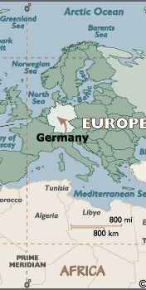
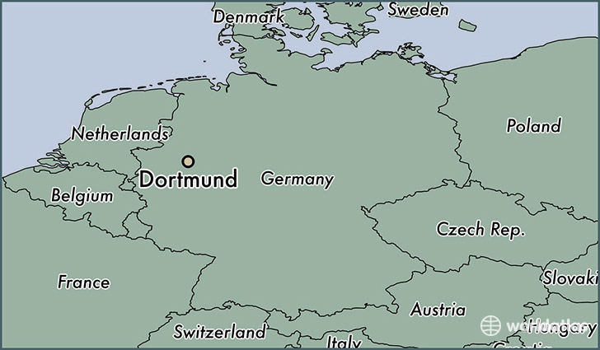
Dortmund, Germany

Slide 17


Program Structure: Engagement

Slide 18
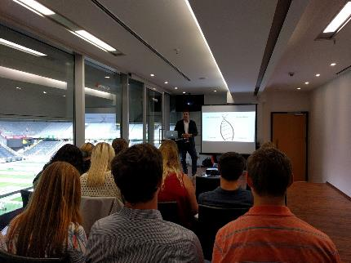
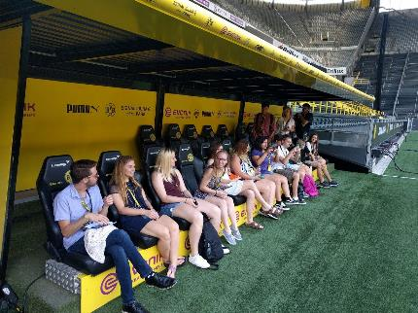
Program Structure: Engagement

Slide 19
“Meeting with the head of marketing at the Borussia Stadium (was most beneficial). This experience has changed my major and I know a few others have changed their major to marketing as well.”

Slide 20
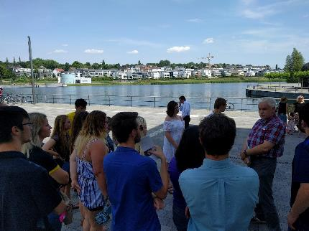
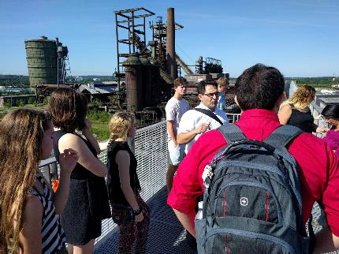
Program Structure: Engagement

Slide 21
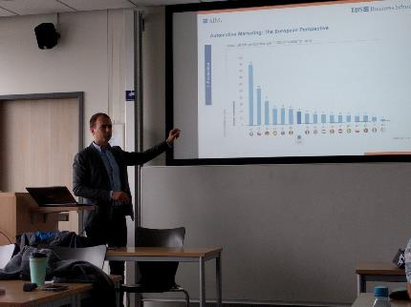
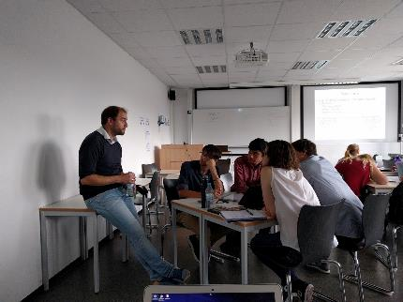
Program Structure: Engagement

Slide 22
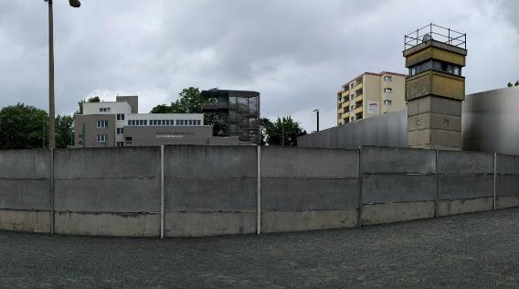
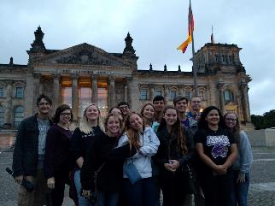
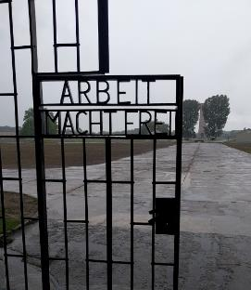
Program structure: Excursions
Berlin

Slide 23

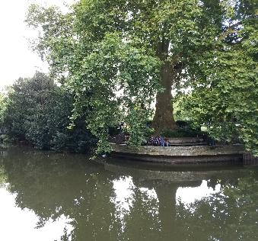

Program structure: Excursions
Köln, Münster, Amsterdam

Slide 24
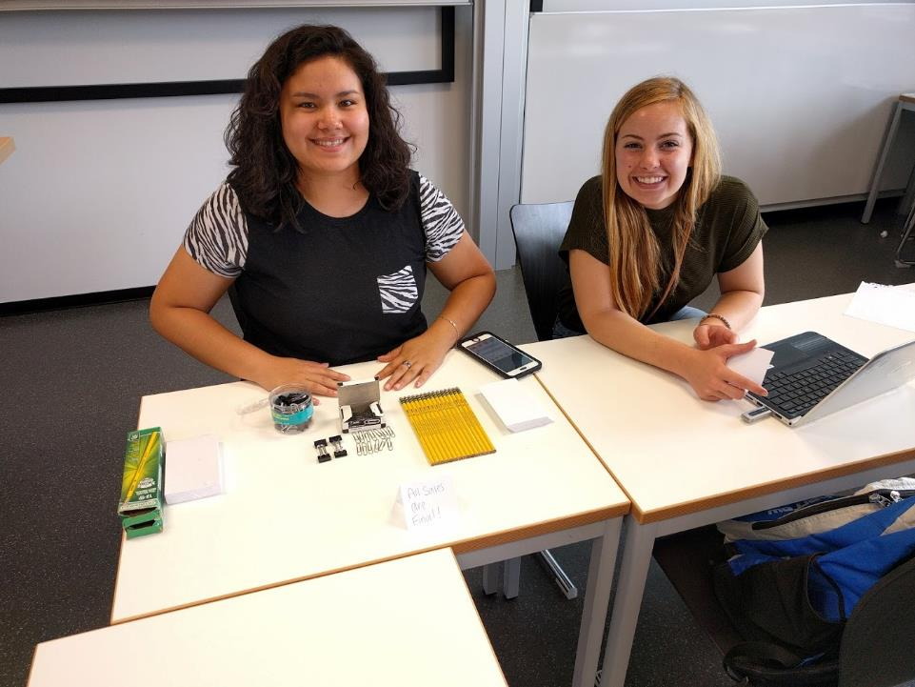
Academic goals

Slide 25
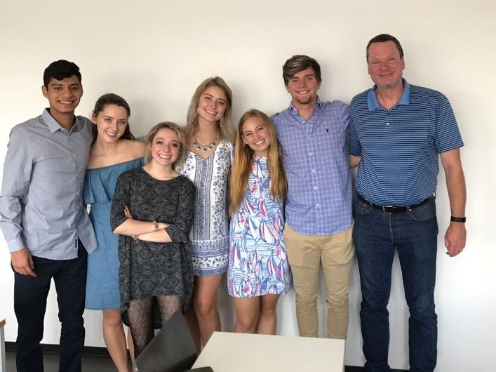
Experiential / Developmental goals

Slide 26
“I feel like I learned a lot of problem solving skills when it came to finding my way around. I had to depend on myself and do ‘research’ to find which train and the times.”

Slide 27
Dates
June 25-26: WCU Orientation
June 27: Depart Asheville Airport
June 28: Arrive in Dortmund; settle in
June 29: Classes begin
        BA 133: June 29-July 12 (11 class days, including 7/4)
        ACCT 195: July 16-30 (11 class days)
July 1 or 7: Day trip 1 (location TBD)
July 12-14: Berlin excursion
July 21 or 28: Day trip 2: Amsterdam
July 30: Last day of class
August 1: Depart Dusseldorf, arrive in Asheville
*Itinerary is Tentative

Slide 28
Typical Day
9:00a Travel to FH Dortmund
9:30a-noon Morning class session
noon-1:30p Lunch/Break
1:30-3:30p Afternoon class session
Beyond 3:30p: program coordinator will assist students to navigate dinner, evening activities, study time, and occasional programming.
Some evening activities will be required

Slide 29
Cost per student
Tuition (6 credits): $1,650.00
Lodging: $998.23
Flight: $1,350.95
Ancillary costs: $589.70
Insurance, excursions, phones, transportation, breakfast
Cost: $3,999.18
Additional potential funding:
  Summer Stipend: -$500 (dependent on EFC)
  COB scholarship: -$250 (est.)
Potential Cost: $3,249.18

Slide 30
Also included in total cost
Transportation from Dusseldorf to Dortmund
Transportation from hostel to FH Dortmund
Temporary cell phone
Student travel and health insurance
3 Day Berlin excursion
2 Day trips: Amsterdam, TBD
Not Included:
Meals
General educational supplies

Slide 31

Lodging
Dortmund Youth Hostel
4 bed room and 6 bed room dormitory style
Recreation room: foosball, billiards, table tennis
2 TV rooms, common room, and internet corner
Café and buffet style restaurant on site
Basic shop, library on site
Fully staffed
WiFi included
DJH Youth Hostel Dortmund

Slide 32
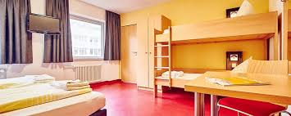
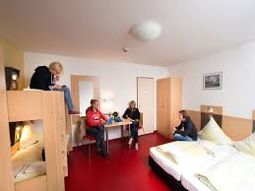
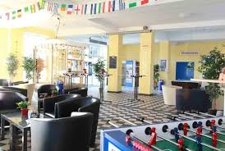



Slide 33
Supervision
Faculty and the coordinator will live among students in the hostel and accompany students in their commute to and from FH Dortmund for at least the first week.
During free time students will communicate with the coordinator as to where they are going.
There will be at least one faculty member on site for the duration.

Slide 34
Communication
Students will be provided temporary cell phones for communication with the coordinator, each other, faculty.
Students will communicate with the coordinator where they plan to go and for how long.
  Log sheets
Students will be asked to check-in with the coordinator occasionally when venturing without him or a faculty member.
Parents will be provided phone numbers for Dr. Tyler, Dr. Lam, Brian, and the coordinator so students can be contacted in case of emergency.

Slide 35
Health and Safety
Student health insurance included in cost
  HTH Worldwide
St. Johannes Hospital – 450 meters from hostel
U.S. Department of State tips for traveling to Germany
Communication plan
Buddy system
No guests at hostel outside of Gap Abroad
Emergency Contact Cards Provided

Slide 36
Daily Commute and Travel
Metro of Dortmund
  Monthly pass included in cost
  Runs daily 3:30am-12:45am
  Every 10 minutes during day, 15-20 evening
Excursion travel: Dr. Davis will coordinate

Slide 37
Logistics
Orientation: June 25,26
  Gap Abroad session June 25 (students & parents)
  Light Breakfast June 27 before departure (students and parents)
Financial Aid: 2017-18 FAFSA
$250(est.) College of Business scholarship
Credit Card without foreign transaction fees
Pre-paid card or cash for meals
Interview process
Admissions paperwork

Slide 38
Contact Us
Mentoring and Persistence to Success (MAPS)
  828.227.7127
  maps@wcu.edu
  http://CatamountGapAbroad.wcu.edu
READY TO GO?
Apply here!

Slide 39

Q&A

Slide 40
Catamount Gap Abroad too much? Check out Catamount Gap instead: catamountgap.wcu.edu

