Slide 1
Western Carolina University’s University Participant Program “Can College Decrease Support Needs and Increase Independence?”
David Westling, Kelly Kelley, Seb Prohn,
Michael Kozicki, and Leslie Kozicki
2013 TASH Conference
Notes:
All introduce

Slide 2
What is the UP Program?
The University Participant (UP) Program is a two year, inclusive transition program for college-aged individuals with intellectual disability
Supports up to 8 selected participants per year; 4 in each graduating cohort during the spring semester
Funded as a model demonstration site in 2010 by U.S. Department of Education. Serves as a model program for the state by providing support to satellite programs in NC and technical assistance to programs across the nation
Notes:
DW

Slide 3
Five Program Components
Personal Development
Community Participation
Vocational Preparation
Course Auditing
Social Participation and Learning
Notes:
DW

Slide 4
UP Certificate Requirements
UP Certificate of Accomplishment
1800 hrs in 4 semesters
80% of objectives in IPCP*
Recommendation based on satisfactory progress
*Individual Plan for College Participation (IPCP)
Notes:
DW

Slide 5
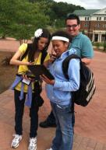
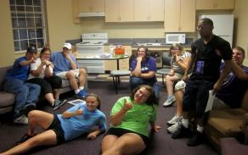
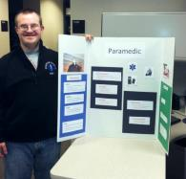
What do UP Participants do at WCU?
Live in campus residence halls and experience college life with same age peers
Have an individual plan that would allow personal development for post-UP success
Attend and audit a limited number of classes
Participate in social events and activities
Notes:
DW

Slide 6
Independence: The Process
Goal review
Entrance video
Successes
Academic road map
Improvements
Vision
Goals
Schedule
PCPs
Next steps
Summer immersion
Personal
Social
Personal
Vocational
Social
Academic
Community
Vocational
Academic
Community
Notes:
KK

Slide 7
Michael’s Academic Roadmap
Who will I be? Future me.
I’ll be good at childcare, have lots of friends, go to concerts and sporting events where I’ll tailgate
I’ll live in Georgia in community housing
Skills Desired
Painting
Public speaking
Money management
Cooking skills
Camping skills
Reading skills
By the time I leave college….
I want to know/ be able to… childcare
I want to prove to others… That people like me and I can think like people without disabilities.
How will people remember me? As a regular person
Back
Notes:
KK

Slide 8
Creating and Assessing IPCP Goals
Back
Notes:
KK

Slide 9
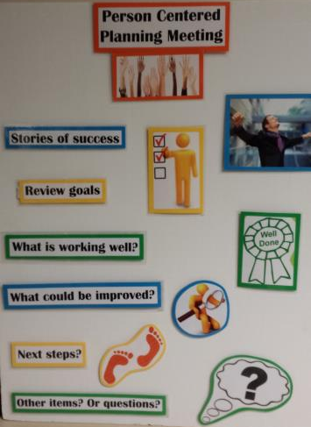
PCP
Back
Notes:
KK

Slide 10
Weekly Activity Schedules
Strengths
Practical tool for students, program & others
Hours as a unit of measure
The Method is an intervention
Positive research
Limitations
Quantity vs Quality
Time consuming
Notes:
KK or SP?
Activity schedules have been part of the UP Program since our first cohort. Initially, these were used to increase punctuality and for students to say connected with supports. Each support on the schedule has a phone number corresponding with the time slot in which they are situated. Schedules, also reduce anxieties about where one should be or what one could be doing.
Also, hours are a pretty attractive unit of measurement; it’s generally something that most people can interpret where they might find difficulty casually discussing standard deviation units. What I like the most, and what research has shown over the last decade, is that schedules generally increase levels of independence and engagement in activities. Just like photovoice or group therapy, the methods for collecting data are also an intervention. The schedules are helping students grow and increasing their opportunities for independent living while also being a way to track and measure student progress. [“representing a series of activities
in a visual format can promote independent performance of not only individuals with autism diagnosis but also with other
types of intellectual disabilities (e.g., intellectual impairment, Down syndrome). Notably, two studies (Anderson, Sherman,
Sheldon, & McAdam, 1997; Wheeler & Carter, 1998) taught children and adults with severe intellectual disabilities to follow
schedule. Furthermore, Anderson et al. (1997) taught adults living in a group home to choose and engage in recreational
activities independently. The implication is that activity schedules can be a useful tool in promoting independence and,
possibly, self-determination of individuals with significant cognitive challenges.” (Koyama & Wang, 2011)
There are downsides. Looking at schedules tells you how much but it doesn’t comment on quality. So, we can measure, for example, that the student was participating in recreational therapy for 4 hours in a month but it is not until the end of the month at a PCP meeting that we find the student was not enjoying that time- that type of information is never packaged within the schedule itself. Which is why it is often important to use what the schedule tells us as means to an end or as a conversation starter, rather than as the end itself. That holds true for most evaluation data.
Teachers and former teachers you know how time consuming it can be to make schedules for your class, but making individual schedules for 8 students and 200 supports for approximately 14 hours a day can take a ton of time. We’ve developed a system where supports meet with UP Participants to develop weekly schedules. Schedules are checked, pictures are added according to literacy levels, and then they are published each week for approximately 30 weeks an academic year.
But there are really two schedules.

Slide 11
Staff/Support View
Whentowork.com
Notes:
KK

Slide 12
Student View
Notes:
KK

Slide 13
Dependent Variable: Support Needs*
Use scheduling software & schedules
Examine ‘hours supported’ while doing program related activities
Self-evaluation: The Face Test
“I’m more independent. On my schedule there are more pictures of me on there.” 2nd Year UP Participant
*We colloquially refer to this as ‘independence’
Notes:
SP
Theoretical independent variables behavior, self-determination, supports intenstity

Slide 14
Participant Support Needs 2012-13 Academic Year
“when we start working independently then our supports start to fade. Eventually you get to work on your own ... And then we will be able to help the new students and that kind of thing.” 1st year UP Participant
Notes:
SP
53, 45, 41

Slide 15
Time is Money*
*At estimated $25 per hour. Start: 53hrs; End: 40hrs.
Notes:
SP
$325 per week
$4,875 per semester (15 weeks x $325)

Slide 16
Michael’s Support Needs Fall 2012-Fall 2013
Notes:
SP
52, 46, 38, 32
Can we put F12, F12 mid, S13, F13? Little confusing the way it looks
Do we want to add money comparison to this one from Y1 start-Y2 middle as well?

Slide 17
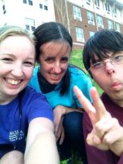
Michael Kozicki
My growing independence
How did UP help me become more independent?
Fading support- how I know I’m ready
My biggest college accomplishments
College opportunities that were not available elsewhere
Notes:
MK

Slide 18
Leslie Kozicki
Ways Michael has become more independent
The structure of WCU UP increases independence (PCP; natural support feedback; fading, etc)
Michael’s growth & accomplishments from college
Notes:
LK

Slide 19
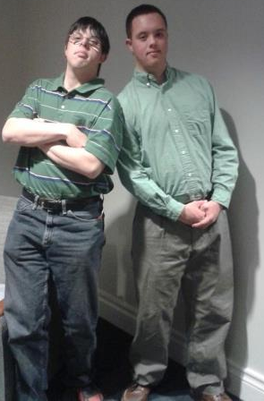
Implications for Practice
Make and quantify schedules, but be flexible
Hold consistent PCP meetings with everyone’s input
Monitor behavior/goals via online questionnaires at least weekly
Set family expectations early and provide guidance with meeting post-UP goals
Notes:
All

Slide 20
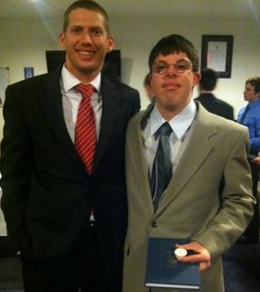
Questions and Contact Info
up.wcu.edu
David Westling westling@email.wcu.edu
Kelly Kelley kkelley@email.wcu.edu
Seb Prohn smprohn@email.wcu.edu
Michael Kozicki makozicki1@catamount.wcu.edu
Notes:
All

