Slide 1


A Crash Course on Assistive Technology Evaluations
Kyle Slough, MS., CRC
Kgslough@live.com
Marie Agius, MS., LCAS, CRC
Dotym07@students.ecu.edu
Melissa Engleman, EdD.
Englemanm@ecu.edu
Irene Howell Assistive Technology Center
http://www.ecu.edu/educ/ci/sped/at/
Greenville, NC

Slide 2
Learning Objectives
What is assistive technology and the different levels of technology available;
Assistive technology theories;
Basic assistive technology evaluation techniques;
Assistive Technology tools
New assistive technology evaluation in progress.

Slide 3
Assistive Technology (AT)
How do you define AT?
How do you think students define AT?

Slide 4
Assistive Technology Device
“The term assistive technology device means any item, piece of equipment, or product system, whether acquired commercially off the shelf, modified, or customized, that is used to increase, maintain or improve functional capabilities of children with disabilities.” (20 U.S.C. 1401(a)(25))

Slide 5

AT Simply Defined
any device, system, appliance or tool which provides better access to the full potential of a person with a disability.
Train
Accessing Natural Potential
Simply AT

Slide 6
Different Types of AT
Aids for Daily Living
Augmentative Communication (or Alternative)
Computer Applications
Environmental Control
Home/Worksite Modifications
Prosthetics and Orthotics
Seating and Positioning
Vision Aids
Sensory Aids for Hearing Impairment
Mobility Aids
Vehicle Modifications

Slide 7
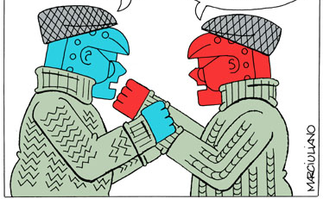
AT verse Universal Design
I am designed to help people with disabilities.
I am designed for the greatest access of all people.
AT versus Universal Design
(round one)

Slide 8
AT verse Universal Design (UD)
Think of them as umbrella terms that differ in the origins of the technology design. They both have a common goal on campuses.
AT
UD

Slide 9
Level of AT
Low-tech AT- options are usually easy to use, have a low cost and typically do not require a power source
Mid-tech AT- are also easy to operate but typically require a power source.
High-tech AT- usually complex and programmable and include items that require computers, and/or electronics, to perform a function.

Slide 10

Range of Assistive Technology
COST
Low-Tech
+ NUMBER of FEATURES --
COST
Needs
of the
User
High-Tech
Notes:
This is a balance of the cost to feature ratio of high-tech verse low-tech. The picture describes how the cost and features increase in the high-tech and decrease in low-tech. The picture is balance on the needs of the user because to determine which AT is truly approach, one needs to make that decision on the needs of the user and not the cost or features of the AT.

Slide 11
Hard and Soft Technologies
Hard Technologies- assistive technology systems which are made from “readily available components.” This includes things from mouth sticks to computers and software.
Soft Technologies- are in three different forms: people, written and computer. Basically soft technologies are AT services. These technologies rely on knowledge, experience and ingenuity of the provider.

Slide 12
Appliances Versus Tools
Appliances “provide benefits to the individual independent of the individual’s skill level” (Vanderheiden, 1987, p. 705).
Tools- require the user to develop skills to use the device.

Slide 13
Alternative and Processing Computer Access Methods
Input | Processing | Output
Alternate keyboards Interface devices Joysticks Keyboard modifications Keyboard additions Optical pointing devices Pointing and typing aids Switches with scanning Scanners & optical character recognition Trackballs Touch screens Voice recognition | Abbreviation/expansion and macro programs Access utilities Menu management programs Reading comprehension programs Writing composition programs Writing enhancement tools (i.e. grammar checkers | Braille displays and embossers Monitor additions Screen enlargement programs Screen readers Speech synthesizers Talking and large print word processors
Source: http://www.pluk.org/AT1.html

Slide 14
Question
What AT do you use or offer?
Why did you select the AT?
How do you suggest AT to students?
How do you assess which AT is appropriate for the student?

Slide 15
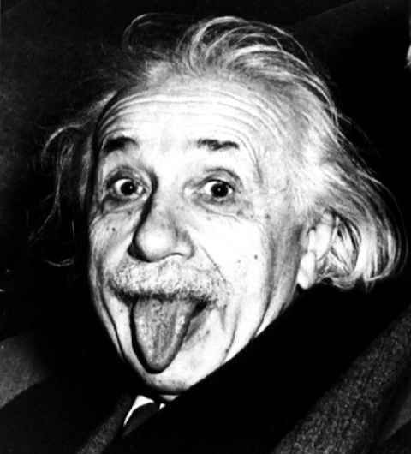
AT Theories and Models
The SETT Framework
Human Activity Assistive Technology Model
(HAAT)

Slide 16
SETT
Student
Environment
Task
Tools
Build off the individual not the tools
Notes:
Smiley Zabala, M.Ed.
Region IV Education Service Center
http://secure.edc.org/ncip/workshops/sett3/SETT.htm
There is an image of a sledge hammer to add emphasis.

Slide 17
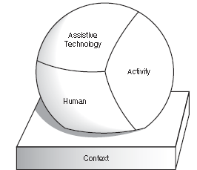
Human Activity Assistive Technology Model
(HAAT)
The HAAT model is made of four components: the human, the activity, the assistive technology and the context.

Slide 18
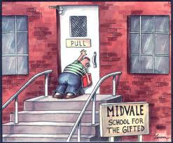
HAAT: Activity
Defines the goal of the assistive technology system
Activities are divided into three different performance areas:
      Daily Living
      Work and productive
      Play and leisure
Notes:
What skills and abilities are required for these activities?
Physical, mental, emotional and cognitive , production requirements etc.
Activities can be broken down into tasks and which each can be completed and build on each other until the activity is completed.

Slide 19
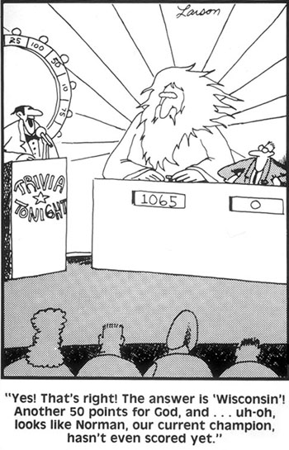
HAAT : Human
Consider the student with a disability because they “operate” the system.
So why the human?
Skills and ability
Novice versus Expert Users
Notes:
Technology use relies on the users needs being met
The HATT model uses two different theories the CMOP and occupational competence. The main difference is the CMOP is a snap shot and the occupational competence spans the user’s lifetime. Capacity refers to potential skill, ability or knowledge
Effectance is the extent to which individual reaches or uses their capacity
When motivated to perform well in activity, effectance approaches capacity.
Affordances are those environmental elements that can facilitate performance of a task
Self-efficacy- belief that the individual can be successful
Competence is the perception of satisfactory performance

Slide 20
HAAT: The Contexts
What is the problem in the environment?
Contexts are environment or circumstances which affect the assistive technology system and user.

Slide 21
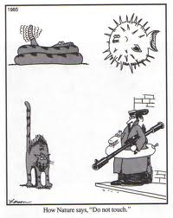
HAAT: The Contexts
Three levels
  Microenvironment
  Mesoenvironment
  Macroenvironment
There are four major areas:
  Physical context
  Social context
  Cultural context
  Intuitional context
Notes:
Microenvironment-closest most intimate environment like the home, work or school
Mesoenvironment- the setting in which a person functions less frequently and includes various community facilities like shopping malls and chruches
Macroenvironment- refers to the broader social and cultural contexts that impose a legislative and moral behavioral framework on the person

Slide 22
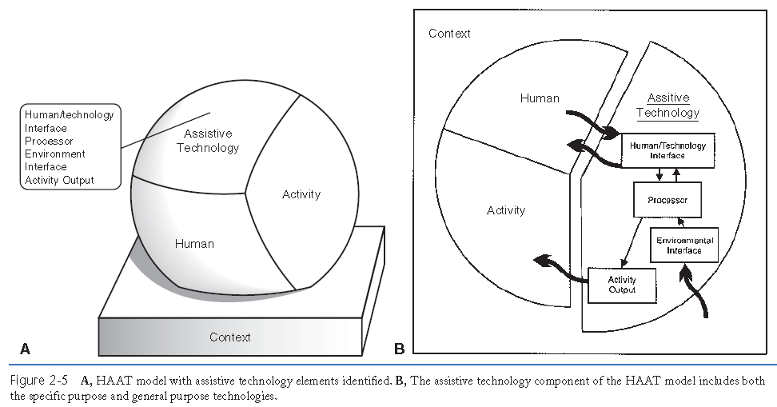
HAAT: The Assistive Technology
The extrinsic enabler
Human/technology Interface
Processor
Environment Interface
Activity Output
Notes:
At improves human performance in the presents of a disability

Slide 23
HAAT: The Assistive Technology
Human/technology Interface
  How both the technology and the human exchange information or forces.
  Types of interfaces
    Positioning devices, or postural support systems
    Control interface
    Display
      Visual
      Auditory
      Tactile

Slide 24
HAAT: The Assistive Technology
Processor
  The system that process the data to complete the task
    Computer
    Mechanical devices
Activity Outputs
  Facilitate performance
  Include cognitive, communication, ambulation, manipulation of objects.
  Functional or augmented

Slide 25
HAAT: The Assistive Technology
Environmental Interface
  Links the device to the context or external world
  This interface in designed to address sensory performance needs.
    Seeing
    Hearing
    Feeling
  Like a microphone for a hearing aid

Slide 26
Basics of AT evaluations
Referral and Intake
Initial Evaluation
Recommendations and Report
Implementation
Follow-up
Follow-along

Slide 27
Referral and Intake
Gather basic information about the client
Determine if there a match between the needs of the client and the at services provided
Identify possible services to be provided

Slide 28
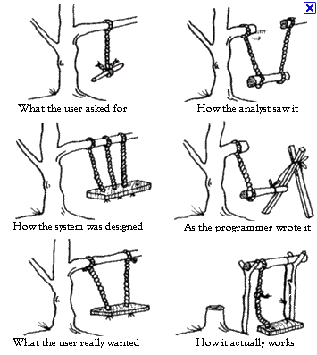
Initial Evaluation
Needs Identification
Skills Evaluation
Device Characteristics

Slide 29
Initial Evaluation
Needs Identification
  So what are some of the goals and needs of the students?
    What are some of the common ones at your college?
  Opportunity barriers- obstacles out of the student’s control place by others or situations.
  Access barriers- hurdles related to the abilities, attitudes and resource limitations of the student or support system.

Slide 30
Initial Evaluation
Skills Evaluation
  Sensory
  Physical
  Cognitive
  Language

Slide 31
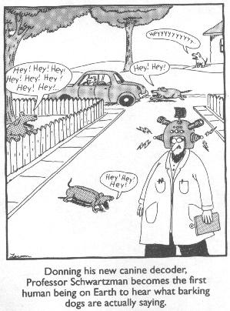
Initial Evaluation
Device Characteristics
  Feature is the expression of a characteristics
    Like 35mpgs
  Characteristics is individual tools or items which the AT offers.
    Like a engine or reads text out loud
Human/Technology Interface
Processor
Activity Output
Environmental Interface
Physical Construction

Slide 32
Recommendations and Report
In most cases a written report outlining the strengths and weakness of the client, summary of assessment scores, interpretation of scores, background information on the client, behavioral observations, recommendations and evidence or justification for the recommendations.
Also, in AT reports justification for funding or recommendations for funding sources.

Slide 33
Implementation
Order and Setup
Delivery and Fitting
Facilitating Assistive Technology System Performance
  Training
  Performance Aids
  Written Instructions

Slide 34
Follow-up
activities that occur during the period immediately after delivery of an assistive technology system and that address the effectiveness of the device, training, and user strategies.
Maintenance
Repair As Needed

Slide 35
Follow-along
used to describe those activities that take place over a longer period.
Reevaluate
Maintenance
Repair As Needed

Slide 36
Partnership
A Partnership would help tech support, students and ODS
Tech support
ODS
Assistive
Technology
Students

Slide 37
Focus on the person
As professionals we need to practice person-centered assessment and recommendation
Goals of the training we provide should be based in the principles of SMARTER goals
  The training should be evaluated and re-evaluated
Maintenance of AT is critical to its continued use
Notes:
tool belt
Specific
Measurable
Attainable
Realistic
Time-bound
Evaluate
Reevaluate

Slide 38
User Needs to Consider
Does the technology address the user’s need which the technology is being provide for?
Does the technology match with the user’s skill level?
If training is required, how long will the training take to complete and what functions will the user be trained on each time?

Slide 39
User Needs to Consider
What is the user’s level of experience?
How resilient is the user?
How will follow training be provided?
Where is the funding coming from?
How will the user seek support?
How will the assistive technology be maintained?

Slide 40
Select your weapon
COPM
FEAT
Comparing and Evaluating Assistive Technology

Slide 41
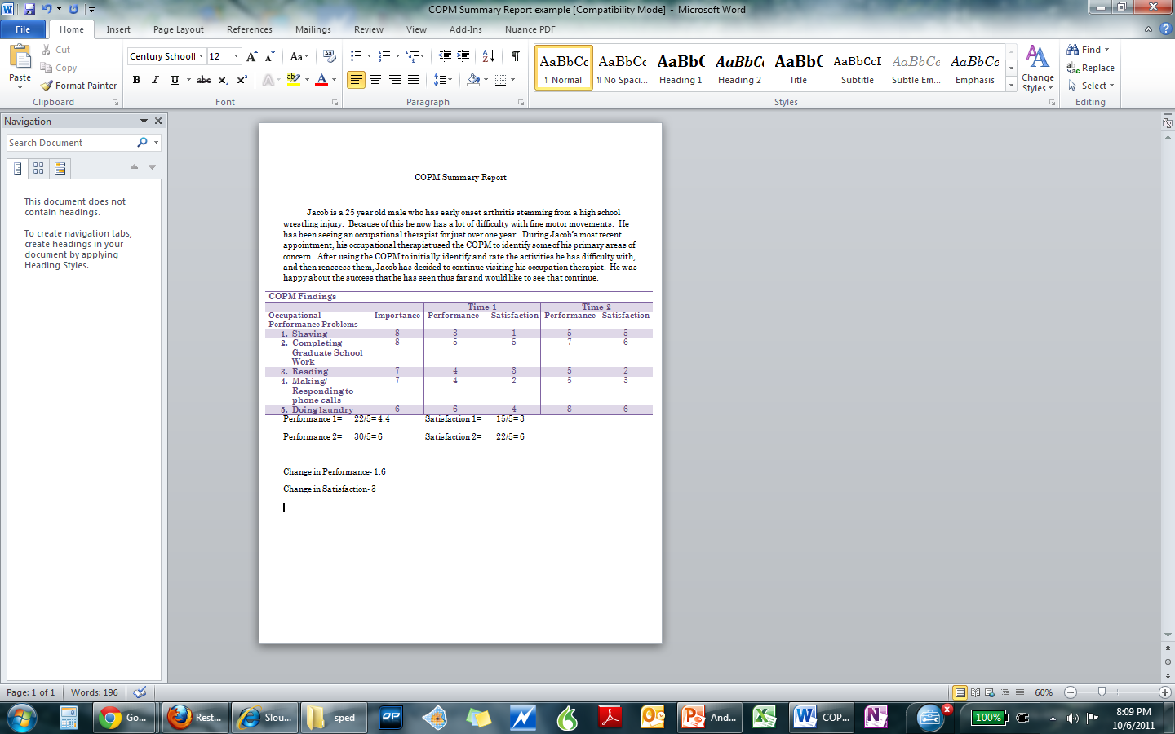
COPM
Canadian Occupational Performance Measure
This assessment relay's on the administrator’s clinical interview skills.
This assess the client’s perception of what is important of a goal they identify.
Then their level of satisfaction with that performance.

Slide 43
COPM Findings
 |  |  | Time 1 |  | Time 2
Occupational Performance Problems |  | Importance | Performance | Satisfaction | Performance | Satisfaction
1) Shaving |  | 8 | 3 | 1 | 5 | 5
2) Completing Graduate School Work |  | 8 | 5 | 5 | 7 | 6
3) Reading |  | 7 | 4 | 3 | 5 | 2
4) Making/ Responding to phone calls |  | 7 | 4 | 2 | 5 | 3
5) Doing laundry |  | 6 | 6 | 4 | 8 | 6
Performance 1= 22/5= 4.4 Satisfaction 1= 15/5= 3
Performance 2= 30/5= 6 Satisfaction 2= 22/5= 6
Change in Performance- 1.6
Change in Satisfaction- 3

Slide 44
FEAT
There are 6 different assessments packets
  Checklist of Strengths and Limitations
  Individual- Technology Evaluation Scale
  Technology Characteristics
  Contextual Matching Inventory
  Checklist of Technology Experiences
  Summary and Recommendation Booklet

Slide 45
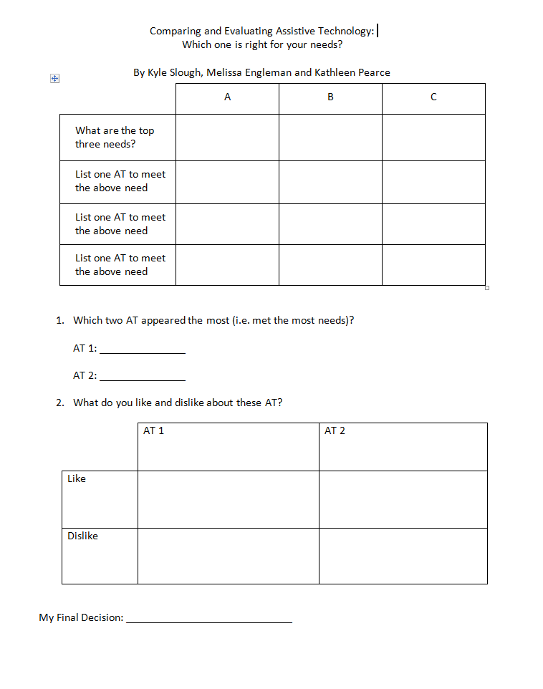
Comparing and Evaluating Assistive Technology
This form is designed to assess up to three needs of the student.
It is designed to be used by the evaluator or client.
Currently, this tool has not been validated.

Slide 47
Case 1
Lashada is an 18 year old, first year student. She grew up in a small town in rural NC. Her experience with accommodations, includes time and half on exams, a scribe, books on tape and one math question per page.

Slide 48
ECU’s AT Graduate Certificate
12 hours of course work including AT evaluations, Grant and funding, Basics of AT
http://www.ecu.edu/cs-educ/ci/sped/at/gradcert.cfm

Slide 49
Resources
Athens
  Access Technologists Higher Education Network
  http://www.athenpro.org/member
  Free journals and a listserv
AHEAD
  Association on Higher Education and Disability
  http://www.ahead.org/resources
ECU Graduate Certificate in Assistive Technology
PEPNet
  Tech for deaf or hard of hearing
  www.pepnet.org

Slide 50
Resources cont.
Link to a good excel file which gives a lot of different tech, funding sources and other resources.
  http://spreadsheets.google.com/ccc?key=0AomYaPFK5E4QdFNCdG5MakZ1dzZZOGpzbzJ6dEQwX1E&hl=en
Apple Access
  http://www.apple.com/macosx/universal-access/
Microsoft Enable
  http://www.microsoft.com/enable/
  http://www.microsoft.com/enable/products/chartwindows.aspx
  http://www.microsoft.com/enable/products/windowsxp/default.aspx
  http://www.microsoft.com/enable/download/default.aspx#step
Irene Howell Assistive Technology Center
  http://www.ecu.edu/cs-educ/ci/sped/at/atlab.cfm

Slide 51
Resources cont.
Alliance for Technology Access
  http://www.ataccess.org/index.php
PCWorld
  http://www.pcworld.com/article/159413/5_great_microsoft_web_services_you_probably_dont_use.html?tk=rel_news
RESNA
  http://resna.org/
  Assistive Technology Professional (ATP)
Trace Center
  http://trace.wisc.edu/
  Research to Make Everyday Technologies Accessible & Usable
Do-it Disabilities, Opportunities, Internetworking, and Technology
  http://www.washington.edu/doit/Brochures/Technology/wtsense.html

Slide 52
References
Cook, A. M., Polgar, J. M., & Hussey, S. M. (2008). Cook & Hussey's assistive technologies: principles and practice (3rd ed.). St. Louis: Mosby elsevier.
Family Guide to Assistive Technology. (n.d.). Parents, Let's Unite for Kids. Retrieved October 13, 2011, from http://www.pluk.org/AT1.html
Slough, K.G., & Engleman, M. (2010, November). Comparing and Evaluating Text-to-Speech Software: Which on is right for your needs? Content session presented at Access Technology Higher Education (ATHEN), Denver, Co.
Slough, K.G., & Engleman, M. (2010, November). Bother sides of the fence: Student and Professor Perspectives on Accessible Textbooks. Content session presented at ATHEN, Denver, Co.
Zabala, S. (n.d.). The SETT Framework: Critical Areas to Consider When Making Informed Assistive Technology Decisions. The SETT Framework: Critical Areas to Consider When Making Informed Assistive Technology Decisions. Retrieved October 3, 2011, from secure.edc.org/ncip/workshops/sett3/SETT.htm

Slide 53

Questions?

