Slide 1
Softball Policies and rules Presentation
2015

Slide 2

IMLEAGUES HAS GONE MOBILE!
RECIT is your source for everything intramurals.
Check game schedules and results, communicate with team members, and receive real-time campus recreation updates on your phone. Download REC*IT

Slide 3
Social Media
For up to date information and activity pictures
“Like” us and favorite us on Facebook - WCU Campus Recreation
Tweet us at @WCUCampusRec

Slide 4
Softball Presentation
• It is highly recommended that all participants review this presentation as it contains important
information regarding intramural sport policies and Softball rules.
• As additional supplement, the Intramural Participant Handbook and Softball rules are viewable at:
- Intramural Sports Website
- IMleagues website: click on the info link on the left side of page, then click handbooks and manuals
• Unawareness is not an excuse

Slide 5
New Registration requirement
To ensure that intramural team participants have a good understanding of our policies and procedures, league sport team captains are now required to complete a captains quiz to register their team
This quiz must be passed with a 80%.
The quiz is based on the intramural handbook/presentation/rules and provides important information that will aid each team during their intramural sports season.

Slide 6
Intramural Staff
Associate Director for Intramural and Club Sports
  Jonathan Johnston
  jdjohnston@wcu.edu
  828-227-8807
Assistant Director for Intramural Sports
  Haley Bosco
  hbosco@wcu.edu
  828-227-8806
6 supervisors and 16 officials

Slide 7
Contact and times
Associate/Assistant Director
  9-12 and 1-5pm Monday-Friday
  In and out of the office during the day
• Calls and emails
  If received after 5pm during the week, you will not get a response until next day
  If received after 5pm on Friday, you will not get a response until Monday

Slide 8
INTramural Supervisors
Policies?
Sport Rules?
Facility Concerns?
Employee Concerns?
Protest?
Eligibility?
First Aid?
Ask an Intramural Supervisor!

Slide 9
STudent Officials
The success of the Intramural Sports program is contingent upon the quality of its sport officials and participants.
Intramural contests are officiated by fellow Western Carolina students. They are not professionals and are paid minimum wage for the service they perform.
They deserve and expect your cooperation, respect and sportsmanlike behavior.
They are trained to perform these jobs, and we expect them to officiate to the best of their ability.
We invite you to apply for the student officials' job available with our Intramural Sports Program

Slide 10
IMLeagues
www.imleagues.com/wcu
• All players must have an imleagues account to be
listed on a team.
Used for:
  League announcement emails and texts
  Schedules, scores, rosters, standings, policies and Rules
  Adding players
• To be approved and scheduled for the Softball league, teams must have a minimum of 10 players joined on imleagues by registration end.

Slide 11
IMLeagues notables
• Always click Western Carolina University at the top
to see a current list of sports and their league/tournament information
• Game notifications can now be sent to your phone or email. Click your name top right, then notifications
• Click on home at the top to see a list of your game
times and an calendar of upcoming sports and registration deadlines.

Slide 12
TIME PREFERENCES
Now including time preferences for game times
Each division has different time options
Input your teams time preferences before league registration closes
System will best fit your preferences within your team’s schedule
Not 100% guaranteed
Time preferences will not apply in playoffs

Slide 13
Intramural Policies and procedures

Slide 14
Facility Policies
Camps Lab Fields
The following is prohibited:
  Food
  Tobacco (including chewing)
Please help keep our fields clean
Pet Policy: All pets must be under control and watch at all times. Leashing a pet to the fence is not acceptable. Please clean up after your pet.

Slide 15
Tobacco, Alcohol, Drug Use
Tobacco (chewing or smoking) is not allowed on the Intramural fields or other activity areas as well as 50 feet from any structure on campus per university policy 45.
Alcohol/Drugs are not allowed on the intramural fields/facilities
If a player or spectator may not be in possession or suspected of being under the influence of alcohol or drugs

Slide 16
Player Release
A player may only be released from a team if they first played for a team in their first regular season game and have not since played for another team or in another game
They must notify an Intramural Sports professional staff member before they participate with another team
Failure to notify will result in the second team they played for forfeiting the game, and the player will be required to play with the first team. Possible suspension may be served.

Slide 17
Assumption of Risk & Injuries
Strive to provide safe and well-supervised activities and facilities, however there is an inherent potential for physical injury or death in all sport activities.
All participants are strongly encouraged to have a yearly medical examination and to carry medical insurance coverage.
Participation in sporting activities may cause injury and exposure to blood borne pathogens.
First Aid Care (IM Supervisors)

Slide 18
TEAM CAPTAINS
As a captain, I agree to and are fully responsible for the following regarding my team:
  Teams schedules
  Eligibility of players
  Behavior of myself, players and spectators
  Knowledge of rules and policies
  Communication and cooperating with all IM Staff
  Being a team leader

Slide 19
Check in Requirements
All players must present their CatCard to the IM Supervisor prior to playing in each game
No ID = No play
Other forms of Identification will not be accepted
Captains responsibility to make sure all players are checked in

Slide 20
MIS-Use Of ID
Any person caught misusing a University ID or falsifying name is subject to suspension from Intramural Sports
Incidents may be reported to Student Community Ethics as it’s a violation of student code of conduct
Either of the above could also result in game forfeit and suspension from Intramural Sports and the Campus Recreation Center

Slide 21
Eligibility
Only current WCU student, faculty/staff or faculty/staff spouse/partner ($10 fee, pay at CRC)
Playing with ineligible players will result in forfeit and suspension of players involved
Teams can’t agree to play with an ineligible players
Ask up front with all eligibility concerns to avoid a forfeit in season

Slide 22
Faculty/staff and Spouse/partners
Faculty/Staff
  Must show Faculty/Staff CatCard
Faculty/Staff/Student Spouses/Partners
  Must have and show a Spouse/Partner CatCard
  Pay a $10 Intramural Fee at the Rec Center
  IM sticker is put on CatCard at Rec Center

Slide 23
Restricted Players
Varsity Athletes
  Baseball/Softball varsity (WCU or other universities) athletes must be two full semesters (summers don't count) removed from playing to be eligible and includes all divisions, red shirts, practice squads, working out with them, etc.
  Allowed four non-softball/baseball varsity athletes on entire softball roster.
  If Athletics recognizes a player as a varsity athlete in this academic year, then they will be identified as such during the entire academic year

Slide 24
RESTRICTED PLAYERS
Softball professional and semi-professional players are not allowed to play intramural softball
Club Players
  Allowed three baseball club players on entire roster
  Clubs players are identified as those who have appeared on the roster or waiver form and considered as such one semester after their last appearance on roster or wavier form
Varsity and Club Sport Coaches
  Coaches may play in their corresponding sport, but they will be considered a club sport player.

Slide 25
Rosters
Rosters
  Players may only play on one CoRec team and one men’s/women’s team
  Once a player checks in for a team that’s it.
Adding
  Add any players at any time on IMLeagues and game site
  Ask all players if they have played for someone before
Removing
  You can remove players if they haven’t checked in for a game, once they check in after a teams first game, they are permanently on your team

Slide 26
Roster Max
20 players maximum on a Softball roster
  10 PLAYERS REQUIRED BY REGISTRATION DEADLINE
Can add if spots available on game sheet
If no space available, then you can scratch out those who have zero games checked in and add new player. They will then be deleted from team.
Remind all players to get imleagues account and on to your roster
Captain’s responsibility to know how many players on their team

Slide 27
Reschedules
Check with Associate or Assistant Director if there are any available times open
Contact the other team’s captain and agree on one of the open times
Contact the Associate or Assistant Director, once agreed upon
We have to receive confirmation from both captains before a reschedule game is approved
All reschedules must be fully approved by noon the day of the original game. Friday by 4pm if a Sunday game
Don’t assume a game is rescheduled unless you’ve heard from an Intramural Sports staff member

Slide 28
Participant Conduct
Participants are expected to treat Intramural Sport staff and fellow participants with respect
Teams and captains are responsible for their own behavior
Please only have captains speak with officials and do so in a respectful manner
Baiting and verbal abuse of supervisors or officials will especially not be tolerated!
Supervisors and officials have every right to end any game if they deem it necessary

Slide 29
Participant Conduct
Examples of unsporting behavior
  Continuously arguing with an official
  Taunting, cursing or gesturing lewdly at other teams or IM Staff
  Insubordination
  Physical contact/altercation with other players or IM Staff
  Anything else deemed unsporting by IM Staff
Failure to compose players or comply with requests from the Intramural Staff will result in a forfeited contest and further disciplinary actions

Slide 30
Participant conduct
Physical contact directed towards an Intramural Sport staff member or involving participants will result in severe consequences.
All participants are governed by the Intramural Sport Handbook and the WCU Student Code of Conduct
Any incidents may be reported to DSCE as a violation of the code
Additionally, participants may have CRC facility access privileges revoked

Slide 31
Sportsmanship Rating
Team Conduct Rating System
  Zero to four scale
  Must have 3.0 cumulative score to qualify for playoffs
  Game officials/supervisors give ratings at end of game
  Given ratings are NOT NEGOTIABLE
One and Zero Ratings:
  Team is suspended from season play until Captain talks with the Assistant Director
  Depending on severity, one or zero ratings could result in a team being dropped from the league

Slide 32
Unsportsmanlike Conduct
Teams that receive 4 UC’s total, 3 UC’s on 3 individual players or or have two ejections in their game will forfeit that game
Unsportsmanlike conduct (UC’s) penalties are tracked and rolling throughout a students intramural career
Players receiving three UC’s during a semester will have to speak with the Assistant Director before they are eligible to play again

Slide 33
Ejected Player
Must leave fields/facility immediately
Automatically suspended from all Intramural Activities
CRC is access is denied
Must set up an appointment with Assistant Director before eligible to play
Game suspension is dependent upon incident severity and case by case

Slide 34
Forfeits/Defaults
Forfeits
  10 minute grace period with penalty
  Clock starts at game time
  Losing team = 2 and winning team = 4
Defaults
  Call by 2 pm the day of the game to default
  Losing team receives a 3 and winning team a 4
Once a team forfeits or defaults twice or has one forfeit and one default they will be removed from the league.
Do not call other teams telling them you are forfeiting!

Slide 35
Protests
A team captain must make the protest with the IM supervisor/official at the instant the question occurs.
If disagree with IM Supervisors final decision, a protest form will then be filled out.
Protests may only be filed concerning rule interpretations, policies or procedures and player eligibility.
Protests that challenge the accuracy of a judgment call by officials or supervisors will not be accepted.

Slide 36
Eligibility Protest
All eligibility protests must be filled in writing with a protest form
Phone calls, hear say, or emails will not be taken as formal eligibility protests
In the regular season, eligibility protests can be filed before, during, or after the contest
In playoffs, eligibility protests must be filed before the game starts, if player arrives mid game, then protest may be filed then

Slide 37
2015 Softball Rules

Slide 38
Rules
All games will be governed by the NIRSA Slow-Pitch Softball Rules Book (3rd Edition) with the following Intramural Sports modifications.
The Intramural Sports Office reserves the right to put into immediate effect any new sport rule changes or modifications based on eligibility, league and tournament structure, or participant safety.
Teams and players may not agree upon a different set of rules
Unawareness is not an excuse!
Rules can be found on the Intramural website

Slide 39
Attire
Only athletic style pants, shorts, shoes and shirts are allowed
Improper attire
  Metal cleats, open toed shoes, boots, or boat shoes
  Jeans, cargo or straight shorts, and belts
  Casts or splints of any nature are not allowed

Slide 40
Jewelry
No rings, watches or bracelets
Must be taped down if wearing bracelets
If a supervisor deems any jewelry unsafe, you will have a choice to take it off or not play
Tape will not be provided by IM Staff

Slide 41
Equipment
IM-provided softballs (.52, 300) will be used during play
Gloves and practice balls will not be provided
Each field will have one bat to use if needed
A catcher’s mask will be provided if player prefers to wear one
All equipment, jewelry and attire decisions are at the discretion of the supervisor on duty

Slide 42




Equipment-Bats
IM sups and officials will check all bats pre-game.
A list of ASA non approved bats will be onsite
Slow-pitch softball bats only. (no fast-pitch or baseball bats allowed)
Bats must have an 2000, 2004 or 2013 ASA or 1.20 USSSA stamp to be legal
Final bat decisions will be made by Assistant Director

Slide 43
ROSTER
10 players in field (8 needed to start the game)
Get line up card from umpire/supervisor
If adding or subbing, must notify the home plate umpire in between innings
Must pick from two types of line ups/substitutions
Courtesy Runners
  Only for injured player during play
  Courtesy runner is last person who go out
There are no pinch runners

Slide 44
TYPe 1
10 players bat
All subs are put in the line-up in batting position with starter
No EP
Starting player leave one time and re-enter one time

Slide 45
Type 2
“Roster Batting”
All players on roster are listed to bat
Any 10 play defense
Defensive changes made at any time
There are no subs

Slide 46
The Game and Field
Home or visitor decide by coin toss
7 innings. 50 minute play time. No new inning will start after 50 minute mark.
Mercy Rule: 20-run rule after 3, 15 after 4, and 10 after 5
Late Penalty
  0-3 Minutes: Choose home or visitor, 1 run
  3-9 Minutes: Choose home or visitor, 1 run per every minute late
  10 Minutes: Game forfeited (score of 8-0)

Slide 47
Extra Innings
If extra innings are needed, begin with last player who batted in previous inning on 2nd base.
In Regular season, one extra inning will be played, game may end in tie.
In playoffs, innings continue until one team has scored more runs than the other.

Slide 48
Field
65 foot bases and 50 feet to home plate
All players must be behind fencing and backstop
Allowed one 1st and one 3rd base coach inside fencing
Special Field Rules
  Any ball that hits the light pole in the air is an automatic ground-rule-double
  Any ball that goes into the creek, woods, or parking lot in the air is a Home Run
  Any ball that goes into the creek, woods, or parking lot by rolling is a dead ball and the batter gets two-bases from when called dead

Slide 49
PitCHING
Pitchers must have one foot on the mound
The pitch has to be between 6ft. and 12ft.
No quick pitches, balks, wind-ups, thrown ball between legs/over back
If a pitched ball hits home plate, it’s an automatic ball.
If a pitch hits a batter, they DO NOT get first base

Slide 50
Batting
All batters start with a 1 and 1 count
The batter is out if they intentionally try to bunt or chop down at the ball
If a player throws the bat, they are automatically declared out. The ball is dead and runners can’t advance

Slide 51
Courtesy Foul
After a batter has two strikes, he or she is allowed one free foul ball on first foul ball.
Example:
  Batter swings and misses (strike two), batter hits foul ball (courtesy foul), batter hits second foul ball (strike 3, out)

Slide 52
Dead Ball Territory
Over-Throw Rule
  Two bases are awarded to each runner from the last base touched at the time the ball left the fielder's hand.
Catch & Carry Rule
  If a field catches and carries a ball over the restraining line, batter is out and runners advance one base.
Ground rule double
  If fair ball rolls into dead ball territory, base runners will advance two bases from original position

Slide 53
Base Running
No stealing or leading off (Runner out)
Feet first sliding will be allowed at home plate this year
  Any other sliding/diving at other bases will result in runner being out
Runners may not run through defensive players

Slide 54
Infield Fly Rule
Fair fly which can be caught by ordinary effort by an infielder with runners on first and second or first, second and third with less than two out. The batter is automatically out, and runner(s) may advance at their own risk.
If the ball is caught, base runners must tag up. If the ball is dropped the batter is still out, & the ball is live. Base runners may advance at their own risk. (force removed). The umpire yells, "INFIELD FLY, BATTER IS OUT,” so all players can hear.

Slide 55
PLAY APPEALS
An appeal play is a play on which an umpire cannot make a decision until requested by a captain, coach, or player.
You must appeal when the play occurs.
Verbal Appeal
Can be made on the following:
    Missing a base
    Leaving a base early on before the ball is touched
    Batting out of order

Slide 56
Co-Rec Modifications
5 males and 5 females. If short, 5m:4f, 4m:5f or 4m:4f. 10th spot is automatic out if shorthanded (may add 10th player at bottom of order anytime with no penalty). If batting 8, no penalty.
Batting order must alternate male and female
If Type 2 sub, must be equal # of male and female
12 inch softball will be used
If a male is walked (intentional or not), they get 2nd base and female must bat. (unless two outs then female has option of hitting or walking).
The male batter is not awarded second base if the following spot in the order is a male batter

Slide 57
Restraining Line
A 165 restraining line will be added for CoRec
Three of the four outfielders must be behind the line until the ball is contacted
If any of the three outfielders crosses the line prior to contact of the ball, the offended team may choose to take the result of play or return batter and resume count prior to the pitch

Slide 58
Playoffs
  Brackets will be posted soon after regular season ends
All teams make playoffs if they fit the following criteria
  Teams must have an avg. 3.0 conduct rating. (NO EXCEPTIONS)
  Must maintain 3.0 through playoffs or dropped from competition

Slide 59
Playoff Player Eligibility
  Rosters lock after the last night of regular season.
Players must have participated in at least one regular season game
Must have an imleagues account and be listed on the printed imleague’s roster
If not listed on game site playoff roster, will not be allowed to play that night
Adding players can only be done through the Assistant Director

Slide 60
Standings
Teams will receive the following points in the standings for every league sport. These points will help determine playoff seeding.
  4 points for win
  3 points for a tie
  2 points for a forfeit or default win
  1 point for a loss
  0 points for a default loss
  -1 point for a forfeit loss

Slide 61
STANDINGS
Tie-breaking Method:
  Winning %
  Head to Head
  Game point differential
  Sportsmanship Rating

Slide 62
Upcoming im events
Free Throw/3 Pt Contest
  3/2 and 3/3 6-8pm in Reid Gym
CoRec Battleship
  Saturday, 3/21
  Register by 3/16
Tennis Doubles League
  Register by 3/16
4 on 4 Flag Football League
  Sundays only, starting 3/22
  Register by 3/16

Slide 63
schedules
Schedule posted on Wednesday, March 18th
Start play on Sunday, March 22nd
Check Imleagues schedule frequently
All games are set at beginning of season
Four or five game regular season
Everyone makes playoffs
*If you are interested in helping our officials train and giving your team some extra practice, sign up for a scrimmage game on either 3/18 or 3/19 at 6pm, 7pm, and 8pm each night.
Email: hbosco@wcu.edu

Slide 64
Free agents
Don’t have a team?
  Sign up as a free agent on IMLeagues
  Come out to the intramural facilities
  Facebook
    WCU Campus Recreation and Wellness
Captains use these resources to pick up players
Free agency is not a guarantee, as captains make the choice to pick up free agents

Slide 65
Final reminders
Tell your teammates to register on IMLeagues and join your team!
Double check player eligibility
Review detailed rules and policies
Make sure you have the minimum amount of players needed to make a team
Any questions, please come ask!

Slide 66
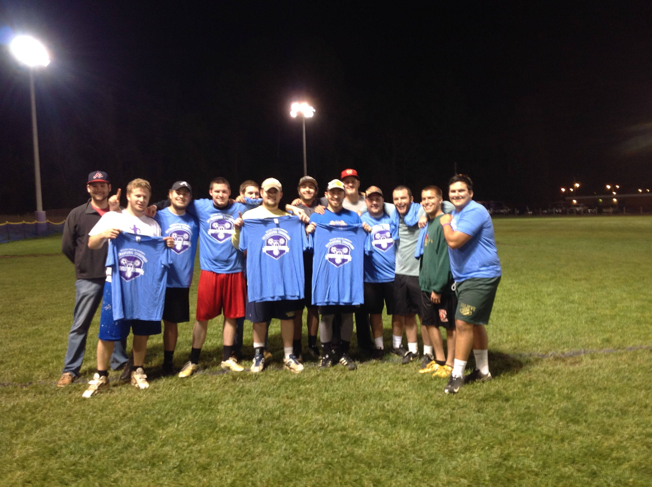
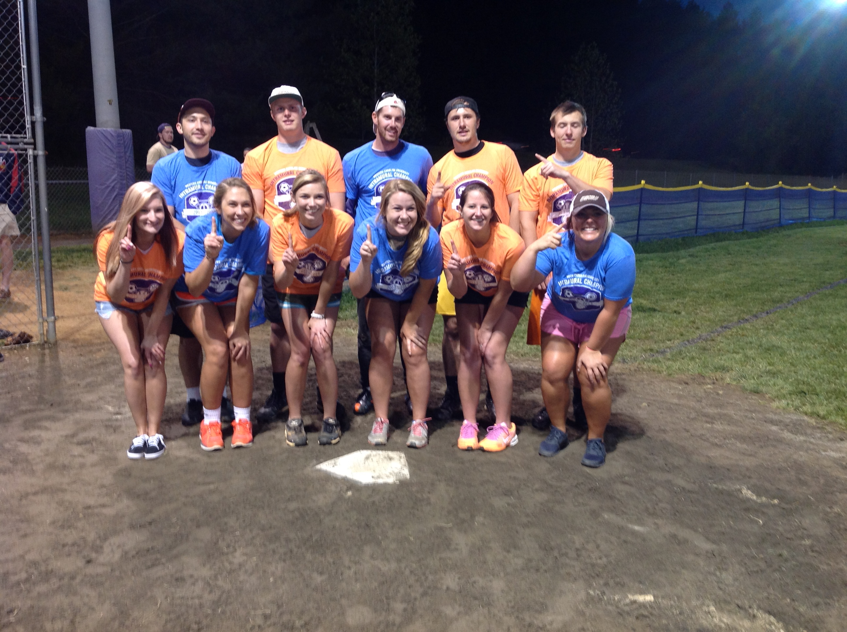
Good luck!

