Slide 1

Western Carolina University Purchasing Department
WCU
P-Card
Program
2016
“The Way of the Future!”

Slide 2
YOUR P-CARD STAFF
Tamrick Mull
P-Card Manager
227-7203
tmull@email.wcu.edu
Misty Blanton
P-Card Assistant
227-7203
mjblanton@email.wcu.edu

Slide 3
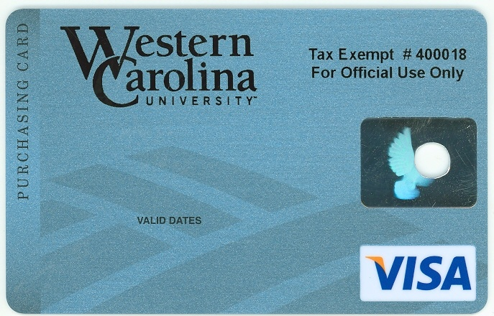
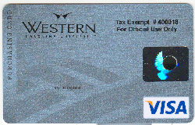
A “P-CARD” IS……
Short for Procurement Card (may also be referred to as Purchasing Card or Procard)
Corporate VISA credit card
For business use only
Issued in employee’s name
Charges are billed to the University

Slide 4

PURPOSE....
Rapid turnaround on small-dollar purchases
Reduce paperwork
Reduce processing time and costs
Save you frustration!

Slide 5
PURPOSE - Continued…..
REPLACES purchase orders, standing orders, check requests, and petty cash accounts for most small dollar purchases
Required purchases on P-Card: Registrations, Membership Dues, Certifications, Publications, Examination Fees, and Subscriptions
For these reasons, every department needs at least one cardholder

Slide 6
University Benefits….
REDUCES:
  Forms
  Data entry
  Number of invoices and checks processed
  Need for reimbursements & petty cash accounts
CONTROLS:
  Merchant categories (MCC codes) can be restricted/blocked
  Spending limits are set for each card (see next slide)
  Reconciler oversight
  Department head/supervisor review
  Audit
Notes:
We will cover some of the unauthorized purchases in a few minutes.
Our local vendor community should find their cash flow situations improve if they accept the ECU p-card. They receive payment within 2-3 days versus 30-60 days under the old requisition system.

Slide 7
P-CARD SPENDING LEVELS
 | WCU – 2 | WCU – 4
Single Transaction | $500 | $2,500
Monthly Transaction | $5,000 | $15,000
**Multiple purchases to the same vendor within a minimal time period that exceeds the card speeding limits, is considered splitting.**

Slide 8
Examples of Splitting to avoid P-Card spending limits.
One should ask themselves, “If I didn’t have a limit on my P-Card, would I purchase all of the items required in one transaction?” If your answer is yes then you are splitting transactions to avoid the card limits.
It is obvious that purchasing a single item by using two transactions against the card that the total exceeds the card limits is splitting to avoid the card limits
Examples:
If your total order is $700 and your limit is $500 per transaction (WCU-2), do not split the transaction or tell the vendor to charge the card for $400 and then charge the remaining $300. This is considered splitting the transaction to avoid spending limits.
If you are wanting to purchase 100 books at $26.00 each totaling $2,600, purchasing 50 books on one transactions and 50 books on a separate transaction is considered splitting to avoid the $2,500 (WCU-4) limit.

Slide 9
University Requirements
All transactions are uploaded to Banner Monthly (Accounting System of record); posted to the GL; and payments issued to the bank monthly
The University conducts an on-going audit of purchases to insure a high degree of integrity and confidence in the system
University must pay the bank within 20 days after close of the monthly billing cycle
Charges are paid in full each billing cycle
Notes:
(Refer to the News & Observer article here)

Slide 10
Vendor Benefits & Requirements
Improves vendor’s cash flow
[Bank pays vendors within 2-3 days]
The vendor has a higher confidence level in VISA than a Purchase Order
Card eliminates need for additional accounts receivable processing
Requires no special enrollment
[If vendor accepts VISA, not restricted]
Vendor pays a transaction fee to VISA
Notes:
No need for the vendor to send out invoices, statements or pursue collection on past due bills. They DO pay a small 2-3 percent fee to VISA for each card transaction.

Slide 11


Cardholder Benefits
Easier to make small purchases
Most merchants accept VISA
Does not require use of personal funds
Eliminates petty cash
A purchase requisition is not required
Allows rapid purchase and receipt of low dollar goods and services
No fee for card use

Slide 12

Cardholder Requirements
View transactions electronically [WORKS Payment Manager]
Report fraudulent charges to your P-Card Staff
Process then sign & date all monthly hard copy statements
(see attached statement)
Keep all receipts and good records
Notes:
The WCU account number is electronically associated with each card. The obect code is a function of something called a merchant category code. The ECU card team sat down with the VISA MCC listings and assigned the object code that seemed to best apply to purchases with that type vendor. It will not be 100% accurate for all purchases. Example ---- You can go into Harris Teeter and purchase household cleaning supplies but the bulk of your purchases will most likely be food items. Therefore, the object code tied to the grocery stores is 2200 for food. The object code will not always be an exact fit. You will have to have some flexibility. The ITCS card support team is finalizing some enhancements to the reconciliation screens that will allow cardholders and reconcilers to change some of the accounts in the near future.

Slide 13
Cardholder Requirements - Continued
Provide vendors with a complete delivery address
Must provide vendor with BILL TO address of
150 HFR Administration Building
Cullowhee, NC 28723
Must reconcile monthly (when notified by email)
Protect and secure your card and paperwork at all times
example: locking file cabinet

Slide 14
Policy and Procedures
Who should have a card? Responsible individuals who have regular purchasing needs
Cardholders must be WCU staff or faculty with “permanent” employment status. (Exceptions can be made in some cases, please contact P-Card Manager for details)
Department Head approval and selection of a spending limit is required
The P-Card must be used ONLY by the named cardholder!
Only one card per person (There are NO “departmental” cards) NO SHARING!

Slide 15
Policy & Procedures – Continued
State & Trust funds are allowed, Grant and Special funds are allowed with appropriate approval
NO FOUNDATION funds allowed (ex: 9XXXXX)
NO PERSONAL purchases allowed
Cardholders sign a “Cardholder Agreement” at the end of P-Card training (or when you receive your p-card)
Cards must be cancelled when transferring to another department OR if you leave the University
Card must be turned in to P-Card Manager to be held during a Leave of absence (for more than 6 weeks) until the employee returns to work
Cards must be returned to the P-Card Manager to be cancelled and destroyed (University property)

Slide 16
Policy & Procedures – Continued
Never accept cash or gift cards for returns
Contract items must be purchased through the contract source.
http://www.doa.state.nc.us/PandC/keyword.asp
Original, priced, itemized receipts or invoices are required for each transaction
Splitting transactions to avoid spending limits is strictly prohibited

Slide 17
Sample Purchases Allowed
Memberships and organization dues (specific approvals required: WCU Policy 2)
http://www.wcu.edu/discover/leadership/office-of-the-chancellor/legal-counsel-office/university-policies/numerical-index/university-policy-2.asp
Subscriptions – To a business address / Annual Only / Inc. software subscriptions
Registrations (all WCU Travel policies apply)
Publications
Interlibrary Loans
Postage (small quantities)
Express shipment charges
Advertising
Certifications
Licenses such as nurses, doctors, etc.
Software (Any computer related purchases must go through IT department)
Other State contract items purchased through State contract vendors
http://www.doa.state.nc.us/PandC/keyword.asp

Slide 18
Paying Registrations
P-Card not used: (note on: Check Request Form)
  Merchant does not accept VISA
  Foundation Funds
  Additional functions-use Check Request Form
ONLY registration fees can be paid
NO MEALS, NO HOTELS, NO TRAVEL
NO add-on luncheons, banquets, etc. (does not apply to meals that are automatically included in your registration fees)
DO NOT request reimbursement for items paid on a P-Card

Slide 19
Paying Registrations Continued..
Attach copy of original, priced, descriptive documentation (who, what, when, where & why)
All WCU travel policies apply
http://www.wcu.edu/12382.asp
Violations (travel and P-Card)
http://www.wcu.edu/11628.asp

Slide 20
UNAUTHORIZED PURCHASES
NO animals
NO purchases over designated spending limits
NO split ticket purchases to circumvent the single purchase limit
NO weapons and ammunition
NO purchases from pawn shops
NO controlled substances (Drugs, Alcohol, Fireworks)
NO Radioactive Materials
NO payments to individuals, consultants or employees
[Vendor must provide a FEIN number versus a SSN]
NO Restaurants (casual or fine dining)/Food/beverages
NO purchases for personal use
NO travel (Lodging, Gas, Food, Meals, Car Rentals)
NO entertainment
NO Cash Advances
NO Gifts/ Contributions, Gift Certificates, or Gift Cards, Prizes or Awards
NO Computers or Printers (all computer orders must go through IT)
Notes:
We don’t allow purchases from University storerooms for the sole reason that the storerooms would have to pay the VISA transaction fee.

Slide 21
Audits
Transactions may be audited by Purchasing, Internal Auditor, Office of the State Auditor, and the Purchase & Contract Compliance Team
P-Card Manager reviews all transactions
Cardholders may receive an email requesting additional information
Must make every effort to resolve any issues
Insufficient statement documentation is considered a violation
Constant problems and errors may result in card cancellation
See section 7 under 8.0 Compliance from the WCU Purchasing Card (P-Card) User’s Guide
http://www.wcu.edu/discover/campus-services-and-operations/purchasing-department/wcu-p-card.asp

Slide 22
Your Card
Issued by Bank of America
User info provided to BOA by P-Card Manager
Call to activate
Activation code is 00000 + your telephone extension number
Call the P-Card Staff if you have problems

Slide 23

Cardholder Responsibilities & Processing
The CARDHOLDER has placed an order on their P-Card :
1 - Review all new purchases online and signoff in Works (BOA)
2 - Report any fraudulent charges to P-Card Staff
3 - Match itemized receipts and staple behind a printed hard copy bank statement
4 - Sign & Date statements in ink (full signatures required)
5 - Forward (sign & dated) Statement and receipts to reconciler by the 18th
6. Due to Purchasing office the 1st of the following month
Notes:
These steps are designed to protect both you the cardholder and the department from misuse or abuse of the card or the departmental funds.

Slide 24
Cardholder Responsibilities & Processing - Continued
Cardholders may edit FOAP codes (what you’re charging the transaction to) or should notify their Reconciler prior to the 18th of the month if changes are needed
Cardholders must work closely with their reconcilers and/or accounting personnel to set up appropriate departmental procedures to ensure proper oversight and processing of card transactions
Charges are not encumbered in advance; do not over-spend your budget

Slide 25
Cardholder Responsibilities & Processing - Continued
Lost or Stolen Cards
Report to Bank of America immediately 1-888-449-2273
Notify P-Card staff
227-7203
Review transactions carefully and notify P-Card staff if there are any fraudulent charges. Report Immediately 1-866-500-8262.
Disputes must be submitted within 30 days of the transaction date
Returns
Credit must be issued back against your card
Never accept cash or cash equivalents
Handle with vendor and follow return instructions

Slide 26
Tax Exempt Status
WCU is NC sales tax exempt for most purchases #400018
All P-Cards display the tax ID number
Cardholder must inform the vendor of the tax exempt status at time of purchase
If tax is charged, it is the cardholder’s responsibility to obtain a credit from the vendor to his/her P-Card
Wal-Mart #993176; Lowe’s #047000032

Slide 27
Statements
Cardholders must print (around the 13th of each month) a hard copy of their monthly statement from Works after the close of each cycle; ONLY if the card has been used for the most recent billing cycle.
A hard copy of the card holder’s Billing Statement is sent to the P-Card Manager by mail or hand delivered by the 1st of the following month

Slide 28
Documentation
Statements
Must attach a receipt for each transaction
Redact Credit Card # from receipt
Requires a minimum of three signatures (cardholder, reconciler & dept. head) and date
Tape corners of small (Wal-mart, etc.) receipts to an 8 ½ x 11 piece of paper; also attach a copy of original receipt
Due to Purchasing by the 1st of the month following the close of the billing cycle
Receipts
Original, itemized receipt or invoice for each transaction
  Vendor
  Description
  Unit Price
  Extended Price
  Tax or shipping
  Total
Packing slips accepted only if priced

Slide 29
Statement & Documentation
Samples Attached

Slide 30
Record Retention
Original statements and receipts ~ P-Card Office
Archived for a period of 5 years in Purchasing Archives
WCU Internal Auditor has recommended: Departments should maintain copies of all documentation long enough to be assured P-Card Administration has the original documentation and to cover an adequate audit cycle, which is suggested to be three years for cardholders.
Keep files secure and confidential as card account numbers may be visible
Shred all discarded P-Card documentation

Slide 31

Reconciler
Responsibilities & Processing
Reconciler over-sees P-Card transactions and verifies FOAP information. A Reconciler can be an Administrative Assistant, Budget person, Cardholder, Department Head, or person authorized to approve purchases.
The Reconciler is a pivotal point of oversight for P-Card transactions.
The RECONCILER must:
1- review and approve each transaction on-line monthly (recommend when notified by email)
2- edit FOAP codes as needed to ensure transactions are charged to the appropriate budget codes in Banner
3- Review and match all Statements with receipts
4- counter-sign & date statements and obtain Dept. Head’s signature & date on statements
5- forward all statements and receipts to Purchasing by 1st of the month following the cycle

Slide 32
Reconciler Responsibilities &
Processing – Continued
Reconciler must report any changes in employee status to the P-Card Manager
Reconciler must report any unusual cardholder spending activity
Reconciler must monitor card spending levels closely to ensure sufficient funds are available to cover departmental charges
NOTE: DEPARTMENTS ARE RESPONSIBLE FOR ANY CARDHOLDER SPENDING BEYOND THE SET BUDGET LIMITS
Notes:
CHANGE IN DEPARTMENT/NAME CHANGES/SEPARATION
BANK PROVIDES MONTHLY TRANSACTION REPORTS TO THE DEPARTMENT.

Slide 33
Processes ~ Credit Lines
CREDIT LINES are not restored until transactions are signed off in the Works system
  Cardholder AND
  Reconciler (Manager/Approver)

Slide 34
Processes ~ FUND Security
Banner FUND security is based on the cardholder
Transactions can only be charged to FUNDS the cardholder has access to
Each card is setup in Works with only those FUNDS specified by the department head

Slide 35

Works Payment Manager
Online system provided by Bank of America
  Help manage your charges and budget
  Review charges and transaction details
  Edit FOAP codes
  Add online comments
  Online reporting
  Electronic approval / Sign off on transactions

Slide 36
Works System Features
Charges can be reconciled (approved) and FOAP codes changed as soon as the transaction posts in Works
System generated email notifications
Sign off on charges daily or when notified by email
Charges can be split coded
Downloadable reports
Comments can be added online
Transactions can be flagged for dispute

Slide 37
Getting Started
All participants will receive a “Welcome email” from Works Payment Manager once we’ve activated you
DO NOT DELETE THIS EMAIL
Email will contain your username, password validation steps, and instructions on changing your password
Email will be deleted after 30 days

Slide 38
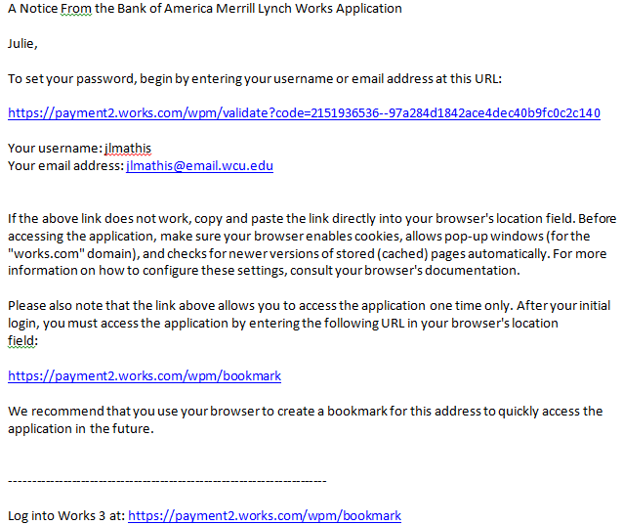
Section 6 – Page 5

Slide 39
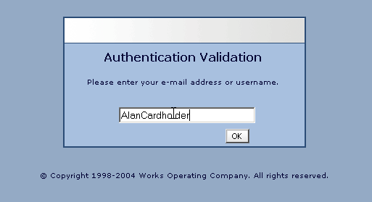
lisaross

Slide 40
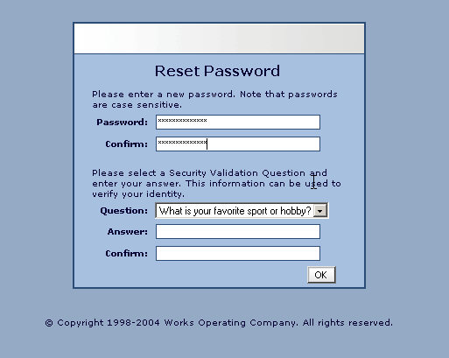

Slide 41
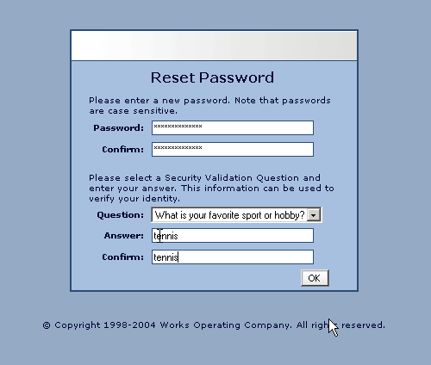

Slide 42
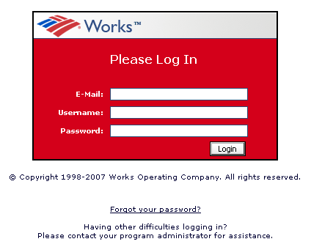
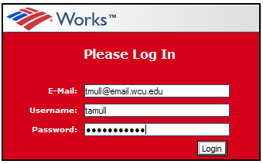
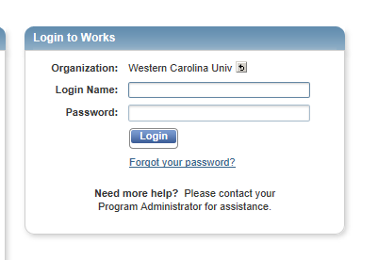
rossli@wcu.edu
lisaross
********

Slide 43
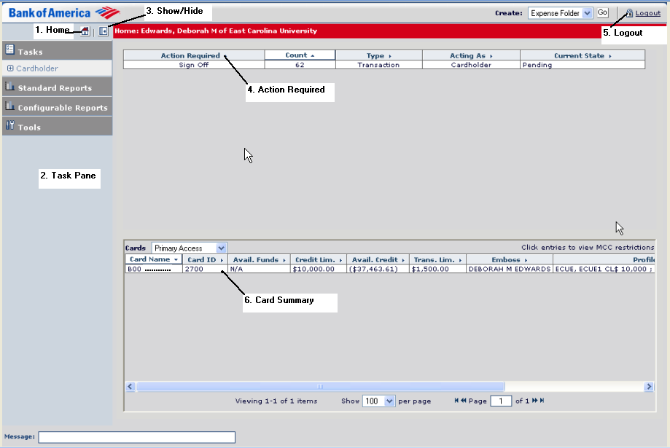
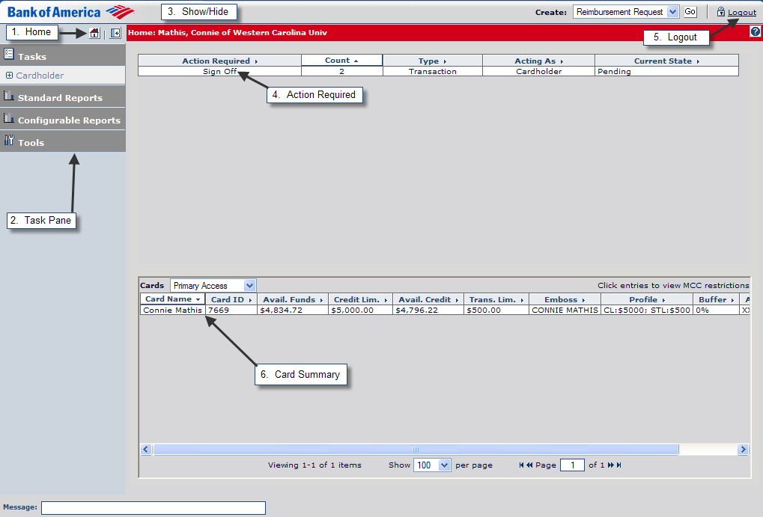
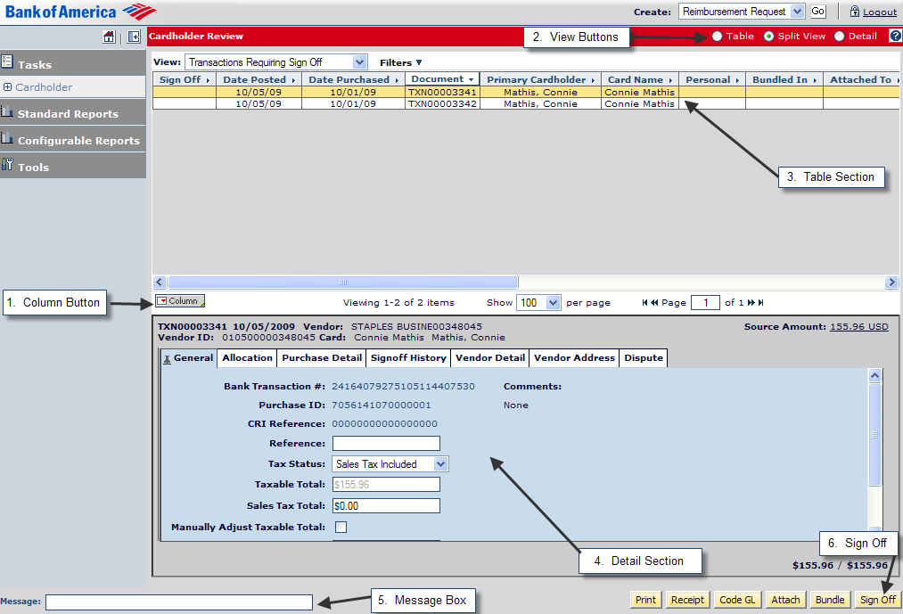
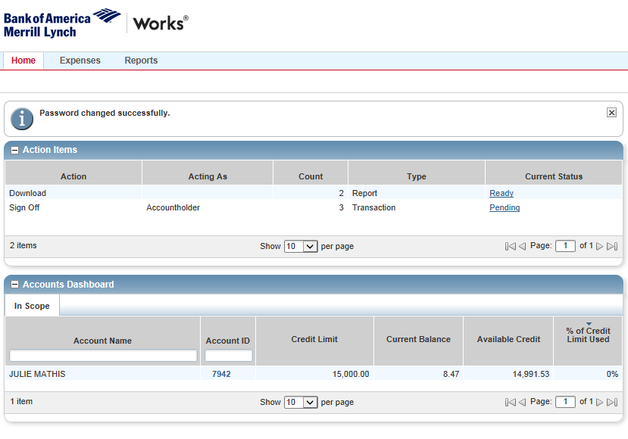
Western Carolina University
WCU

Slide 44
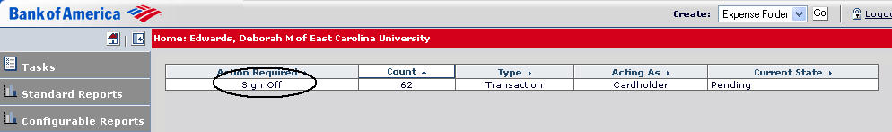
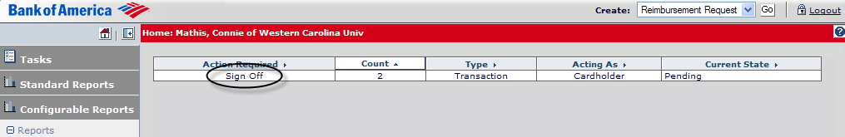
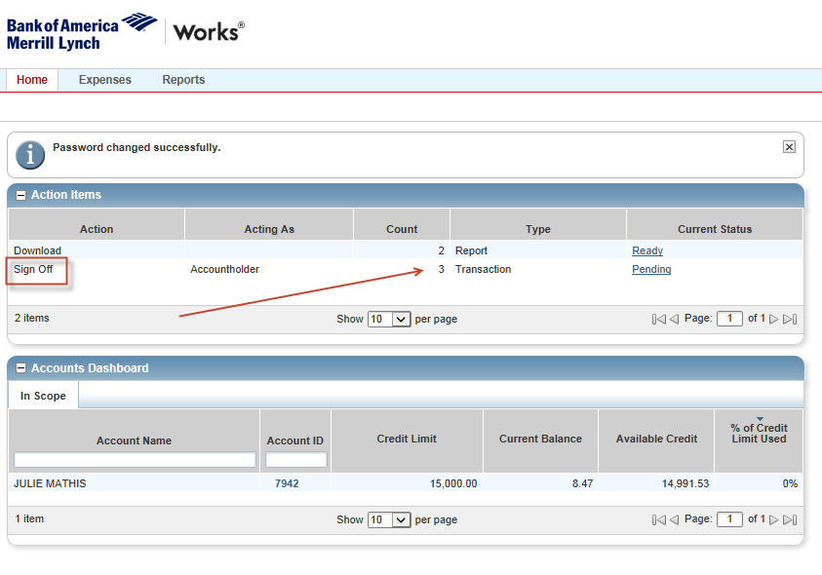
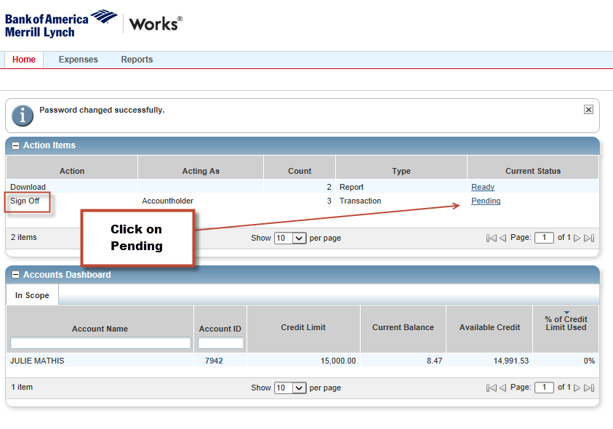

Slide 45
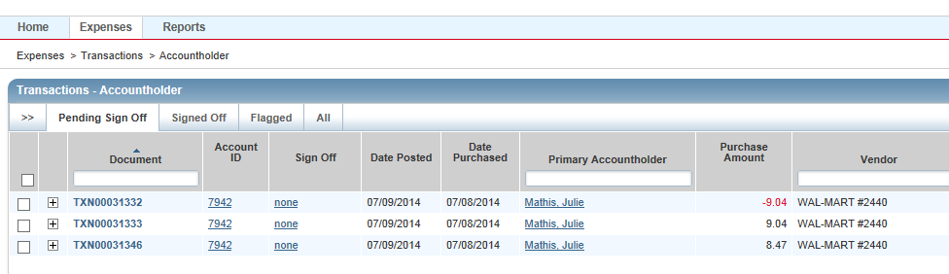

Slide 46
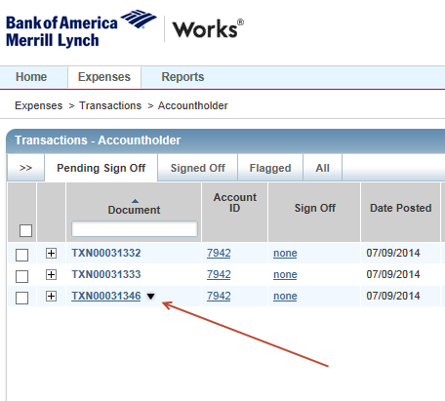

Slide 47
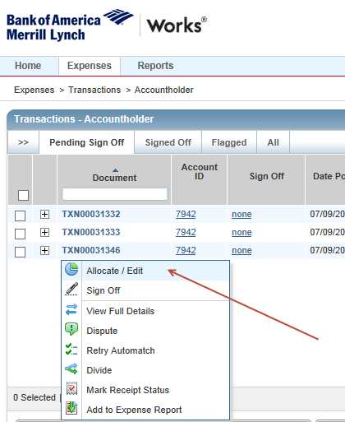

Slide 48
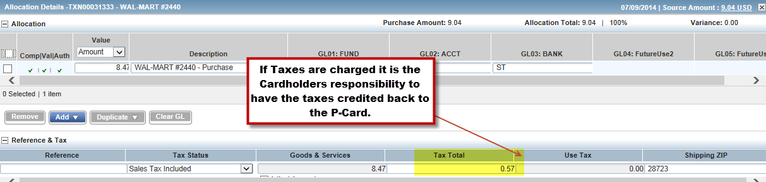
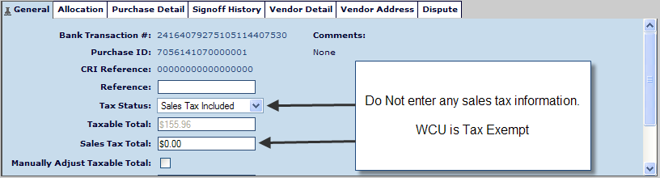
DO NOT enter any information in these fields

Slide 49
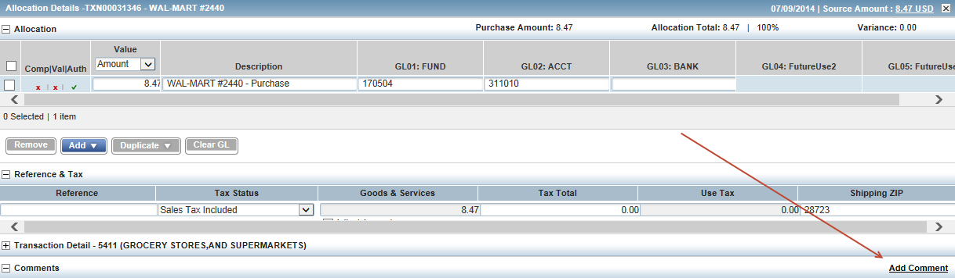
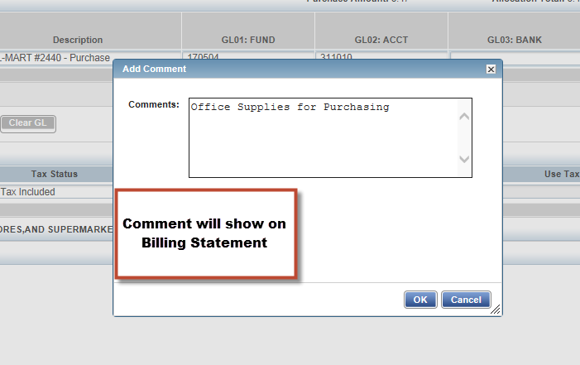

Slide 50
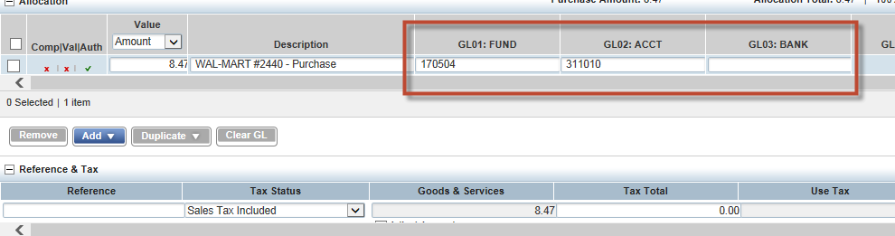

Slide 51
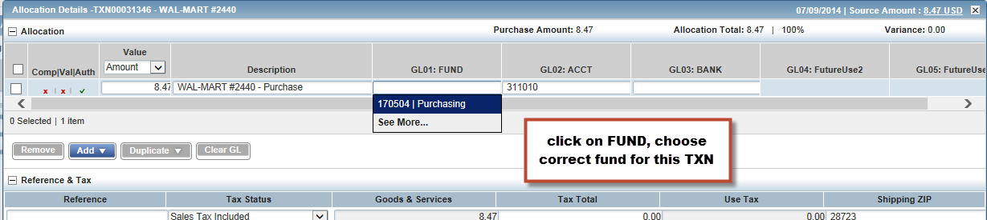
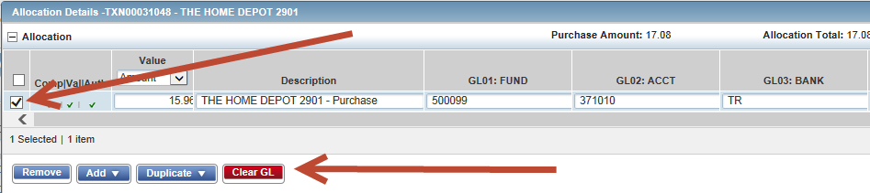
If your funds do not show up, choose “Clear GL” or Clear out the Fund, Acct and Bank. Search again.

Slide 52
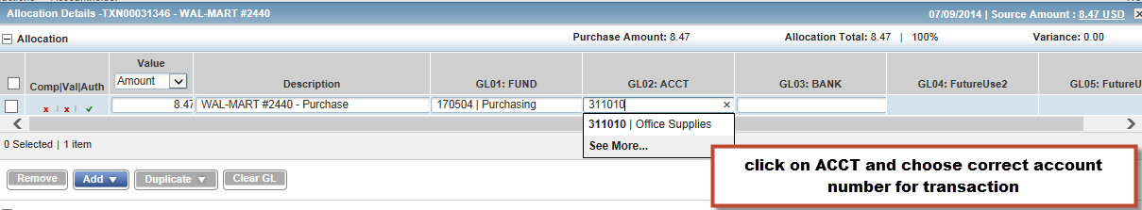

Slide 53
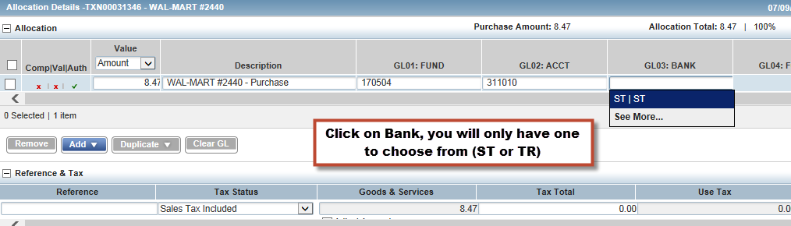

Slide 54
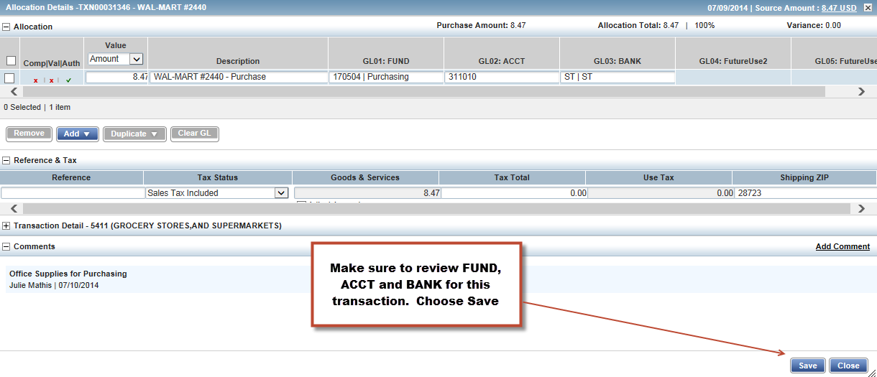

Slide 55
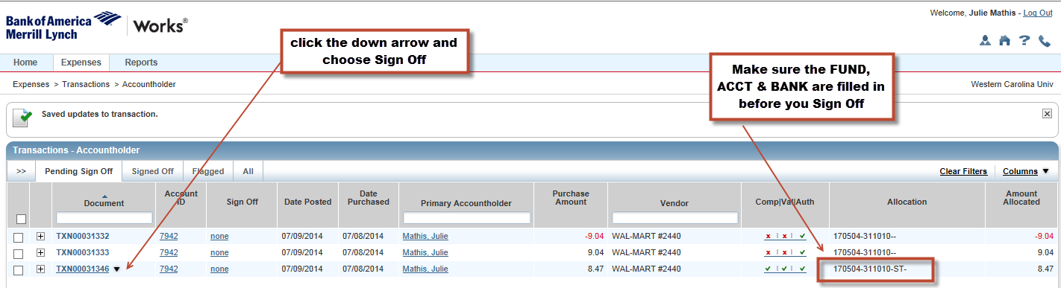

Slide 56
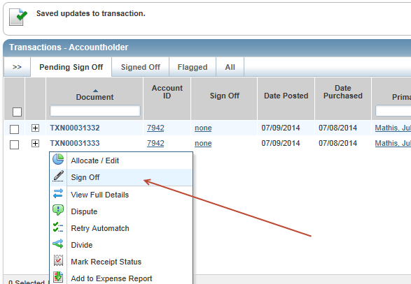

Slide 57
Split Coding

Slide 58
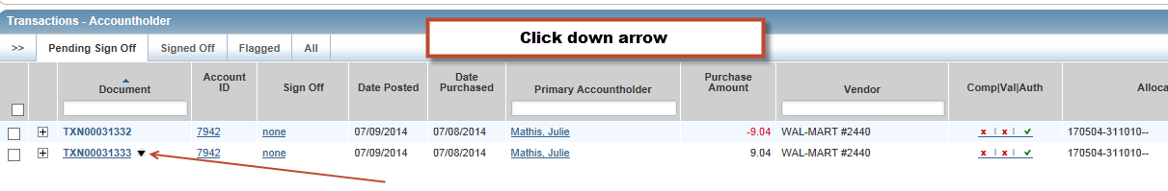

Slide 59
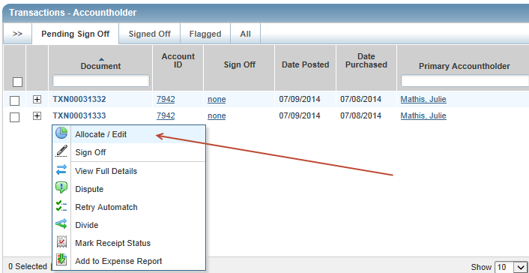

Slide 60
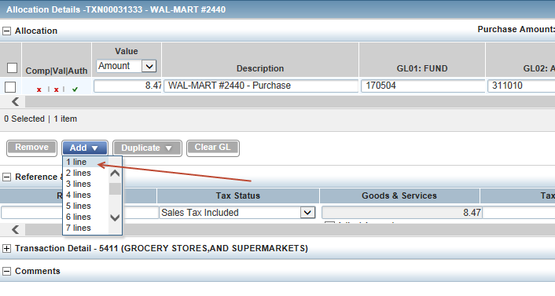

Slide 61
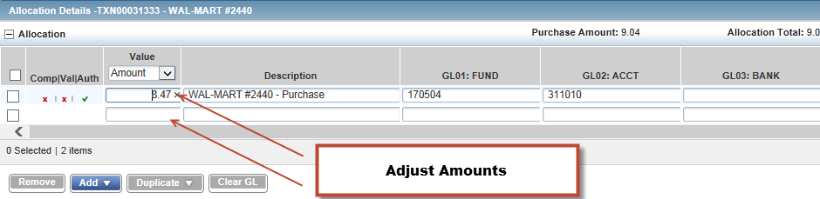
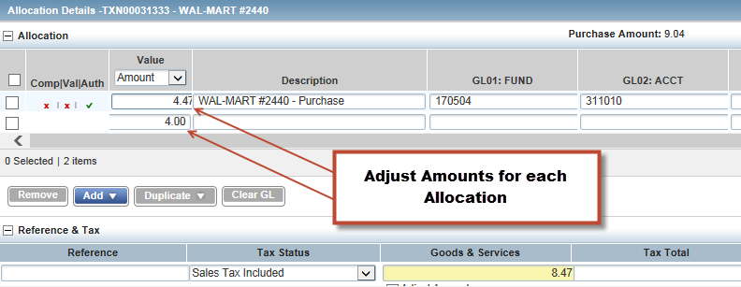
**Be sure to reallocate each GL to the correct Fund/Acct/Bank**

Slide 62
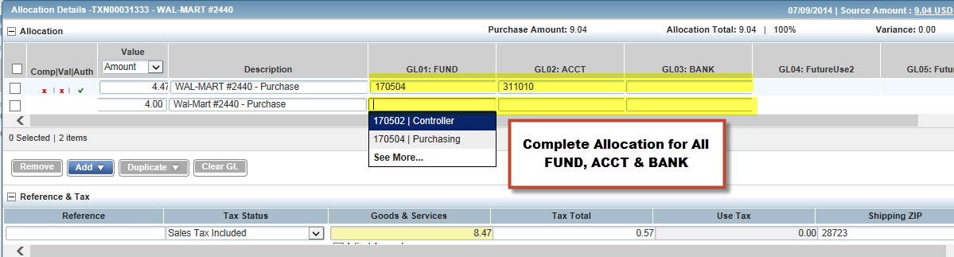

Slide 63
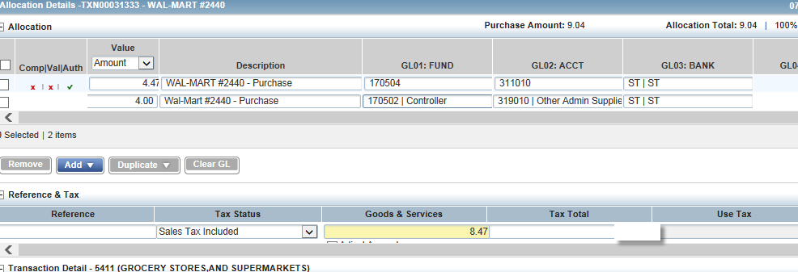

Slide 64
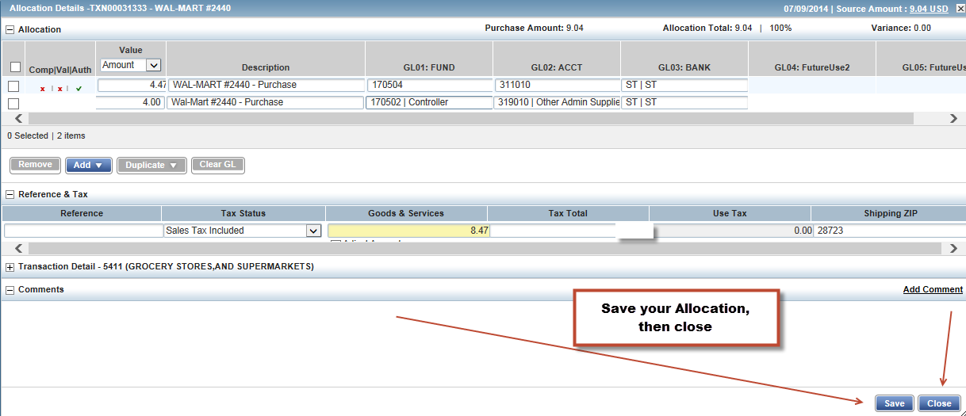

Slide 66
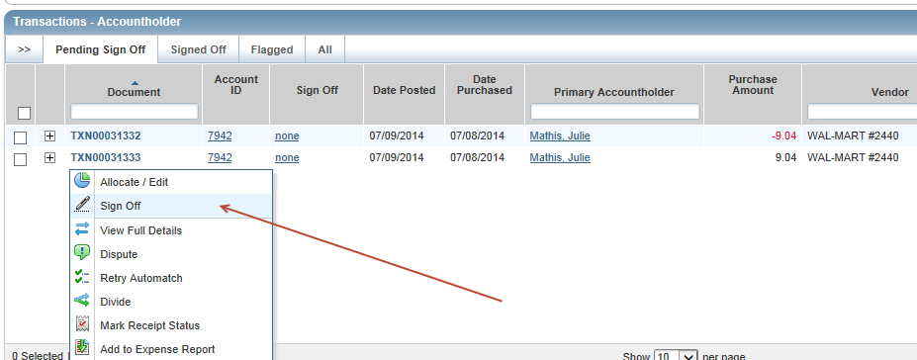

Slide 67
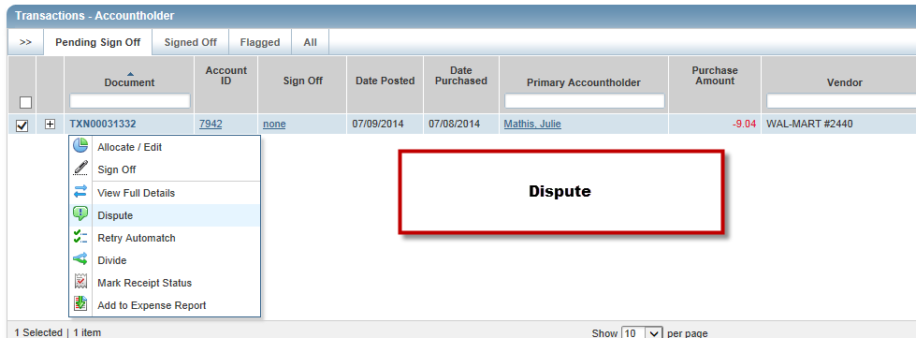
Disputing Transactions
Dispute

Slide 68
Monthly Process
Cycle ends on the 10th of each month
Cardholders and Reconcilers have 8 days to process approvals and complete FOAP reallocations not already completed
On the 18th or next business day following that date charges are “locked” so that no further FOAP updates can be made
RECONCILERS need to complete approvals to restore credit lines
Statements should be printed 3 business days after cycle ends

Slide 69
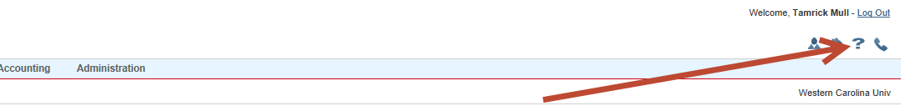
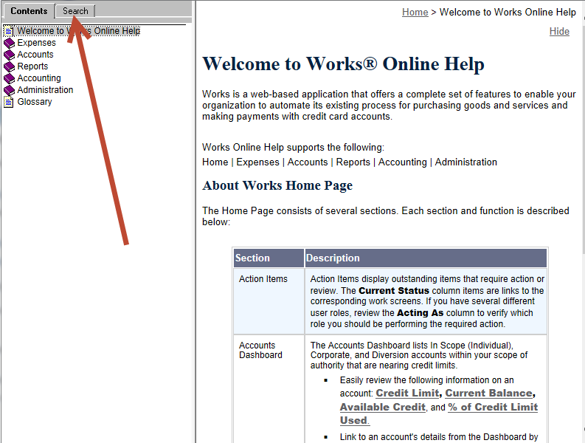

Slide 70
Your Card Has Been Declined
Single transaction limit
Monthly limit
MCC code
Invalid information (cvc/cv2 number)
Call Purchasing, 227-7203

Slide 71
Suggestions
Make a folder
Be sure your internet
sites are secure (https: or padlock locked)
Mark your calendar
Review your transactions
Don’t be scammed
Keep the Purchasing Card User’s Guide and Training Guide handy!
Reconcilers need to attend CataMart Training
If unsure, ask!

Slide 72
Purchasing Pointers
IS IT A STATE CONTRACT ITEM?
(If so, am I purchasing thru the contract source? If not contract, am I purchasing the best value item through the most economical source reasonably available?)
DOES IT VIOLATE WCU OR STATE POLICY?
(Check the WCU Purchasing Manual/Contact Purchasing)
HAVE I REQUESTED AN ITEMIZED RECEIPT?
YOUR CARD IS LIKE CASH - KEEP IT AND YOUR PAPERWORK SECURE
Notes:
You will want to familiarize yourself with the general purchasing regulations. You can find assistance via the Materials Management home page (http://www.ecu.edu/purchasing). You will probably want to bookmark this site for future reference. You may also contact the purchasing agent that handles the specific commodity you are considering purchasing if you have a question about policy or state regulations. I will show you some purchasing sites that you may find helpful in a few minutes. You will want to keep a record of the transaction because the item is paid within 2-3 days and you will need to confirm that you do actually receive the merchandise.

Slide 73
REMEMBER
What you can purchase has not changed - all State of NC purchasing rules and WCU purchasing policies still apply.
ONLY the method of payment has changed.
Is it allowed by your funding source?

Slide 74
Conclusion
Questions?
Comments?
Look for new things to come!
Thank you for your support!

