Slide 1
A Mental Health Primer for First Year Teachers
Presented by:
Steve McRae, LCSW (JCPS Jackson County Director)
Raymond Turpin, Psy.D. (JCPS Clinical Director)
Jackson County Psychological Services
September 30, 2014 Western Carolina University

Slide 2
Topics Ahead
Trauma and Its Effects on Development and Learning
Self-Injury (Cutting) and How to Respond
What to Know About School Violence Threats
Signs of Suicidal Behavior and When To Take It Seriously

Slide 3
Trauma and Its Effects on
Development and Learning

Slide 4
DSM5 Definition of Traumatic Event
An event that is experienced, witnessed, or confronted that involves actual or threatened death or serious injury, or a threat to the physical integrity of self or others. The person’s response to this event involves intense fear, helplessness, or horror. In children, this may be expressed instead as disorganized or agitated behavior.
For kids, this could be:
Physical Abuse Sexual Abuse Neglect Accident
Domestic Violence Emergency Medical Procedure Death of a Parent
Emotional Abuse Bullying

Slide 5
“Traumatic events call into question basic human relationships. They breach the attachments of family, friendship, love and community. They shatter the construction of the self that is formed and sustained in relation to others. They undermine the belief systems that give meaning to human experience. They violate the victim into a state of existential crisis.”
Judith Lewis Herman, MD author of
Trauma and Recovery

Slide 6
“Repeated trauma in childhood forms and deforms the personality. The child trapped in an abusive environment is faced with formidable tasks of adaptation. She must find a way to preserve a sense of trust in people who are untrustworthy, safety in a situation that is unsafe, control in a situation that is terrifyingly unpredictable, power in a situation of helplessness. Unable to care for or protect herself, she must compensate for the failures of adult care and protection with the only means at her disposal, an immature system of psychological defenses.”
Judith L. Herman, MD
psychiatrist and author of Trauma and Recovery

Slide 7
Prevalence of Psychological Trauma
“Current policy and practice responses do not match in urgency, depth, or quality the epidemic levels of trauma symptoms among children and youth.”
National Center for Children in Poverty (2007)

Slide 8
Prevalence Facts
Estimated 90% of U.S. population will be exposed to a traumatic event over the course of their lives.
At least 25% (perhaps up to 40%) of youth in the U.S. will experience at least one significant, potentially traumatizing event by age 16.
Many of these youth experience multiple or chronic trauma events – these are usually the kids with the most profound effects.

Slide 9
Trauma Facts
18% of those who grow up in an abusive home attempt or commit suicide.
Childhood trauma greatly impacts the ability to learn: 30% of those who were abused as children have language or cognitive impairment; 50% have problems in school; 22% have been labeled learning disabled; 25% need special ed classes
25% of all foster children suffer from PTSD (higher % than war veterans)

Slide 10
Factors Impacting the Severity of the Trauma Response
Nature of the Trauma:
*Chronic vs. Episodic vs. Single Event
*Proximity: Personal Victim
Loved One/Friend
Witness See on TV
Hear about trauma
*Suddenness/Lack of Predictability
*Degree of: Physical Contact
Force
Injury
Invasiveness

Slide 11
Other Factors Impacting the Severity of the Trauma Response
Level of Disruption in Life
Level of Social Support (#1 buffer; foster homes)
Parental Response (Supportive, Overwhelmed,
Minimizing, Denial, Guilt Induction, Anger)
Ongoing Medical Problems (reminder)
Presence of Guilt/Self-Blame

Slide 12
“Trauma is when your biology is assaulted in such a way that you might not be able to reset yourself.”
Bessel van der Kolk,MD

Slide 13
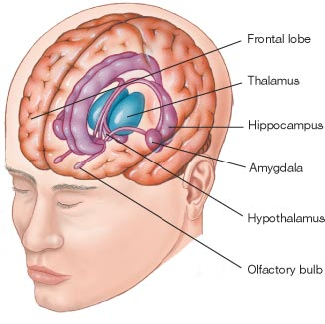
The Limbic System

Slide 14
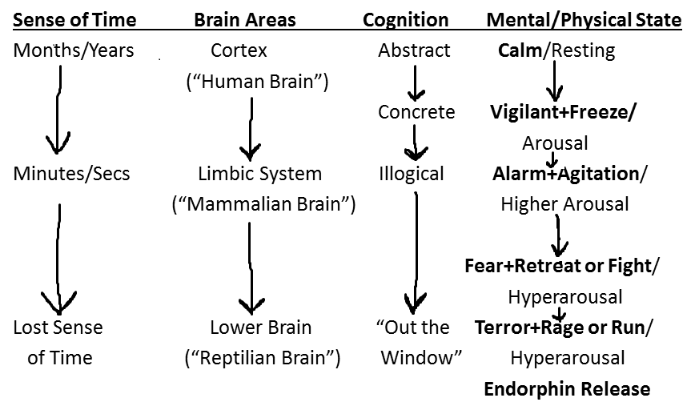
Fight & Flight Response Patterns Going from “Learning” to “Survival” Mode

Slide 15
“In a child who has experienced chronic threats, the result is a brain that exists in a persisting state of fear.”
Bruce D. Perry, MD

Slide 16
Long Term Effects of Trauma
Depression (at least 2x normal risk)
Impulse Control Disorders: anger/aggressive behaviors
Anxiety Disorders
Increased self-harm and suicide risk (significantly)
Poorer response to both medications and psychotherapy
Trust Problems
Sense of Betrayal/Loss of Faith in Adults and Systems
Substance Abuse/Dependency
Physical Health Problems later in life (ACEs study)
Academic Problems
Illegal Activities

Slide 17
Effects of Trauma on Children (cont)
*Young children (5 and younger) may experience new fears such as separation anxiety or fear of strangers or animals. They may regress and lose previous skills.
*Elementary school-aged children (6 to 11) may complain of bodily symptoms w/out medical cause or they may stare into space, seem “spacey”, or startle easily.
*Adolescents (12 to 18) may experience visual, auditory, or bodily flashbacks, have unwanted thoughts or images of the events, demonstrate impulsive and aggressive behaviors, or use alcohol or drugs to try and feel better. They may feel depressed or have suicidal thoughts.

Slide 18
What To Do For A Child Dealing With Trauma
If you see a student having a “meltdown” there is a chance that he or she could be struggling with hyperarousal related to trauma.
Calmly tell the student that things are alright and invite them to go to a quiet place away from witnesses and unnecessary stimulation.
Try to calm them by suggesting that they take some deep slow breaths while reassuring them they are OK and safe.
Ask them about what is going on in a sensitive, non-judgmental way and prepare to listen carefully to the student.
Refer them to the school counselor for follow-up.

Slide 19
Self-Injury
(Cutting)
and How to Respond

Slide 20
Definition
“Self-mutilation or self-injurious behavior (SIB) is defined as a variety of behaviors in which an individual purposefully inflicts harm to his or her body for purposes not socially recognized or sanctioned and without the obvious intention of committing suicide.”
Alderman, 1997; Favazza 1996
“A purposeful act of self-help.”

Slide 21
“Cutting is done secretly, usually in a trancelike state, and the act of creating pain…or drawing blood, is in itself the goal. Cutters then develop an “addiction” to this method of exchanging physical pain for emotional pain.”
Steven Levenkron
Cutting: Understanding and Overcoming
Self-Mutilation

Slide 22
“…self-mutilation is distinct from suicide. Major reviews have upheld this distinction…A basic understanding is that a person who truly attempts suicide seeks to end all feelings whereas a person who self-mutilates seeks to feel better.”
Armando Favazza
“The Coming of Age of Self-Mutilation”
Journal of Nervous and Mental Diseases
1998

Slide 23
“Self-harm results in part from chronic invalidation, from always being told that your feelings are bad or wrong or inappropriate.”
Marsha Linehan
1993

Slide 24
“Almost 90% of self-injurers say they are discouraged from expressing emotions. Almost 50% report past physical or sexual abuse. Most have low self-esteem. These conditions, coupled with hormone changes, make adolescents especially susceptible to self-injury. There is a real sense of being out of control. This is a way to attack the body to regain control.”
Karen Conterio co-author of Bodily Harm

Slide 25
“Self-mutilation is a desperate attempt to have some control over unbearable feelings of aloneness, loneliness and helplessness. When a teen or young adult has not learned healthy ways of managing these intense feelings, they turn to physical pain as a way to blot out the emotional pain or gain a sense of control over the pain they feel. In a strange way, they are really not trying to hurt themselves—they are trying to protect themselves from something even more painful than the physical pain.”
Dr. Margaret Paul
co-author of Healing Your Aloneness

Slide 26
“The proximal causes for those who engage in self-injurious behavior in both clinical and community settings are strongly linked to difficulties in regulating strong emotions and coping with stress.”
Whitlock, Powers, & Eckenrode
Developmental Psychology
May 2006

Slide 27
“It expresses emotional pain or feelings that I am unable to put into words. It puts a punctuation mark on what I’m feeling on the inside.”
“It’s a way to have control over my body because I can’t control anything else in my life.”
“I usually feel like I have a black hole in the pit of my stomach…at least if I feel pain, it’s better than feeling nothing.”
“I feel relieved and less anxious after I cut. The emotional pain slowly slips away into the physical pain.”
Anonymous Self-Mutilators

Slide 28
“It really hurt but I figured if I could tough it out, it would prove I could get through the other things happening in my life. I then felt an odd sense of peace. I knew it didn’t make sense, yet I felt better. For that moment, I was in charge.”
Caia Pattynama (15yo)
Family Circle magazine, July 2011

Slide 29
“I think my greatest fear is to be forgotten. A teacher I had last year doesn’t even remember my name…it makes me think that no one remembers me. How do I know I exist? At least I know I exist when I cut.”
Self-injury message board post

Slide 30
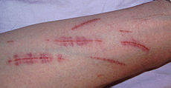
Typical self-harm example

Slide 31
Self Injuring Facts
A few recent studies have shown between 14% and 21% of high school students and between 14% and 35% of psychology students at large public universities have practiced self injury.
Generally believed that females are more prone to self injury but more recent studies show a much narrower gap between gender
Self injury may be socially contagious (epidemic-like patterns in hospitals and detention facilities)

Slide 32
Self Injuring Facts
Self injury often stems from events that occur in the first six years of a child’s development.
Research shows that the phenomenon appears most commonly associated with middle to upper middle class adolescent girls or young women.
They are usually likeable, intelligent, and functional and pose no threat to the safety of others.
Many come from a background of abuse or from a home with at least one alcoholic parent.
Eating disorders occur much more frequently among self-injurers.

Slide 33
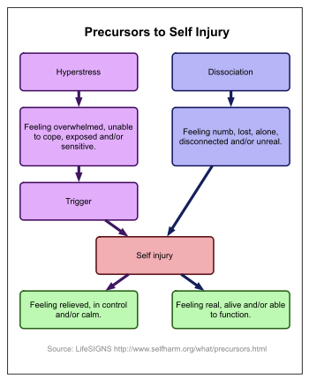
Two Reasons People Self-Injure

Slide 34
Methods of Self-Injury
Cutting: 72%
Burning: 35%
Self-hitting: 30%
Interference w/ wound healing: 22%
Hair pulling: 10%
Bone Breaking: 8%
Multiple methods: 78%

Slide 35
Signs of Possible Self-Injurious Behavior
Unexplained or frequent injuries
Wearing jeans, long pants or long sleeves consistently-even in warm or hot weather
Exhibiting the want for isolation or “being alone” for long periods of time
Blood stains on the inside of clothing
Finding hidden razor blades, knives, box cutters and other sharp objects
Peers cut or burn themselves

Slide 36
Pattern of Self-Injurious Behavior
Self-injurious behavior follows typical adolescence-limited course that emerges in early adolescence and declines in late adolescence or early adulthood.

Slide 37
“The intense emotions that provoke self-injury are transient; they come and go like waves, and if you can stay upright through one, you get some breathing room before the next. The more waves you tolerate without falling over, the stronger you become.”
Anonymous

Slide 38
Intervening at School
Do not ignore the situation. It needs to be addressed immediately.
Respond in a calm, non-judgmental way.
Do not reprimand the student or send them to the principal as a behavior problem.
Don’t be afraid to ask the student directly about self-injuring but your tone and words will be important as to not create shame or defensiveness.
Ask about suicidal ideation or plans. If reported, consider getting an evaluation with a trained clinician.
Let them know that you want to try and assist them with finding help.
If you feel competent to do so, demonstrate knowledge and empathy regarding self-injury.
Follow your school’s protocol in regard to contacting the student’s parent. If possible, encourage/empower the student to tell the parent themselves, perhaps with you present as a support.

Slide 39
Intervening with Families
Remember that families will often initially react with shock, fear, frustration and confusion.
Parents must be educated not to display anger or blame the child. Parents need to know that this is incredibly counterproductive.
Ultimatums do not work. Resist the urge to punish or ground them.
Do not attempt to confiscate cutting materials.
Encourage/coach parent to approach child with understanding and sensitivity. Parents do not need to be focused on how their child’s self-injuring reflects on them or the family.
The initial goal cannot be to stop the behavior. It must be acceptance and a desire/willingness to understand the behavior. Let the child know they can come talk whenever they are ready.
Encourage the parents to seek professional help for their child. Family therapy will need to be a part of treatment.

Slide 40
School Violence Threats
And What You Need To Know

Slide 41
School Violence Facts
The most reported crime at school was physical attacks or fights without a weapon
Most of the serious crimes occurred in the middle and high schools
A larger percentage of violent crimes occurred in city schools and in large schools (over 1000 students)
About 25% of the adolescent population is at high risk for psycho-social problems and poor developmental outcomes such as academic failure, alcohol and drug abuse, delinquency, and problems with the law and violence.
20% have a diagnosable mental health disorder at sometime during adolescence, the highest rate for any age group through the life span

Slide 42
April 20, 1999

Slide 43
Ten Key Findings after Columbine
Violent incidents are rarely impulsive acts
Prior to most incidents, others knew
Most attackers did not directly threaten targets before the attack
No useful “profile” of the attacker
Most attackers engaged in behaviors that caused others to be concerned

Slide 44
Ten Key Findings after Columbine (cont)
Most attackers had difficulty coping with loss/failure. Many considered suicide.
Many attackers felt bullied/persecuted.
Most attackers had access to weapons.
Other students were often involved.
Despite law enforcement response, most attacks stopped by other means.

Slide 45
Important Characteristics to Assess
“Leakage” (considered to be one of the most important clues that may precede an adolescent’s violent act)
Low tolerance for frustration
Poor coping skills
Lack of resiliency
Failed love relationship
“Injustice Collector”

Slide 46
Characteristics (cont)
Signs of depression
Narcissism
Alienation
Dehumanizes others
Lack of empathy
Exaggerated sense of entitlement
Exaggerated or pathological need for attention
Masks low self-esteem
Anger management problems
Intolerance

Slide 47
Characteristics (cont)
Inappropriate humor
Seeks to manipulate others
Lack of trust
Closed social group
Change of behavior
Rigid and opinionated
Unusual interest in sensational violence
Fascination with violent entertainment
Negative role models

Slide 48
Characteristics (cont)
Turbulent parent-child relationship
Parents’ acceptance of pathological behavior
Access to weapons
Family lack of intimacy
Student “runs the show” in the home
No limits or monitoring of TV and internet
Student’s attachment to school
School tolerance for disrespectful behavior
Inequitable discipline perceived at school
Drugs and alcohol
Outside interests
The copycat effect

Slide 49
Signs of Suicidal Behavior
and When To Take It Seriously
(Always)

Slide 50
Suicide Facts
Suicidal behavior is the end result of a complex interaction of psychiatric, social and familial factors. There are far more suicidal attempts and gestures than actual completed suicides. One study estimated that there were 23 suicidal gestures and attempts for every completed suicide. However, 10% of those who attempted suicide went on to a later completed suicide.
A youth commits suicide every two hours in the U.S.
Suicide claims more adolescents than any disease or natural cause
Adolescents now commit suicide at a higher rate than the national average of all ages

Slide 51
Suicide Facts(cont)
Adolescent males 15 to 19 years old had a suicide success rate 6 times greater than the rate for females. The incidence of unsuccessful suicide attempts is higher among females than males.
Native American males have the highest suicide rate, African American women the lowest.

Slide 52
Suicide Facts (cont)
A survey of students in grades 7 through 12 found that 28.1% of bisexual and homosexual males and 20.5% of bisexual and homosexual females had reported attempting suicide.
The National Youth Risk Behavior Survey of students in grades 9 through 12 indicated that nearly one fourth of students had seriously considered attempting suicide during the 12 months preceding the survey.

Slide 53
Risk Factors for Suicide
Previous suicide attempt
Close family member who has committed suicide
Past psychiatric hospitalization
Recent losses
Social isolation
Drug or alcohol abuse
Exposure to violence in the home or the social environment
Guns in the home, especially if loaded

Slide 54
Suicide Warning Signs
Suicidal talk
Preoccupation with death and dying
Signs of depression
Behavioral changes
Giving away special possessions/making arrangements to take care of unfinished business
Difficulty with appetite and sleep
Taking excessive risks
Increased drug use

Slide 55
Suicide Warning Signs (cont)
Loss of interest in usual activities
Withdrawal from friends and family
Unusual neglect of personal appearance
Complaining of being a bad person
Becoming suddenly cheerful after a period of depression
Having signs of psychosis (hallucinations and bizarre thoughts)

Slide 56
How to Respond to a Suicidal Student
Talk privately with the student. Do not accuse them of being suicidal and do not be judgmental. Just say something like you have noticed that they seem to be struggling and you were wondering if you could help. See if they will talk with you about their problem(s).
Listen to the student. They may be reluctant to talk but try to express sympathy and understanding.
Know your district policy. Every state mandates that a teacher report a student who is in danger of hurting themselves. Don’t lie to the student. Do not make promises about confidentiality that you cannot keep.
Tell the school counselor about the student regardless of whether you approach the student to help or not. Don’t become the only person dealing with the student’s problem. Make sure the counselor and the administration knows of the student’s situation.
Work with the parents. Even if parents are a part of the problem, the teacher needs to try and work with them if possible. You may be the initial bridge of communication that will likely be necessary.
Encourage the student to seek professional help where their issues can be worked on in confidence with a trained, objective adult. Medications may also help but are not always necessary.

Slide 57
Questions? Comments? Feedback?
Steve McRae, LCSW (JCPS Jackson County Director)
smcrae@jcpsmail.org
Raymond Turpin, Psy.D. (JCPS Clinical Director)
rturpin@jcpsmail.org

